Slide 1
Pharmacy Data Analysis & ML Models
Final Project
Name : Rahma Rabee

Slide 2
Problem :
  No clear sales insights
  Unknown key drivers
  No prediction system
  Decisions not data-driven

Slide 3
Data Preparation :
  Handled missing values (Median / Mode)
  Removed duplicates (Invoices logic)
  Validated age outliers

Slide 4
Outlier Handling :
  Winsorization (99th percentile)
  Preserved extreme values
  Avoided data loss

Slide 5
Feature Engineering
Key drivers :
Quantity & Discount
Created Total Feature
Strong linear relationship

Slide 6
Classification Models
Logistic Regression: 79.5%
Decision Tree: 78.5%
SVM: 79.5%
Random Forest: 80.4% (Best)

Slide 7
Models Comparison (Insight)
  Small performance gap
  Data is stable
  Random Forest more reliable

Slide 8
Thank you
for your attention

Slide 9
Strategic Insights:
1. Financial Vitality
Growth: Achieved $357.92K in total sales with a healthy 42.61% profit margin.
Volume: Stable average invoice value of $187.79, driven by high-demand brands.
2. Inventory & Risk Control
Stock Health: Identified 2,000 low-stock items requiring immediate restock.
Loss Prevention: Proactive tracking of 472 products expiring in 2025 to minimize waste.
3. Predictive Intelligence
Model Accuracy: Implemented Random Forest (RF) as the lead predictive model with 80.40%
accuracy.
Future-Proofing: Transitioning from reactive ordering to data-backed demand forecasting.

Slide 10
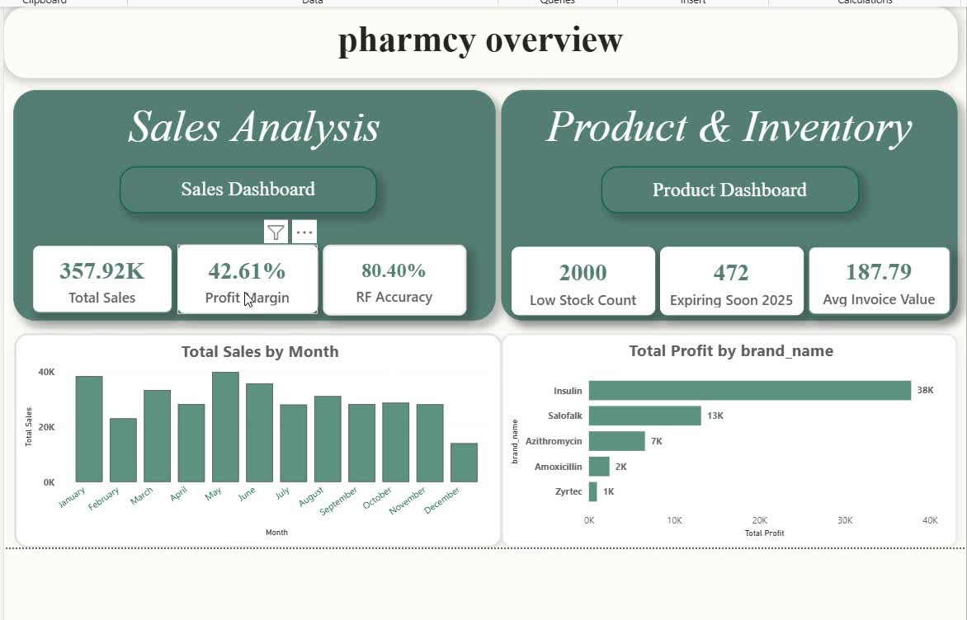
Dashboard :

