Slide 1

OZZYL
ozzyl.com | Dhaka, Bangladesh | HealthTech SaaS
ozzyl.com | Dhaka, Bangladesh | HealthTech SaaS
STARTUP TAGLINE
STARTUP SECTOR:
Website/Social link
Email address
Office address

Slide 2


PROBLEM
STATEMENT
1. Fragmented health records — patients repeat history at every visit
Solution Statement that the startup is offering.

Slide 3
OUR SOLUTION
& ECOSYSTEM
A two-sided integrated health ecosystem:
FOR PATIENTS — Ozzyl Lifestyle App (Free)
• Unified health profile with Universal Health ID (UHID)
• Daily tracking: vitals, nutrition, activity, sleep, mental health
• Medication history, reminders, barcode-based food logging
• Hospital search, doctor reviews, appointment booking
• Women's health (cycle tracking, pregnancy mode)
• Mental health screenings (PHQ-9, GAD-7)
• Medical document vault, family health hub
FOR HOSPITALS — Ozzyl HMS (SaaS)
• Cloud-native Hospital Management System
• AI-powered clinical assistant — instant patient overview for doctors
• Complete billing, pharmacy, laboratory, OT management
• Multi-role portals (Reception, Lab, Pharmacy, Admin, Director)
• Bilingual (English + Bengali), zero hardware needed

Slide 4

MARKET SIZE &
GLOBAL DIGITAL HEALTH: $573B–$946B by 2030 (22-23% CAGR) BANGLADESH MARKET: $14B (2025) → $23B by 2033 • 5,000+ registered hospitals & clinics • 70M+ smartphone users | Digital Health growing 10%+ CAGR • Govt Strategy 2027 mandates hospital digitization

Slide 5
BUSINESS MODEL &
REVENUE STREAMS: 1. HMS Setup Fee — BDT 15,000–1,00,000 (One-time) 2. Monthly Subscription — BDT 3,000–25,000/month 3. AI Clinical Features — BDT 2,000–10,000/month add-on 4. Partner Commissions — 5-10% from lab & pharmacy TECH: Cloudflare Edge + D1 + Gemini AI (Clinical Intelligence)

Slide 6
MEET THE TEAM
[Dev Lead]
[CTO Name]
Founder & CEO
CTO
[Your Name]
[Team Member]
Lead Developer
Medical Advisor

Slide 7
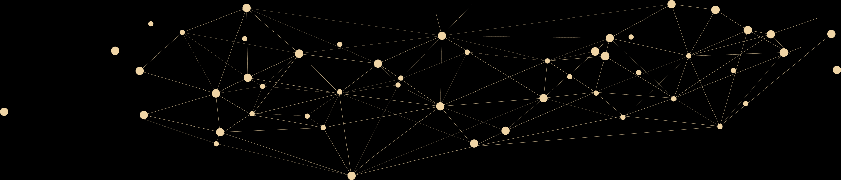
FINANCIAL PROJECTIONS
PRICING (Competitive with BD Market):
On-Premise (Others) Ozzyl Cloud
Small Clinic (1-10 bed) BDT 3-10 lakh one-time BDT 15K setup + 3-5K/month
Medium Hospital (10-50) BDT 5-15 lakh one-time BDT 50K setup + 8-15K/month
Large Hospital (50+) BDT 10-30 lakh one-time BDT 1L setup + 20-25K/month
3-YEAR REVENUE PROJECTION (BDT):
Year 1 Year 2 Year 3
Hospitals Onboarded 8 25 60
Avg Monthly/Hospital BDT 8,000 BDT 12,000 BDT 15,000
Hospital Setup Fees BDT 4 lakh BDT 12 lakh BDT 30 lakh
Subscriptions (Annual) BDT 7.7 lakh BDT 36 lakh BDT 1.08 crore
Partner Commissions BDT 1 lakh BDT 8 lakh BDT 25 lakh
AI/Premium BDT 50K BDT 5 lakh BDT 15 lakh
TOTAL ANNUAL REVENUE BDT 13.2 lakh BDT 61 lakh BDT 1.78 crore
MRR (Last Month) BDT 1.5 lakh BDT 6 lakh BDT 18 lakh
UNIT ECONOMICS:
• Customer Acquisition Cost: ~BDT 30,000 per hospital
• Lifetime Value (3yr): ~BDT 5 lakh | LTV:CAC = 17:1
• Gross Margin: 80%+ (no hardware, serverless infrastructure)
• Cloud Cost per Hospital: ~BDT 500-1,000/month (Cloudflare)

Slide 8
COMPETITIVE
LANDSCAPE
COMPETITOR COMPARISON:
MySoft / Pridesys / Sara HMS (On-Premise)
→ BDT 5-30 lakh setup + BDT 1-3 lakh/year AMC
→ Legacy desktop, no AI, no patient app, no cloud
Arch HMS (Cloud)
→ BDT 3-8K/month subscription
→ Basic cloud HMS, no AI, no ecosystem, no patient app
Praava Health
→ Closed ecosystem (own clinics only), doesn't sell software
DocTime / Sheba.xyz
→ Marketplace only (appointment booking), no HMS
Epic / Cerner (International)
→ $500K+ setup, unaffordable for BD market
OZZYL'S UNFAIR ADVANTAGES:
✓ Only full ecosystem: Patient App + HMS + AI + Partners
✓ AI-powered clinical intelligence (patient health overview)
✓ Universal Health ID — true data portability across hospitals
✓ 50-70% lower TCO vs on-premise (zero hardware)
✓ Bilingual (English + Bengali) from Day 1
✓ Working product: 137+ DB migrations, 100+ React components

Slide 9


GO-TO-MARKET STRATEGY
Hospital-first approach: onboard hospitals with HMS, patients follow organically.
Network effects: more hospitals → more patients → more hospitals need Ozzyl.
Marketing Approach
Sales Approach
• Direct outreach to hospital owners/directors
• Free 30-day trial with full features
• Social media health awareness campaigns
• Hospital success story case studies
• Medical conference presence
• Referral program for existing hospitals
• Phase 1 (M1-6): 8 hospitals, launch app
• Phase 2 (M7-12): 25 hospitals, partners
• Phase 3 (M13-18): AI features, insurance
• Phase 4 (M19-24): Regional expansion
• 3-month pilot → annual contract model
• Upsell AI add-ons to existing clients

Slide 10
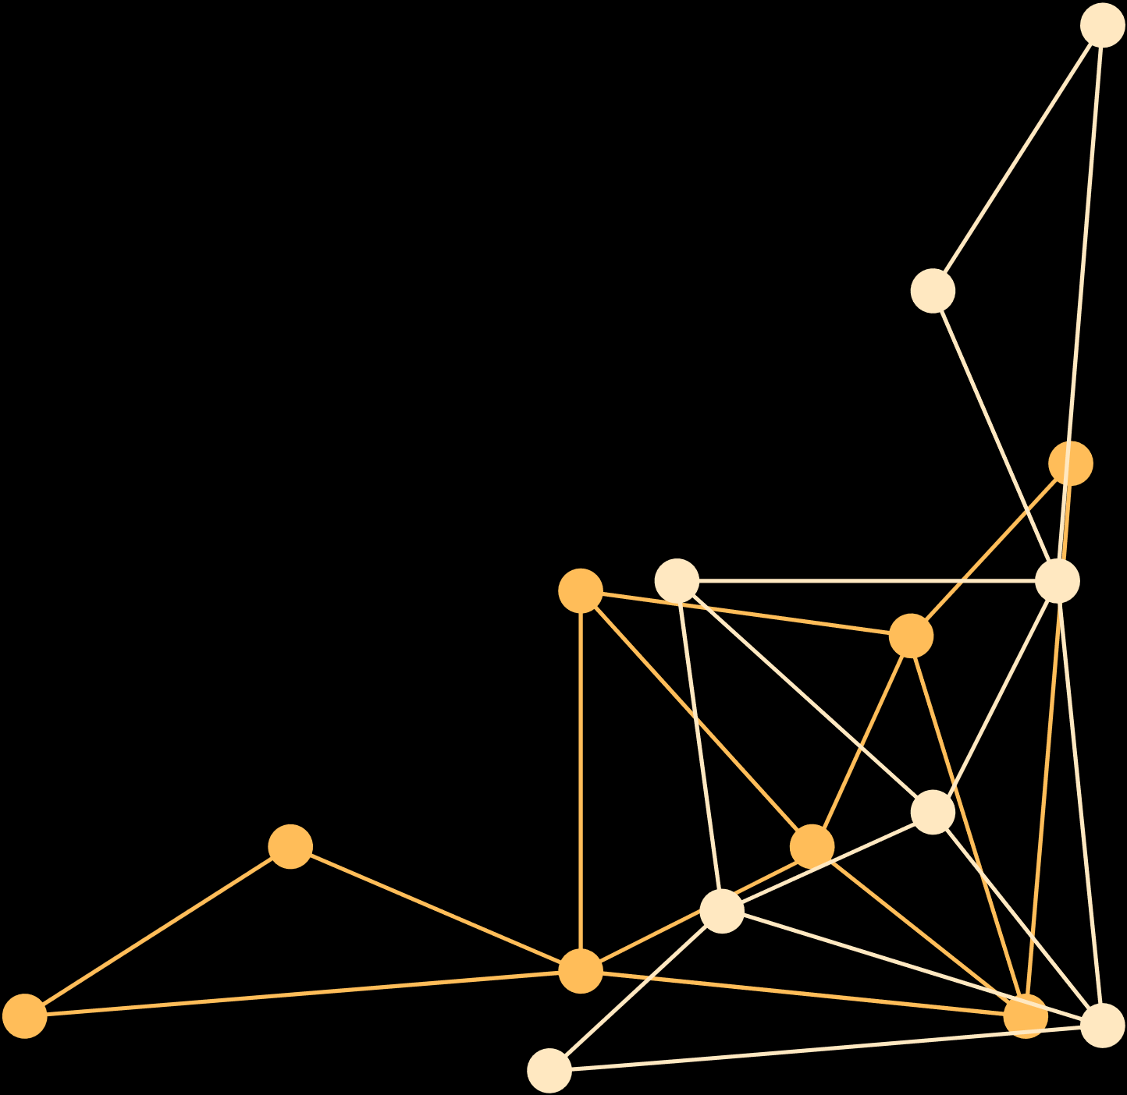
USE OF FUNDS
We are seeking BDT 10 lakh (maximum available fund) to accelerate
hospital onboarding, product polish, and initial marketing.
Expected ROI: With 8 hospitals onboarded in Year 1 at avg BDT 8,000/month,
annual revenue reaches BDT 13+ lakh — achieving fund payback within 12 months.
Product Development
_%
Marketing and Sales
_%
Infrastructure and Operations
_%
Expansion and Growth Initiatives
_%

Slide 11








OZZYL
THANK
YOU
[Your Phone]
ozzyl.com
[your@email.com]
Dhaka, Bangladesh

