Slide 1
EXPLORATION 4 · DISCUSSION SECTION
Description of Relationships III:
Categorical Variables and Tables
PS530 · Introduction to Applied Statistics in Political Science
Rahnuma Siddika · Methods Preceptor

Slide 2
WHERE WE LEFT OFF
Exploration 3 → Exploration 4
EXPLORATION 3
EXPLORATION 4
Continuous variables
Categorical variables
CBINDEX, Politystand2014: values shade smoothly across a range
Tool: loess, a local curve, no straight-line assumption
Tuning: span, chosen by 10-fold cross-validation
Fit quality: R², held-out RMSE
DD_democracy, Britcol, region
Tool: tables, counts and proportions, no model at all
Tuning: none. a category is a category, not a spectrum
Fit quality: does lm() reproduce the table's cell means?
See more (“Three Cheers for Description”, Ch. 5 → Ch. 6)
PS530 · Exploration 4 · Discussion Section
2

Slide 3
THE BIG IDEA
“Describe first, model second”
“Don't jump to a regression before you've looked at the plain counts.”
Continuous → Loess
Categorical → Tables (and what else?)
Values shade smoothly. A line forces one fixed slope everywhere; loess instead asks, “what does the relationship look like right here?” neighborhood by neighborhood.
A country is either “Africa” or it isn’t. Nothing in between. There's no “shape” to estimate, so the honest first move is just counting: table(), prop.table(), addmargins().
Once you DO run a regression on a category, it turns out to just be the table's numbers, rearranged.
PS530 · Exploration 4 · Discussion Section
3

Slide 4
A QUICK TAXONOMY
Not all categorical variables are alike
NOMINAL
ORDINAL
LIKERT-TYPE
no order at all
ordered, gaps not equal
ordered AND roughly even gaps
Region · Britcol
education level · income bracket
5-pt agreement scale · 7-pt ideology scale
A code number, if the raw data has one, is just a label. Region8a = 3 isn’t “more region” than Region8a = 2 , relabel the categories in any order and nothing about the data changes.
You can rank the categories, but the jump from category 2→3 isn’t guaranteed to be the same “size” as 3→4. Averaging the codes is a much shakier move than it looks.
Designed so the gaps are roughly equal by construction. This is the ordinal exception from Slide 2/3. Treating the scale as numeric (means, correlations, even a loess curve) becomes defensible.
Where a variable sits on this spectrum is a judgment call you make and defend — R’s factor() treats all three identically unless you explicitly pass ordered = TRUE.
PS530 · Exploration 4 · Discussion Section
10

Slide 5
ROADMAP
Four moves, eight questions
Q1–Q2
Describe your variables alone
Pick a binary outcome y and a small-category driver z. Describe each on its own, before relating them.
1
Q3
Relate them (tables only)
y vs. z with table()/prop.table()/addmargins(). No model yet. Interpret substantively.
2
Q4–Q6
Add a second category, x
Show a table and a regression give the identical cell means — if the regression is fully interacted.
3
Q7–Q8
Who's influential?
Leverage on a category is exactly 1/(cell size). Swap in a continuous variable and watch that break.
4
PS530 · Exploration 4 · Discussion Section
4

Slide 6
OUR WORKED EXAMPLE
Norris's Democracy Cross-National Data
Same dataset as Exploration 3 (Norris's Democracy Cross-National Data, 195 countries).
y
DD_democracy
Binary regime classification (Cheibub-Gandhi-Vreeland)
z
Britcol
Former British colony? Theory: colonial legal/electoral legacy → democracy
x
region4
Region8a collapsed to 4: Europe / Americas / Asia & Middle East / Africa
Q8 swap
log(GDPPC2007)
Continuous stand-in for z, to see influence change character
PS530 · Exploration 4 · Discussion Section
5

Slide 7
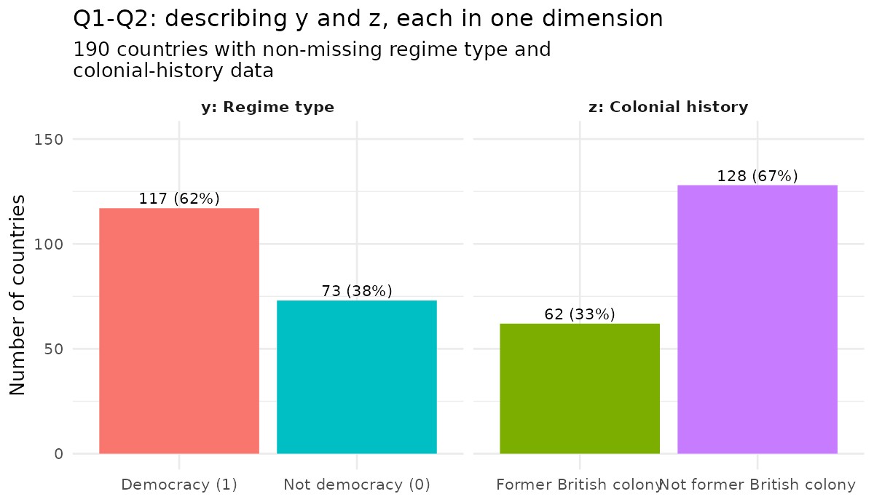
Q1 – Q2
Describe each variable alone, first
61.6%
of countries coded democracies (117 of 190)
32.6%
were former British colonies (62 of 190)
Two separate tasks: (1) describe the variable, (2) say what it means substantively about the world.
PS530 · Exploration 4 · Discussion Section
6

Slide 8
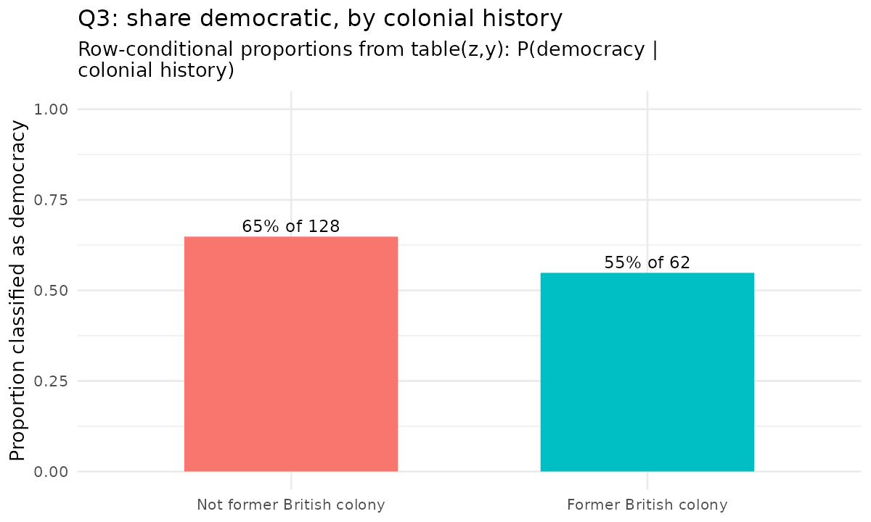
Q3
Relate them with tables, no model yet
64.8% vs. 54.8%
Not-former-colonies are democracies 64.8% of the time; former colonies, 54.8%. A 10-point gap — the OPPOSITE direction from the colonial-legacy theory.
Why row-conditional, not column-conditional?
prop.table(margin=1) answers “within each colonial-history group, what share are democracies?” — the question the theory actually makes. margin=2 answers a different question (composition of democracies), not this one.
PS530 · Exploration 4 · Discussion Section
7

Slide 9
BEFORE Q4 — LET’S PAUSE ON A CONCEPT
Wait! could region just be a confounder?
A confounder is a variable that causes BOTH z and y. So it can create (or hide) an association between them even if z has no real effect on y at all.
Region is a plausible confounder here: it plausibly causes Britcol (colonial history is geographically clustered) AND DD_democracy (regions differ in regime type for other reasons).
REGION
the suspected confounder
Britcol (z)
the relationship actually in question
DD_democracy (y)
former colony?
regime type
That's exactly why Q4 adds region as x -- and why Q6 checks it two ways, additive and interacted. If the colony-democracy gap survives once region is held constant, region isn't the whole story; if it vanishes or flips, it was.
PS530 · Exploration 4 · Discussion Section
8
Notes:
Give some other examples. Imai's confounder definition ("associated with both the treatment and outcome").

Slide 10
CONFOUNDERS, CONTINUED
Left out, it breaks things. Here's how you fix it.
WHAT BREAKS
HOW YOU ADJUST
when you leave it out
once you've measured it
Spurious or masked relationship -- z and y can look related when they aren't, or unrelated when they are
Sign reversal -- the pooled comparison can point the OPPOSITE direction from what's true within groups (exactly Q3 vs. Q6)
Magnitude distortion -- an “average effect” can hide very different group-specific effects that cancel toward zero
Control for it (additive): y ~ z + x -- one fixed adjustment, same for every group
Interact it in: y ~ z * x -- lets the z-y relationship differ by group instead of forcing one number (Q6)
Stratify: split into confounder-level groups, compare z and y within each -- the table version of the same idea
Match: pair z=1 and z=0 cases with similar confounder values, compare only within pairs
The one thing none of these fix: a confounder you never measured. Only random assignment of z guarantees balance on every confounder, known or not -- which is exactly why observational data like this dataset always leaves some doubt these methods reduce but never fully close.
PS530 · Exploration 4 · Discussion Section
9

Slide 11
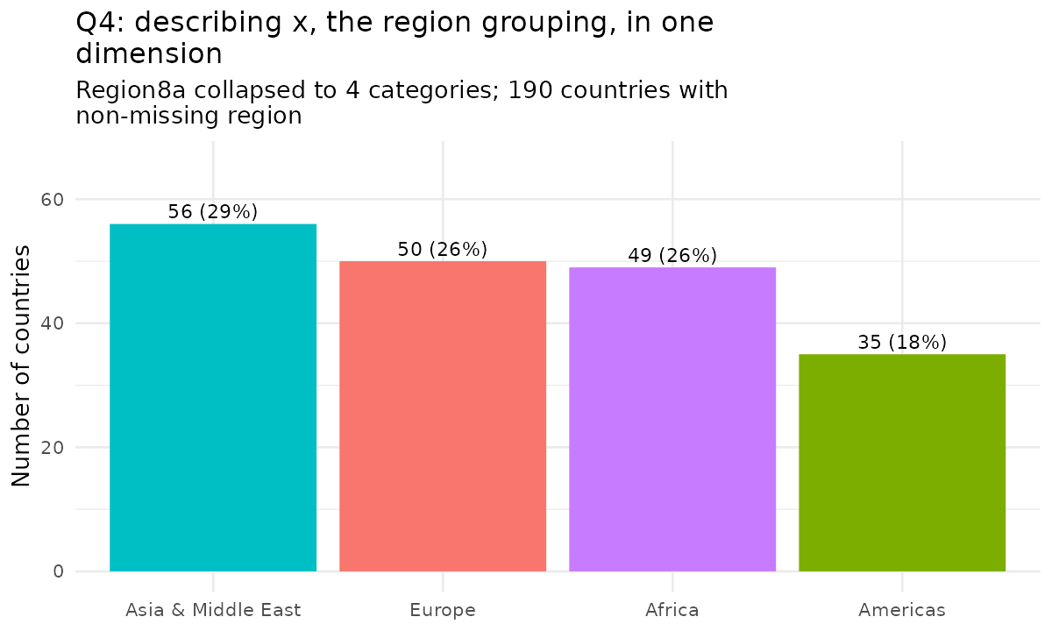
Q4
Bring in a second category: region
Two requirements, easy to skip:
Must be a real R factor(), not a number R will just average
plausibly relate to BOTH y and z. It's a stand-in for a potential confounder, not a random extra variable
Region8a (8 categories) collapsed here to 4: Europe / Americas / Asia & Middle East / Africa
PS530 · Exploration 4 · Discussion Section
9

Slide 12
Q5 — THE KEY IDEA
lm() on a category IS the table
lm(y ~ x) coefficients
tapply(y, x, mean)
Intercept (Europe)
0.840
Europe
0.840
Americas
+0.074
=
Americas
0.914
Asia & Middle East
−0.376
Asia & Middle East
0.464
Africa
−0.493
Africa
0.347
(Europe as the reference category)
(the plain group averages, no lm() involved)
Every coefficient is exactly a group mean, or a difference between two group means. lm() didn't discover anything tapply() couldn't already show you.
PS530 · Exploration 4 · Discussion Section
10
Notes:
Explain about the reference/base category.

Slide 13
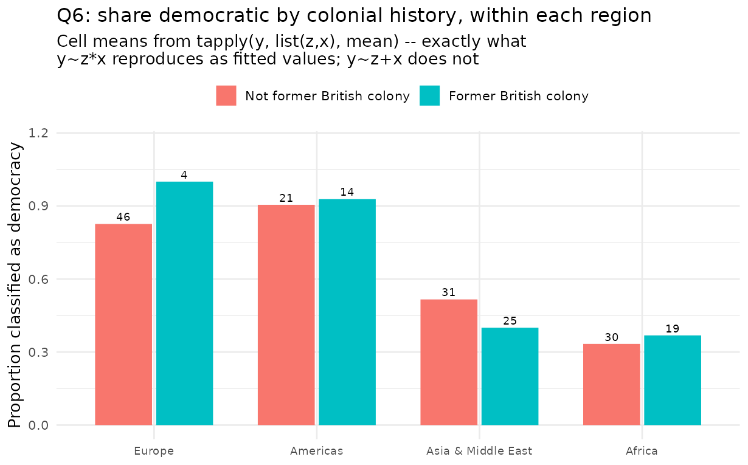
Q6
Two categories at once: interacted vs. additive
~ 0 (5.6×10⁻¹⁶)
max gap: y~z*x fitted values vs. table cell means — exact match
0.169
max gap for the additive model y~z+x — it can't reach the table at all
Europe gives the sharpest example
True cell means: 0.826 (not-colony) vs. 1.000 (colony-- all 4 ex-British-colony European countries are democracies). The additive model reports ~0.83 for BOTH, it can't see the gap.
PS530 · Exploration 4 · Discussion Section
11

Slide 14
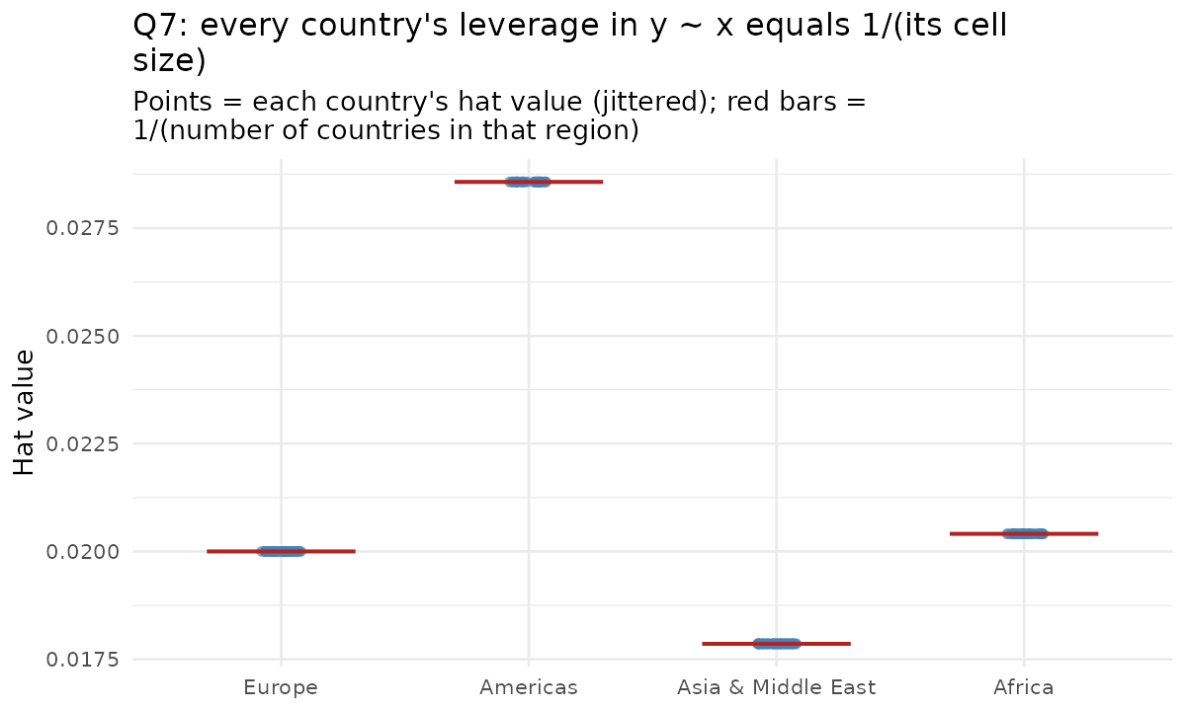
Q7
Who's influential? Leverage = 1 / (cell size)
No such thing as an “extreme” country within a category
Every country in the same region has IDENTICAL leverage. What matters is only: how small is the region, and does this country buck the majority outcome in it?
Cuba, Guyana, Haiti
91% of “Americas” countries are democracies — these 3 aren't. Highest Cook's D (0.034) of any countries in the data. Drop one, and the region's share moves 1/35 ≈ 2.9 points.
PS530 · Exploration 4 · Discussion Section
12

Slide 15
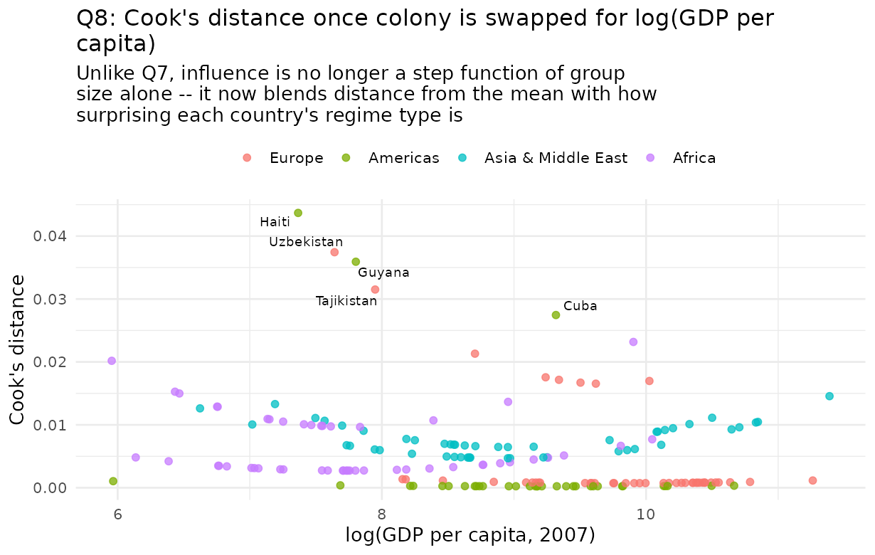
Q8
Swap in a continuous variable, watch it change
0.16 vs. 0.39
correlation of Cook's D / |dfbeta| with distance from mean logGDP — weak-to-moderate, not exact
Carries over
Cuba, Guyana, Haiti are still poor-ish non-democracies in an otherwise-democratic region
Newly prominent
Uzbekistan, Tajikistan, Mauritius, Liberia-- unusual income, invisible to the categorical model
PS530 · Exploration 4 · Discussion Section
13
Notes:
Depends on the choice of predictors.

Slide 16
BIG PICTURE
Same philosophy but two toolkits
Continuous (Exploration 3)
Categorical (Exploration 4)
“Don't assume a shape” means…
loess, not a straight line
a table, not a coefficient you haven't checked
The regression eventually shown to be…
a local average, smoothed (loess IS the local mean)
a set of group differences (lm() IS the table)
Tuning parameter
span, chosen by cross-validation
None. categories are what they are
Influence looks like…
a smooth function of local density
a step function of cell size, until you add a continuous variable back (Q8)
PS530 · Exploration 4 · Discussion Section
14

Slide 17
Questions?

