Slide 1




PS 530 · INTRODUCTION TO APPLIED STATISTICS · SEPTEMBER 22
Exploration 5
Estimating Unobserved Causal Quantities in Randomized Experiments
Act 1
Act 2
Act 3
Does randomization work?
Estimate a causal effect
Compare two estimators

Slide 2
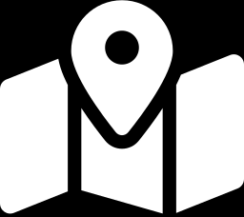
WHERE THIS FITS
September 22 — Estimation and Unobserved Causal Counterfactuals
This week's question
Assigned readings
What do we mean when we say “Z caused Y”?
What is the counterfactual interpretation of that statement?
What is the role of variables we observe that are neither Z nor Y?
“Work on the idea of ‘unbiased estimation’ in the exploration”
Brady (2008) — Neyman's ATE & the fundamental problem
Rosenbaum (2017) Ch.1–2; (2010) Ch.1–2
Imbens & Rubin (2015) Ch.1–2 — potential outcomes, SUTVA
Dunning (2012) Ch.1–2 — causal-inference foundations
Gerber & Green (2012) Ch.1–3 — the load-bearing reading
EGAP “Estimands and Estimators” module
PS 530 · Exploration 5 — Estimating Unobserved Causal Quantities
2

Slide 3
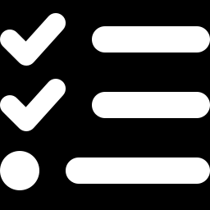
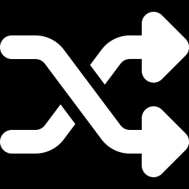
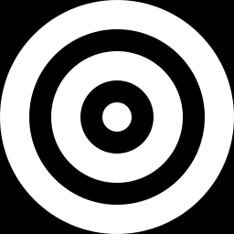
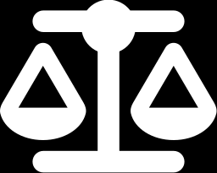

ROADMAP
Three acts
Every question below reuses the same 28 Kansas City precincts (nothing is simulated data until Q9).
Act 1 · Q1–Q6
Act 2 · Q7–Q8
Act 3 · Q9–Q12
Does random assignment actually protect ACORN, and how would you show a skeptic it worked?
Estimand, estimator, estimate: and what the standard error is really guessing at.
Two estimators of the same quantity: unbiased, precise, and close-to-truth are three different things.
The running example: ACORN's canvassing experiment
Kansas City, 2003: 28 precincts, 14 randomly assigned to canvassing ahead of a local tax vote (Arceneaux 2005).
PS 530 · Exploration 5 — Estimating Unobserved Causal Quantities
3

Slide 4
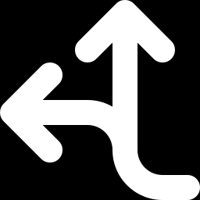
CONCEPT
The fundamental problem of causal inference
A causal effect for precinct i compares two potential outcomes:
Yᵢ(1) -- turnout if precinct i is canvassed
Yᵢ(0) -- turnout if precinct i is not canvassed
We only ever observe ONE of the two, for any precinct, ever.
“No causation without manipulation” (Rubin 1975; Imbens & Rubin 2015, Ch.1). A causal claim presumes the same unit could have received a different treatment.
Gerber & Green's village example
Precinct | Y(0) | Y(1)
1 | ? | 15
2 | 15 | ?
3 | 20 | ?
... | ... | ...
7 | ? | 30
The “?” cells are never observed
PS 530 · Exploration 5 — Estimating Unobserved Causal Quantities
4

Slide 5
CONCEPT
Random assignment breaks the link on purpose
If organizers picked which precincts to canvass, that choice would track things that also predict turnout-- an endless list of possible confounders (Gerber & Green, Ch.1: the “bottomless pit”).
Random assignment makes a precinct's chance of treatment independent of everything about it, observed or not.
E[ Yᵢ(1) | Dᵢ=1 ] = E[ Yᵢ(1) | Dᵢ=0 ] = E[ Yᵢ(1) ]
In expectation, before treatment happens, the treated and control groups look alike on every characteristic, not for certain on any one draw, but on average across all the ways the coin flip could go.
PS 530 · Exploration 5 — Estimating Unobserved Causal Quantities
5

Slide 6
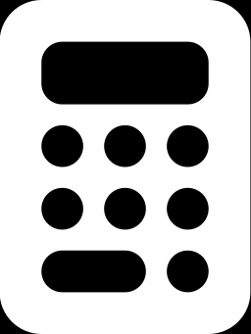
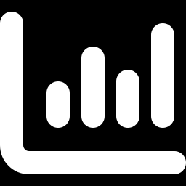
CONCEPT
Estimand → Estimator → Estimate
Estimand
Estimator
Estimate
The fixed, usually-unobservable TARGET. “The true average effect of assignment to canvassing on turnout, across all 28 precincts.”
The pre-specified PROCEDURE for guessing at it. “Treated-precinct average minus control-precinct average.” A recipe, reusable on any dataset.
The single NUMBER that procedure produces on this one dataset. 0.036 — 3.6 percentage points, for ACORN's 28 precincts.
Only a PROCEDURE (the estimator), not a single number (the estimate) can meaningfully be called “biased” or “unbiased.”
Gerber & Green, Box 2.6: “An estimator is a procedure or formula for generating guesses about parameters... The guess that an estimator generates based on a particular experiment is called an estimate.”
PS 530 · Exploration 5 — Estimating Unobserved Causal Quantities
6

Slide 7
CONCEPT
Unbiasedness, formally
An estimator is unbiased if the expected value of the estimates it produces equals the true parameter.
E[ θ̂ ] = θ
Replicate the experiment infinitely many times, under identical conditions. Some guesses too high, some too low. But the average guess is exactly right.
Gerber & Green prove this algebraically for the difference-in-means estimator (their eq. 2.14). We reconstruct that proof for ACORN in Q11.
Box 2.7, Gerber & Green (2012)
“We say that θ̂ is unbiased if E(θ̂)=θ; in words, the estimator θ̂ is unbiased if the expected value of this estimator is θ, the parameter of interest... we refer to the estimates generated by an unbiased estimator as ‘unbiased estimates.’”
PS 530 · Exploration 5 — Estimating Unobserved Causal Quantities
7

Slide 8
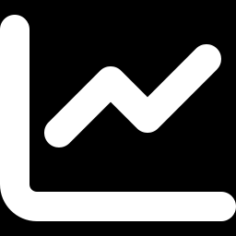
CONCEPT
CONCEPT
Unbiased ≠ precise ≠ close to the truth
Unbiased ≠ precise ≠ close to the truth
Unbiased
Precise
Close to truth
Right on average, across hypothetical repetitions of the design. Says nothing about any one estimate.
A small spread (sd_estimate) across those repetitions. Estimates cluster tightly, wherever they're centered.
Low RMSE. Combines bias AND spread. A biased-but-precise estimator can beat an unbiased-but-noisy one.
Act 3 (Q9–Q12) races two real estimators against a KNOWN truth to make this point.
PS 530 · Exploration 5 — Estimating Unobserved Causal Quantities
8

Slide 9
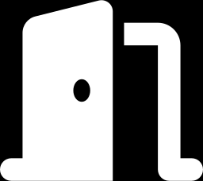
THE DATA
ACORN's 2003 Kansas City canvassing experiment
Arceneaux (2005), “Using Cluster Randomized Field Experiments to Study Voting Behavior.”
ACORN canvassed door-to-door. Educating voters about a proposed tax and encouraging turnout.
Cluster-randomized: the PRECINCT, not the person, is the unit of assignment.
28 precincts total. 14 assigned to canvassing, 14 to control (complete random assignment, Gerber & Green Box 2.5).
28
14 / 14
precincts total
treated / control
347
16–78%
avg. registered voters / precinct
range of contact rates (treated)
Why cluster-randomize? Canvassers work a precinct at a time. Door-to-door effort can't be targeted at named individuals the way a mailer can.
PS 530 · Exploration 5 — Estimating Unobserved Causal Quantities
9

Slide 10
THE DATA
What's in acorn03.csv
Variable | What it is
z | Treatment: 1 = assigned to canvassing, 0 = not
vote03 | OUTCOME. Turnout share in the Nov. 2003 tax-measure election
contact | Share of voters actually reached. 0 for all controls; 0.16–0.78 for treated. This is an ITT, not a TOT, effect
size | Registered voters in the precinct
v_<type><year> | 20 PRE-TREATMENT covariates. Turnout in past elections, 1996–2003 (g=general, p=primary, m=municipal, s=special)
PS 530 · Exploration 5 — Estimating Unobserved Causal Quantities
10

Slide 11
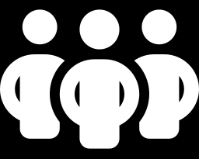
Q1
Explain the benefit of random assignment
The move: translate “independence of potential outcomes” into a sentence a canvassing director would actually accept.
“If your captains had picked which precincts to canvass, that choice would track things that ALSO predict turnout. More-engaged precincts, ones a captain knew well. We could never fully rule that out.”
“A coin flip doesn't have opinions about which precincts are already primed to vote. Before canvassing happened, treated and control precincts looked alike, on average, on everything, measured or not.”
This argument predates potential-outcomes notation, Fisher and Neyman made it in the 1920s–30s (Brady 2008).
PS 530 · Exploration 5 — Estimating Unobserved Causal Quantities
11

Slide 12
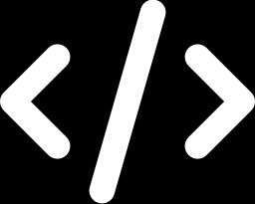
Q2
The “funky” covariate-balance code
mean_diff <- function(x, z) {
mean(x[z == 1] - mean(x[z == 0]))
}
What it produces, sorted by |gap|
size | +11.0
v_m2003 | −0.0231
v_g2002 | −0.0211
v_g1996 | −0.0132
v_g1998 | +0.0118
Reads inside-out: mean(x[z==0]) is ONE number (control mean); subtracting it from every treated value, then averaging, still equals the ordinary difference in means, subtracting a constant commutes with averaging.
Cleaner rewrite: mean(x[z==1]) - mean(x[z==0])
These are exactly the two numbers ACORN's reps push back on in Q3.
PS 530 · Exploration 5 — Estimating Unobserved Causal Quantities
12

Slide 13
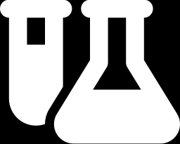
Q3
Did randomization fail?
“Treated precincts had 2.3 pts lower 2003 turnout, and were larger by 11 people. Did something go wrong?”
+11
−2.3 pts
No.
A fair coin can land heads 6/10 without being unfair.
more registered voters, treated vs. control
lower March 2003 turnout, treated vs. control
Randomization is a promise about the PROCEDURE, not that any one draw looks perfectly balanced.
With 28 precincts and 21 covariates checked, some chance imbalance on SOME covariate is close to guaranteed.
How to actually reassure ACORN: Show them, by simulating the space of draws the design could have produced. That's Q4–Q6.
PS 530 · Exploration 5 — Estimating Unobserved Causal Quantities
13

Slide 14
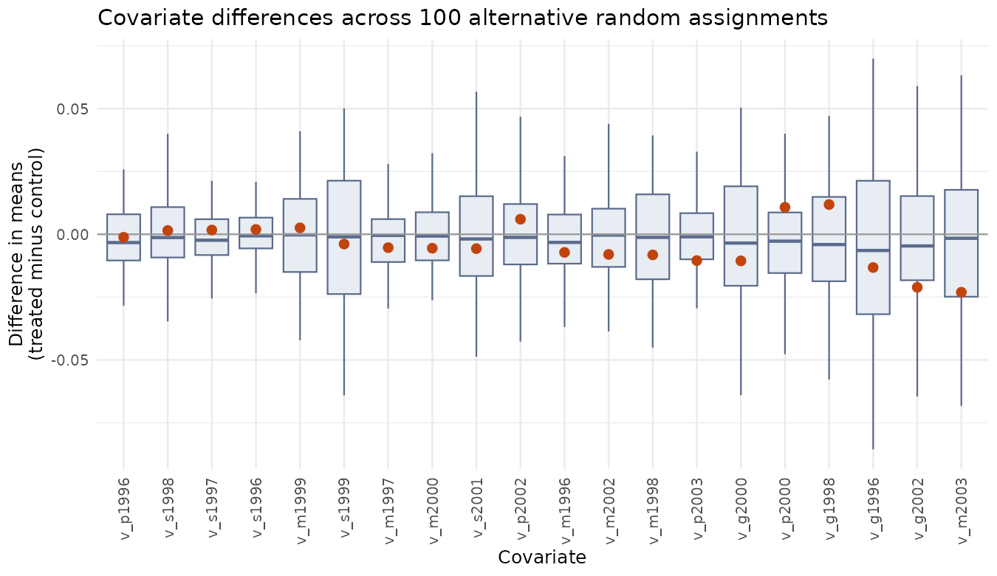
Q4–Q6
Simulate the space of possible random assignments
set.seed(123): reshuffle z across the SAME 28 precincts, 100 times. Repeat the design.
Box = the distribution of chance imbalances; dot = ACORN's actual draw.
Both size (+11) and v_m2003 (−0.023) sit comfortably mid-distribution, nowhere near the tails.
PS 530 · Exploration 5 — Estimating Unobserved Causal Quantities
14

Slide 15
Q5
What the three “SE of a proportion” numbers are for
NOT about the covariates. About how precisely the simulation's own 5th/95th-percentile cutoffs are estimated.
±0.044
±0.014
±0.004
at nsims = 100 (what the .qmd uses)
at nsims = 1,000
at nsims = 10,000
Whether a simulated draw falls beyond a 5% cutoff is a coin flip. Estimating that cutoff from only 100 draws carries its own Monte Carlo noise.
ACORN's gaps aren't near the tails, so this doesn't change the conclusion here. But a borderline case (near the 4th or 6th percentile) would need far more than 100 simulations to call confidently.
PS 530 · Exploration 5 — Estimating Unobserved Causal Quantities
15

Slide 16
Q7
Estimating the ITT and replicating Arceneaux's number
Estimand
Estimator
Estimate
Average effect of ASSIGNMENT to canvassing on turnout, across all 28 precincts. Already includes imperfect contact.
lm_robust(vote03 ~ z, se_type=“HC2”). Unweighted treated-mean minus control-mean.
0.0363 — 3.63 percentage points. SE = 0.0244. Matches Arceneaux's Table 3 precinct-level ITT.
32.5% vs. 28.9%
“Precincts we canvassed voted at a rate about 3.6 points higher, on average, than precincts we didn't. Because which precincts got canvassed was a coin flip, no other systematic difference explains that gap away.”
treated-precinct turnout vs. control-precinct turnout
PS 530 · Exploration 5 — Estimating Unobserved Causal Quantities
16

Slide 17
Q8
What the standard error actually means
The true sampling variability of the estimator -- how far the estimate would move under a different 14-of-28 draw -- is UNKNOWABLE (needs both potential outcomes for every precinct).
lm_robust()'s HC2 SE is a GUESS at that spread, built from the one dataset we have.
That guess turns out to equal the classical Neyman (1923) two-sample variance formula:
SE = √( s¹₁/n₁ + s²₀/n₀ ) = 0.0244
95% CI: [−0.011, 0.084] comfortably includes zero. Worth having ready if asked “so is this real?” even though Q3 told us to avoid that language earlier.
PS 530 · Exploration 5 — Estimating Unobserved Causal Quantities
17

Slide 18

Q9
Building a race we can actually judge
The trick: rig the truth so we can check who's closest to it.
Doctor the outcome (newY): set the highest-turnout precinct to 1, lowest to 0. Then Y = 0.3·Z + newY -- True effect is EXACTLY 0.3 everywhere, by construction.
m = 2 of 28 treated (not 14) on purpose:
with only 2 treated precincts, the treated mean is an average of just two numbers, one unusual precinct can swing it enormously. That's what makes the two estimators' behavior diverge.
1,000 simulated re-randomizations; each time, fit BOTH estimators on the same fake data and record what they guess.
Two estimators
OLS / diff-in-means. Every precinct weighted equally
lmrob() M-estimator. Down-weights precincts with unusually large residuals
“We get to know the true effect in advance -- something we could never do with ACORN's real data -- so we can check which method's guesses land closer to it.”
PS 530 · Exploration 5 — Estimating Unobserved Causal Quantities
18

Slide 19
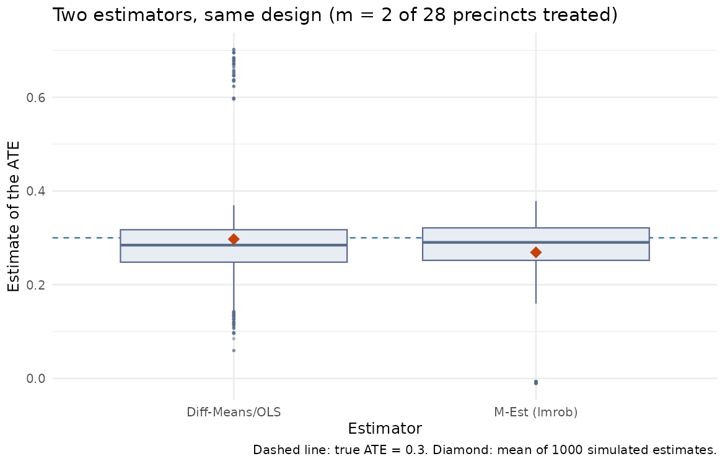
Q10
Two estimators, same design, 1,000 runs
estimator | bias | rmse | sd
OLS | −0.003 | 0.113 | 0.113
lmrob | −0.031 | 0.093 | 0.087
lmrob's mean estimate sits farther from the dashed true-ATE line -- real bias, the deliberate cost of down-weighting.
But lmrob's box is narrower (sd 0.087 vs 0.113) AND its RMSE is lower — in THIS rigged design, it lands closer to the truth on average.
Notice: OLS's own reported SE (0.076) understates its true sd_estimate (0.113). The Q8 caution, made concrete.
PS 530 · Exploration 5 — Estimating Unobserved Causal Quantities
19

Slide 20
Q11
Proving diff-in-means is unbiased
E[ (1/m)Σ treated Yᵢ − (1/(N−m))Σ control Yᵢ ]
= E[Yᵢ(1) | Dᵢ=1] − E[Yᵢ(0) | Dᵢ=0] (what's actually observed)
= E[Yᵢ(1)] − E[Yᵢ(0)] (random assignment — Q1)
= ATE
The middle equality IS Q1's independence argument, formalized (Gerber & Green, eq. 2.14): conditioning on Dᵢ=1 or Dᵢ=0 doesn't change the expected potential outcome.
Simulation check: swap m=2 for m=14 (ACORN's ACTUAL design) and rerun. OLS's bias should land at (or very near) zero, without the engineered m=2 outlier.
PS 530 · Exploration 5 — Estimating Unobserved Causal Quantities
20

Slide 21
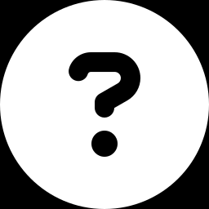
Q12
Back to ACORN: what's still missing?
ITT ≠ TOT
One average but many precincts
External validity
contact averages well under 100%. ACORN's real strategic question needs an effect among those actually reached, not everyone assigned.
The ITT could hide precincts strongly moved and others not moved at all-- averaging to the same number.
??
Unbiasedness answers “is the procedure stacked in one direction?” not “is this the number ACORN needs, and is it worth the canvassing budget?”
PS 530 · Exploration 5 — Estimating Unobserved Causal Quantities
21

