Slide 1

How to do linguistic analysis with the Universal dependencies
Luigi Talamo (Universität des Saarlandes, Germany)
Digitale historische Wortforschung (DhW)
“Testi e parole in rete: nuovi accessi digitali”

Slide 2
outline
What is token-based typology
What is miniCIEP+
A very short introduction to Universal Dependencies (UD)
Experimenting with miniCIEP+

Slide 3
Corpus linguistics meet typology: Token-based typology
A (relatively) new way to do linguistic typology (Naranjo & Becker 2018; Levshina 2019, 2021; Talamo & Verkerk 2022; Levshina et al. 2023; but Wälchli & Cysouw 2012!)
“In most typological research, languages have been treated as single data points with a categorical value (e.g. OV or VO, prepositional or postpositional). The overwhelming majority of typological universals […] are of this type. I will refer to this approach as type-based. In contrast, token-based typology makes generalizations and classifies languages using the tokens of specific linguistic units or structures observed in language use, as approximated by corpora.” (Levshina 2019)
But not only corpora:
“Examples of such token-based comparative concepts are visual stimuli, as employed in much recent research on semantic typology, as well as translation contexts, as employed by questionnaire-based studies and in parallel text typology“ (Haspelmath 2018)

Slide 4
What is miniciep?
Notes:
We will use a portion of miniciep+ for our workshop.

Slide 5

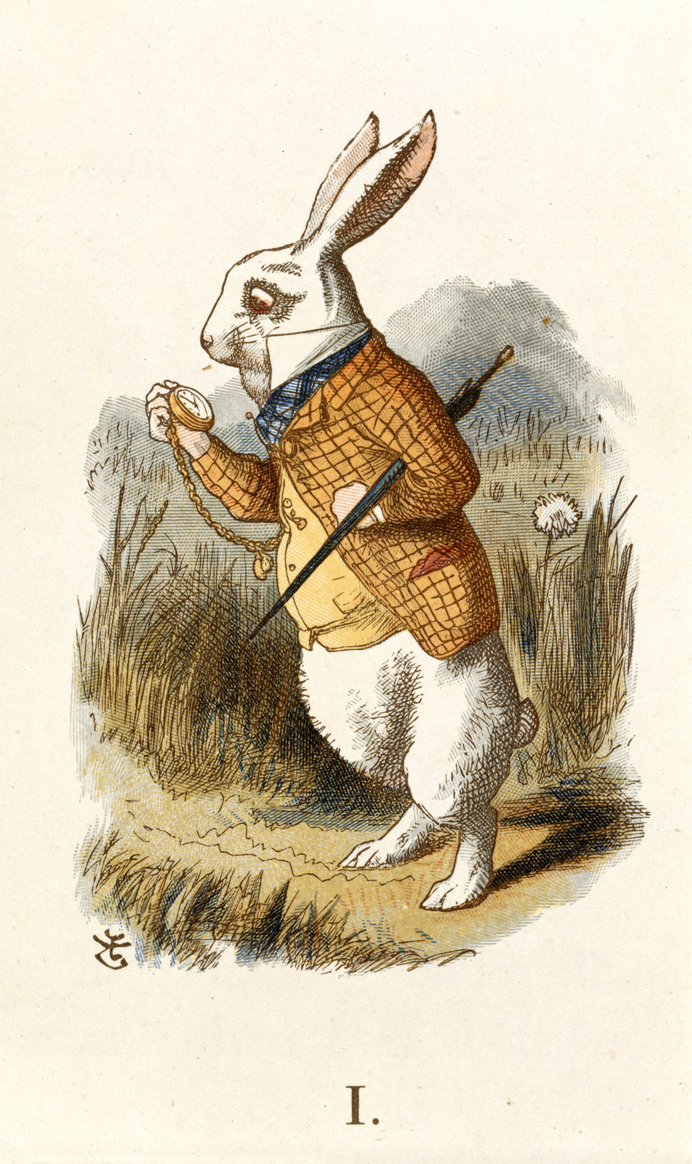
A sharable parallel corpus of prose
Started at Saarland University in Autumn 2019 – Credits: Annemarie Verkerk (PI), Luigi Talamo (Post Doc) and Andrew Dyer (PhD candidate) - Verkerk & Talamo 2024
Derivative of CIEP+; the Corpus of Indo-European Prose Plus /kiːp plʌs/
Contents: contains about 14% of 10 frequently translated literary works
Language sample: 35 Indo-European (5 Romance languages); 15 non-IE languages
Size: subcorpora typically ~ 5750 sentences and up to 125K tokens
Annotation in the Universal Dependencies format + information status
Sharable: we offer considerations of German law as to what constitutes “a select group of people”
Status: mini-CIEP+ v. 1.0 contains 35 languages

Slide 6
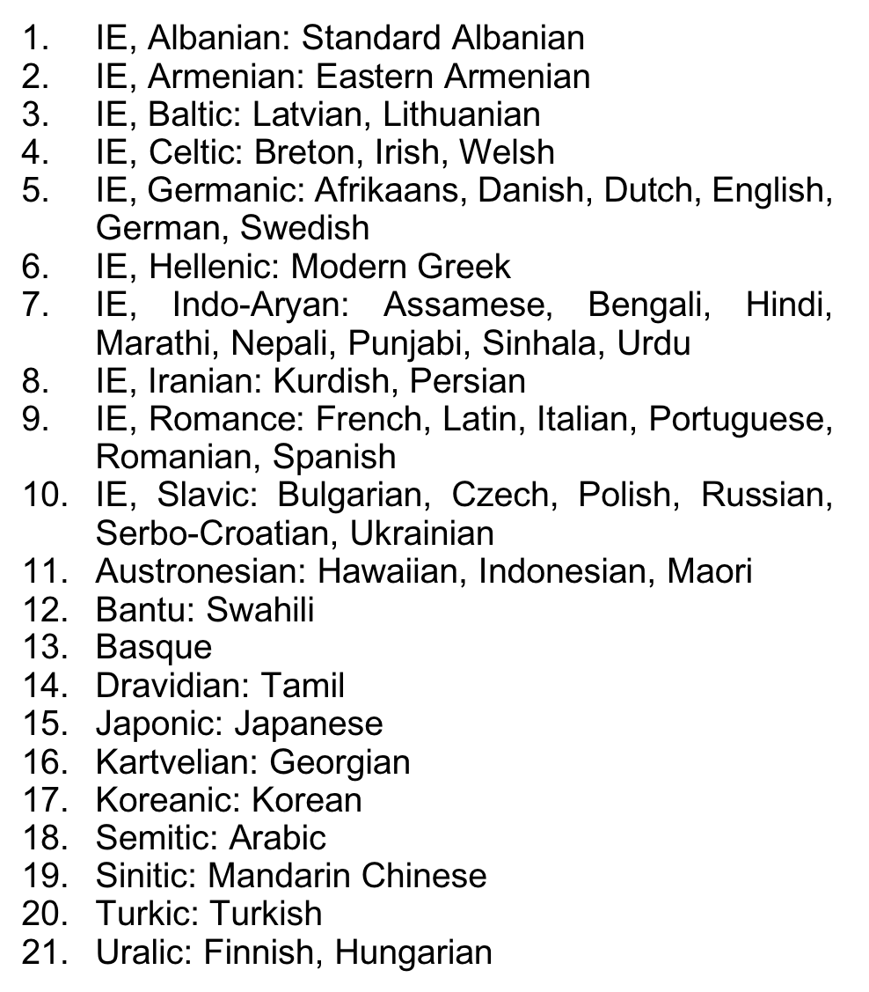
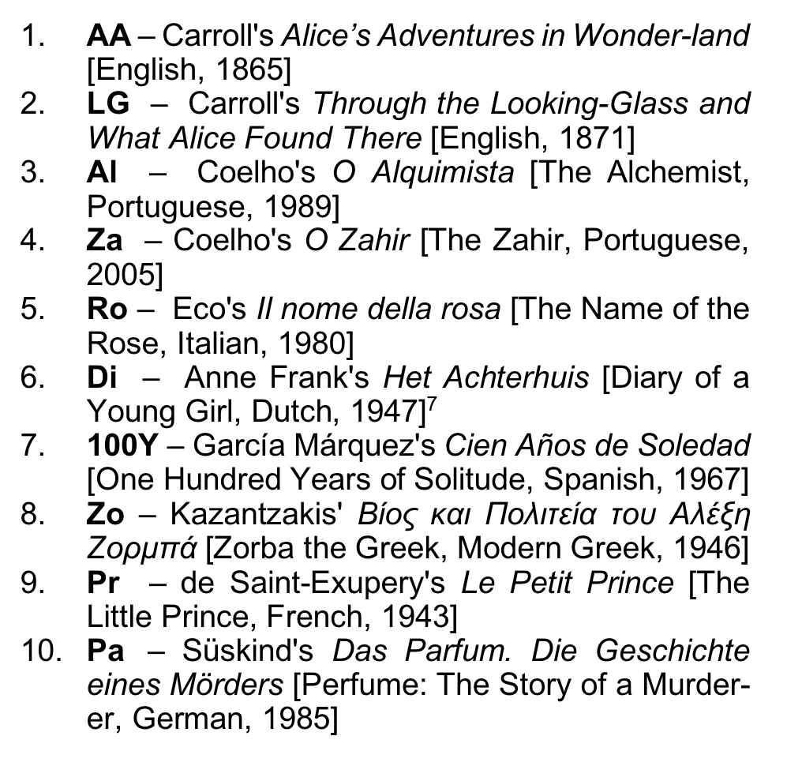
What’s inside

Slide 7



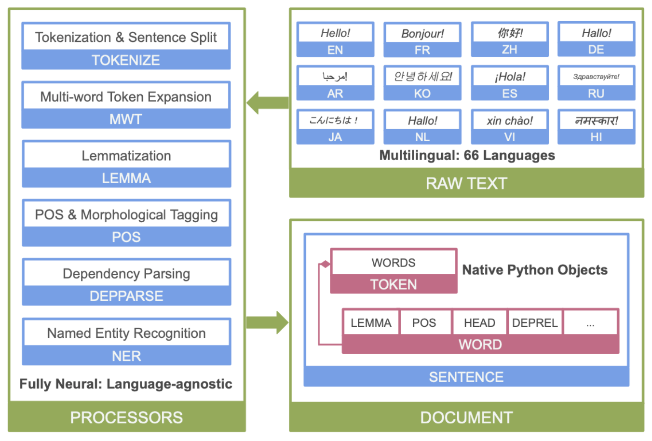
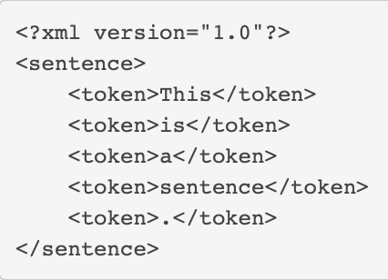



What you get (and how we did it)
Multi-layer and modular structure
# sent_id = 13
# text = Die Glastür
1 Die der DET
2 Glastür Glastür
3 öffnete öffnen
4 sich er|es|sie
5 , , PUNCT
6 ein ein DET
7 kleiner klein
………<given> ….
.. <new> …………
<contrastive> …
……………………….
……….<new> …..
………<0.87> ….
.. <4.15> …………
<3.65> …
……………………….
……….<3.25> …..
# text = José Arcadio Buendía made no at.
# sent_id = 32
1 José ner=B-PERSON
2 Arcadio ner=I-PERSON
3 Buendía ner=E-PERSON
4 made ner=O
5 no ner=O
6 at. ner=O
Metadata
Universal Dependencies
information status
surprisal
Named Entity Recognition
Tools
CQPweb; hosted by Prof. Teich
Python: converting between formats;
Python Stanza library for UD parsing
(pyconll, conllu)
xml for other annotation layers, CQPweb for querying some of the relevant layers together
Notes:
Ultimately, CIEP+ will have multiple layers of annotation; including metadata; dependency parsing using the UD framework, information status, surprisal, probably several types, right now we have trigrams; and named entitiy recognition. To this may be added coreference resolution.
The structure of CIEP+ is conceived as modular, with a pipeline of Python scripts producing and combining different layers of annotation starting from UTF-8 encoded text files.
As for tools, we are using the python library Stanza to parse CIEP+ using universal dependencies models; which outperforms other parsers. We use CQP web tobe able to query several layers of annotation at once. We will use other tools for sentence and word alignment, as I will explain in a minute.

Slide 8
How we did it
…steps in creating CIEP+ and mini-CIEP+
obtain a physical copy of each book (the university library now owns some antiques, rarities, illustrated works… some come with great stories)
create or buy in addition a digital version of each book; in most cases this means OCR + OCR correction by a human annotator
add metadata and catalogue the physical books in the university library
use the Stanford Stanza natural language analysis package to parse the texts (sentence splitting, tokenization, lemmatization, parts-of-speech and syntactic dependencies tagging)
find solutions for sampled languages without a pretrained Stanza parser and/or without a UD treebank (creating treebanks ourselves)

Slide 9
How can we share miniciep+ with you?
Hartmann (2023): “The replication crisis in linguistics is highly relevant to corpus-based research: Many corpus studies are not directly replicable as the data on which they are based are not readily available.”
German copy-right law (Urheberrecht)§ 60c and 60d: “For the purpose of non-commercial scientific research, up to 15 percent of a work may be reproduced, distributed and made publicly accessible [...] to a defined circle of people for their own scientific research”
Audience mini-CIEP+: corpus-based typologists, contrastive linguists and language specialists, especially for low-resourced languages;
Condition: data usage agreement that specifies exactly what the researchers need; and how they are supposed to make sure it does not become public.

Slide 10
A very short introduction to universal dependencies (UD)

Slide 11
Universal dependencies
Why a dependency treebank? Pros and cons according to Daniel Zeman (https://ufal.mff.cuni.cz/~zeman/2023/docs/1-introduction.pdf)
  Economical, free word order, head of a phrase ✅
  No derivation history, coordination/apposition, secondary predicates (two dependencies) ❌
But, most important, why Universal Dependencies?
  ‘universal’, lots of languages (over 150 languages);
  widely employed (over 200 treebanks);
  several layers of annotation.
Notes:
Daniel Zeman is one of the people behind UD.
At the end of the day, this is mostly an opportunistic choice, as Universal Dependencies use this type of formalism.

Slide 12
Universal dependencies
de Marneffe, Marie-Catherine; Manning, Christopher D.; Nivre, Joakim & Zeman, Daniel 2021. Universal dependencies. Computational Linguistics 47,2. 255-308. From the abstract:
"Universal dependencies (UD) is a framework for morphosyntactic annotation of human language, which to date has been used to create treebanks for more than 100 languages. In this article, we outline the linguistic theory of the UD framework, which draws on a long tradition of typologically oriented grammatical theories. Grammatical relations between words are centrally used to explain how predicate–argument structures are encoded morphosyntactically in different languages while morphological features and part-of-speech classes give the properties of words. We argue that this theory is a good basis for crosslinguistically consistent annotation of typologically diverse languages in a way that supports computational natural language understanding as well as broader linguistic studies.”
Notes:
I thought that the best way to introduce Universal Dependencies is using the words of its author.

Slide 13
Universal dependencies: basic tenets
Dependency grammar: head and dependent;
Three fundamental units: nominal (entity), clause (event) and modifier (attribute);
Words (tokens) as basic units;
Grammatical relations are between words.

Slide 14
Universal dependencies: basic tenets
Head and Dependents
  Binary grammatical relation: an arrow goes from the head to the dependent and is labelled for a grammatical relation.
  How do we identify the head?
  Nominal phrases: noun;
  Clause: usually verbs, but could be also nominals or adjectives.
  When in doubt, the element with most important content/meaning is the head.

Slide 15
Universal dependencies: basic tenets
Head and Dependents
  Binary grammatical relation: an arrow goes from the head to the dependent and is labelled for a grammatical relation.
  How do we identify the head?
  Nominal phrases: noun; The good doctor
  Clause: usually verbs, but could be also nominals or adjectives. The good doctor visits her patients
  Adjectives: The doctor is good. Nominals: My sister is a good doctor.
  When in doubt, the element with most important content/meaning is the head.
  The good doctor has arrived.

Slide 16
Universal dependencies: basic tenets
Nominals, clause and modifiers
Nominals: default/canonical items for referring to an entity
Clause: default/canonical items for referring to event
Modifiers: default/canonical items for modifying a clause, a nominal or another modifier

Slide 17
Universal dependencies: basic tenets
Nominals, clause and modifiers
Nominals: default items for referring to an entity Reference
Clause: default items for referring to event Predication
Modifiers: default items for modifying a clause, a nominal or another modifier Modification
This may remind some of you of Croft’s propositional acts / information packaging functions!
Notes:
Croft 2001: Radical Construction Grammar

Slide 18
Universal dependencies: conll-u files
Ten fields for the annotation, separated by single tab characters:
ID: Word index, integer starting at 1 for each new sentence; may be a range for multiword tokens; may be a decimal number for empty nodes (decimal numbers can be lower than 1 but must be greater than 0).
FORM: Word form or punctuation symbol.
LEMMA: Lemma or stem of word form.
UPOS: Universal part-of-speech tag.
XPOS: Optional language-specific (or treebank-specific) part-of-speech / morphological tag; underscore if not available.
FEATS: List of morphological features from the universal feature inventory or from a defined language-specific extension; underscore if not available.
HEAD: Head of the current word, which is either a value of ID or zero (0).
DEPREL: Universal dependency relation to the HEAD (root iff HEAD = 0) or a defined language-specific subtype of one.
DEPS: Enhanced dependency graph in the form of a list of head-deprel pairs.
MISC: Any other annotation.

Slide 19
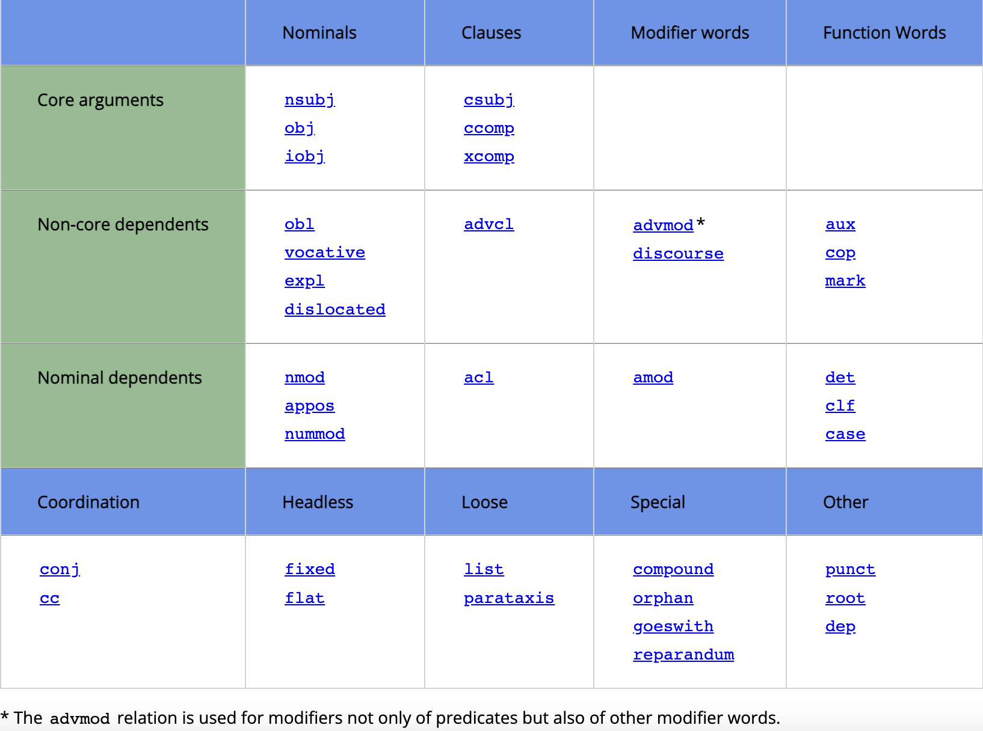
Universal dependencies: basic tenets
There is a fundamental distinction between Nominals and Clauses
Notes:
This fundamental distinction is reflected in the official table summing up the dependency relations of UD.

Slide 20
Universal dependencies: UPOS
Universal Parts of Speech (UPOS)
Words can be classified into categories: lexical categories aka word categories aka parts of speech.
These categories are not universal but language-specific. Still, if we want to use the same set of categories, we have to live with that. There are 17 UPOSes in UD, defining both words and elements of text such as punctuations or symbols.
We fit language-specific categories into these universal categories using several approaches:
  a semantic approach: nouns usually -> objects, verbs -> actions and adjectives -> properties.
  A distributional approach:
    Syntactic and morphological properties: i.e., nouns usually pop up as verbal arguments, they inflect for given features in the language X, …

Slide 21


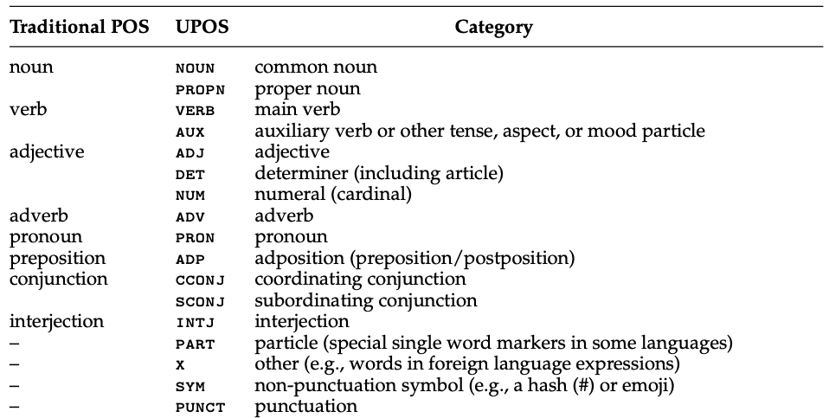
Universal dependencies: UPOS
Universal Parts of speech (UPOS)
https://universaldependencies.org/u/pos/all.html
Notes:
pattern {
X [upos=ADJ];
Y [upos=VERB];
Y -[nsubj]-> X;
}

Slide 22
Universal dependencies: Morphological features (feats)
Universal morphological features
As the name suggests, this annotation field concerns the features of the word: nominal, adjectival and verbal categories such as gender, degree and tense.
TBH, this is a bit of misnomer, as some of these features are actually syntactic features, so morpho-syntactic features should be a better term…
We can conceive this annotation field as a subset of the UPOS
  For instance verbs (VERB) can be better described with the verbal form (VerbForm=) feature as Finite Verbs (Fin), Participles (Part), Gerund(ive)s (Ger), …
This is again something working at the language-specific level but with a universal set of features.

Slide 23
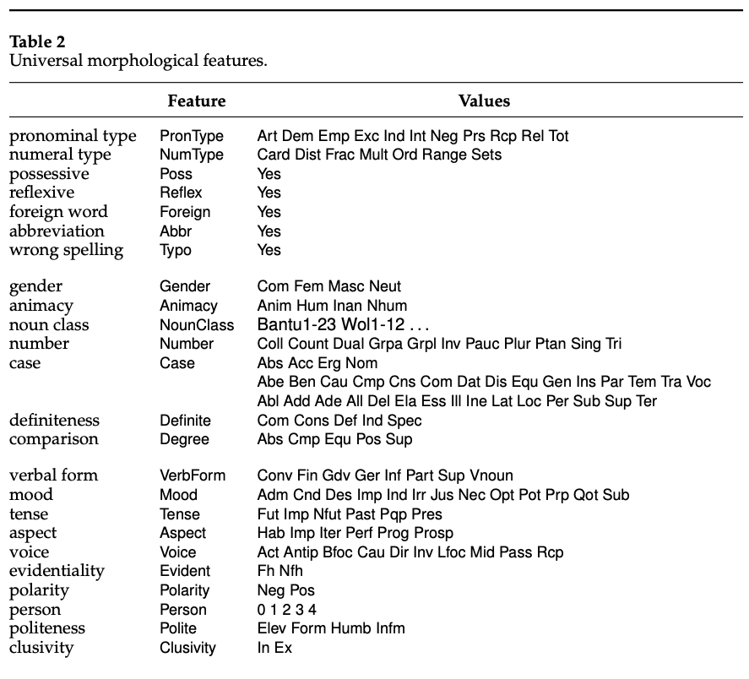
Universal dependencies: Universal morphological features (FEATS)
Universal Morphological features
https://universaldependencies.org/u/feat/all.html

Slide 24
Universal dependencies: relations (HEAD+DEPREL)
UPOS and Morphological Features ‘work’ without any other tokens, describing only some features of the annotated token;
UD Relations, as the name implies, need exactly two tokens to work: the annotated token and its head;
The only element without a head is the root token, which is unique to each sentence and the mother of all other tokens.
Two fields/columns:
  Head: ID of the head of the token;
  Deprel: UD offers 37 Relations to describe the relation between the token and its head.

Slide 25
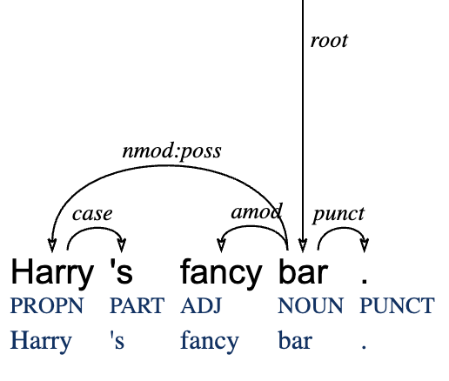
Universal dependencies: relations
Some examples
Nominal modification (nmod: a relation between two nouns), adpositions (case: syntactic case marking) and adjectival modification (amod: modification by adjectives).
# text = Harry's fancy bar.
1-2 Harry's _ _ _ _ _ _ _ _
1 Harry Harry PROPN SG Number=Sing 4 nmod:poss _ _
2 's 's PART GEN _ 1 case _ _
3 fancy fancy ADJ POS Degree=Pos 4 amod _ _
4 bar bar NOUN SG-NOM Number=Sing 0 root _ SpaceAfter=No
5 . . PUNCT Period _ 4 punct _ SpaceAfter=No

Slide 26
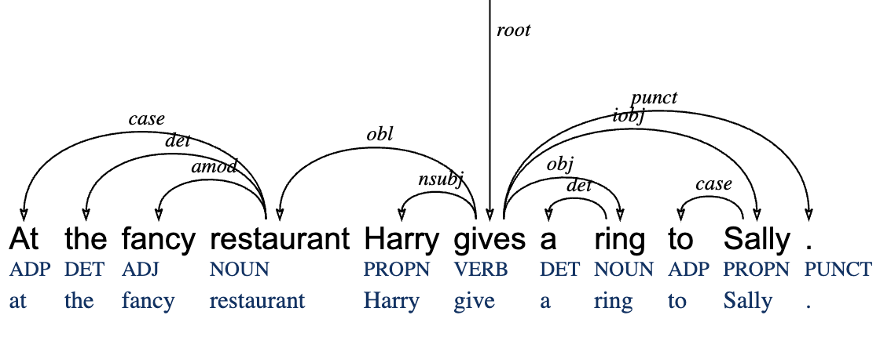
Universal dependencies: relations
Some examples
Syntactic roles: subject (nsubj), object (obj), indirect object (iobj), oblique (obl)
# sent_id = 1# text = At the fancy restaurant Harry gives a ring to Sally.
1 At at ADP _ _ 4 case _ _
2 the the DET DEF Definite=Def|PronType=Art 4 det _ _
3 fancy fancy ADJ POS Degree=Pos 4 amod _ _
4 restaurant restaurant NOUN SG-NOM Number=Sing 6 obl _ _
5 Harry Harry PROPN SG-NOM Number=Sing 6 nsubj _ _
6 gives give VERB PRES Mood=Ind|Number=Sing|Person=3|Tense=Pres|VerbForm=Fin 0 root _ _
7 a a DET IND-SG Definite=Ind|PronType=Art 8 det _ _
8 ring ring NOUN SG-NOM Number=Sing 6 obj _ _
9 to to ADP _ _ 10 case _ _
10 Sally Sally PROPN SG-NOM Number=Sing 6 iobj _ SpaceAfter=No
11 . . PUNCT Period _ 6 punct _ SpaceAfter=No
# text = Harry's bar.
1 Harry Harry PROPN SP _ 0 root _ SpaceAfter=No
2 's 's PART PART _ 1 case _ _
3 bar bar NOUN S Gender=Masc 1 nmod _ SpaceAfter=No
4 . . PUNCT FS _ 1 punct _ SpaceAfter=No

Slide 27
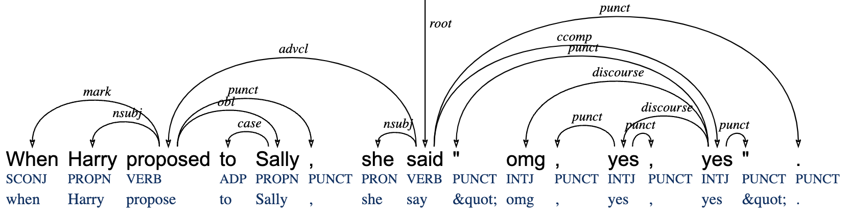
Universal dependencies: relations
Some examples
Subordinate clauses: adverbial clauses (advcl), object clauses (ccomp)
# text = When Harry proposed to Sally, she said "omg, yes, yes".
1 When when SCONJ _ _ 3 mark _ _
2 Harry Harry PROPN SG-NOM Number=Sing 3 nsubj _ _
3 proposed propose VERB PAST Mood=Ind|Tense=Past|VerbForm=Fin 8 advcl _ _
4 to to ADP _ _ 5 case _ _
5 Sally Sally PROPN SG-NOM Number=Sing 3 obl _ SpaceAfter=No
6 , , PUNCT Comma _ 3 punct _ _
7 she she PRON PERS-SG-NOM Case=Nom|Gender=Fem|Number=Sing|Person=3|PronType=Prs 8 nsubj _ _
8 said say VERB PAST Mood=Ind|Tense=Past|VerbForm=Fin 0 root _ _
9 " &quot; PUNCT Quote _ 14 punct _ SpaceAfter=No
10 omg omg INTJ _ _ 14 discourse _ SpaceAfter=No
11 , , PUNCT Comma _ 12 punct _ _
12 yes yes INTJ _ Polarity=Pos 14 discourse _ SpaceAfter=No
13 , , PUNCT Comma _ 12 punct _ _
14 yes yes INTJ _ Polarity=Pos 8 ccomp _ SpaceAfter=No
15 " &quot; PUNCT Quote _ 14 punct _ SpaceAfter=No
16 . . PUNCT Period _ 8 punct _ SpaceAfter=No

Slide 28
Universal dependencies: conll-u files
From https://universaldependencies.org/format.html:
”Annotations are encoded in plain text files (UTF-8, normalized to NFC, using only the LF character as line break, including an LF character at the end of file) with three types of lines:
Word lines containing the annotation of a word/token/node in 10 fields separated by single tab characters; see below.
Blank lines marking sentence boundaries. The last line of each sentence is a blank line.
Sentence-level comments starting with hash (#). Comment lines occur at the beginning of sentences, before word lines.”

Slide 29
Useful tools
A selection of useful tools for working with UD. See more on https://universaldependencies.org/query.html and https://universaldependencies.org/tools.html
Query
TEITOK: You can use TEITOK to query UD treebanks (and encode your own), combining CQP with UD. https://lindat.mff.cuni.cz/services/teitok/ud217/
Match/Grew: probably the most famous tool to query UD treebanks, with a sophisticated query syntax. https://match.grew.fr/
UDEasy: a stand-alone software written in Python. https://unipv-larl.github.io/udeasy/
Visualize
CoNLL-U: a simple tool for visualize CoNLL-U files, in a fancy tree output. https://universaldependencies.org/conllu_viewer.html
Create
Arborator: an intuitive, graphical editor for create and visualize CoNLL-U files. https://arborator.grew.fr/
Notes:
A selection of tools for working the UD

Slide 30
Experimenting with miniciep+

Slide 31
How to work with miniciep+
In its most basic form, miniciep+ is a collection of text (txt) files using the UTF-8 encoding, so you can explore it using a simple text editor. However, it might be not so useful, as (i) you miss any form of annotation and (ii) you cannot perform elaborate queries.
Enter the CoNLL-U files, which are the UD-parsed version
With or without its annotations, miniciep+ can be encoded in Corpus Query Processors such as CWB (Corpus WorkBench) or Sketch Engine, allowing you to perform complex queries.
In this workshop, we will focus on an alternative way of exploring corpora, learning the art of extracting data from CoNLL-U files using Python scripts and storing results in comma-separated value (CSV) files for further analyses.

Slide 32
References
Haspelmath, Martin. 2018. How comparative concepts and descriptive linguistic categories are different. In Van Olmen, D.; Mortelmans, T. & Brisard, F. (eds.), Aspects of Linguistic Variation. Berlin: De Gruyter. 83-114.
Levshina, Natalia. 2021. Corpus-based typology: Applications, challenges and some solutions. Linguistic Typology 26(1). 129-160.
Levshina, Natalia, Namboodiripad, Savithry, Allassonnière-Tang, Marc, Kramer, Mathew, Talamo, Luigi, Verkerk, Annemarie, Wilmoth, Sasha, Rodriguez, Gabriela Garrido, Gupton, Timothy Michael, Kidd, Evan, Liu, Zoey, Naccarato, Chiara, Nordlinger, Rachel, Panova, Anastasia and Stoynova, Natalia. 2023. "Why we need a gradient approach to word order”. Linguistics, vol. 61, no. 4, 825-883.
Mayer, Thomas & Michael Cysouw. 2014. Creating a Massively Parallel Bible Corpus. Proceedings of the International Conference on Language Resources and Evaluation (LREC), Reykjavik, 3158-3163.
Naranjo, M. G., & Becker, L. (2018). Quantitative word order typology with UD. Proceedings of the 17th International Workshop on Treebanks and Linguistic Theories (TLT 2018), Linköping Electronic Conference Proceedings # 155, 91–104.
Talamo, Luigi & Verkerk, Annemarie. 2022. A new methodology for an old problem: A corpus-based typology of adnominal word order in European languages. Italian Journal of Linguistics 34(2), 171-226.
Verkerk, Annemarie & Luigi Talamo. 2024. mini-CIEP+ : A Shareable Parallel Corpus of Prose. In Pierre Zweigenbaum, Reinhard Rapp & Serge Sharoff (eds.), Proceedings of the 17th Workshop on Building and Using Comparable Corpora (BUCC) @ LREC-COLING 2024. 135–143. ELRA and ICCL.
Wälchli, Bernhard & Michael Cysouw. 2012. Lexical typology through similarity semantics: To-ward a semantic map of motion verbs. Linguistics 50 (3). 671–710.

