Slide 1
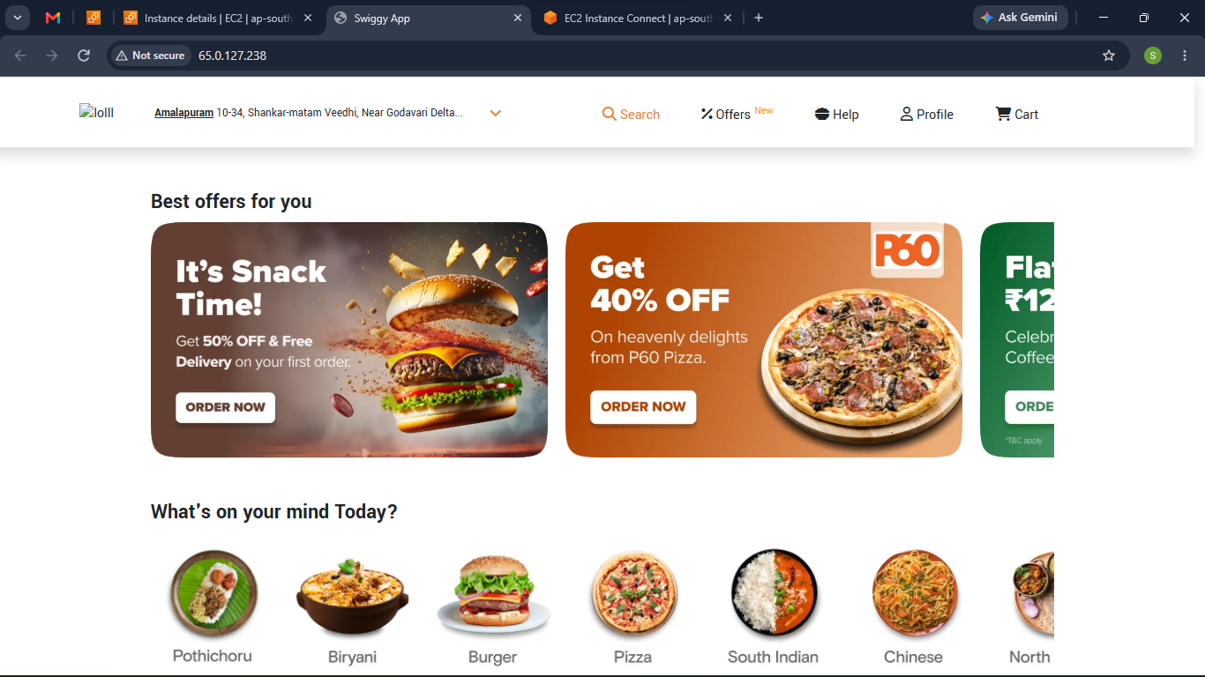
AWS • DEVOPS • CLOUD PROJECT
Automated CI/CD Pipeline & 3-Node Architecture for Swiggy Clone
Modern Web Deployment, Containerized Automation, and Cloud Monitoring
Name: Sejal Pranay Rahood
Target roles: Cloud Engineer | DevOps Engineer | System Administrator

Slide 2
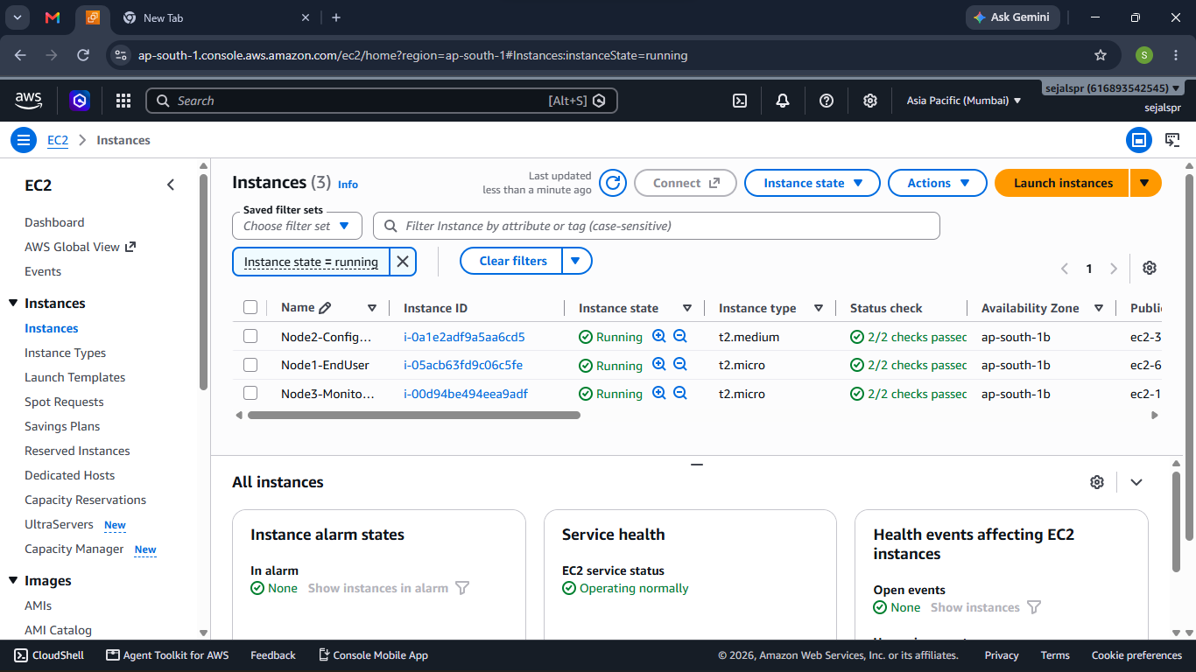
AWS EC2 • UBUNTU
Infrastructure Provisioning (3-Node Setup)
Node 1 – Node1-EndUser
Apache web server hosting the production-ready app
t2.micro
1
Node 2 – Node2-Configuring
Docker + Jenkins host for the CI/CD pipeline
t2.medium
2
Node 3 – Node3-Monitoring
Observability node tracking system health
t2.micro
3
Three EC2 instances running in ap-south-1 (Mumbai)

Slide 3
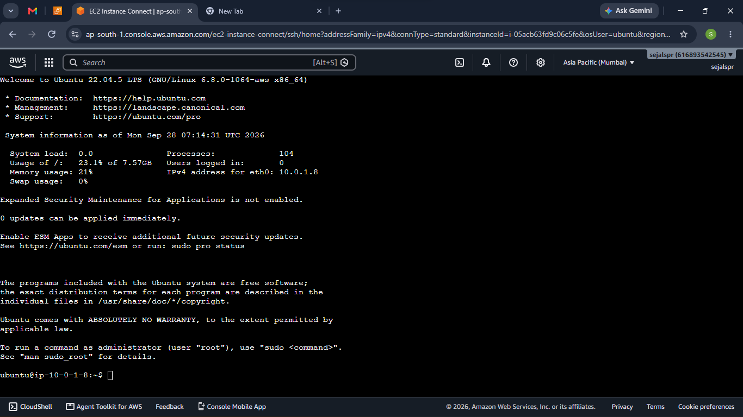
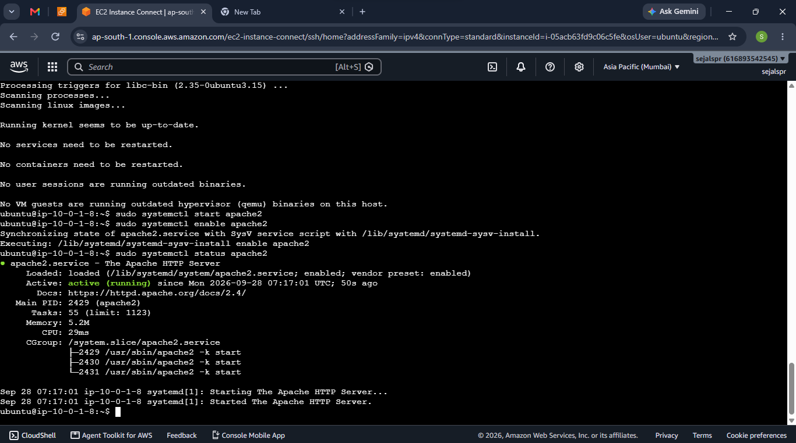
NODE 1 • WEB SERVER
Node 1 – Apache Web Server Setup
sudo apt update -y
sudo apt install apache2 -y
sudo systemctl start apache2 && sudo systemctl enable apache2
sudo systemctl status apache2
Connected via EC2 Instance Connect
apache2 active (running)

Slide 4
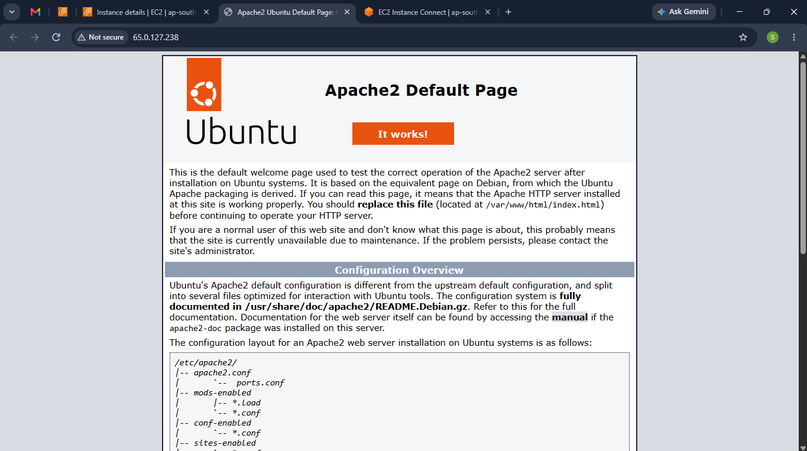
NODE 1 • WEB SERVER
Node 1 – Live Deployment
Default Apache page confirmed, then the Swiggy React build was deployed to /var/www/html/ and served live on public IP 65.0.127.238.
→
Apache2 default page
Swiggy React clone live

Slide 5
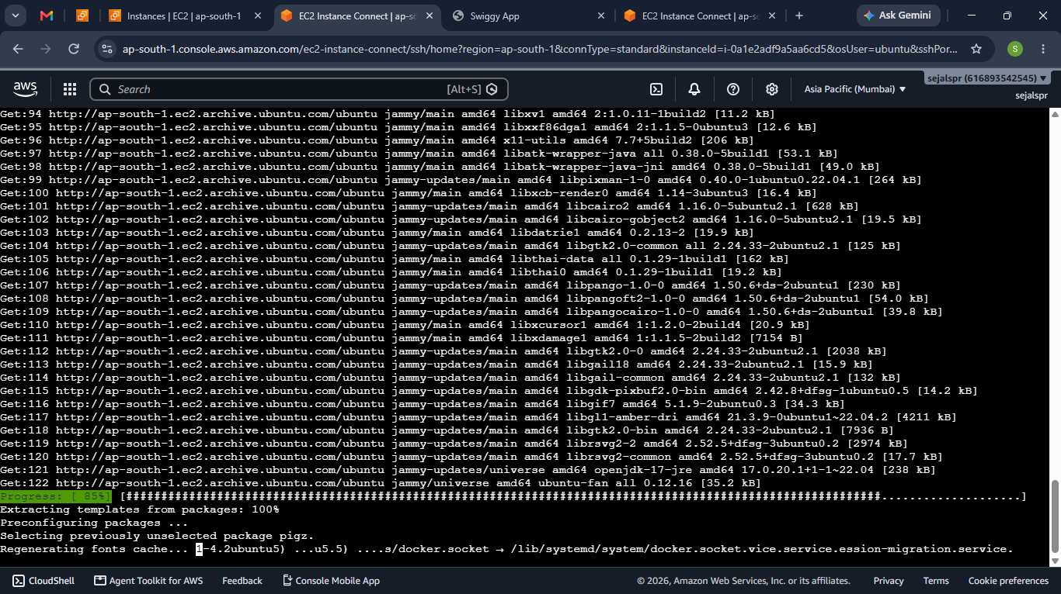
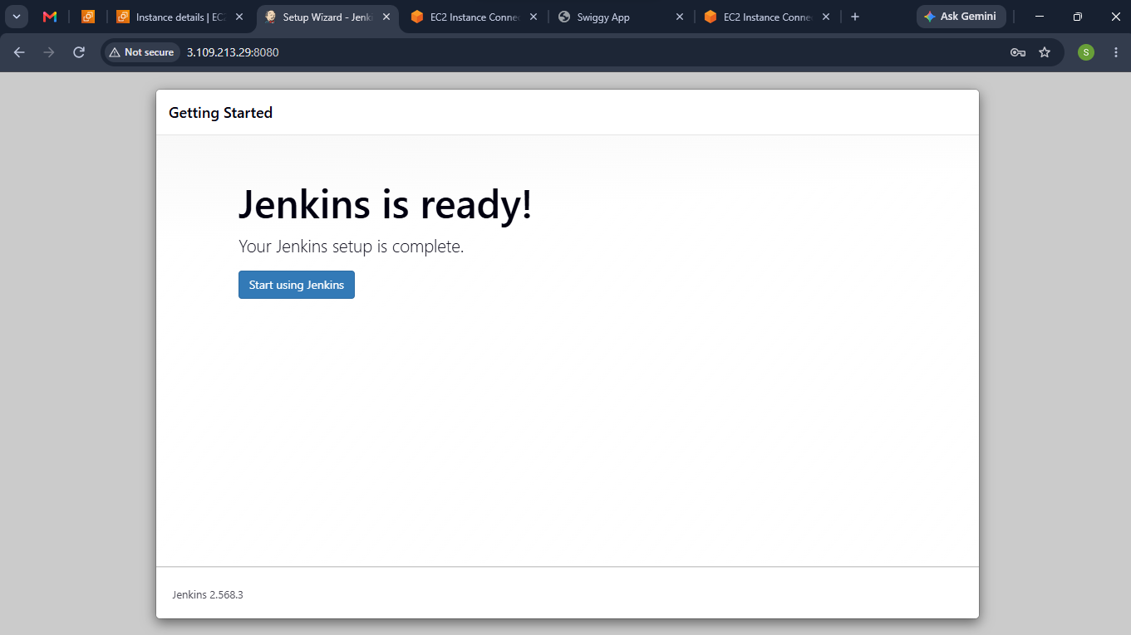
NODE 2 • CI/CD HOST
Node 2 – Toolchain & Jenkins Installation
Provisioned Docker, Git and Java on Node 2, then deployed Jenkins and completed the setup wizard.
Installing Docker, Git, Java
Jenkins is ready

Slide 6
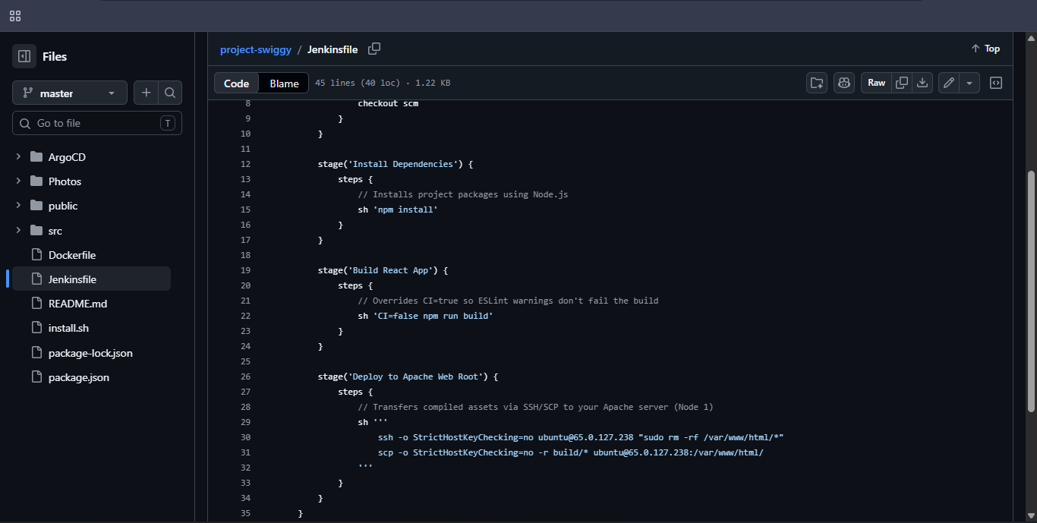
NODE 2 • PIPELINE SCRIPT
Declarative Jenkinsfile
Checkout SCM
Pull latest code from GitHub
1
Install Dependencies
npm install
2
Build React App
CI=false npm run build
3
Jenkinsfile in the project-swiggy repository
Deploy to Apache
SSH/SCP build/* to Node 1
4

Slide 7
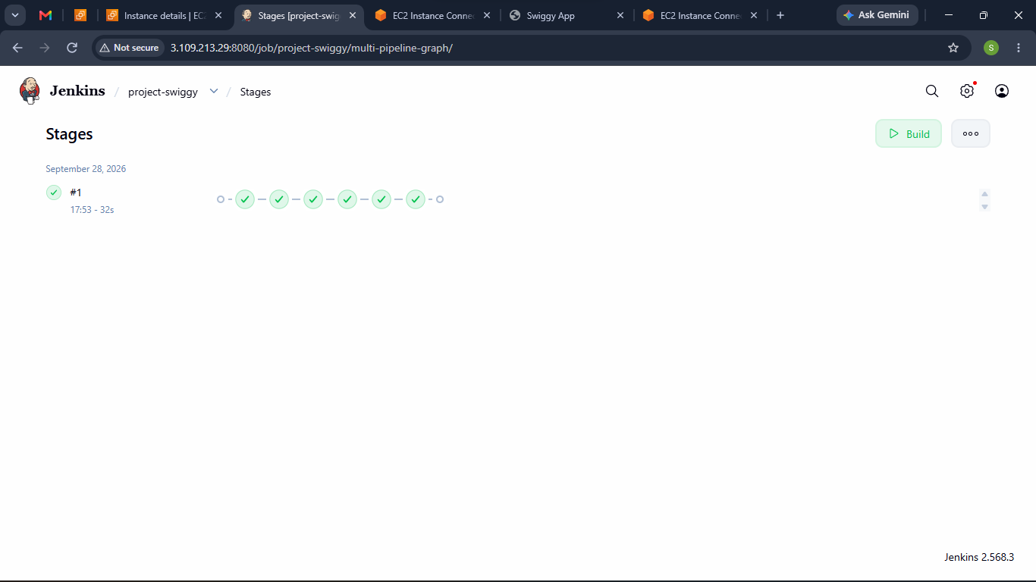
NODE 2 • JENKINS BUILD
Pipeline Execution & Success
#1
Build number
32 s
Total build time
PASS
All stages green
Jenkins pipeline stages – Build #1 successful
Jenkins tracks the master branch of the project-swiggy repository via SCM integration.

Slide 8
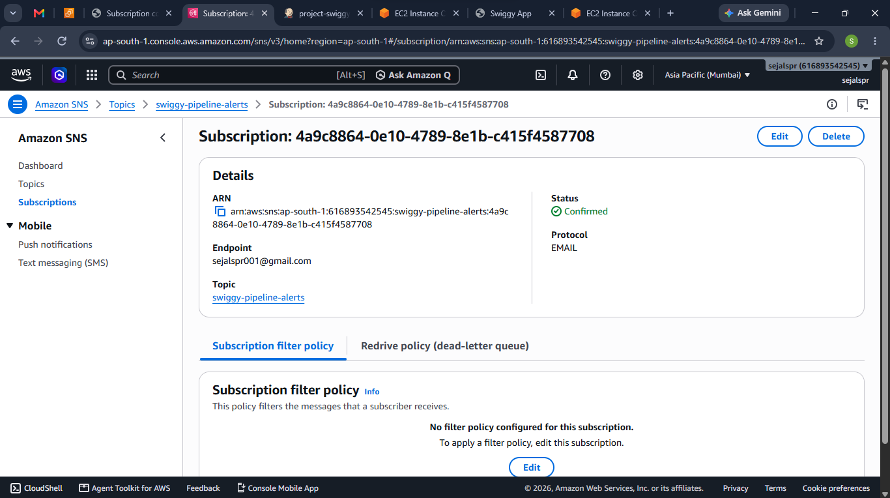
NODE 3 • MONITORING
Node 3 – Amazon SNS Alerting
Created standard SNS topic: swiggy-pipeline-alerts
Email subscription endpoint added and confirmed
Instant notifications for infrastructure alarms
SNS subscription status: Confirmed

Slide 9
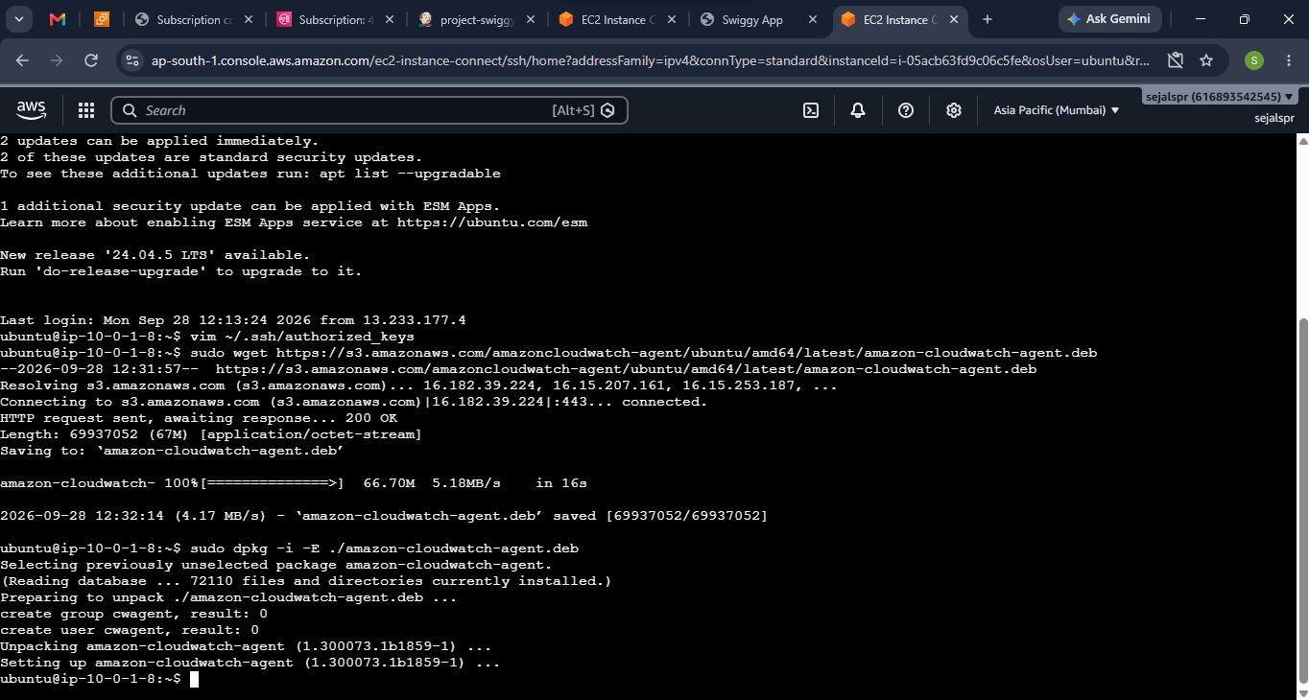
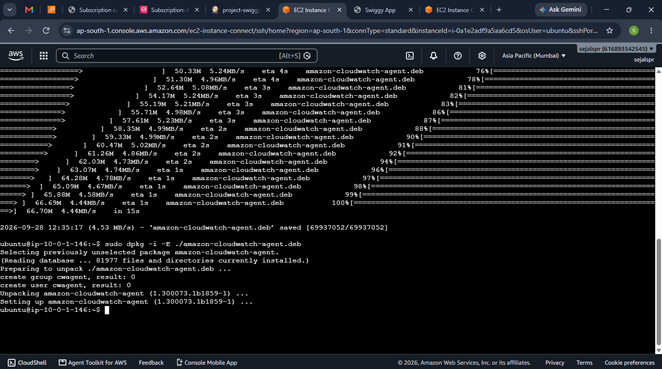
NODE 3 • MONITORING
CloudWatch Agent Deployment
sudo wget https://s3.amazonaws.com/amazoncloudwatch-agent/ubuntu/amd64/latest/amazon-cloudwatch-agent.deb
sudo dpkg -i -E ./amazon-cloudwatch-agent.deb
Agent installed on Node 1
Agent installed on Node 2

Slide 10
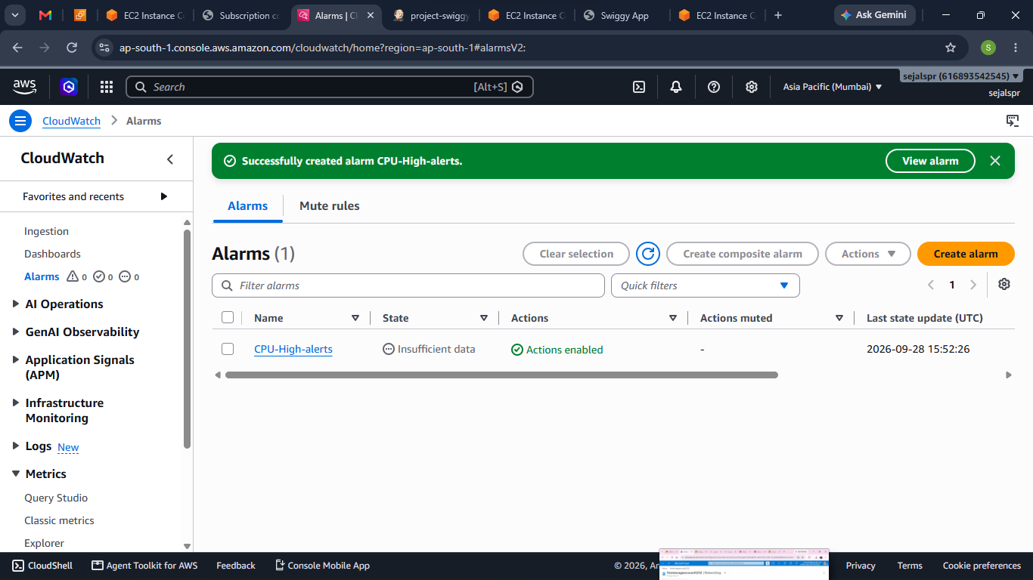
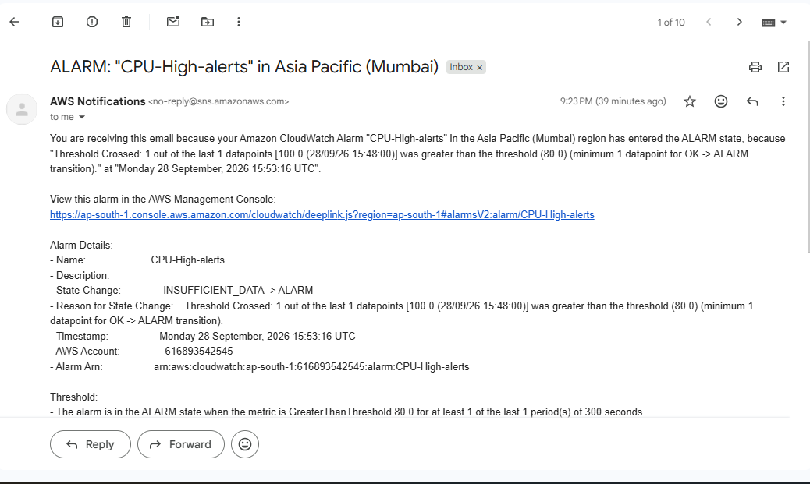
NODE 3 • OBSERVABILITY
CloudWatch Alarms & Email Alert
CPU-High-alerts alarm created; when the threshold was crossed, SNS delivered the alert email.
Alarm created in CloudWatch
Alert email received via SNS

Slide 11
Project Outcome
A fully automated, resilient and monitored multi-node cloud deployment pipeline.
Node 1
Node 2
Node 3
Hosting the live, automated Swiggy React app via Apache
Dockerized Jenkins CI/CD server that builds and deploys code updates
CloudWatch monitoring and SNS alerts to keep infrastructure safe
AWS EC2 • Apache • Docker • Jenkins • CloudWatch • SNS

