Slide 1
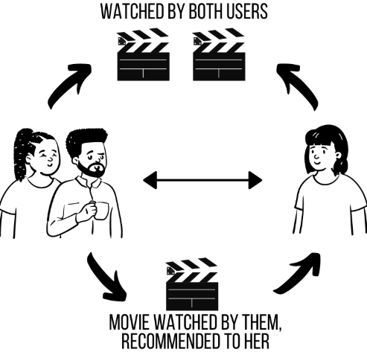
Movie Recommendation System
Machine Learning: Collaborative Filtering
Value:
Reduce choice overload • Increase engagement • Support retention
Author: Rahaman Yusuf
Flatiron School • Phase 4

Slide 2
Business Problem
Stakeholder
Movie streaming platform product & personalization team
Problem
Users face choice overload. If they can't quickly find movies they'll enjoy, engagement drops and churn risk increases.
Goal
Predict how a user would rate unseen movies and return Top-5 personalized recommendations.
How it would be used
“Recommended for You” row on homepage
Email/push recommendation campaigns
Content discovery and retention initiatives
MovieLens recommender

Slide 3
Data Overview
Dataset
Sparsity
MovieLens “latest small” (GroupLens)
Explicit ratings on a 0.5–5.0 scale
98.3%
Key facts
100,836 ratings
610 users
9,742 movies
3,683 tag applications
Only ~1.7% of user×movie pairs have ratings
Limitations
Why this matters
Cold start for new users/movies
No demographics
Offline error ≠ business KPIs
The user–movie matrix is ~98.3% sparse. Sparsity makes similarity-based methods harder and motivates matrix factorization.
Data understanding

Slide 4
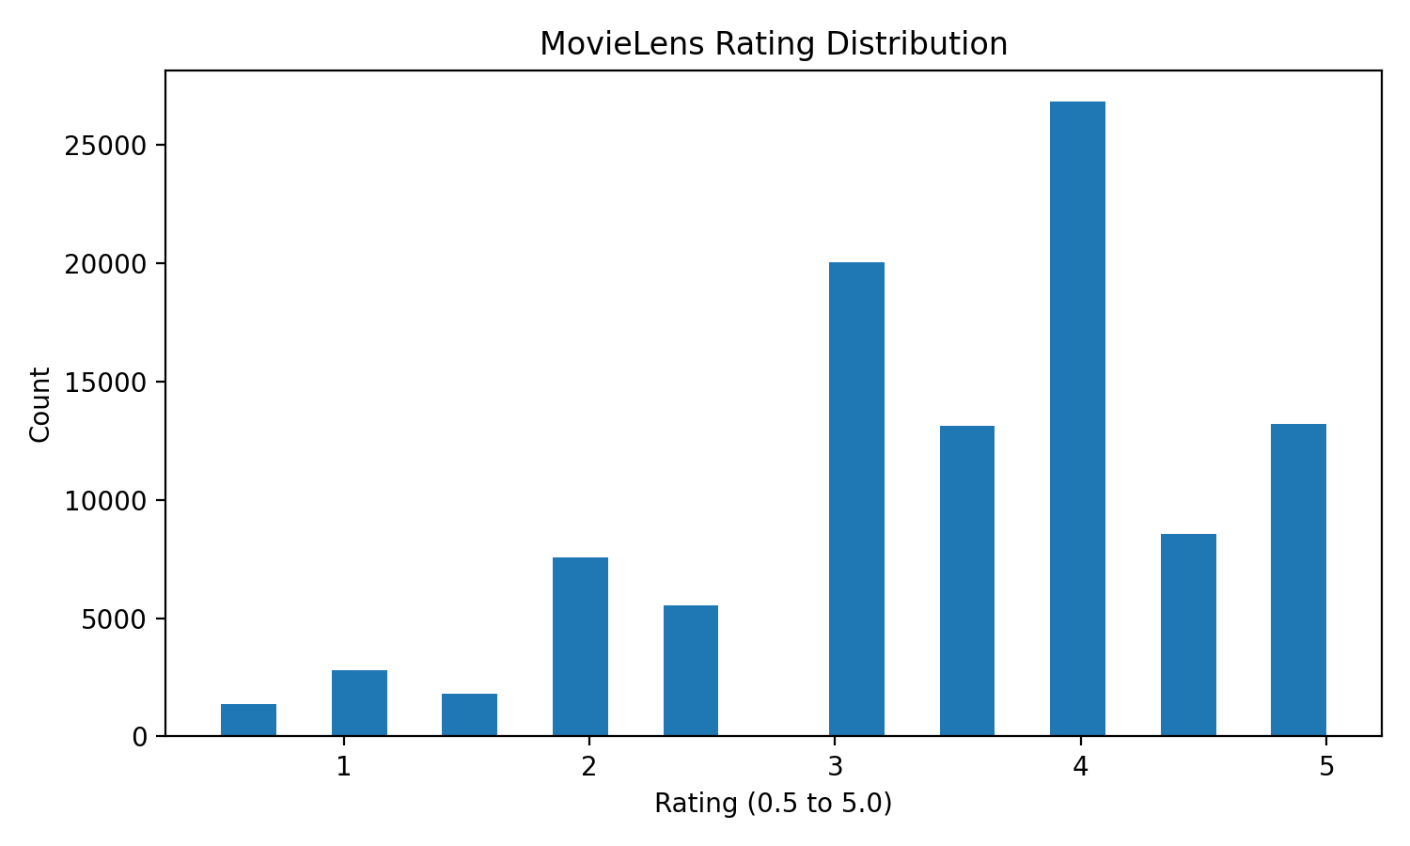
Exploratory Data Analysis
Rating distribution (explicit feedback)
Observation: ratings cluster around 3–4 stars (selection bias: users tend to rate movies they chose to watch).
EDA

Slide 5
Modeling Approach
Iterative modeling: start simple → add complexity → tune → evaluate on holdout test
BaselineOnly
kNNBaseline
SVD (MF)
Tuned SVD
Global + user + movie biases
Item-item similarity
Latent factors
GridSearchCV (CV)
Why factorization helps: learns global structure from sparse ratings
Evaluation plan
80/20 split (holdout test)
3-fold CV on train for model selection
Metrics: RMSE + MAE (error in “stars”)
Modeling

Slide 6
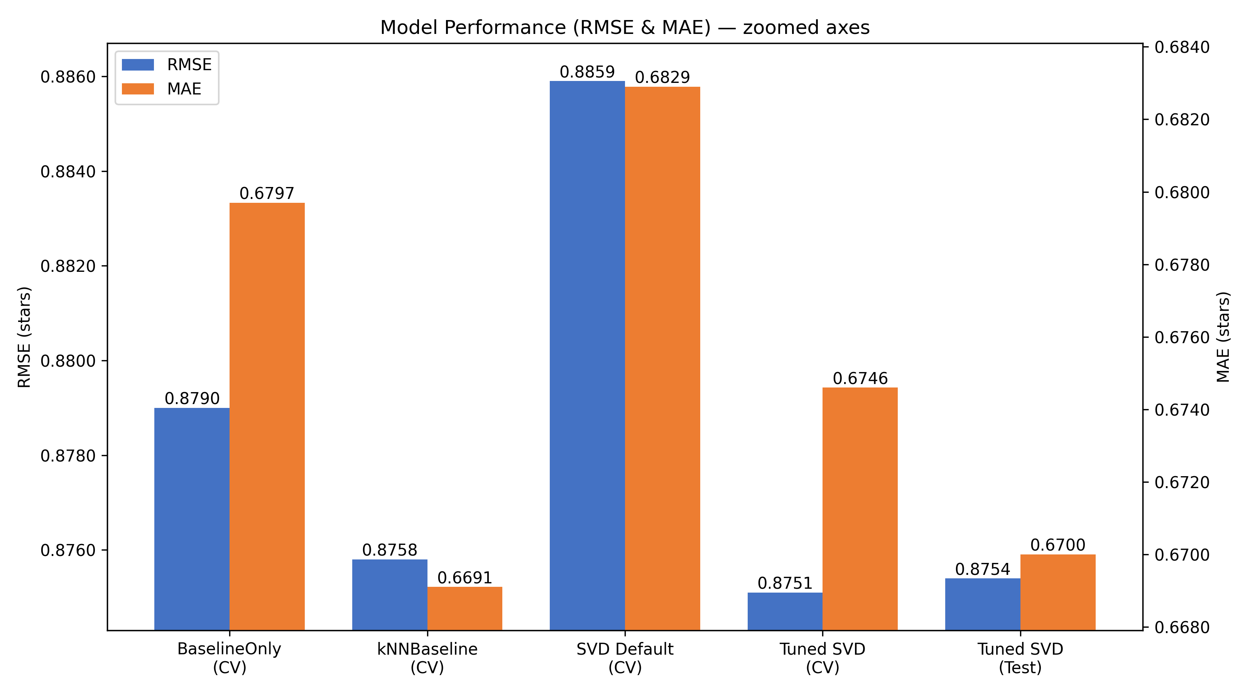
Results
Model performance (lower is better)
Note: RMSE and MAE use separate (zoomed) y-axes so small differences are easier to see. Lower is better.
Key takeaways
Baseline is strong (bias effects explain much of rating behavior)
Tuning makes SVD competitive and stable on holdout (CV ≈ Test)
RMSE ≈ 0.88 ⇒ typical error ~0.9 stars on a 0.5–5 scale
Evaluation

Slide 7
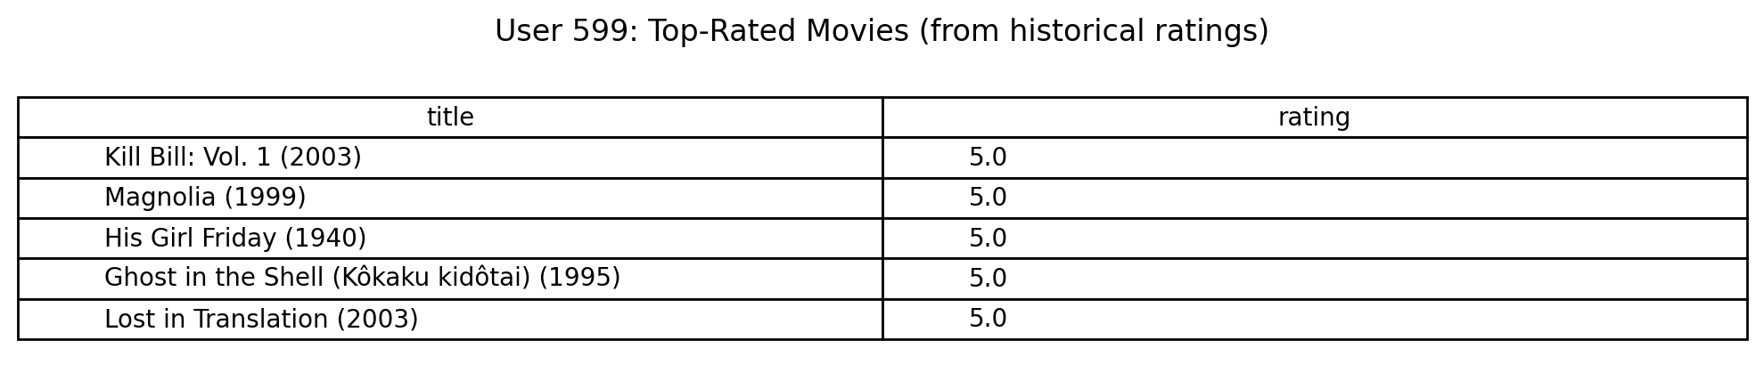
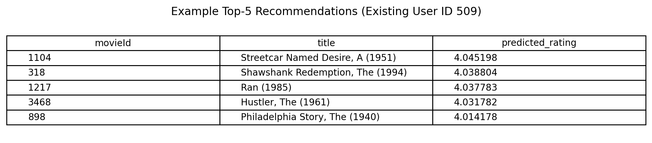
Demo: Existing User Recommendations
User 599: what they loved
Top-5 recommendations (example)
Note: recommendations table shows an example user demo output from the notebook run.

Slide 8
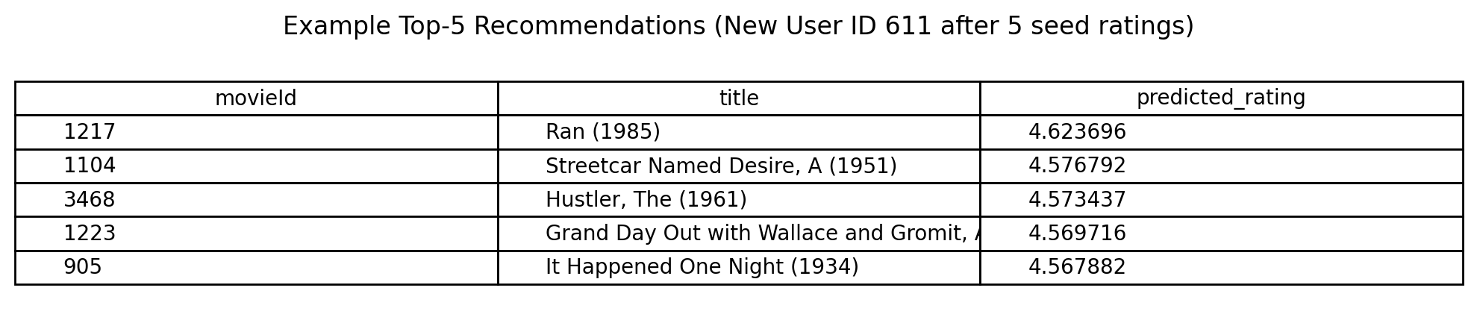
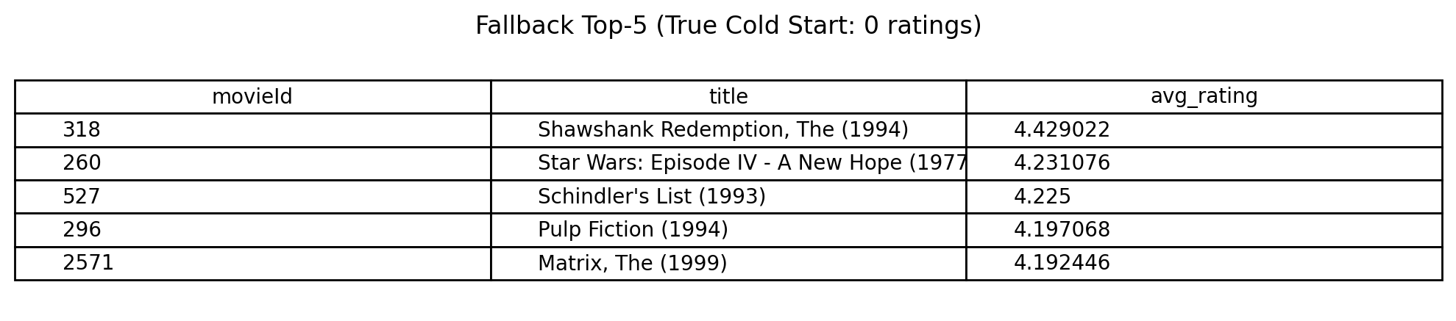
Cold Start: New User Strategy
Problem: collaborative filtering cannot personalize for a user with 0 ratings.
Solution: ask for 5–10 initial ratings (popular movies) → refit/update user profile → recommend Top-5.
Fallback: if 0 ratings are provided, recommend popular + highly-rated movies until feedback arrives.
New user Top-5 (after 5 seed ratings)
True cold start fallback (0 ratings)
Cold start handling

Slide 9
Limitations & Next Steps
Limitations
Sparse data limits personalization for low-activity users
No demographics or rich item metadata
RMSE/MAE are offline metrics; production success is measured by CTR, watch-time, retention
Next steps (production-minded)
Hybrid recommender: combine CF with genres/tags for better cold start
Add ranking metrics (Precision@K / Recall@K / NDCG@K)
Online A/B test to validate business lift
Incorporate implicit feedback (clicks, watch time) for scale
Thank you

