Slide 1
Uber vs. Other FHVs 67-364 Project 1
Richard Huang, Vinitha Ranganeni

Slide 2
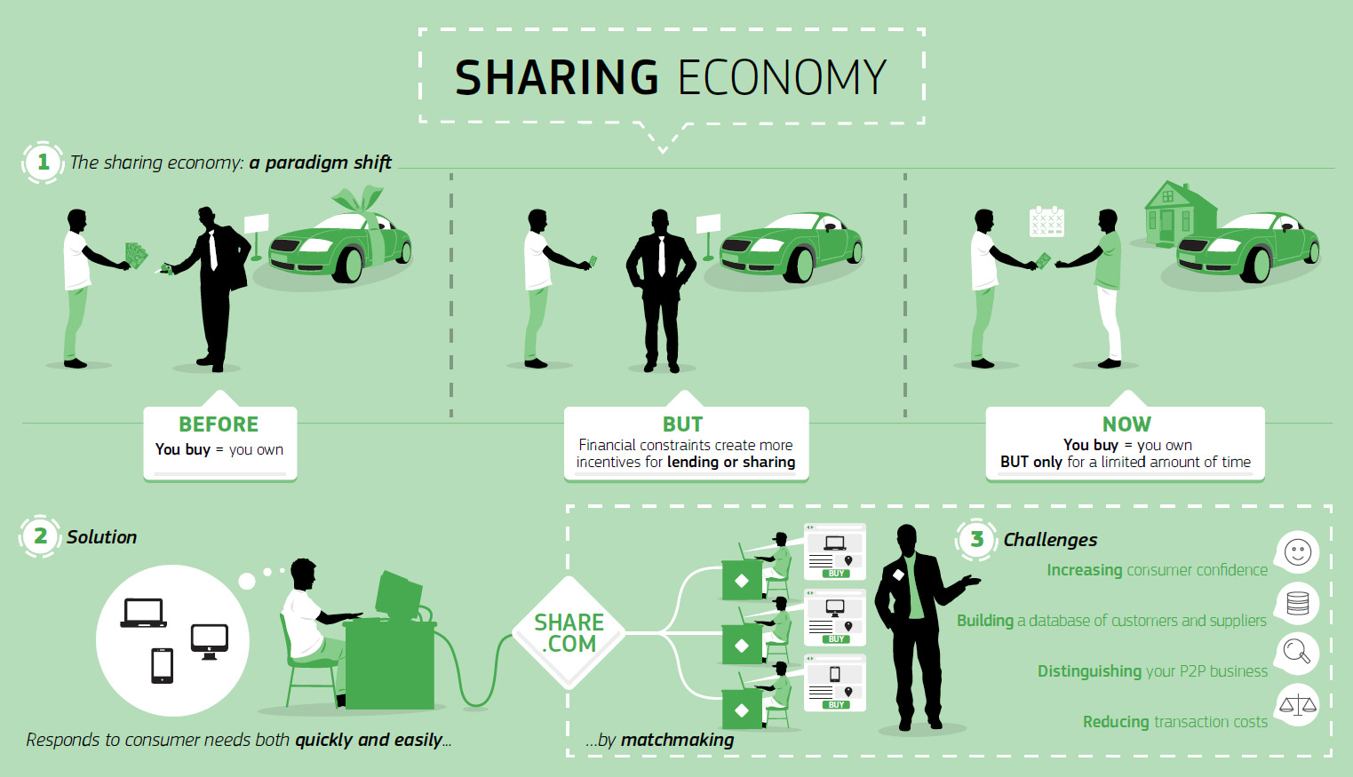

Slide 3
In what neighborhoods of New York City is Uber the most/least popular?
What are the characteristics of the various neighborhoods that Uber is most/least popular in?
What is the trend of the activity between Uber and other FHV services from 2014-2015?
Has Uber increased in popularity or even surpassed Yellow Cab in number of trips per day?
What is the activity of Uber during different times of the day in various neighborhoods in New York City?
Are there certain times of day that Uber is more popular? Why?
What should Uber do to maximize their profit in NYC?
What are we interested in?

