Slide 1


Unlock
Hidden Value

Slide 2

Agenda
2025 Look Back
Financial Review (Q4, FY 2025, Budget 2026)
Consulting Sales Review
Delivery Update
Marketing Update
Q1 2026 Company Goals
2

Slide 3
2025 Look Back – Sales
Wins
Misses
Consulting bookings steady at ~$3M/quarter; pipeline adds trending favorably throughout the year
KSA pipeline growing: LLCP emerged as a strong KSA; Core Industrial similarly situated (using x-portfolio as a blueprint)
GP Stakes – Ridge Lake (Gridiron, Gauge)
15 new PE logos; 40 consulting projects sold
Greater involvement of delivery/SME in scoping/closing calls
Additions: David (CT), Jake (Bluwave). Offer out to Kevin Buckley (ex-Grant Thornton PE sales)
Consulting bookings consistently below budget ($3M actual vs. $4.8–$5.3M budget each quarter)
Small parcel bookings significantly below plan + churn
BDR turnover: Jack/CJ (underperformance) and Shaun departure
Close rate at ~30%
2026 Focus
Add 6–8 new KSAs; continue to improve KSA opportunity contributions to improve pipeline consistency
Continue to iterate on BDM model: NYC-based hires, improved comp model, senior pairing
Prioritizing X-Portfolio data collection; creating value/goodwill through PVP
Verticalization of sales approach for top verticals (multi-site healthcare, HVAC, manufacturing)
3

Slide 4
2025 Look Back – Delivery
Wins
Misses
Strong project delivery, with highlights including RoadSafe ($5.7M savings across 3 phases), Epika ($1.5M in savings), Hy-Tek ($1.2M in savings), Naturpak ($1.1M in savings), D&H ($1.5M in savings)
New industries: auto collision (OpenRoad), warehousing automation (Hy-Tek), pet food (NaturPak), nutritionals (K-1/Everest)
COGS scope expansion successful and increasing across projects
Strong client satisfaction – NPS results positive; enthusiastic participation in video customer testimonials
Successful team development: 4 promotions; 8 new hires (3 departures) (Jan. ‘25 – ‘Feb. 26); Delivery Team-wide training held in October, Delivery Manager team-building offsites held Jan. & Sept. 2025
Colab91 (offshore India delivery) relationship; 3 resources (2 delivery, 1 AP support) starting between Feb. – May 2026
Only 13% of projects closed out on-time (in a 6 month time frame) - on-time delivery remains a challenge
Revenue collection challenges on contingent/hybrid projects – baseline reductions impacted ROI achievement (while contractual language protects us when baselines fall more than 20%, this language is challenging to enforce)
Managed spend offering gained minimal traction
2026 Focus
Improve consistency of delivery through New Hire training (to be held 2/24-2/25 in Chicago) and roll out of Delivery Principles (“The Treya Way”), Delivery Playbook, and slide template library by start of Q2 2026
Improve on-time delivery through granular Wrike milestone tracking and more proactive client communication re: delays
100% revenue collection: obtain baseline/savings approval as early in project as possible; escalate unpaid invoices much earlier
Continue COGS scope expansion as a differentiator
Re-allocate CDO’s time through delegation and reprioritization to increase focus on client relationship development and business development support and decrease focus on day-to-day project management support
4

Slide 5
2025 Look Back – Marketing
Wins
Misses
Marketing plan established for 2026
Customer video testimonials (3/5 complete; 2 scheduled)
3/31 – 4/1 ”Treya PE Summit”
Initiated initial demand gen campaigns
LLM/AI based content generation - POC
Very sluggish initial progress with marketing plan and activities and an appropriate marketing cadence
Have not yet reached a 100% rhythm
2026 Focus
Support for KSA expansion; Improved demand gen (PVP, Parcel, Consulting); Sales Enablement
More details on slides 19-20
5

Slide 6
2025 Look Back – PVP
Wins
Misses
PVP concept validated: multiple vendor partners actively engaged in consulting projects
Great buy-in from Delivery team driving widescale adoption in consulting channel
Key hire of VP level sales position dedicated to PVP onboarded and producing
More than $35M spend converted to date, with $40k revenue recognized in December
PVP revenue still modest relative to long-term potential
Pipeline and conversion tracking still to be formalized in Salesforce and beyond
Slower conversion than expected: time from "conversion" to first dollar shipped can drag out
No real outbound marketing plan in place
Adoption by PEs at the portfolio level has been limited to date
2026 Focus
100% PVP vendor engagement in eligible consulting project categories
Scale PVP revenue through increased portfolio company adoption and marketing-driven demand gen
Add new PVP vendor categories to expand addressable market; specifically, nail down playbook in Telecom
Establish 2-3 meaningful channel relationships with other service providers (e.g., Harbor, OOCFO Firms, IBs, etc.)
6

Slide 7
2025 Look Back – Org. Health
Wins
Misses
Implemented equity comp structure for managers – aligns incentives and improves retention
Significant delivery team build-out: added multiple new consultants and analysts
Stronger leadership alignment
New sales leadership in place and performing well – stronger execution and accountability
Adopted EOS (Entrepreneurial Operating System) for leadership alignment, accountability, and traction on strategic initiatives
CRO transition mid-year created short-term disruption
2026 Focus
Embed EOS operating rhythm: Level 10 meetings, quarterly rocks, scorecard tracking across all departments
Continue building bench strength in delivery – right-size team for projected 2026 revenue growth
Formalize talent development and succession planning for key roles
Maintain and build on improved leadership and managers group alignment – quarterly strategic offsites
7

Slide 8
2025 Look Back – M&A
Wins
Misses
Developed initial M&A thesis and prioritization framework with market map across fit dimensions
Evaluated multiple opportunities (mostly inbound from bank processes), notable include: Moresby Group, Holden, Acustraetgy
Refined acquisition strategy: acqui-hire identified as lower-risk, higher-probability path for building pricing capability
Did not close any acquisitions in 2025
Moresby Group IOI withdrawn due to elevated valuation expectations
Holden and Acustrategy both ruled out after deeper evaluation (fit and interest gaps respectively)
2026 Focus
Pricing capability remains high priority – acqui-hire as preferred path, with 4 active candidates in pipeline
Continue sourcing right-sized targets with strong complementary fit (product and market synergies) at attractive valuations
Maintain valuation discipline
8

Slide 9
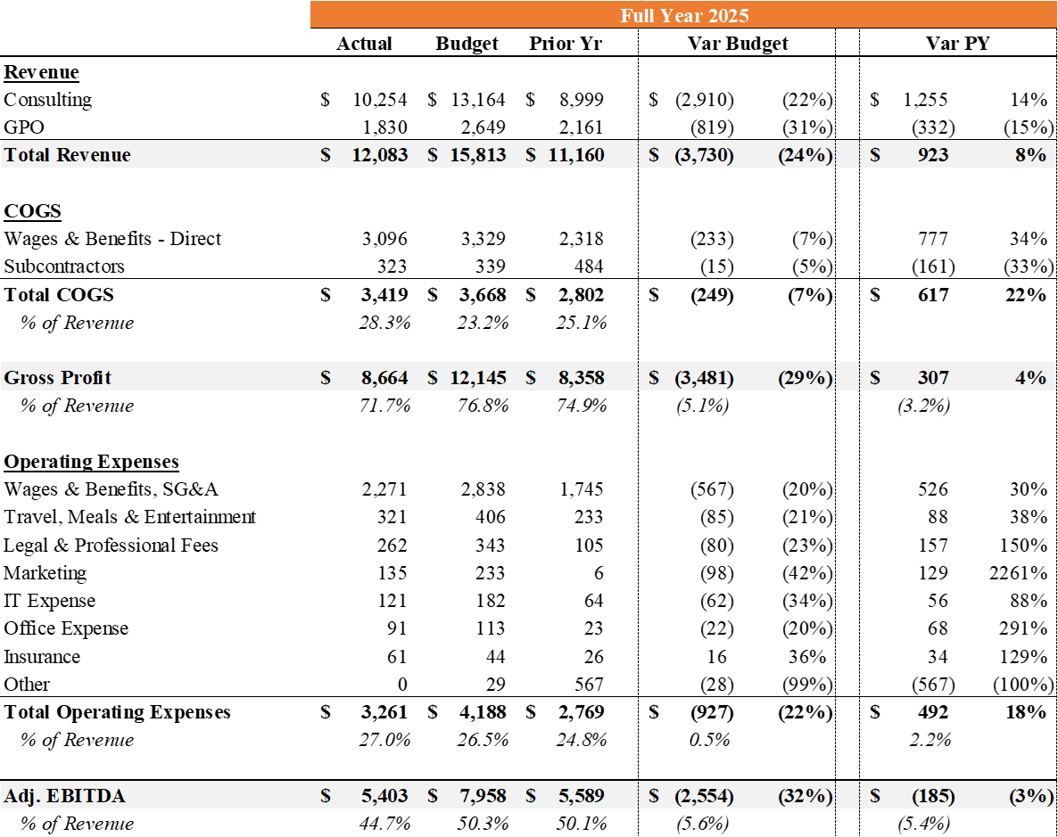
2025 Financial Summary
($ in Thousands)
Revenue: Good growth in consulting revenue in post-audit numbers despite a large miss in bookings ($11.9M vs. $16.3M budget). UPS largely stabilized after significant declines through Q3; PVP revenue starting to offset losses ($150k run rate as of 12/31/25).
Cost of Sales & Gross Profit: Good cost control vs. Budget, with hiring largely deferred to Q4 2025 and Q1 2026.
Opex: Costs significantly lower than plan but higher than the prior year, in line with expanded sales function and infrastructure to support planned growth. Positive variance on wages due to bonus accrual true-up. Under invested in marketing in 2025.
9

Slide 10
FY 2025 Consulting Sales
Sales by Quarter
Sales by Pricing Model
Total: $12.0M (40 deals)
Total: $12.0M (40 deals)
(12 deals)
(8 deals)
(10 deals)
(10 deals)
(55%)
(29%)
(16%)
Bookings steady at ~$3m / quarter [avg. deal size (booked): $300K]
Increasing pivot to hybrid pricing (~55% by booking amount)
10

