Slide 1

MACHINE LEARNING • ELECTRICITY DEMAND ANALYSIS • POWER BI DASHBOARD
SMART GRID
ELECTRICITY DEMAND
FORECASTING
Rahul P
Data Analyst | BCom (CA)

Slide 2






02
OVERVIEW
Introduction
Demand changes constantly, shaped by time, season, weather, and consumer behavior.
FROM DATA TO DECISIONS
Electricity Data
Historical data reveals recurring consumption patterns across hours and days.
Data analytics turns raw electricity records into usable operational insight.
Analysis
Machine learning extends that insight into forecasts of future demand.
Prediction
Power BI packages the analysis into an interactive decision-support dashboard.
Decision Support
SMART GRID ELECTRICITY DEMAND FORECASTING
02

Slide 3

03
THE CHALLENGE
Problem Statement
Electricity demand is not constant — it shifts by the hour, day, and season.
Unplanned demand swings create real challenges for power system planning.
How can historical electricity data be used to understand demand patterns and forecast future electricity demand?
Traditional review of electricity data is largely retrospective and manual.
A data-driven approach can turn history into a usable forward-looking estimate.
SMART GRID ELECTRICITY DEMAND FORECASTING
03

Slide 4




04
GOALS
Project Objectives
Analyze historical electricity demand
Identify daily, weekly & seasonal patterns
Study renewable generation behavior
Clean and prepare the raw dataset
Perform exploratory data analysis
Engineer predictive model features
Build a demand forecasting model
Deliver an interactive Power BI dashboard
SMART GRID ELECTRICITY DEMAND FORECASTING
04

Slide 5






05
MOTIVATION
Why Electricity Demand Analysis?
Power generation planning
Grid stability
Peak-demand management
Energy resource allocation
Renewable energy integration
Demand forecasting
→
→
→
Demand Analysis
Forecasting
Planning
Grid Management
SMART GRID ELECTRICITY DEMAND FORECASTING
05

Slide 6
06
THE DATA
Dataset Description
86,976
2021–2025
30-min
27
Half-hourly records
Time span (England & Wales)
Observation frequency
Raw source columns
KEY FIELDS
SAMPLE RECORDS
Electricity Demand, National & Transmission Demand (target domain)
Date | Period | Demand | Wind | Solar
2021-01-15 | 1 | 25,826 | 699 | 0
2021-01-15 | 2 | 26,297 | 703 | 0
2021-01-15 | 3 | 26,133 | 624 | 0
Wind Generation & Capacity, Solar Generation & Capacity
Calendar fields — Year, Month, Day, Day of Week, Hour, Quarter
Demand lag features — previous 30 min, 1 hr, 24 hr, 7 days
Units in MW. Solar/Wind shown as generation output.
Target variable: Electricity Demand (MW)
SMART GRID ELECTRICITY DEMAND FORECASTING
06

Slide 7

07
PIPELINE
Data Preprocessing
Raw Dataset
Data Cleaning
Datetime Build
Column Reduction
Feature Engineering
ML-Ready Dataset
›
›
›
›
›
86,976 rows, 27 columns
Missing values & duplicates checked
Date + Period → timestamp
Dropped non-predictive interconnector flows
Cyclical encoding + lag features
86,976 rows, 13 model features
New time-series features engineered: Hour, Month & Day-of-Week cyclical (sin/cos) encoding, plus demand lag features at 30 min, 1 hr, 24 hr and 7 days.
SMART GRID ELECTRICITY DEMAND FORECASTING
07

Slide 8
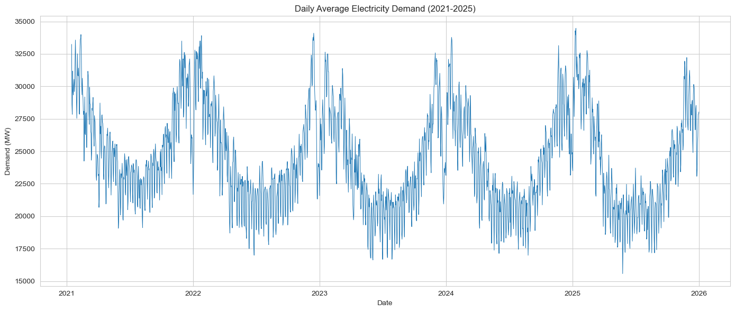
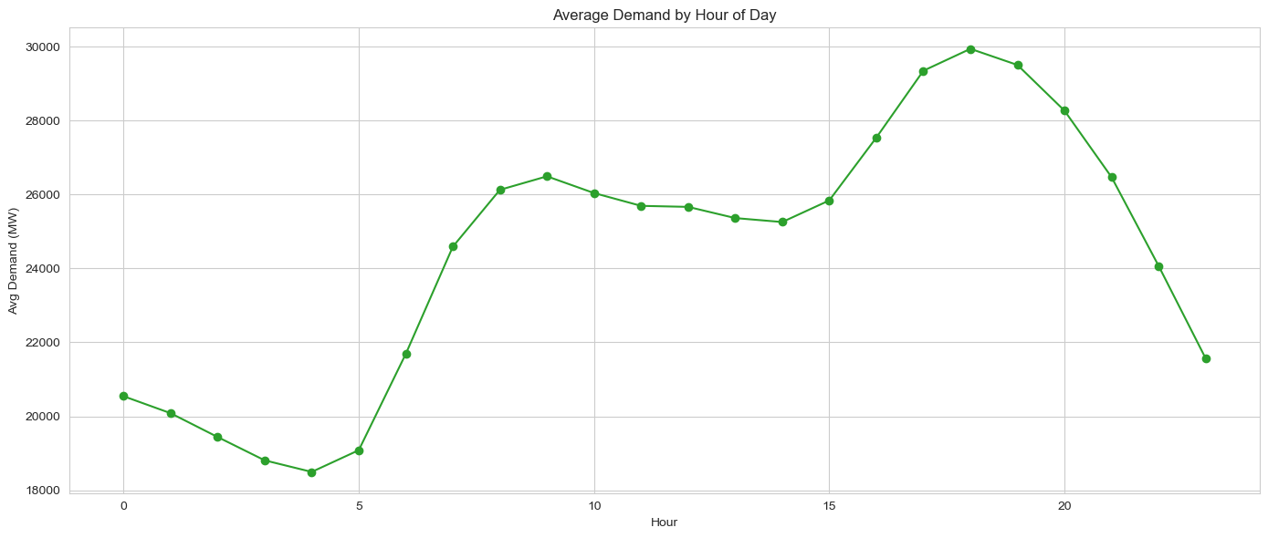
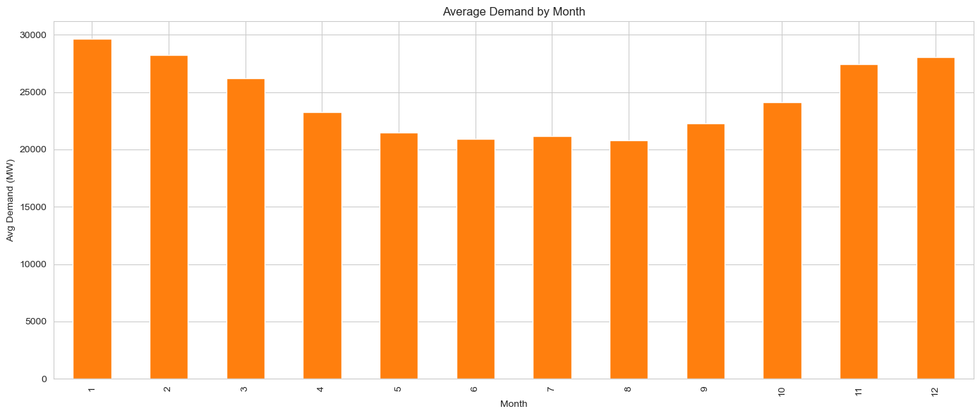
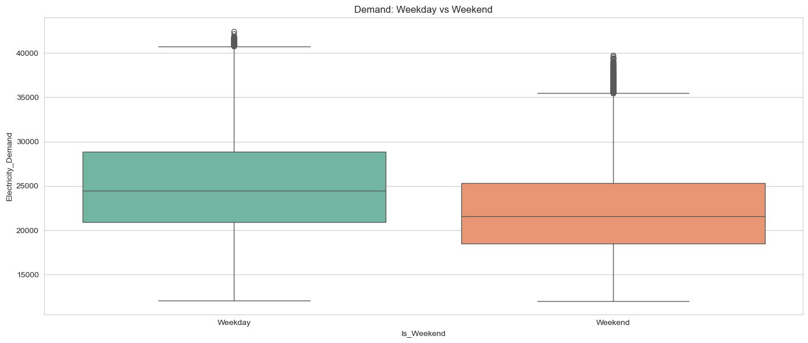
08
EDA
Exploratory Data Analysis
Daily average demand shows a stable multi-year pattern with a mild long-term dip and recovery.
Demand peaks around hour 18 (6 PM) and bottoms out overnight near hour 4.
Demand is highest in winter months and lowest across the summer.
Weekday demand runs consistently above weekend demand.
SMART GRID ELECTRICITY DEMAND FORECASTING
08

Slide 9
09
DEEP DIVE
Electricity Demand Analysis
Total Demand
2 bn kWh
Average Demand
24.41K kWh
Maximum Demand
42K kWh
Minimum Demand
12K kWh
Peak Hour
18:00
Average demand by hour of day — a clear morning ramp and an evening peak around 18:00.
Peak Day
Wednesday
SMART GRID ELECTRICITY DEMAND FORECASTING
09

Slide 10
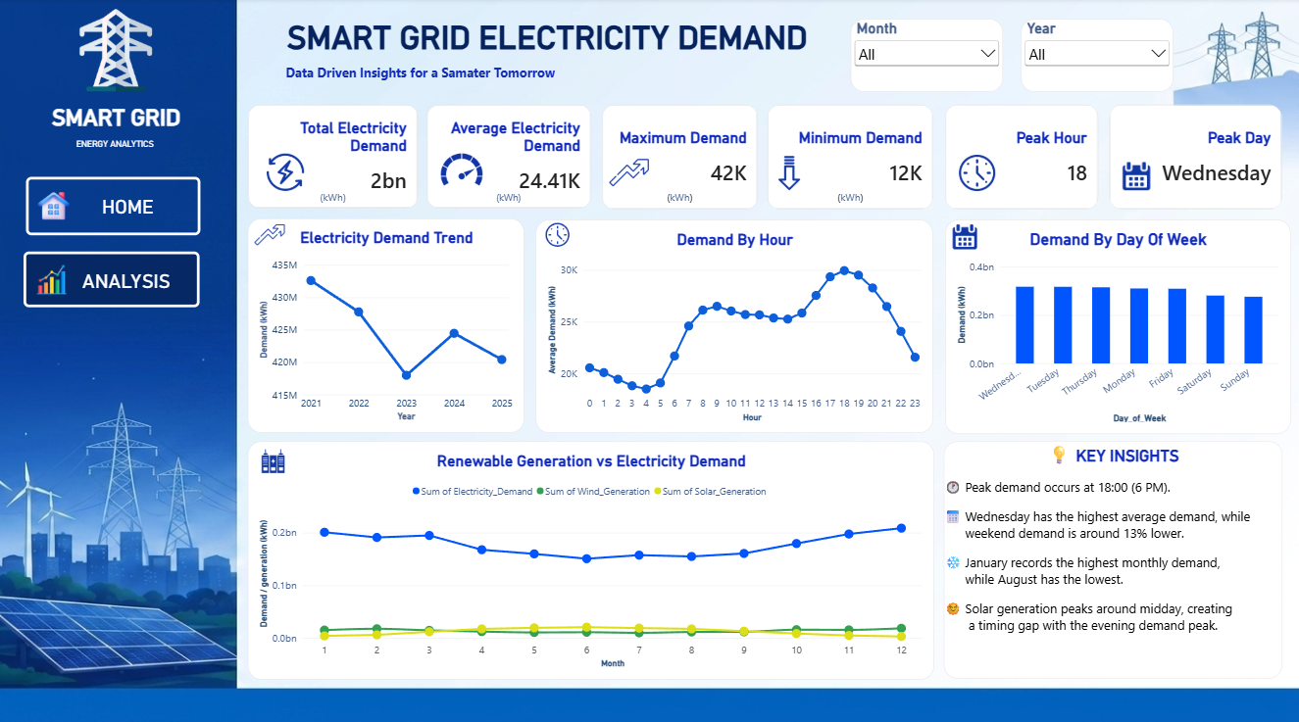



10
RENEWABLES
Renewable Energy Analysis
Solar generation shows a strong midday peak, tracking daylight hours across the year.
SOLAR + WIND vs DEMAND
Wind generation and capacity are tracked alongside demand as supporting features.
Solar output falls away well before the evening demand peak — a timing gap.
Renewable generation stays a small fraction of total demand across the dataset, with solar's seasonal and daily cycle visible against the flatter demand line.
Solar generation peaks around midday, creating a timing gap with the evening demand peak at 18:00 — a key insight for storage and dispatch planning.
SMART GRID ELECTRICITY DEMAND FORECASTING
10

Slide 11





11
MODELING
Machine Learning / Demand Forecasting
→
→
→
→
→
Historical Data
Feature
Engineering
Train/Test
Split
Model
Training
Demand
Prediction
Forecasted
Demand
TARGET & FEATURES
HOW IT WORKS
Target: Electricity Demand (MW)
Key inputs:
cyclical time features (hour, month, day-of-week), calendar flags, wind/solar capacity, and demand lags (24 hr, 7 day)
The model learns relationships between historical demand-related features and actual demand, then uses those learned patterns to estimate demand for unseen future periods.
Model used: Random Forest Regressor (300 trees, max depth 14), selected after comparing three algorithms.
SMART GRID ELECTRICITY DEMAND FORECASTING
11

Slide 12
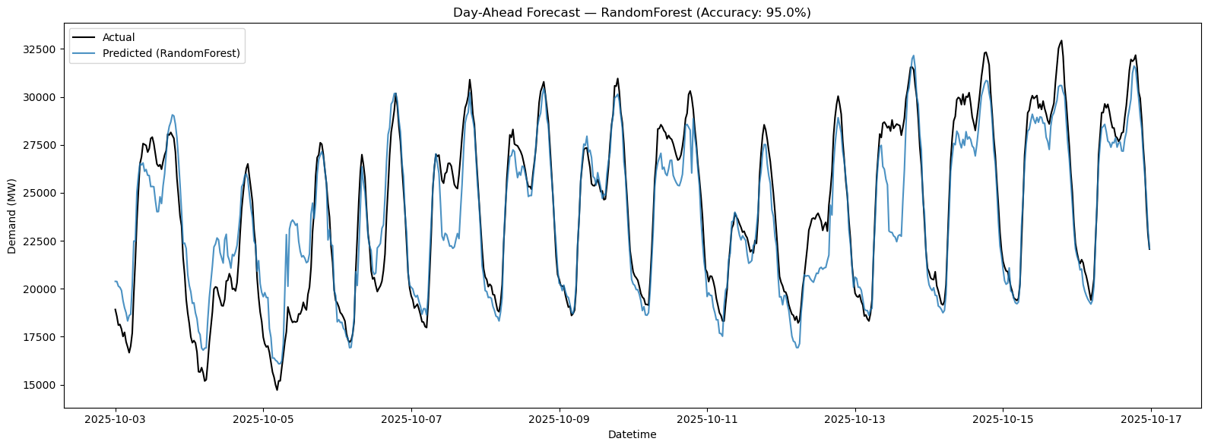
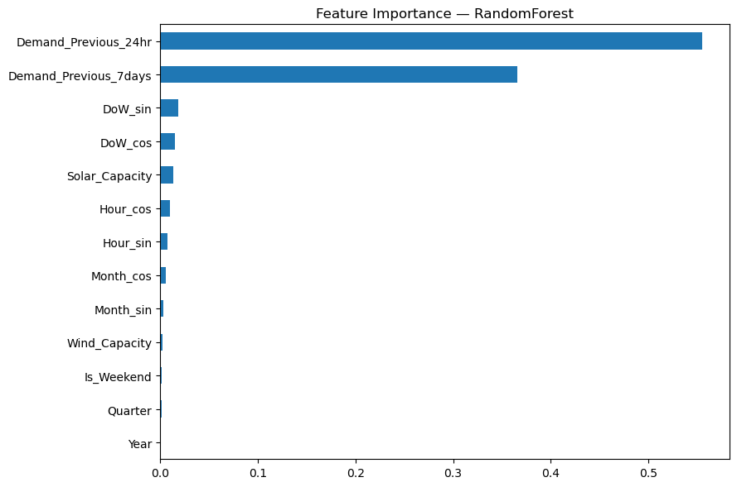
12
EVALUATION
Model Performance & Evaluation
MAE
RMSE
MAPE
ACTUAL vs PREDICTED DEMAND
Average prediction error, in MW
Penalizes larger errors more heavily
Average error as % of actual demand
MODEL COMPARISON — TEST SET
Model | MAE (MW) | RMSE (MW) | MAPE
Random Forest (selected) | 1,334.7 | 1,817.0 | 5.00%
Linear Regression | 1,353.4 | 1,763.8 | 5.15%
Gradient Boosting | 1,564.0 | 2,153.0 | 5.65%
95.00%
held-out test accuracy (1 − MAPE)
Random Forest gave the lowest MAPE and highest accuracy across the three models tested, and was selected as the final model.
SMART GRID ELECTRICITY DEMAND FORECASTING
12

Slide 13




13
DELIVERABLE
Power BI Dashboard
Real-time demand monitoring & KPI cards
Hour-of-day and day-of-week demand breakdown
Renewable generation vs demand comparison
Interactive month & year filters
Multi-year demand trend view
INTERACTIVE ENERGY ANALYTICS DASHBOARD
SMART GRID ELECTRICITY DEMAND FORECASTING
13

Slide 14

14
FINDINGS
Key Insights
Evening Peak
Weekday Effect
Seasonal Swing
Demand peaks around 18:00 (6 PM) on a typical day, then falls through the night to a low near 4 AM.
Wednesday runs the highest average demand, while weekend demand sits roughly 13% lower.
January is the highest-demand month and August the lowest — a clear winter/summer split.
Solar Timing Gap
Strongest Predictor
Forecast Accuracy
Solar generation peaks at midday, well before the evening demand peak — a mismatch for planning.
Demand 24 hours earlier is by far the most influential model feature, followed by demand 7 days earlier.
The selected Random Forest model reaches 95% accuracy (MAPE 5.00%) on unseen test data.
SMART GRID ELECTRICITY DEMAND FORECASTING
14

Slide 15


15
WRAP-UP
Conclusion & Future Scope
CONCLUSION
FUTURE SCOPE
Historical England & Wales electricity data (2021–2025) was analyzed in depth.
Real-time electricity and weather data integration
Clear daily, weekly and seasonal demand patterns were identified.
Advanced time-series forecasting (e.g. deep learning)
Preprocessing and feature engineering prepared the data for modeling.
Broader renewable-energy variable coverage
A Random Forest model forecasts demand with 95% accuracy on unseen data.
Live Power BI monitoring with automated refresh
Power BI turned the analysis into an interactive, decision-ready dashboard.
Deployment as a production forecasting application
SMART GRID ELECTRICITY DEMAND FORECASTING
15

Slide 16
Thank You
Questions & Discussion
Rahul P
Data Analyst | BCom (CA)
Smart Grid Electricity Demand Forecasting

