Slide 1
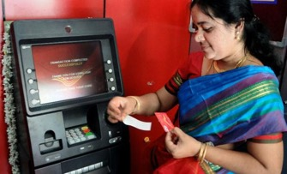

Go Cashless Easy, Convenient and Safe
Common Man
Reduced cash, more safety.
Faster payments - no need to wait for change, currency, checking etc.
Infrequent visits to Banks, ATMs preferred mode for withdrawing money.
Earn interest on money in bank account.
Vendors
Settles transaction quickly, no issues of change etc.
Larger transactions are made easier.
Improved accounting and book keeping.
No need to keep huge amount of cash at the shop/establishment.

Slide 2
Various Modes of Digital Payments
Point of Sale and Cards(Credit card, Debit Card)
Internet banking(NEFT/RTGS/IMPS)
UPI (Unified Payment Interface)
BBPS(Bharat Bill Payment System)
USSD (Unstructured Supplementary Service data)
AEPS(Aadhaar Enabled Payment System)
App Based payment system(BHIM)
E-Wallets

Slide 3

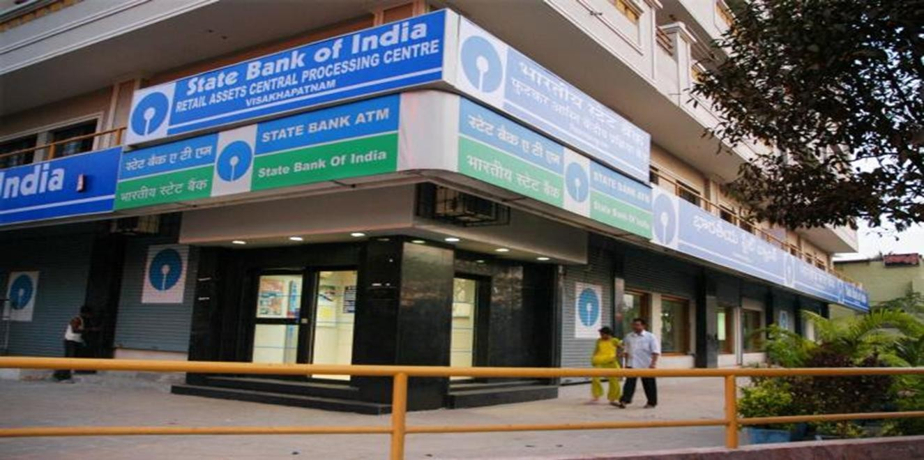

Have a bank account, no mobile?
You can still go Digital
Ask Bank to issue RuPay card.
Swipe your card for all purchases.

Slide 4

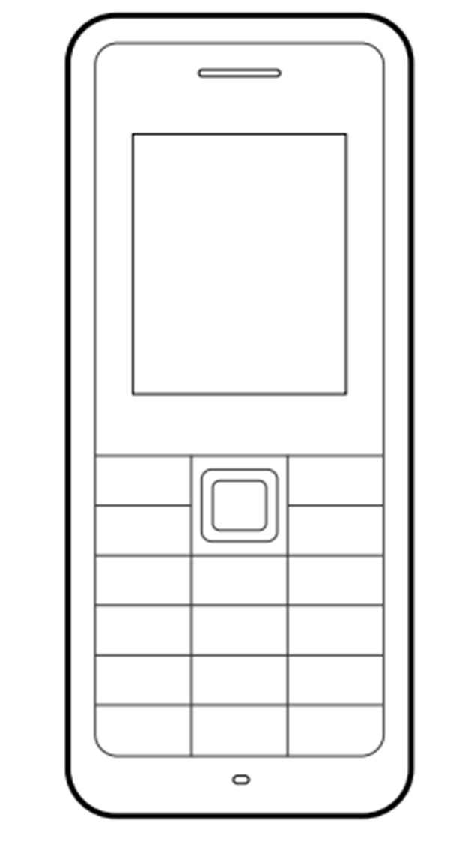
Have a bank account, only a feature Phone?
You can still go digital
Use RuPay card where there is a PoS
Use USSD (Unstructured Supplementary Service data)for where there is no PoS
USSD is special application for digital payment for feature phone

Slide 5


Have a bank account & a smart phone with internet?
You can go digital
Use RuPay/Debit card - PoS
Use Mobile wallets
Use App Based Payment(BHIM,UPI)

Slide 6
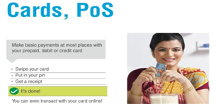

Slide 7
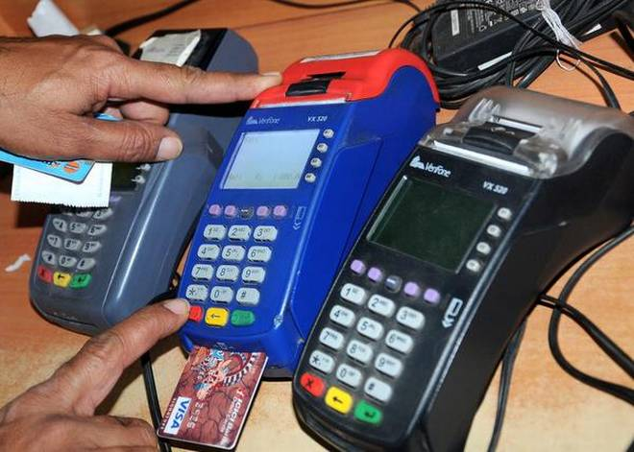
POS (Point of Sale)
A point-of-sale (POS) terminal is a computerised replacement for a cash register which can process credit and debit cards.
A customer needs to enter a card PIN to complete the transaction using the PoS terminal.

Slide 8
POS (Point of Sale)
How to install one?
If you are a merchant, then you can request the bank
where you have an account to install PoS machines at
your establishment

Slide 9
POS (Point of Sale)
What are the charges?
The end-customer does not have to pay any charges for swiping his or debit/credit cards at the PoS terminals.
However, the merchant has to pay the issuer bank what is known as merchant discount rate (MDR).
The issuer bank is the one which installs the machines at the merchant establishment.

Slide 10
The merchant discount rate is the rate charged to a merchant for payment processing services on debit and credit card transactions. The merchant must setup this service and agree to the rate prior to accepting debit and credit cards as payment.

Slide 11
Point of Sale (PoS) & Card
BANKS ISSUE VARIOUS CARDS FOR THEIR ACCOUNT HOLDERS
USE YOUR CARD TO SHOP ANYWHERE
PREPAID CARD CAN BE ISSUED BY ANY BANK FROM ACCOUNT OR CASH
Prepaid Cards
Debit Cards
Credit Cards
At any position
At ATM
Online Shopping
Pre-Loaded Card
Recharged Several Times
Equivalent to cash

Slide 12
RuPay Card
RuPay is an Indian domestic card scheme conceived and launched by the National Payments Corporation of India (NPCI) on 26 March 2012.
It was created to fulfil the Reserve Bank of India’s (RBI) desire to have a domestic multilateral system of payments in India.
In India, 90% of credit card transactions and almost all debit card transactions are domestic
The cost of transactions was high due to monopoly of foreign gateways like Visa and Mastercard.
RuPay facilitates electronic payment at all Indian banks and financial institutions.
NPCI maintains ties with Discover Financial to enable the card scheme to gain international acceptance.

Slide 13
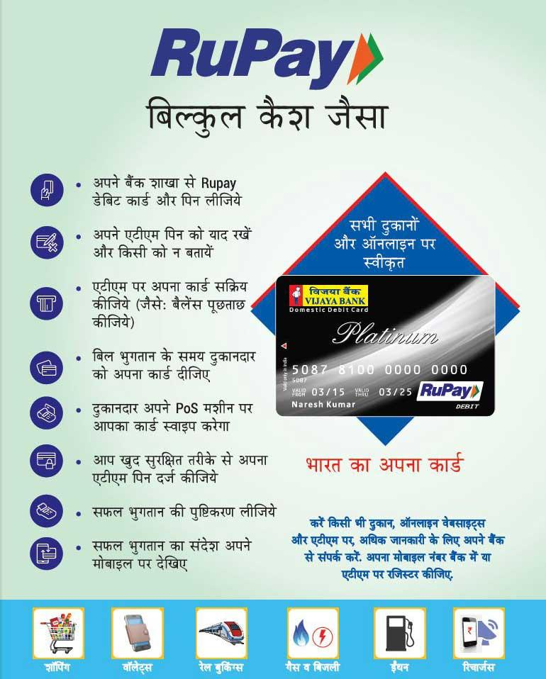
 | RuPay Card | Visa Debit Card
Processing Fee | As it is a domestic product, this will make the transaction cost affordable and will drive usage of cards in the industry. | Processing takes place in a foreign country which involves higher fee and cost.
Speedy Transaction | Processing happens within India and transactions are much faster. | Processing will take time compared to RuPay Card as it happens at international level.
Domestic or international | As of now, these cards are accepted only domestically. | Visa debit cards can be used internationally anywhere.
Fee Structure | Banks need not pay a quarterly fee or entry fee to join the network. | Banks need to pay quarterly and fee to enter with the respective network.
Card | As of now, it offers only debit card with online transaction. | Visa and Mastercard offer debit and credit cards.
Safety | Transaction data would be available in India and thus prevent customer purchase data going out of the country. | Transaction and customer data related to RuPay card transactions should be shared with international payment gateway.

Slide 14
Acceptability
INDIA
RuPay cards are accepted at almost all ATMs across India.
In addition to the ATMs and PoS terminals, RuPay cards are accepted online on most domestic payment gateways and some international payment gateways (through its alliances with other networks)
RuPay Cards are accepted at 97% of all PoS terminals in India. RuPay has partnered 39 PoS Acquiring Banks in India to accept their cards at PoS terminals located at different merchant locations.
Singapore
Prime Minister of India, Narendra Modi launched the RuPay platform in Singapore on 31 May 2018. The launch took place in parallel with related services offered by NPCI, such as, UPI and BHIM. State Bank of India, Singapore will be the first bank to issue RuPay cards in the country

Slide 15
Rupay Card and Visa Debit Cards
 | RuPay Card | Visa Debit Card
Processing Fee | As it is a domestic product, this will make the transaction cost affordable and will drive usage of cards in the industry. | Processing takes place in a foreign country which involves higher fee and cost.
Speedy Transaction | Processing happens within India and transactions are much faster. | Processing will take time compared to RuPay Card as it happens at international level.
Domestic or international | As of now, these cards are accepted only domestically. | Visa debit cards can be used internationally anywhere.
Fee Structure | Banks need not pay a quarterly fee or entry fee to join the network. | Banks need to pay quarterly and fee to enter with the respective network.
Card | As of now, it offers only debit card with online transaction. | Visa and Mastercard offer debit and credit cards.
Safety | Transaction data would be available in India and thus prevent customer purchase data going out of the country. | Transaction and customer data related to RuPay card transactions should be shared with international payment gateway.

Slide 16
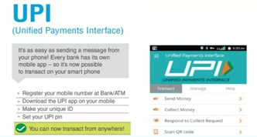

Slide 17
UPI (Unified Payments Interface)
Unified Payments Interface (UPI) is an instant real-time payment system developed by National Payments Corporation of India facilitating inter-bank transactions. The interface is regulated by the Reserve Bank of India and works by instantly transferring funds between two bank accounts on a mobile platform.^{[1]}
UPI is built over Immediate Payment Service (IMPS) for transferring funds. Being a digital payment system it is available 24-7 and across public holidays. Unlike traditional mobile wallets, which takes a specified amount of money from user and stores it in its own accounts, UPI withdraws and deposits funds directly from the bank account whenever a transaction is requested. It uses Virtual Payment Address (a unique ID provided by the bank), Account Number with IFS Code, Mobile Number with MMID (Mobile Money Identifier), Aadhaar Number, or a one-time use Virtual ID. A UPI-PIN (UPI Personal Identification number that one creates on the UPI app of the bank) is required to confirm each payment.
Unified Payments Interface
Operating area India
Founded 11 April 2016
Owner National Payments Corporation of India

Slide 18
Mobile Money Identifier (MMID) is a seven digit unique number issued by the bank upon registration. Remitter (customer who wants to send money) and Beneficiary (customer who wants to receive the money) should have this MMID for doing this interbank funds transfer through Mobile Number and MMID.

Slide 19
UPI is also available as a mobile phone USSD service where users can access the service by dialing the code *99#. The various services provided in USSD mode are categorized as follows,
Financial Services
Fund Transfer
Send Money
Request Money
Non-financial services
Balance Enquiry
Change MPIN

Slide 20
UPI – Transaction directly to your bank account
Download any of the UPI Apps like SBI Pay
Register & create a Virtual Payment Address
(similar to an email address) like
amit@sbi.com
Send or request money using the virtual payment address

Slide 21
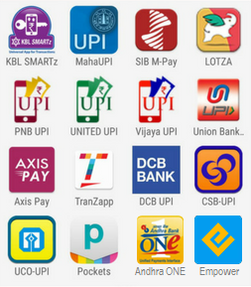

















UPI Enabled Banks/Merchant Apps

Slide 22
UPI enables bank account holders (of banks participating in UPI) to send and receive money using a Virtual Payment Address (VPA) without entering additional bank information. ... A VPA is an ID, which a user creates by linking their accounts to a bank's mobile application.

Slide 23
Sending Money on UPI
Choose “Send Money”
Enter payee’s Virtual Payment Address
Enter amount
Write remarks for transaction
Hit “Send”
Confirm the details

Slide 24

Bharat Interface for Money(BHIM)
Bharat Interface for Money (BHIM) is an app that lets you make simple, easy and quick payment transactions using Unified Payments Interface (UPI).
You can easily make direct bank to bank payments instantly and collect money using just Mobile number or Payment address.

Slide 25
Services available with BHIM
Send Money
Request Money
Scan & Pay
Transactions

Slide 26
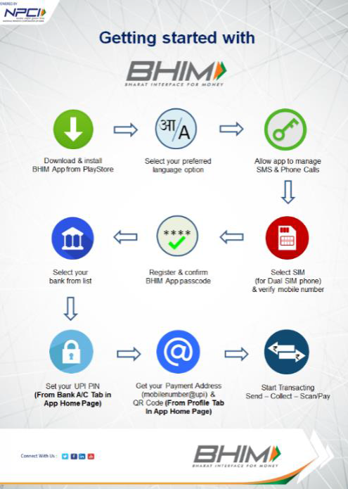

Slide 27
How to Reset/Change UPI PIN on BHIM
Choose Bank account option.
Select on Reset UPI PIN.
For setting UPI PIN, enter the last six digits and the expiry date of the card
Bank OTP is requested and auto detected within the app.
Enter his/her new UPI PIN
Reconfirm the UPI PIN
UPI PIN registration success message will be shown

Slide 28
How to Send Money
Open the app and enter the app’s passcode
Enter the virtual payment address or Mobile Number & click on verify to check the name of the payee
Select Send Money Option
Name of the PAYEE is fetched from the Bank CBS
Confirmation of money sent is shown to the customer
Enter the amount and remarks for the transaction and Click on PAY
UPI PIN entry page opens where customer enter his UPI PIN
Customer gets a notification for the success of the transaction from the app

Slide 29
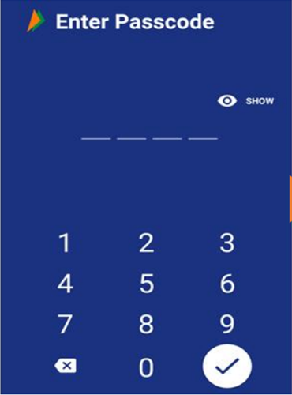
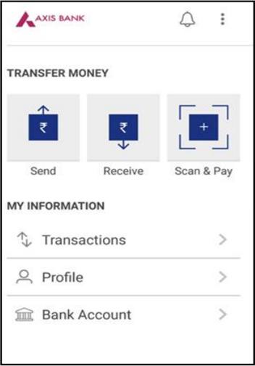

Slide 30
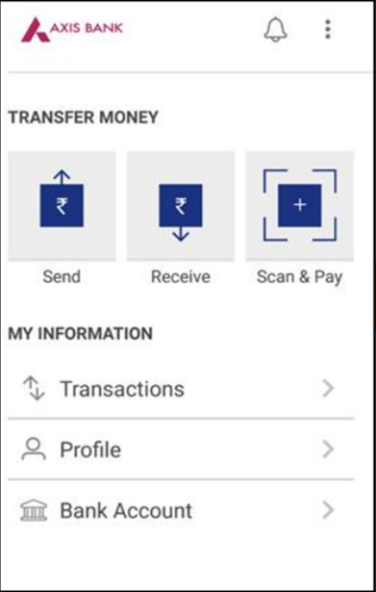
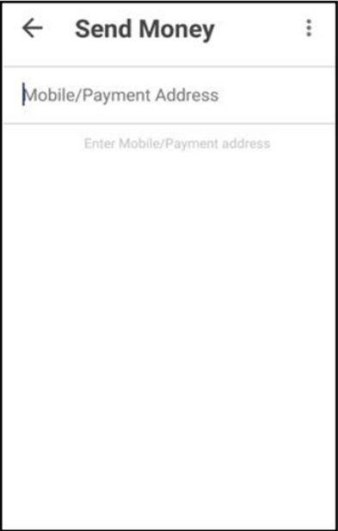

Slide 31
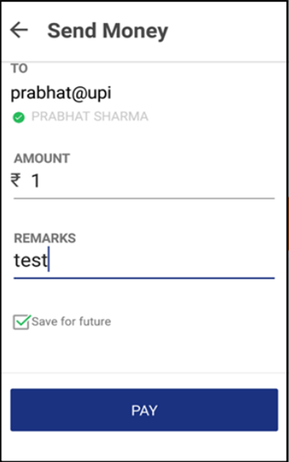
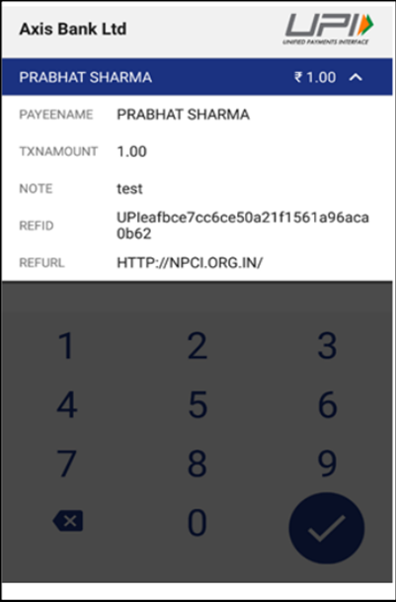

Slide 32
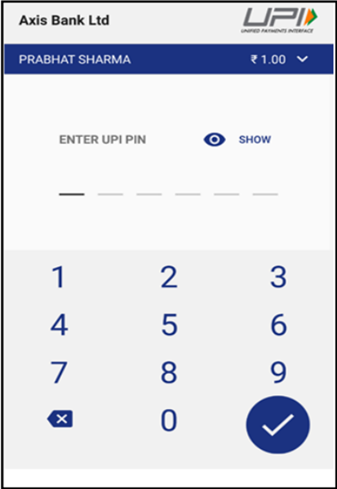
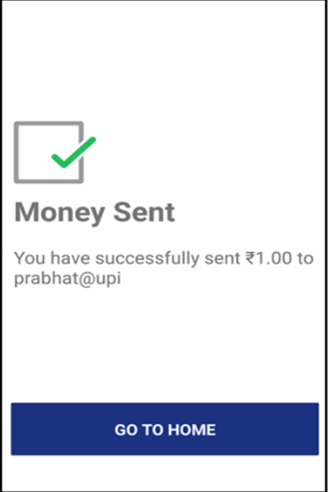

Slide 33
How to Collect Money
open the app and enter the app login and pass code
Select Receive Money Option and initiates a request transaction.000000
Enter virtual payment address (VPA) or Mobile Number to collect money
Enter the amount and remarks
Confirmation of Request Sent is given to the initiator.
Click on verify to check the name of payer
Initiator is notified once PAYER accepts the request for money
PAYER name is shown to the requester

Slide 34
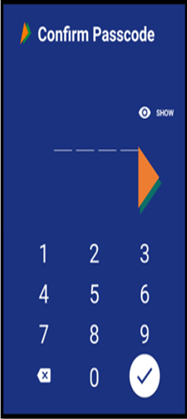
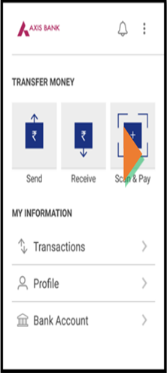

Slide 35
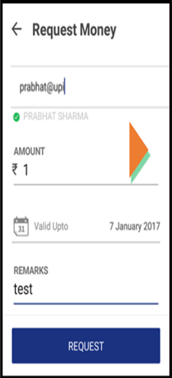
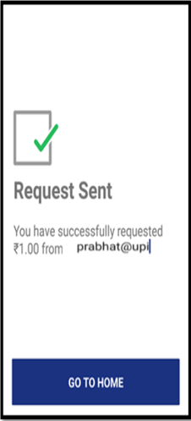

Slide 36
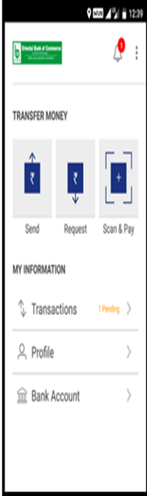
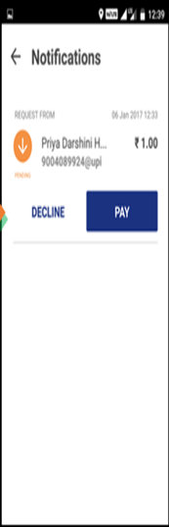

Slide 37
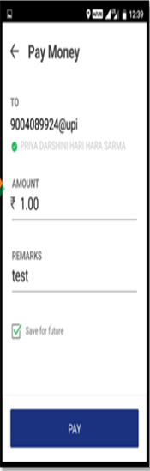
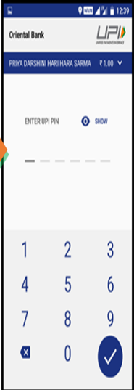

Slide 38


Slide 39
Charges for using BHIM
For Smart Phones with Internet option BHIM can be executed via the app whereas for feature phones, BHIM can be executed via phone dialer using *99# option.
The charges for BHIM is one time SMS charges depending on the mobile operator ( Standard SMS charges of your operator).
For *99# the charges are Rs.0.50/- for one transaction. It is up to bank’s discretion to levy any charges on the customers for using BHIM.

Slide 40
USSD (Unstructured Supplementary Service data) Dial *99#
Mobile Banking for Feature Phones
No internet connection is required.
Single number for all Banks
Use directly from mobile number registered with Bank

Slide 41
Overview of *99# Service
One of the innovative payment service launched by NPCI (National Payments Corporation Of India).
Works on Unstructured Supplementary Service Data (USSD) channel.
launched for envisioning the potential of Mobile Banking and the need for immediate low value remittances
It will help in financial deepening and inclusion of under banked society in the mainstream banking services

Slide 42
*99# : Services Offered
Financial Transactions
Balance Enquiry
Value Added Service
Non-Financial Transactions
Fund Transfer (Mobile No. & MMID)
Fund Transfer (IFSC & Account No.)
Fund Transfer (Aadhaar)
Mini Statement
Request MMID
MPIN (Generate & Change)
Generate OTP
Query Service on Aadhaar Mapper (*99*99#)

Slide 43
*99# : Benefits
Simplicity – User required to just dial a short code
Convenient – Simple and easy to use service
Round the Clock Availability – Works 24*7*365
Real Time Transaction – Immediate in nature
Easy Accessibility – No internet connection required
Language Flexibility – Available in 12 languages

Slide 44
*99# : Banks’ Short Code & IFSC
S. No. | Bank Name | Short Name | IFSC
1 | Allahabad Bank | ALB | ALLA
2 | Andhra Bank | ANB | ANDB
3 | Axis Bank | AXB | UTIB
4 | Bank of Baroda | BOB | BARB
5 | Bank of India | BOI | BKID
6 | Bank of Maharashtra | BOM | MAHB
7 | Canara Bank | CNB | CNRB
8 | Central Bank of India | CBI | CBIN
9 | Corporation Bank | CRB | CORP
10 | Dena Bank | DNB | BKDN
11 | HDFC Bank | HDF | HDFC
12 | ICICI Bank | ICI | ICIC
13 | IDBI Bank | IDB | IBKL
14 | Indian Bank | INB | IDIB
15 | Indian Overseas Bank | IOB | IOBA
16 | ING Vysya Bank | ING | VYSA
17 | Karur Vysya Bank | KVB | KVBL
18 | Kotak Mahindra Bank | KMB | KKBK
19 | Oriental Bank of Commerce | OBC | ORBC
20 | Punjab and Sindh Bank | PSB | PSIB
21 | Punjab National Bank | PNB | PUNB

Slide 45
ONLINE MONEY TRANSFER USING BANK’S WEBSITE
The convenience of transferring money online has helped individuals to make most out of the modern technology-based banking services
To transfer money from one account to another the banks provide multiple options based on various factors and customer’s requirements which are
National Electronic Funds Transfer (NEFT)
Real Time Gross Settlement (RTGS)
Immediate Payment Service (IMPS)
Each of them have their own advantages and disadvantages, they provide flexibility and convenience to the customers.
Many banks have their own digital wallets to facilitate additional methods of fund transfers online.

Slide 46
Robust fund transfer methods which allow individuals and businesses to transfer money online from anytime and anywhere in the world
Most banks provide Net Banking facility to their customer. By using either a computer or a smartphone with internet, a bank account holder can use the fund transfer section to access any of the online banking services provided by the bank.
Each of the transfer will provide different kinds of features and flexibility
The various factors to decide upon the type of online facility
The value of the transaction
the speed of transfer
service availability

Slide 47
Requirements For Fund Transfer
The remitter who wants to transfer money must have internet banking enabled account and transaction password
To initiate a fund transfer, the individual who is transferring the money, also known as the originator or remitter, is required to have the basic account details of the beneficiary
Details such as the account number, beneficiary’s name on the account, IFSC Code , and the branch name are the most important and essential factors for using any transfer methods
It is the originator who is considered responsible for ensuring the correctness of the account details used for a transfer of fund.
The originator must enter all the details of the account in his net banking enabled account and a mobile number linked with the account

Slide 48
NEFT
The funds transferred under this method are settled in batches (based on Deferred Net Settlement (DNS) and at a specific time of the day.
Previously the fund transfer requests under NEFT were processed in twelve batches between 8 a.m. to 7 p.m. on weekdays and six batches between 8 a.m. to 1 p.m. on Saturdays. NEFT was not available on Sundays and bank holidays. If the transfer was initiated beyond the cut-off time specified by RBI, the funds are typically settled on the next working day.
But now NEFT is also available 24X7. Money can be transferred any time using NEFT

Slide 49
The transactions can be initiated and settled from the bank account of one particular bank to another bank’s account throughout India at no additional cost apart from the standard charges, provided both the banks are a part of the NEFT transfer network (NEFT-enabled).
Some banks might have their own policies concerning the NEFT service provided by them, such as
restrictions on transferring funds immediately to a newly added beneficiary
fund value limits restricting the value of transfer beyond a specified limit
These protocols are proven to be effective for safeguarding the customer’s financials.

Slide 50
Advantage Of NEFT
The biggest advantages of NEFT is the cost-effectiveness, an individual can carry out smaller value transfers without worrying about the transaction fee and service charges.
A smaller fee on the transfer enables the individual to carry out more payments which make NEFT the most popular and extensively used method for online fund transfers.

Slide 51
RTGS
This type of transfer methods is applicable and available for fund transfers between Rs.2 lakh to Rs.10 lakh
In order to take advantage of the RTGS facility, both the originator's and the beneficiary’s account has to be RTGS-enabled
Most banks are a part of the vast and popular RTGS transfer network facilitated by RBI but it is recommended to either get in touch with their bank directly or refer to their online banking section to discover their eligibility concerning access to RTGS payment system.
The transaction fee under RTGS is higher than the other methods due to the faster settlement speed performed on an instruction by instruction basis.
RTGS comes with limits on the minimum and maximum fund value
It is efficiently used in situations where individuals and businesses require immediate settlement of high-value funds that are well within the specified limits.

Slide 52
the biggest advantage for RTGS is the fastest/real-time settlement factor. As soon as the transfer instructions are sent, the fund gets settled almost immediately
Efficiency, speed, and reliability factors are few factors that make RTGS as one the most-sought medium of online fund transfers.

Slide 53
IMPS
IMPS is used widely across most banks
IMPS functions 24/7 allowing a fund transfer at any time of the day
IMPS also allows transfer of low value-funds but what makes it unique is, it immediately settles the funds.
IMPS facility is provided only on the internet and online banking services
Few banks may offer SMS-based IMPS service to mobile banking users
Many of the digital wallets in India utilise IMPS services to credit the money from an individual's wallet to his/her bank account. Though IMPS provides an immediate fund settlement facility, the transaction fees are as low as NEFT.

Slide 54
NEFT functions more or less as the combined version of NEFT and RTGS, where remitters are neither worried about the size of the fund and service availability nor do they have to be concerned about the settlement speed.

Slide 55
 | NEFT | RTGS | IMPS
Min. Transfer Value | Rs1 | Rs. 2 Lakh | Rs 1Lakh
Max. Transfer Value | No Limit | Rs. 10 Lakh | Rs 2 Lakh
Type of Settlement | Batches | One-on-One-Settlement | One-on-One-Settlement
Speed Of Settlement | 2 Hrs. Subject to cut-off timings and batches | Immediately | Immediately

Slide 56
 | NEFT | RTGS | IMPS
Service Availability | Weekdays 8 to 6:30pm(12 batches) Sat:8 to 1pm(6batches) Not on Sun and Bank Holidays | Weekdays 8 to 4 pm Sat:9 to 4:30 pm Not on Sun and Bank Holidays | 24 X 7
Transaction fee | Up to Rs.10,000 - Rs.2.50 Rs.10,000 to Rs.1 lakh - Rs.5 Rs.1 lakh to Rs.2 lakh - Rs.15 Rs.2 lakh to Rs.5 lakh - Rs.25 Rs.5 lakh up to Rs.10 lakh - Rs.50 | Between Rs.2 lakh up to Rs.5 lakh - Rs.25 Rs.5 lakh up to Rs.10 lakh - Rs.50 | Up to Rs.10,000 - Rs.2.5 Rs.10,000 to Rs.1 Lakh- Rs.5 Rs.1Lakh to Rs.2 Lakh - Rs.15

Slide 57
Paytm Wallet
Paytm stands for Pay through Mobile. It is an e-commerce shopping website based in Noida, Uttar Pradesh, India. It started with mobile recharge and utility bill payments and today it has become a full marketplace and has around 100 million registered users. In a short span of time, it has managed to reach 60 Million orders per month.
It is a digital payment instrument where you can transfer money from your bank account or credit card to use for transactions on the platform. Paytm is an Indian e-commerce payment system and digital wallet company, based out of NOIDA SEZ, India.
Founded in August 2010 by Vijay Shekhar Sharma in NOIDA

Slide 58
It started as a prepaid mobile and DTH recharge platform, and later added data card, postpaid mobile and landline bill payments in 2013
By January 2014, the company launched the Paytm Wallet, and the Indian Railways and Uber added it as a payment option
By 2015, it unveiled more use-cases like education fees, metro recharges, electricity, gas, and water bill payments, the payment gateway for Indian Railways.^{[8]}
By 2016, Paytm launched movies, events and amusement parks ticketing as well as flight ticket bookings and Paytm QR
In 2017, Paytm became India's first payment app to cross over 100 million app downloads
By 2018, it started allowing merchants to accept Paytm, UPI and Card payments directly into their bank accounts at 0% charge.
It also launched the ‘Paytm for Business’ app, allowing merchants to track their payments and day-to-day settlements instantly.

Slide 59
Set up a Paytm account using your mobile phone number and email ID
Transfer cash to the wallet using netbanking, debit card, or credit card
Add money up to Rs. 10,000 in a month in the Wallet
To increase the monthly limit, one can get the KYC (Know Your Customer) processor done
With KYC done one can have up to Rs. 1 lakh in the Paytm Wallet at any point of time.
To transfer money to someone else, select the 'Pay or Send' option
One can also make offline payments to others or to bank accounts on Paytm by scanning a QR code or bar-code and OTP
For Offline payment open the app, select the ‘Pay or Send’ option, and choose between QR code or bar codes (in two separate tabs).
Scan the code and enter the OTP to authorize the payment offline

Slide 60
Areas Of Digital Transactions
Make bill payments
Make money transaction through online banking
Book train and bus tickets
Pension transactions
Income Tax related Transactions
Premium payments of post offices, insurance etc.
Seek information on agricultural operations and land records
Interact with employment exchange, municipalities, gram panchayats, police and passport offices

Slide 61
THANK YOU

