Slide 1
O-Level UNIT-7
E-Mail, Social Networking and e-Governance services

Slide 2
E-Commerce
E-Commerce or Electronics Commerce is a methodology of modern business, which addresses the need of business organizations, vendors and customers to reduce cost and improve the quality of goods and services while increasing the speed of delivery.
Ecommerce refers to the paperless exchange of business information using the following ways −
Electronic Data Exchange (EDI)
Electronic Mail (e-mail)
Electronic Bulletin Boards
Electronic Fund Transfer (EFT)
Other Network-based technologies

Slide 3
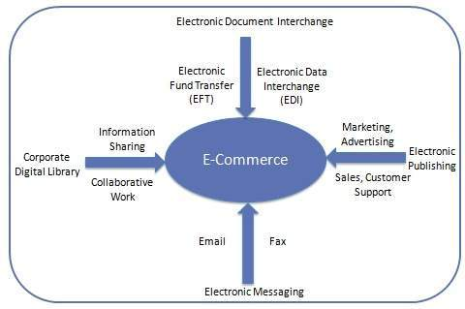

Slide 4
E-Commerce is a set of integrated software components that provides a solution for a business to sell goods and services through an electronic catalog on the internet
It is ideal for both business to business and business to consumer applications
It integrates easily with a company’s existing business systems
It extends beyond buying and selling to streamlining the business operations

Slide 5
Features Of E-Commerce
Cashless Payment
E-Commerce enables the use of credit cards, debit cards, smart cards, electronic fund transfer via bank's website, and other modes of electronics payment.
24x7 Service availability
E-commerce automates the business of enterprises and the way they provide services to their customers.
It is available anytime, anywhere.
Advertising / Marketing
E-commerce increases the reach of advertising of products and services of businesses
It helps in better marketing management of products/services.
Improved Sales
Using e-commerce, orders for the products can be generated anytime, anywhere without any human intervention
It has increased the sale of products for a business enterprise

Slide 6
Support
E-commerce provides various ways to provide pre-sales and post-sales assistance to provide better services to customers.
Inventory Management
E-commerce automates inventory management
Reports get generated instantly when required
Product inventory management becomes very efficient and easy to maintain.
Communication improvement
E-commerce provides ways for faster, efficient, reliable communication with customers and partners.
Strengthens relations by marketing, sales, customer support staff and better communication with the suppliers

Slide 7
E-Commerce Business Applications
E-Commerce business applications or business models can be classified into the following categories:
Business - to - Business (B2B)
Business - to - Consumer (B2C)
Consumer - to - Consumer (C2C)
Consumer - to - Business (C2B)
Business - to - Government (B2G)
Government - to - Business (G2B)
Government - to - Citizen (G2C)

Slide 8
Business-to-Business(B2B)
This includes wholesaling, where businesses sell goods and services to other businesses on the web.
A website following the B2B business model sells its products to an intermediate buyer who then sells the product to the final customer
With Internet based supply chain trading, businesses work closely to streamline the supply of goods for production and distribution and improve productivity.
For example:a wholesaler places an order from a company's website and after receiving the consignment, sells the end product to the final customer who comes to buy the product at one of its retail outlets.

Slide 9
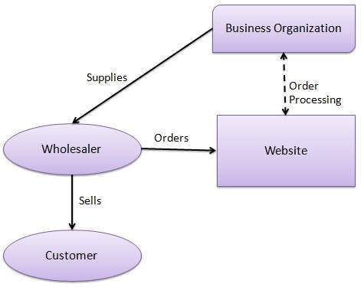

Slide 10
Business-to-Consumer(B2C)
A website following the B2C business model sells its products directly to a customer.
A customer can view the products shown on the website, choose a product and order the same.
The website will then send a notification to the business organization via email and the organization will dispatch the product/goods to the customer.
In B2C model companies market physical goods to consumers online in a more personalized dynamic environment.
This includes the delivery of digital goods, software, electronic media and information

Slide 11
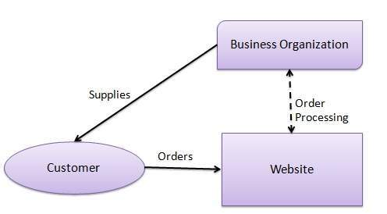
B2C Model

Slide 12
Consumer-to-Consumer(C2C)
A website following the C2C business model helps consumers to sell their assets like residential property, cars, motorcycles, etc., or rent a room by publishing their information on the website.
Website may or may not charge the consumer for its services.
The consumer may opt to buy the product of the first customer by viewing the post/advertisement on the website.
The seller sell his service/goods by providing its information on the net.
The information is evaluated by a buyer to carry out a transaction.

Slide 13
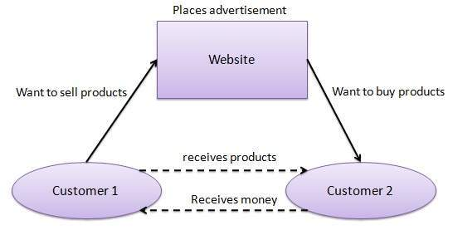

Slide 14
Consumer-to-Business(C2B)
In this model, a consumer approaches a website showing multiple business organizations for a particular service.
The consumer places an estimate of amount he/she wants to spend for a particular service.
A business organization who fulfills the consumer's requirement within the specified budget, approaches the customer and provides its services.
For example, the comparison of interest rates of personal loan/car loan provided by various banks via websites.

Slide 15
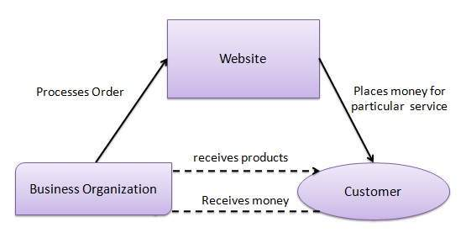
C2B

Slide 16
Business-to-Government(B2G)
B2G model is a variant of B2B model.
Websites are used by governments to trade and exchange information with various business organizations.
Such websites are accredited by the government and provide a medium to businesses to submit application forms to the government.

Slide 17

B2G

Slide 18
Government-to-Business(G2B)
Governments use B2G model websites to approach business organizations.
Such websites support auctions, tenders, and application submission functionalities.

Slide 19

G2B

Slide 20
Government-to-Citizen(G2C)
Governments use G2C model websites to approach citizen in general.
Such websites support auctions of vehicles, machinery, or any other material.
These type of websites also provides services like registration for birth, marriage or death certificates.
The main objective of G2C websites is to reduce the average time for fulfilling citizen’s requests for various government services.

Slide 21

G2C

Slide 22
E-Commerce Payment System
E-commerce sites use electronic payment system
E-payment refers to paperless monetary transactions.
E-payment has revolutionized the business processing by reducing the paperwork, transaction costs, and labor cost
It is user friendly and less time-consuming than manual processing of payments
It helps business organization to expand its market reach/expansion.

Slide 23
Advantages of E-Commerce
E-commerce advantages can be classified into three categories:
Advantages to Organizations
Advantages to Consumers
Advantages to Society

Slide 24
Advantages to Organisations
Organizations can expand their market to national and international markets with minimum capital investment. An organization can easily locate more customers, best suppliers, and suitable business partners across the globe.
Reduces paper work Helps organizations by creating a process to distribute, retrieve and manage by digitizing the information.
Improves the brand image of the company.
Helps organization to provide better customer services.
Helps to simplify the business processes and makes them faster and efficient.
Increases the productivity of organizations. It supports "pull" type supply management. In "pull" type supply management, a business process starts when a request comes from a customer and it uses just-in-time manufacturing way.

Slide 25
Advantages to Customers
It provides 24x7 support. Customers can enquire about a product or service and place orders anytime, anywhere from any location.
Provides users with more options to compare and select the cheaper and better options and also quicker delivery of products.
A customer can put review comments about a product and can see what others are buying, or see the review comments of other customers before making a final purchase.
E-commerce provides options of virtual auctions.
It provides readily available information. A customer can see the relevant detailed information within seconds, rather than waiting for days or weeks.
Increases the competition among organizations and as a result, organizations provides substantial discounts to customers.

Slide 26
Advantages To Society
Customers need not travel to shop a product, thus less traffic on road and low air pollution.
E-commerce helps in reducing the cost of products, so less affluent people can also afford the products.
E-commerce has enabled rural areas to access services and products, which are otherwise not available to them.
E-commerce helps the government to deliver public services such as healthcare, education, social services at a reduced cost and in an improved manner.

Slide 27
Disadvantages
The disadvantages can also be divided into two categories:
Technical Disadvantages
Non-technical disadvantages

Slide 28
Technical Disadvantages
Lack of system security, reliability or standards owing to poor implementation of e-commerce.
The software development industry is still evolving and keeps changing rapidly.
In many countries, network bandwidth might cause an issue.
Special types of web servers or other software might be required by the vendor, setting the e-commerce environment apart from network servers.
Sometimes, it becomes difficult to integrate an e-commerce software or website with existing applications or databases.
There could be software/hardware compatibility issues, as some e-commerce software may be incompatible with some operating system or any other component.

Slide 29
Non-Technical Disadvantages
Initial cost
The cost of creating/building an e-commerce application in-house may be very high.
There could be delays in launching an e-Commerce application due to mistakes, and lack of experience.
User resistance
Users may not trust the site being an unknown faceless seller.
Such mistrust makes it difficult to convince traditional users to switch from physical stores to online/virtual stores.
Security/ Privacy
It is difficult to ensure the security or privacy on online transactions.

Slide 30
Lack of touch or feel of products during online shopping is a drawback.
E-commerce applications are still evolving and changing rapidly.
Internet access is still not cheaper and is inconvenient to use for many potential customers, for example, those living in remote villages.

Slide 31
Modes of E-Payment
The modes of electronic payments are:
Credit Card
Debit Card
Smart Card
E-Money
Electronic Fund Transfer (EFT)

