Slide 1
O-Level UNIT-7
E-Mail, Social Networking and e-Governance services

Slide 2
About Unit-7
This unit involves understanding various aspects of Communication over the Internet.
The term communication means exchange of information through different mediums
With the advancement of technology different modes of communications has developed including telecommunication and wireless communication.

Slide 3
Communication Over Internet
Communication is an activity of conveying information
It needs a sense, a message and a recipient
Communication can occur across vast distances in time and space
Social scientists Claude Shannon and Warren Weaver structured their communication model based on
An information source, which produces messages
A transmitter which encodes the message into signals
A channel to which signals are adapted for transmission
A receiver which decodes (reconstructs) the message from signals
A destination where the message arrives

Slide 4
E-Mail
The first mode of Communication to study is E-mail (Electronic Mail)

Slide 5
Basics of E-mail
Define E-mail
E-mail is the method of exchange of computer-stored messages by telecommunication. The messages can be text messages as well as graphic images , sound files as attachments
Electronic mail or e-mail is one of the most popularly used mode of communication over the internet
For this one has to have an e-mail account through which electronic messages could be send to other person’s e-mail account if you have the e-mail address
The first e-mail was send by Ray Tomlinson in the Year 1971

Slide 6
E-mail Process
It is a method of exchanging digital messages from a sender to one or more recipient (receiver of the message)
E-mail works across the internet or other computer networks
Early mail systems required that both the sender and the receiver should be online at the same time then only messages could be communicated
Today’s e-mail systems are based on store and forward method
E-mail servers accept, forward, deliver and store messages
The users are not required to be online simultaneously
They need to connect to the e-mail server as long as they require to send and read messages

Slide 7
Features of E-mail
Send A Message
We can send a message to one/many persons at the same time
The message can be text message, an attached file/audio/video
Reply To a Message
We can reply to a message send by others
The reply includes the original message also known as ‘quoting’
Quoting helps the reader to know of the message being replied to

Slide 8
Forward A Message
A message received can be forwarded to someone else without retyping
Store A message
Important messages can be stored
This option enables to go through the message again later on

Slide 9
Delete A Message
Unwanted messages can be deleted
If this is not available then the mail messages will pile up in the inbox.
Print A Message
A message can be printed to be made available as hardcopy

Slide 10
E-Mail Networks And Servers
The main component of e-mail system is the ‘post office’ which is an area on the shared hard disk that is reserved for mail
The post office serves as the central message holder and has both “in” and “out” basket for each user.
To send a message a link is established between the sender’s “out” basket and receiver’s “in” basket

Slide 11
How E-mail works on the Internet
A message can be send or received by anyone who is connected to the Internet or any computer network that has a connection to the internet
E-mail messages are send in the same way as internet data
The “TCP(Transmission Control Protocol)” breaks the message into packets and the “IP(Internet Protocol)” delivers the packet to the proper location. The TCP then reassembles the message on the receiving end so that it can be read

Slide 12
Structure Of E-mail
An e-mail message is made up of binary data which is usually in ASCII format
ASCII standard enables any computer, regardless of its system or hardware, to read text
ASCII code are the characters we see on the screen
The e-mail structure is similar to the postal mail message
Like the postal message e-mail message must also have the receiver and the sender’s address along with the message
In e-mail message we can attach pictures, executable programs, sound, video and other binary files

Slide 13
Procedures For e-mail
Subscribe to e-mail service such as Hotmail, gmail, rediffmail , yahoo mail etc.
Install your own e-mail server on the internet
Notes:
name to which email

Slide 14
Main Components of E-mail Message
Till now what you have studied about e-mail, we can gather that an internet e-mail message consists of three main components
Message Envelope
It privately encloses the contents of the e-mail
Message Header
It determines where a message is sent and records the specific path the message follows as it passes through each mail server
Consists of fields such as From, To, CC, Subject, Date and other information about the E-mail
Message Body
To enter text, images, attachments to be send to the recipient

Slide 15
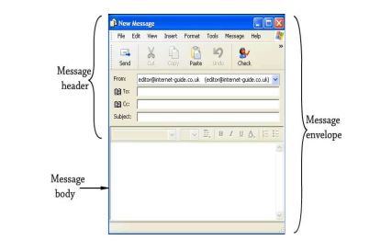

Slide 16
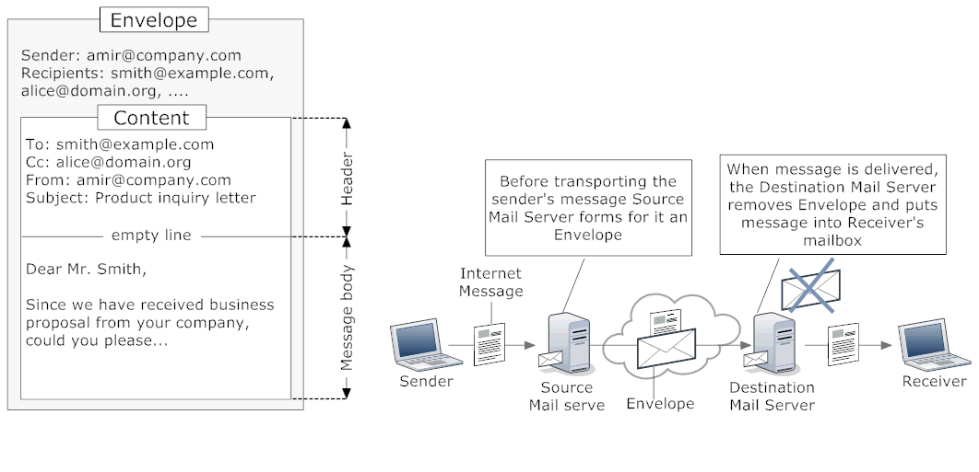
E-mail Envelope

Slide 17
The information contained in the envelope is used by the sender and the receiver’s machine
This communication is to be done according to the SMTP i.e. Simple Mail Transfer Protocol

Slide 18
Sections of E-mail message
There are 5 main sections of an e-mail message
E-mail Address
Header
Body
Signature(optional)
Attachments(optional)

Slide 19
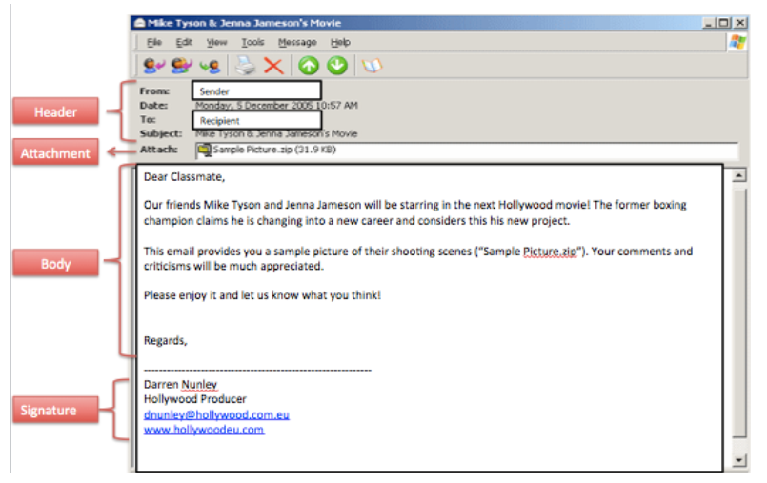
E-mail Header And Body

Slide 20
E-mail Address
An e-mail address identifies an e-mail box to which the email messages are received
It consists of two parts divided by @ symbol
First Part after @ symbol
It is the domain name of the mail server computer on which the e-mail account is created and the messages will be send like gmail.com, yahoo.com etc.
Second Part before @ symbol
It is local-part of the address which is often the username of the recipient.
It is the personal identity or account name on that mail server

Slide 21
Example of e-mail address
For example 1000 people have an e-mail account with the same ISP or organisation(mail server)
All 1000 users will have the same domain name(like gmail.com)
But each person will have a unique user name such as “ram”, “shyam123” etc.
The user name and the domain name together will form a unique e-mail address . For eg: shyam123@gmail.com
shyam123 username
gmail domain name
com domain extension which identifies the type of
organisation
There should not be any space in the e-mail address.

Slide 22
Components of E-mail message
Header
It is the uppermost section which displays the information regarding the status of the message
A header records message information and provides to the recipient of the message
Headers are present in both outgoing and incoming message

Slide 23
Header Fields
Name | Function
To: | E-mail address/addresses of primary receipient(s)
Cc: | E-mail address/addresses of secondary recipient(s) to whom copy needs to be send and the primary addresses should know that the mail has been send to these addresses
Bcc: | E-mail address/addresses of secondary recipient(s) to whom copy needs to be send and the primary addresses should not know that the mail has been send to these addresses
From: | The address of the originator/creator of the e-mail
Sender: | E-mail address of the actual sender
Received: | Line added by each transfer agent along the route containing the agent’s identity, the date and time the message was received
Return Path: | May be used to identify the path back of the sender
Subject: | Subject of the message as typed by the sender

Slide 24
Body
The body of the message is the part that contains the actual message.
Some ISP’s limits the size of an e-mail message
Attachments
Any file can be attached externally with the message
It can be a word processing document, excel sheet, power point presentation, images, audio/video files etc.
The e-mail message shows an icon within the message that represents an attached file
The attachment can be directly opened or can be downloaded and saved on the computer

Slide 25
Signature
The signature for an e-mail message is personal information which automatically appears at the bottom of the outgoing message
Use of signature is optional
The contents of the signature can be set from the settings option appearing in the right hand side at the top
Drafts
The message can be saved into drafts if it is to be send at some later stage

Slide 26
Using e-mail
First of all an e-mail account is to be opened on the webmail provider of your choice like gmail, hotmail etc.
Connect to the internet
Open the browser loaded on your computer like Internet Explorer, Google Chrome etc.
Open the choice of mail provider in the browser
The option of creating a new e-mail account appears. Click the option
A form is displayed in which the personal details as well as e-mail address(of your choice) is to be filled

Slide 27
An option to create a password is also there. The password enables you to connect to that account. This is confidential so that no other person can have access to your account
A user can connect to the e-mail account anytime by opening the mail service provider in the browser and then with the username and password

Slide 28
Mailbox
The Mailbox is an area in memory or on a storage device where e-mail is placed.
In e-mail systems, each user has a private mailbox. When the user receives email, the mail system automatically puts it in the mailbox.
The mailbox consists of
Inbox
Outbox

Slide 29
Inbox:
The Inbox is a collection of recent mails by user which is available to read, answer, store or delete.
Mails can be checked through a webmail interface or by a program like Outlook or Mac OS X Mail
each downloaded message gets stored in respective user's inbox.
Most people receive more mail which can be managed in one folder.
After reading the messages, the user has an option to move them to other folders or delete them

Slide 30
Outbox:
The outbox is where outgoing e-mail messages are temporarily stored.
When a message is composed most mail programs automatically save a draft message in the outbox.
The message is then stored in the outbox until it is successfully sent to the recipient.
Once the message has been sent, most e-mail programs move the message to the "Sent" or "Sent Messages" folder.
The inbox is often overflowing with e-mail but the outbox often does not contain any messages as all the messages that have been sent have already been transferred to the Sent Messages folder.

Slide 31
Create a Mail Message
Login into your mail account
All the messages received will be shown
The messages are received in the “Inbox”
To send message click on “Compose” if the mail server used is “gmail.com”

Slide 32
To Create a New E-mail
To create new mail use Compose Option. Click on it and then type
To Address/Addresses-
It is Recipient’s e-mail address
While typing a recipient's address, Gmail will suggest addresses from existing Contacts list using auto complete.
To edit the E-mail address or name, double-click a contact name
CC Address/Addresses- Carbon Copy
The address of the recipient’s to whom the copy of same mail is to send
BCC Address/Addresses- Blind Carbon Copy
The address of the recipient’s to whom the same mail is to be send but don not want the recipient mentioned in the “To” should know about these addresses to whom the mail is also send
Subject of the mail
Enter a subject message in the “Subject” field for identification.

Slide 33
Body:
Type detail text in the body
Attachments:
Select from your computer/mobile device the file, image or any video file to be send by clicking on Attach Button
When the message is complete you can beautify it using the formatting features of Bold, Italic, Underline, Bullets etc. given at the bottom line.
Emoticons can also be added
Send:
When the message is complete it can be send to the recipients using the Send button.

Slide 34
Reply to the Message
One can send reply to the mail received by clicking on the Reply button after reading the mail received
The option of Reply and Reply All is there.
Forward
The mail Received can be forwarded to other e-mail account by clicking on the Forward Option

Slide 35
The selective mails can be deleted by selecting it by clicking on the small box in the left hand side and then click on the Delete Option.
The order of the mails can also be changed by choosing the various options
Like recent first(ON date)
Older first (On Date)
Using the Search option you can search the mail Inbox for the mail you want to look into
The mail sent can be seen by clicking on the Sent button
You can create a folder according the users from which you receive mail and move the mails to the specific contact person folder

Slide 36
Advantages of E-mail
It has number of advantages over other forms of communication
Speed:
It is a quicker means of correspondence than ordinary postal system
A message can reach any part of the world in few seconds
Content
A message can contain few lines or a large amount of text including attachments of various type of files.
Unlike the postal service, the message is not charged by weight

Slide 37
Ease of Use
It is easy to send an e-mail than a letter through normal postal system
In postal system we have to buy an envelope, a stamp and then find a letter box to drop the letter
Receiving A Message
We need not be connected to internet all the time to receive a message
We can read it any time at our convenience and can retain the message till we want. It will be stored in our inbox

Slide 38
Multiple Copies
We can send the same message to multiple users without retyping the message again and again
Always Available Information
Storing data online means less space occupied which would otherwise take files, folders, cabinets
Access of information is quicker

Slide 39
Easy To Prioritize
Incoming messages have subject lines that enables to delete unwanted messages without opening

Slide 40
Disadvantages of E-mail
Emotional Responses
Some e-mail causes anger or upset a person
A reply in the heat of the moment can’t be retracted
Information Overloaded
Too many people send too much information due to ease of sending
Lacks the personal touch
Some things are best left untyped.
A handwritten card or letter builds relationships

Slide 41
Misunderstandings
E-mail from people who does not take time to read what they write before clicking send can create misunderstandings
Time is wasted to clarify the misinterpretation of the message
Pressure To Reply
Once the mail is received in the Inbox the pressure to act on it is increased
Spam
To deal with spam mail messages wastes lots of time and is a passive activity

Slide 42
Time Consumer
Over checking messages is also one of the activity which wastes lots of time
Viruses
If e-mails are not handled properly it can seriously effect the computer with unwanted virus attacks
If one does not know how to avoid reading such infected e-mails

Slide 43
Forgery
E-mail doesn’t prevent from forgery, that is, someone impersonating the sender, since sender is usually not authenticated in any way.
No Response
It may be frustrating when the recipient does not read the e-mail and respond on a regular basis.

