Slide 1
O-Level UNIT-7
E-Mail, Social Networking and e-Governance services

Slide 2
Social Networking
Social Networking refers to grouping of individuals and organizations which come together via some medium
It is an online service platform that focuses on facilitating the building of social networks or social relations among people who share interests, activities, backgrounds, or real-life connections
A social network service consists of a representation of each user (often a profile), his/her social links, and a variety of additional services.
Most social network services are web-based and provide means for users to interact over the Internet, such as e-mail and instant messaging. Online community services are

Slide 3
Several web based social network services are available are
Facebook
Twitter
linkedin etc.
These services offer easy to use and interactive interface to connect with people with in the country an overseas as well.
There are also several mobile based social networking services in for of apps such as Whatsapp, hike, Line etc.

Slide 4
Social networking was born one day in 1971,when the email was sent. The two computers were sitting right next to each other. The message said "qwertyuiop”. Day by day people invented many sites and its popularity began.

Slide 5

Social Networking Sites

Slide 6
Social Networking Sites
S.no | Service | Description
1. | Facebook | Allows to share text, photos, video etc. It also offers interesting online games.
2. | Google+ | It is pronounced as Google Plus. It is owned and operated by Google.
3. | Twitter | Twitter allows the user to send and reply messages in form of tweets. These tweets are the small messages, generally include 140+ characters.
4. | Faceparty | Faceparty is a UK based social networking site. It allows the users to create profiles and interact with each other using forums messages.
5. | Linkdin | Linkedin is a business and professional networking site.

Slide 7
Social Networking Sites
S.No | Service | Description
6. | Flickr | Flickr offers image hosting and video hosting.
7. | Ibibo | Ibibo is a talent based social networking site. It allows the users to promote one’s self and also discover new talent.
8. | Whatsapp | It is a mobile based messaging app. It allows to send text, video, and audio messages
9. | Line | It is same as whatsapp. Allows to make free calls and messages.
10. | Hike | It is also mobile based messager allows to send messages and exciting emoticons.

Slide 8
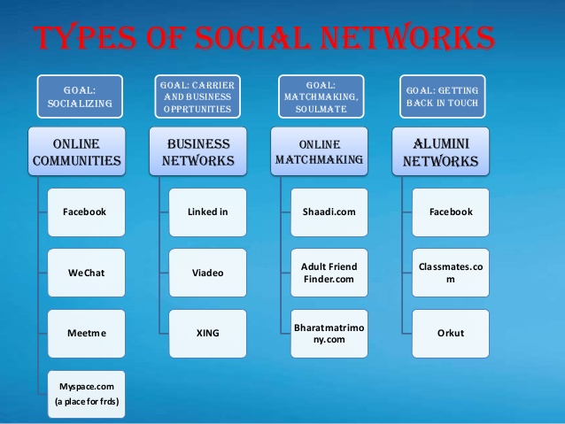
Types of Social Networks

Slide 9
Features Of Social Networking
Messaging
News
Communities and Connectivity
Like Buttons
Games
Audio and Video Uploads

Slide 10

Twitter
Founded in 2006
Twitter is a real-time information network that connects you to the latest stories, ideas, opinions and news about what you find interesting.
Simply find the accounts you find most compelling and follow the conversations.
At the heart of Twitter are small bursts of information called Tweets.
Each Tweet is 140 characters long, but don’t let the small size fool you—you can discover a lot in a little space.
One can see photos, videos and conversations directly in Tweets to get the whole story at a glance, and all in one place.

Slide 11

Facebook
Social Network launched in February 2004 by Mark Zuckerberg
Connects people on an innovate platform that fosters increasing interaction.
To provide users with value beyond interaction.

Slide 12

LinkedIn
Reid Hoffman is the founder of LinkedIn
Social Networking site designed for the business community
The goal of the site is to allow registered members to establish and document networks of people they know and trust professionally

Slide 13

Instagram
Instagram is an American photo and video-sharing social networking service owned by Facebook, Inc.
It was created by Kevin Systrom and Mike Krieger, and launched in October 2010
It allows users to share photos and videos from their lives, add captions, edit filters, tweak settings, engage with others etc.

Slide 14
Instant Messaging
Instant messaging technology is a type of online chat that offers real-time text transmission over the Internet.
A LAN messenger operates in a similar way over a local area network.
Short messages are typically transmitted between two parties, when each user chooses to complete a thought and select "send".
It establishes a direct connection between users so they can talk to each other synchronously, in real time.

Slide 15
Examples of Instant Messaging
WhatsApp.
WhatsApp is a well-known instant messaging app that many users use to chat with friends and colleagues
Skype.
Though Skype is more popularly known and used for video calling, its instant messaging ability cannot be avoided
Yahoo Messenger etc.

Slide 16

Whatsapp
WhatsApp Messenger or simply WhatsApp is an American freeware, cross-platform messaging and Voice over IP service owned by Facebook, Inc.
It allows users to send text messages and voice messages, make voice and video calls, and share images, documents, user locations, and other media
cross-platform means an instant messaging application that allows iPhone, BlackBerry, Android, Windows Phone and Nokia smartphone users to exchange text, image, video and audio messages for free. .

Slide 17

Skype
Skype is a telecommunications application that specializes in providing video chat and voice calls between computers, tablets, mobile devices over the Internet.
It's built for both one-on-one and group conversations and works wherever you are
Skype also provides instant messaging services.
Users may transmit text, video, audio and images.

Slide 18

Facebook Messenger
Facebook Messenger is an American messaging app and platform developed by Facebook, Inc. Originally developed as Facebook Chat in 2008
It is a free mobile messaging app used for instant messaging, sharing photos, videos, audio recordings and for group chats.
The app, which is free to download, can be used to communicate with your friends on Facebook and with your phone contacts

Slide 19
Advantages of Social Networking
Online Marketing
Website like facebook allows us to create a page for specific product, community or firm and promiting over the web.
Online Jobs
Website like linkedin allows us to create connection with professionals and helps to find the suitable job based on one’s specific skills set.
Online News
On social networking sites, people also post daily news which helps us to keep us updated.

Slide 20
Chatting
Social networking allows us to keep in contact with friends and family. We can communicate with them via messages.
Reduces feeling of loneliness by communicating
Share Picture, Audio and video
One can share picture, audio and video using social networking sites.

Slide 21
Disadvantages
Opens up the possibility for hackers to commit fraud and launch spam and virus attacks.
Increases the risk of people falling prey to online scams that seem genuine, resulting in data or identity theft
May result in negative comments from employees about the company or potential legal consequences if employees use these sites to view objectionable, illicit or offensive material
Potentially results in lost productivity, especially if employees are busy updating profiles, etc. and also lowers academic performance
Increases feeling of inferiority due to comparisons

