Slide 1
UNIT-8 Digital Financial Tools
Financial Literacy

Slide 2
To Understand Digital Financial Tools You Need To Know About Basics Of Financial Literacy. We start with Financial Literacy

Slide 3
What is 'Financial Literacy '
Financial literacy is the education and understanding of various financial areas including topics related to managing personal finance, money and investing.
Focuses on the ability to manage personal finance matters in an efficient manner, and it includes the knowledge of making appropriate decisions about personal finance such as investing, insurance, real estate, paying for college, budgeting, retirement and tax planning.
Financial literacy also involves the proficiency of financial principles and concepts such as financial planning, compound interest, managing debt, profitable savings techniques and the time value of money. The lack of financial literacy may lead to making poor financial choices that can have negative consequences on the financial well-being of an individual.
The main steps to achieving financial literacy include learning the skills to create a budget, the ability to track spending, learning the techniques to pay off debt and effectively planning for retirement. These steps can also include counselling from a financial expert. Education about the topic involves understanding how money works, creating and achieving financial goals and managing internal and external financial challenges.

Slide 4
Financial literacy is the ability to understand how money works: how someone makes, manages and invests it, and also expends it (especially when one donates to charity) to help others. ... Problems of debt are severe for a large proportion of the population because of financial illiteracy.

Slide 5
The Importance of Financial Education
individuals become self-sufficient so that they can achieve financial stability. Those who understand the subject should be able to answer several questions about purchases, such as whether an item is required, whether it is affordable, and whether it an asset or a liability.
Financial illiteracy affects all ages and all socioeconomic levels. Financial illiteracy causes many people to become victims of predatory lending, subprime mortgages, and fraud and high interest rates, potentially resulting in bad credit, bankruptcy or foreclosure.
The lack of financial literacy can lead to owing large amounts of debt and making poor financial decisions.
Financial literacy education should also include organizational skills, attention to detail, consumer rights, technology and global economics because the state of the global economy greatly affects the Country’s economy

Slide 6
Why savings are needed
Saving money can help you become financially secure and provide a safety net in case of an emergency.
Here are a few reasons why we save:
Emergency cushion
Retirement
Average Life Expectancy
Education
Without money put away in savings and/or investments, you open yourself up to other risks as well. For example, not having enough money to pay for emergency care may force you into taking a loan that your savings might otherwise have covered.
How much can you potentially save?
It’s important that you develop a budget using your net income as it reflects your take home pay after taxes and dedications. A common mistake people make is developing a budget off of their gross income. It’s a mistake because you're budgeting money you never possessed. Remember your potential savings is the difference between your net income and your expenses.

Slide 7
Saving with a bank
The easiest and safest way to save money is to deposit it in a bank. Banks offers various types of savings account in which you can save your money and also earn interest. You can rest assured that your savings are safe at the bank – they cannot be lost or stolen.
There are several types of savings products available on the market. They can basically be divided into two main categories – savings accounts and time deposits.
The main difference between savings accounts and time deposits is that savings accounts are more flexible because they enable you to withdraw and deposit money without losing any of the interest earned on your savings while they were in the bank,
whereas time deposits enable you to earn higher interest rates, but only if you leave the money in the bank for the full period specified in the contract that you signed. Within each of these two categories, there are several different types of account. The most common are: standard time deposit accounts, flexible time deposits, savings plans and children’s deposits.

Slide 8
banking services offered by banks
Transactional accounts
Checking accounts (American English)
Current accounts (British English)
In banking terminology, the term transaction account refers to a basic bank account with a financial institution which allows for the efficient transfer of funds by the account holder to third parties as well as receiving electronic payments into this account.
Savings accounts
A checking account is a type of bank deposit account that is designed for everyday moneytransactions. The money in a savings account, however, is not intended for daily use, but is instead meant to stay in the account — be saved in theaccount — so that it might earn interest over time.
Savings accounts have higher interest rates than checking accounts, Checking Accounts have overdraft facility
Debit cards
ATM cards
Credit cards
Mortgages
Home equity loans
Personal loans
Certificates of deposit/Term deposits

Slide 9
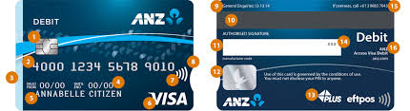
ATM Cards

Slide 10
Banking Instruments
Saving money instruments incorporate checks, drafts, bills of trade, credit notes and so on. It is a report ensuring the installment of a particular measure of cash, either on request or at a set time, with the player named on the archive. These are the accompanying
Checks or cheques
Demand Drafts
Letters of Credit
Voucher
Bills of Exchange
Debit Card
Credit Card
ATM
Internet Banking
Mobile Banking
Core Banking Solution

Slide 11
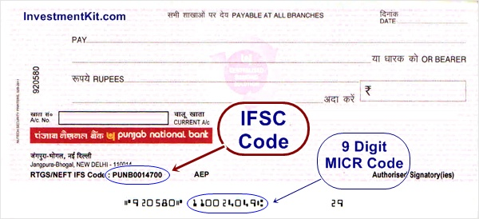
Checks or cheques
A cheque, or check is a document that orders a bank to pay a specific amount of money from a person's account to the person in whose name the cheque has been issued. The person writing the cheque, known as the drawer, has a transaction banking account (often called a current, cheque, chequing or checking account) where their money is held. The drawer writes the various details including the monetary amount, date, and a payee on the cheque, and signs it, ordering their bank, known as the drawee, to pay that person or company the amount of money stated.

Slide 12
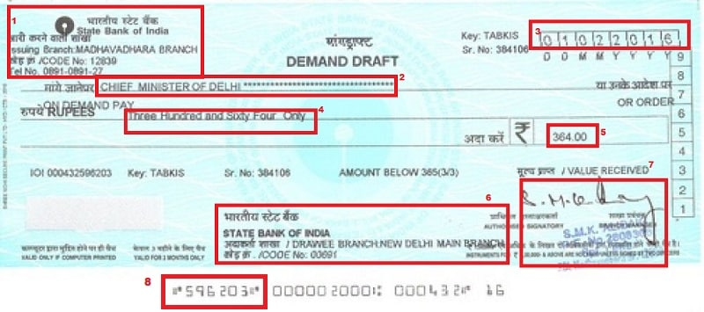
Demand Draft
Demand draft is like a prepaid instrument. One can issue demand draft only when he pay value of the DD in a bank. So a person when presents DD in a bank will definitely get money. There will be no chance of bouncing here as money is already paid for that DD by issuer.

Slide 13
Letter of credit
A letter of credit is a letter from a bank guaranteeing that a buyer's payment to a seller will be received on time and for the correct amount.
Letters of credit or documentary collections, which are also commonly known as drafts, are often used to protect the interests of both buyer and seller.
These two methods require that payment be made on presentation of documents conveying the title and showing that specific steps have been taken.
Letters of credit and drafts may be paid immediately or at a later date. Drafts that are paid on presentation are called sight drafts. Drafts that are to be paid at a later date, often after the buyer has received the goods, are called time drafts or date drafts.
The parties rely on a transmittal letter, which contains complete and precise instructions on how the documents should be handled and how the payment is to be made

Slide 14
A letter of credit is a letter from a bank guaranteeing that a buyer's payment to a seller will be received on time and for the correct amount.
In the event that the buyer is unable to make payment on the purchase, the bank will be required to cover the full or remaining amount of the purchase.
Due to the nature of international dealings, including factors such as distance, differing laws in each country, and difficulty in knowing each party personally, the use of letters of credit has become a very important aspect of international trade.

Slide 15
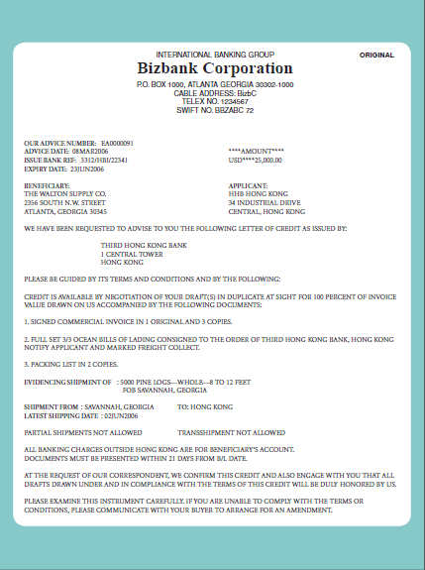

Slide 16
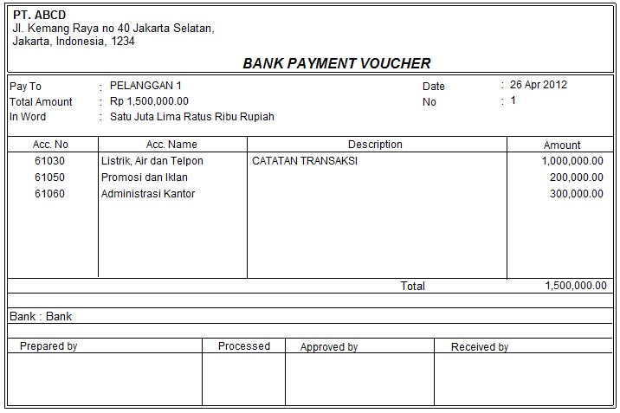
Vouchers
A document which can be used as proof that a monetary transaction has occurred between two parties. In business, a payment voucher can be used for a variety of purposes, sometimes taking the place of cash in a transaction, acting as a receipt, or indicating that an invoice has been approved for payment.

Slide 18
Voucher is a very primary accounting record which shows the authenticity of the transactions.
In business so many transactions take place.
To record any transaction in account books, first of all a voucher is prepared by the accountant. Therefore, we call the vouchers as the base of the accounting system.
Generally a voucher shows following details:
Serial number of voucher
Type of Voucher
Date of Voucher
Debit Column
Credit Column
Amount in figures and words.
Total Column
Particulars column in which brief description of the transaction is being mentioned
Signature of accountant
Signature of Manager or other authourised person.
In Case of Bank Payment Voucher or Cash Payment Voucher, signature of receivers is also shown

Slide 19
Bills of Exchange:
A non-enthusiasm bearing composed request utilized essentially as a part of a global exchange that ties one gathering to pay a settled total of cash to another gathering at a foreordained future date. It is a promissory note.
Bills of exchange are similar to checks and promissory notes. They can be drawn by individuals or banks and are generally transferable by endorsements.
a written order to a person requiring them to make a specified payment to the signatory or to a named payee; a promissory note.
Debit Card:
A card used to make an electronic withdrawal from assets on stored in a financial balance or in obtaining products through EDC (Electronic Data Capture) machine. ➢ The debit card number is as a rule of 16 digits. ➢ There are exchange charges past 5 quantities of exchanges in a month.
Credit Card:
A card issued by a money related organization giving the holder an alternative to acquiring stores, generally at the purpose of the offer. Visas charge intrigue and are essentially utilized for transient financing. Intrigue, as a rule, starts one month after a buy is made and obtaining points of confinement are pre-set by individual’s FICO score. There are the yearly expense, benefit charges, late installment charges and different charges connected to a Visa.
ATM:
Mechanized Teller Machine is a modernized machine that gives the clients of banks the office of getting to their record for apportioning money and to complete other budgetary and non-monetary exchanges without the need to really visit their bank branch

Slide 20
Internet Banking:
Web-based keeping money or the Internet saving money is an electronic installment system that empowers clients of a monetary establishment to lead budgetary exchanges on a site worked by the bank. Web-based saving money was initially presented in the mid-1980s in New York. Four noteworthy banks—Citibank, Chase Manhattan, Chemical and Manufacturers Hanover—offered this administration.
a method of banking in which transactions are conducted electronically via the Internet.
Online banking, also known as internet banking, is an electronic payment system that enables customers of a bank or other financial institution to conduct a range of financial transactions through the financial institution's website.
The online banking system will typically connect to or be part of the core banking system operated by a bank and is in contrast to branch banking which was the traditional way customers accessed banking services.

Slide 21
Mobile Banking:
Portable keeping money alludes to the utilization of a mobile phone or another cell gadget to perform the internet managing an account errands. Versatile managing an account administrations are normally constrained to an electronic development of assets and information recovery.
Mobile banking refers to the use of a smartphone or other cellular device to perform online banking tasks while away from your home computer, such as monitoring account balances, transferring funds between accounts, bill payment and locating an ATM.
Core Banking Solution:
This is a procedure in which the data is put away in a brought together server of the bank, which is accessible to all system branches.

Slide 22
The primary difference between mobile banking and internet banking is that mobile banking is accessed through an application on the smartphone, whereas internet banking is accessed through a browse, typically on a computer. ... It typically requires one to download the mobile banking application from the respective bank.

Slide 23
KYC (Know Your Customer)
KYC means “Know Your Customer”. It is a process by which banks obtain information about the identity and address of the customers. This process helps to ensure that banks’ services are not misused. The KYC procedure is to be completed by the banks while opening accounts. Banks are also required to periodically update their customers’ KYC details.
To open a bank account, one needs to submit a ‘proof of identity and proof of address’ together with a recent photograph.
KYC is a legal requirement in many sectors, apart from banks. Whether it’s mutual Funds, insurance, broking, or commodity trading KYC has been made compulsory in order to verify the identity of the clients.

Slide 24
Opening of bank account and documents required
Eligibility Criteria for a Savings Account
Should be a citizen of India.
The customer should be 18 years and above.
In the case of minors, the parents or legal guardian of the minor can open the account on their behalf.
The applicant is required to have valid identity and address proof that is Government approved.
Documents Required:
Proof of identity - Passport, Driving license, Voter’s ID card, etc.
Proof of address - Passport, Driving license, Voter’s ID card, etc.
PAN card
Form 16 (only if PAN card is not available)
2 latest passport size photographs

Slide 25
Types of bank accounts
Saving Account
Regular Savings
Current Account
Recurring Deposit Account
Fixed Deposit Account
DEMAT Account
NRI Accounts

Slide 26
Bank’s services
Remittance:
Transfer of funds, usually from a buyer to a distant seller, instrument of transfer (such as a check or draft), or funds so transferred.
Loan:
Loans are a common banking service offered, and they come in all shapes and sizes. Some common types of loans that banks provide include:
Personal loans
Home equity loans
Home equity lines of credit
Home loans
Business loans

Slide 27
Mobile banking:
Mobile banking is a service provided by a bank or other financial institution that allows its customers to conduct financial transactions remotely using a mobile device such as a smartphone or tablet. Unlike the related internet banking it uses software, usually called an app, provided by the financial institution for the purpose. Mobile banking is usually available on a 24-hour basis. Some financial institutions have restrictions on which accounts may be accessed through mobile banking, as well as a limit on the amount that can be transacted.
Overdraft:
An overdraft is an extension of credit from a lending institution when an account reaches zero. An overdraft allows the individual to continue withdrawing money even if the account has no funds in it or not enough to cover the withdrawal. Basically, overdraft means that the bank allows customers to borrow a set amount of money.
Pension:
A pension is a fund into which a sum of money is added during an employee's employment years, and from which payments are drawn to support the person's retirement from work in the form of periodic payments. A pension may be a "defined benefit plan" where a fixed sum is paid regularly to a person, or a "defined contribution plan" under which a fixed sum is invested and then becomes available at retirement age. Pensions should not be confused with severance pay; the former is usually paid in regular installments for life after retirement, while the latter is typically paid as a fixed amount after involuntary termination of employment prior to retirement.

Slide 28
Insurance
Insurance is a means of protection from financial loss. It is a form of risk management, primarily used to hedge against the risk of a contingent or uncertain loss.
Types
Auto insurance,
Gap insurance
Health insurance
Income protection insurance
Life insurance
Property
Liability
Insurance financing vehicles
Closed community and governmental self-insurance

Slide 29
Social Security Schemes
The Government of India has initiated a number of social security schemes to boost the financial stability of its citizens and to reinforce the economic development of the nation.
1. Sukanya Samriddhi Yojana
2. National Pension Scheme
3. Pradhan Mantri Jan Dhan Yojana
4. Public Provident Fund (PPF)
5. National Savings Certificate (NSC)
6. Atal Pension Yojana
7. Pradhan Mantri Jeevan Jyoti Bima Yojana
8. Pradhan Mantri Mudra Yojana (PMMY).

Slide 30
Sukanya Samriddhi Yojna
As part of the BBBP Campaign, Prime Minister Narendra Modi launched a scheme called ‘Sukanya Samriddhi Yojana (SSY)’, that means ‘Girl Child Prosperity Scheme’ in line with the above objectives
The scheme was launched by Prime Minister Narendra modi on 22 January 2015 as a part of the Beti Bachao, Beti Padhao campaign. The scheme currently provides an interest rate of 8.1% (for October 2017 to December 2017 ) and tax benefits. The account can be opened at any India Post office or branch of authorised commercial banks.
Sukanya Samriddhi Account ( Girl Child Prosperity Account) is a Government of India backed saving scheme targeted at the parents of girl children. The scheme encourages parents to build a fund for the future education and marriage expenses for their female chil

Slide 31
The account can be opened anytime between the birth of a girl child and the time she attains 10 years age by the parent/guardian. Only one account is allowed per child. Parents can open a maximum of two accounts for each of their children (exception allowed for twins and triplets). The account can be transferred to anywhere in India

Slide 32
National Pension Scheme
National Pension System, also known as NPS, is a voluntary defined contribution pension system in India.
The NPS started with the decision of the Government of India to stop defined benefit pensions for all its employees who joined after 1 January 2004. While the scheme was initially designed for government employees only, it was opened up for all citizens of India between the age of 18 and 60 in 2009
NPS is a quasi-EET instrument in India where 40% of the corpus escapes tax at maturity, while 60% of the corpus is taxable.Of the 60% taxable corpus, 40% is tax-exempt as it has to be compulsorily used to purchase an annuity. The annuity income will be taxed, though. The remaining 20% alone will now be taxed at slab rates on withdrawal.
NPS offers subscribers a choice of two record keeping agencies: NCRA (NSDL-CRA) and KCRA (Karvy-CRA).. In 2017 Union budget of India, 25% exemption of the contribution made by an employee has been announced as a form of premature partial withdrawal in NPS.This amendment will take effect on 1 April, 2018 and will, accordingly, apply in relation to the assessment year 2018-19.NPS is a market-linked annuity product.

Slide 33
Pradhan Mantri Jan Dhan Yojana (PMJDY)
Pradhan Mantri Jan-Dhan Yojana (PMJDY) is National Mission for Financial Inclusion to ensure access to financial services, namely, Banking/ Savings & Deposit Accounts, Remittance, Credit, Insurance, Pension in an affordable manner.
PMJDY focuses on coverage of households as against the earlier plan which focused on coverage of villages.
It focuses on coverage of rural as well as urban areas.
Earlier plan targeted only villages above 2000 population while under PMJDY whole country is to be covered by extending banking facilities in each Sub-Service area consisting of 1000 – 1500 households such that facility is available to all within a reasonable distance, say about 5 Km.
Account can be opened in any bank branch or Business Correspondent (Bank Mitr) outlet. Accounts opened under PMJDY are being opened with Zero balance. However, if the account-holder wishes to get cheque book, he/she will have to fulfill minimum balance criteria.

Slide 34
An account can be opened by presenting an officially valid document.
the passport,
the driving licence,
the Permanent Account Number (PAN) Card,
the Voter’s Identity Card issued by Election Commission of India,
job card issued by NREGA duly signed by an officer of the State Government,
the letter issued by the Unique Identification Authority of India containing details of name, address and Aadhaar number, or
any other document as notified by the Central Government in consultation with the Regulator: Provided that where simplified measures are applied for verifying the identity of the clients the following documents shall be deemed to be officially valid documents:—
identity card with applicant's Photograph issued by Central/State Government Departments, Statutory/Regulatory Authorities, Public Sector Undertakings, Scheduled Commercial Banks, and Public Financial Institutions;
letter issued by a Gazetted officer, with a duly attested photograph of the person.

Slide 35
Reserve Bank of India (RBI), vide its Press Release dated 26.08.2014, has further clarified that those persons who do not have any of the ‘officially valid documents’ can open “Small Accounts” with banks.
A “Small Account” can be opened on the basis of a self-attested photograph and putting his/her signatures or thumb print in the presence of officials of the bank.
Such accounts have limitations regarding the aggregate credits (not more than Rupees one lakh in a year), aggregate withdrawals (nor more than Rupees ten thousand in a month) and balance in the accounts (not more than Rupees fifty thousand at any point of time).
These accounts would be valid normally for a period of twelve months. Thereafter, such accounts would be allowed to continue for a further period of twelve more months, if the account-holder provides a document showing that he/she has applied for any of the Officially Valid Document, within 12 months of opening the small account.

Slide 36
Benefits
Interest on deposit.
Accidental insurance cover of Rs. 1.00 lac
No minimum balance required.
The scheme provide life cover of Rs. 30,000/- payable on death of the beneficiary, subject to fulfillment of the eligibility condition.
Easy Transfer of money across India
Beneficiaries of Government Schemes will get Direct Benefit Transfer in these accounts.
After satisfactory operation of the account for 6 months, an overdraft facility will be permitted
Access to Pension, insurance products.
The Claim under Personal Accidental Insurance under PMJDY shall be payable if the Rupay Card holder have performed minimum one successful financial or non-financial customer induced transaction at any Bank Branch, Bank Mitra, ATM, POS, E-COM etc. Channel both Intra and Inter-bank i.e. on-us (Bank Customer/rupay card holder transacting at same Bank channels) and off-us (Bank Customer/Rupay card holder transacting at other Bank Channels) within 90 days prior to date of accident including accident date will be included as eligible transactions under the Rupay Insurance Program 2016-2017.
Overdraft facility upto Rs.5000/- is available in only one account per household, preferably lady of the household.

Slide 37
Public Provident Fund
The public provident fund is established by the central government. One can voluntarily open an account with any nationalized bank,selected authorized private bank or post office. The account can be opened in the name of individuals including minor. The minimum amount is Rs.500 which can be deposited.
Public Provident Fund (PPF) scheme is a popular long term investment option backed by Government of India which offers safety with attractive interest rate and returns that are fully exempted from Tax .Investors can invest minimum Rs. 500 to maximum Rs. 1,50,000 in one financial year
Only one PPF account can be opened per person. Resident Indians, 18 years or older, can open a Public Provident Fund Account. There is no upper age limit for opening this account. Accounts can be opened for minors.

Slide 38
National Saving Certificates
National Savings Certificates, popularly known as NSC, is an Indian Government Savings Bond, primarily used for small savings and income tax saving investments in India. It is part of the postal savings system of Indian Postal Service (India Post).
These can be purchased from any Post Office in India by an adult (either in his/her own name or on behalf of a minor), a minor, a trust, and two adults jointly. These are issued for five and ten year maturity and can be pledged to banks as collateral for availing loans. The holder gets the tax benefit under Section 80C of Income Tax Act 1961

Slide 39
ATAL PENSION YOJNA
Atal Pension Yojana (previously known as Swavalamban Yojana) is a government-backed pension scheme in India targeted at the unorganised sector. It was mentioned in the 2015 Budget speech by Finance Minister Arun Jaitley.It was launched by Prime Minister Narendra Modi on 9 May in Kolkata.As of May 2015, only 20% of India's population has any kind of pension scheme, this scheme aims to increase the number
In Atal Pension Yojana, for every contribution made to the pension fund, The Central Government would also co-contribute 50% of the total contribution or ₹1,000 (US$14) per annum, whichever is lower, to each eligible subscriber account, for a period of 5 years. The minimum age of joining APY is 18 years and maximum age is 40 years. The age of exit and the start of pension would be 60 years. Therefore, a minimum period of contribution by the subscriber under APY would be 20 years or more.
The national Aadhaar ID number is the primary "know your customer" document for identification of beneficiaries, spouses, and nominees to avoid entitlement-related disputes in the long-term. For proof of address, an individual may submit a copy of their ration card or bank passbook.

Slide 40
Pradhan Mantri Jeevan Jyoti Bima Yojana is a government-backed Life insurance scheme in India. It was originally mentioned in the 2015 Budget speech by Finance Minister Arun Jaitley in February 2015.^{[1]} It was formally launched by Prime Minister Narendra Modi on 9 May in Kolkata.^{[2]} As of May 2015, only 20% of India's population has any kind of insurance, this scheme aims to increase the number.^{[3]}

Slide 41
Pradhan Mantri Mudra Yojana (PMMY)
The scheme was launched on 8th April, 2015 by the Hon'ble Prime Minister.
Pradhan Mantri Mudra Yojana (PMMY) is a flagship scheme of Government of India to “fund the unfunded” by bringing such enterprises to the formal financial system and extending affordable credit to them.
It enables a small borrower to borrow from all Public Sector Banks such as PSU Banks, Regional Rural Banks and Cooperative Banks, Private Sector Banks, Foreign Banks, Micro Finance Institutions (MFI) and Non Banking Finance Companies (NBFC) for loans upto Rs 10 lakhs for non-farm income generating activities.

