Slide 1
Ad hoc Wireless Networks
EE452

Slide 2
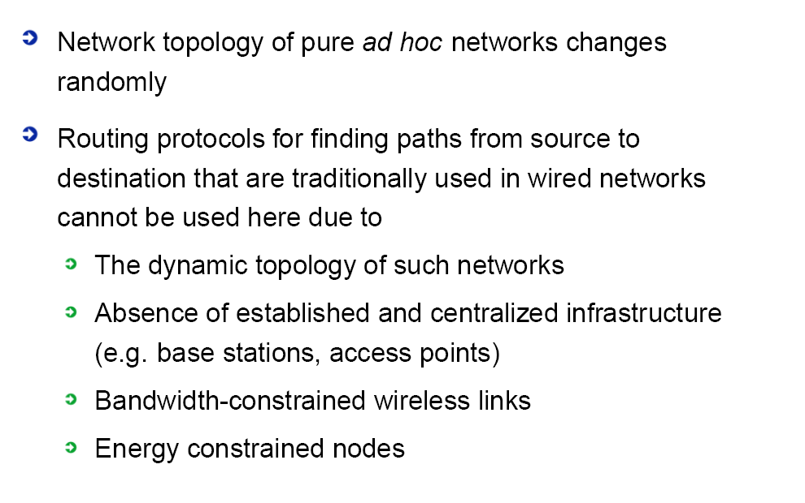
Necessity
EE452

Slide 3
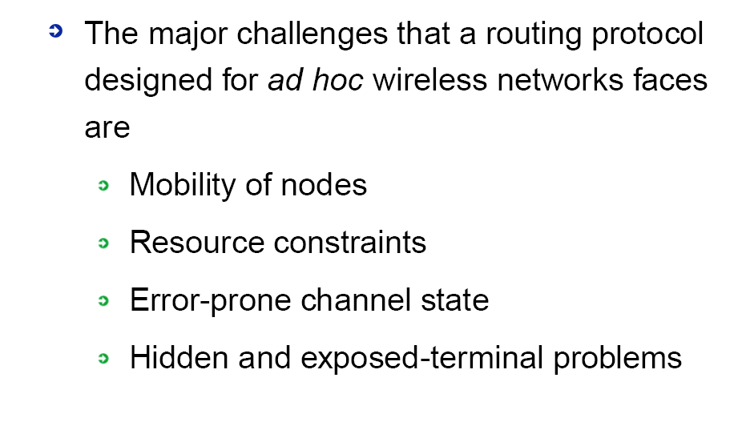
Challenges

Slide 4

Mobility Challenge - I
EE452

Slide 5

Mobility Challenge - II
EE452

Slide 6
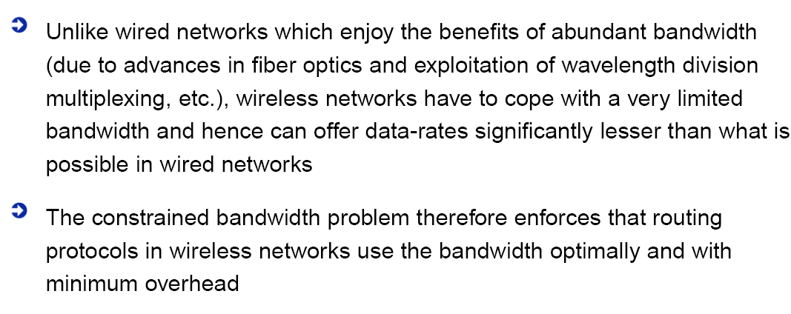
Bandwidth Challenge - I
EE452

Slide 7

Bandwidth Challenge - II
EE452

Slide 8
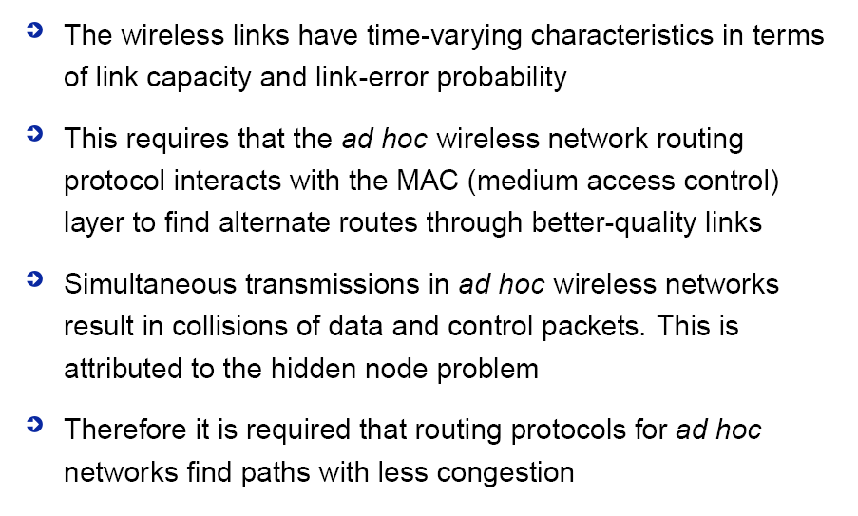
Error-Prone Channel
EE452

Slide 9
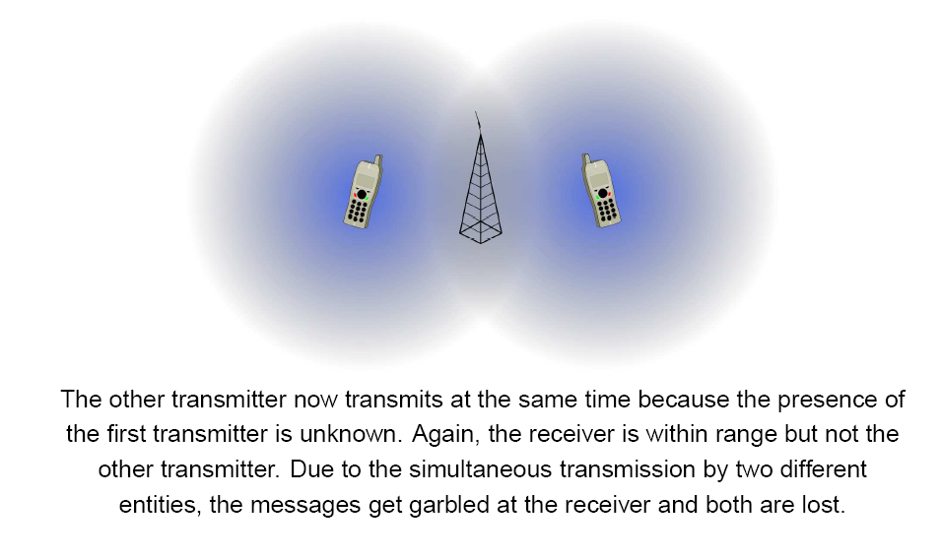
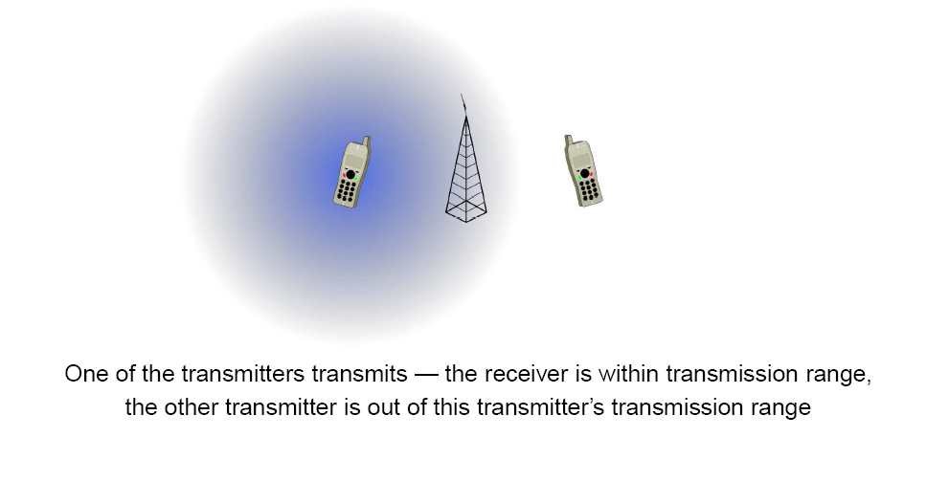
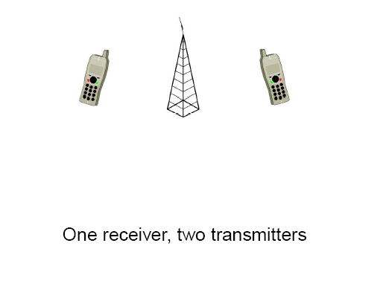
Hidden Node Problem
EE452

Slide 10
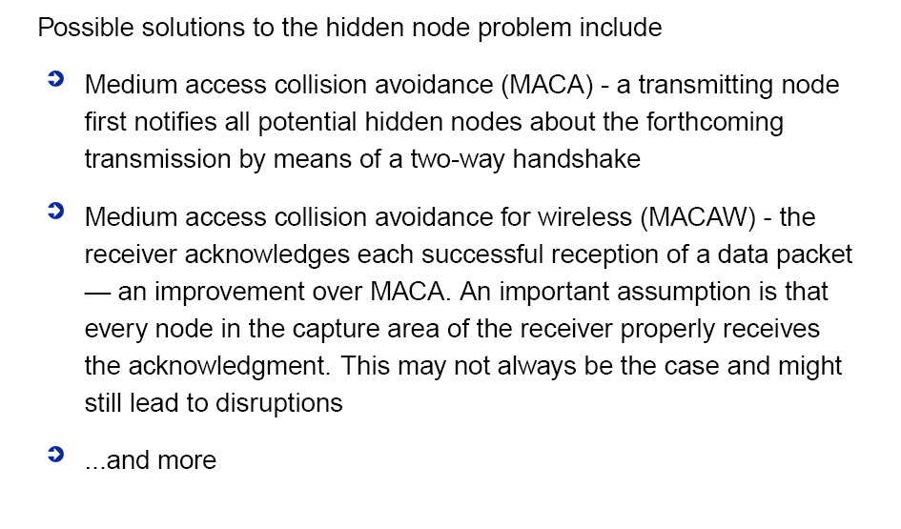
Solutions to Hidden Node
EE452

Slide 11
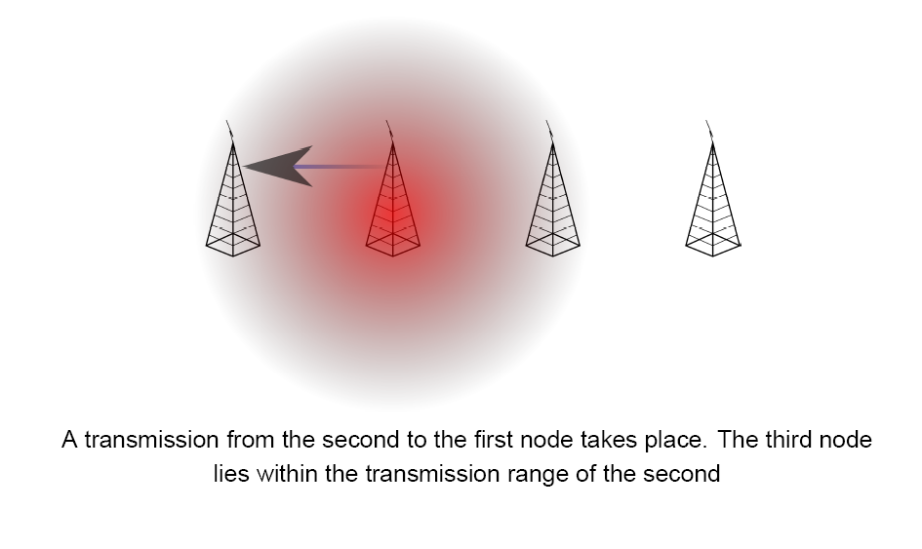
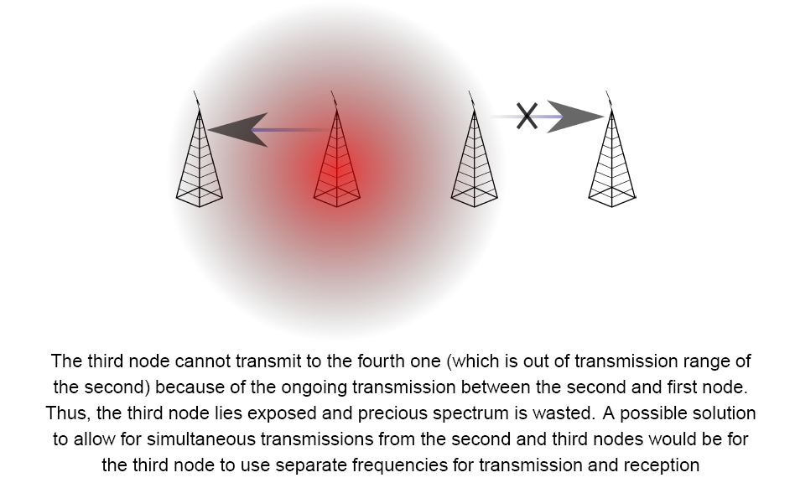
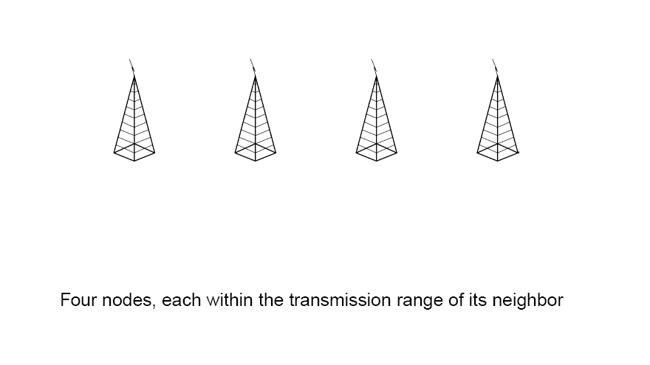
Exposed Node Problem
EE452

Slide 12
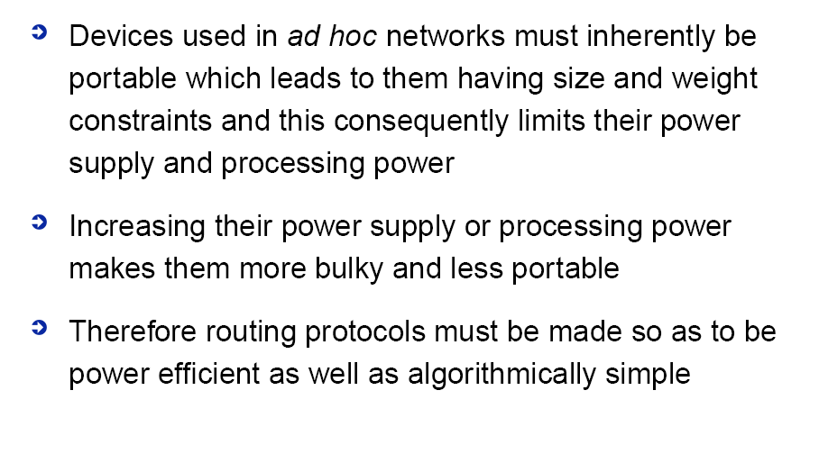
Resource Constraints
EE452

Slide 13
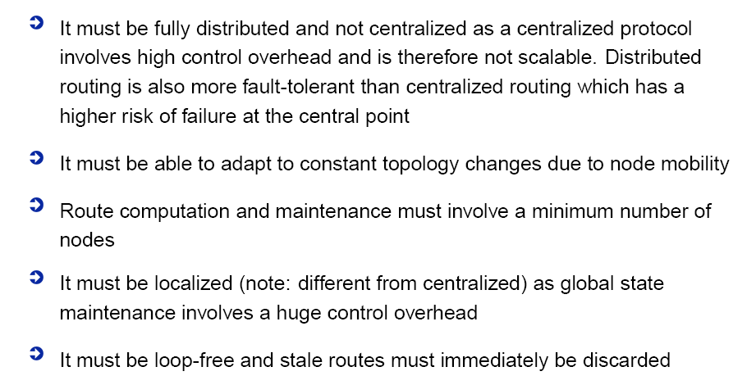
Ideal Routing Protocol - I
EE452

Slide 14
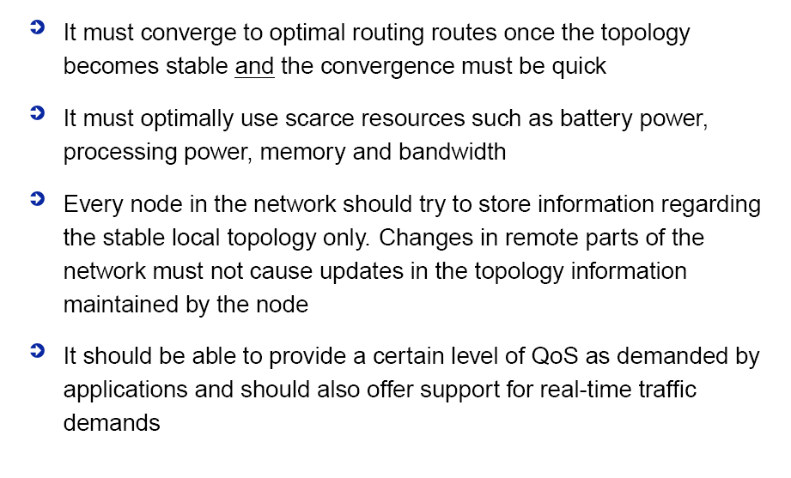
Ideal Routing Protocol - II
EE452

Slide 15
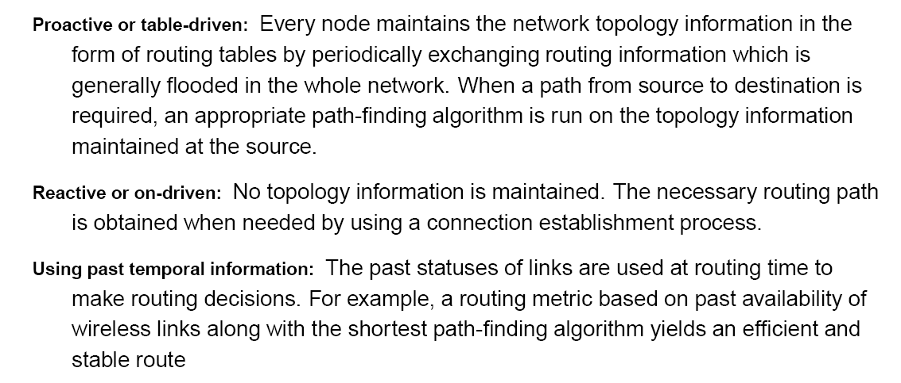
EE452

Slide 16

EE452

Slide 17
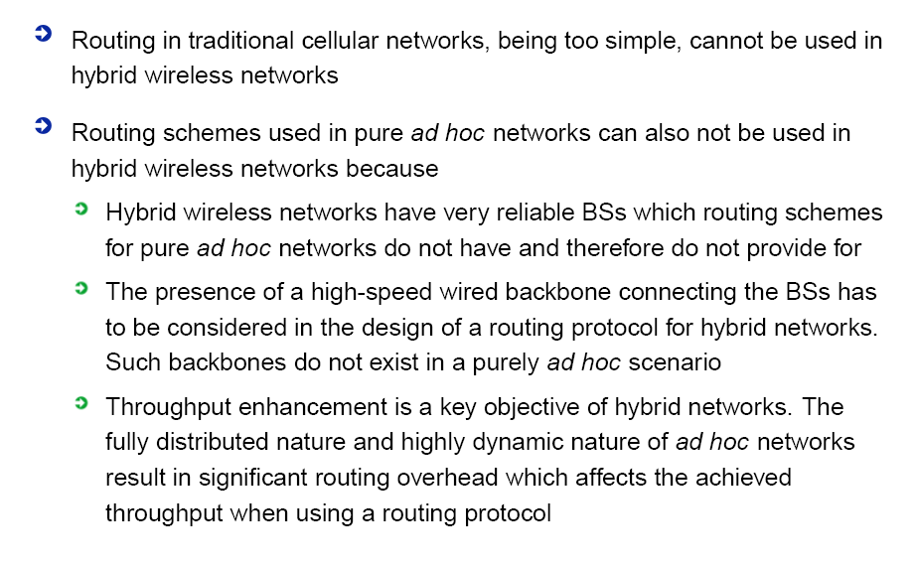

Slide 18
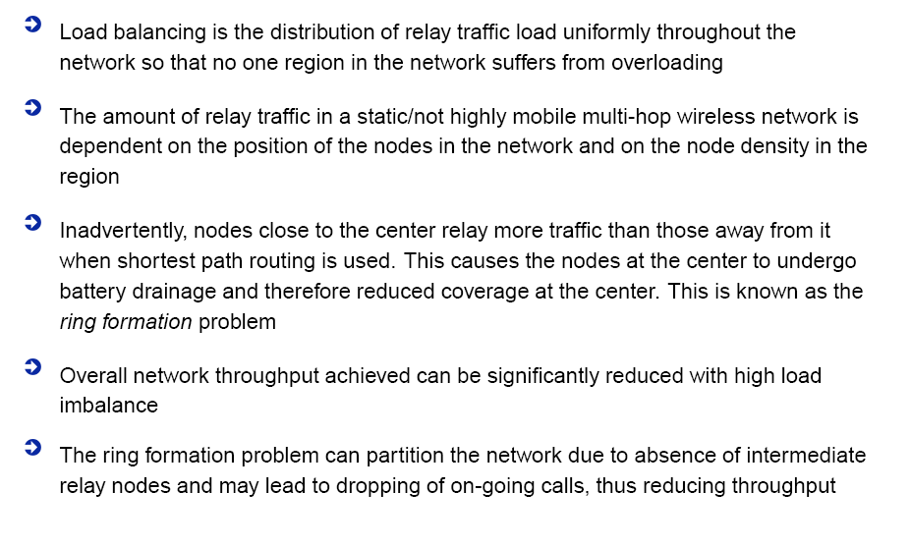
EE452

Slide 19
