Slide 1

Vehicular Communications towards and beyond
Intelligent Transportation System
(ITS)

Slide 2
Outline
- Scope
- MANET and VANET
- 802.11p, DSRC and WAVE
- Protocols in Vehicular Networks
Research Issues
Standard Projects

Slide 3
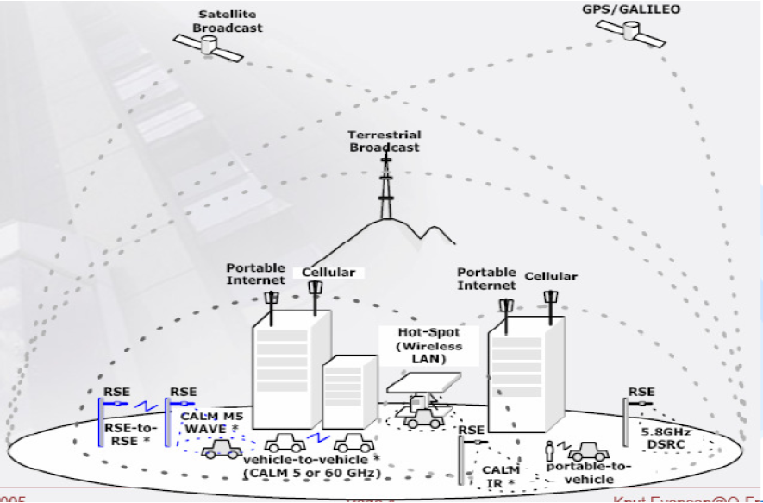
Typical Communication Scenario

Slide 4
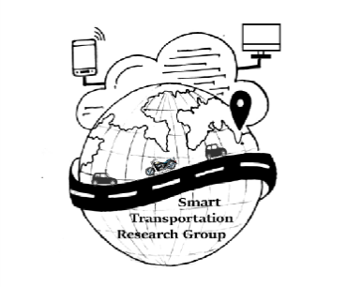
Future Traffic Estimate
LTE --- 50%
Vehicle --- 20%
WiFi --- 20%
Satellite --- 10%

Slide 5
Different Potential Vehicular Applications
Safety applications
Comfort applications
Intersection warning
Environmental/Road data collection
Speed management
Early breaking
Safer navigation
Internet access
Video streaming
Online chat
Online games
Parking lot information
Commercial information
Overall goal:
Reduce traffic accidents
Overall goal:
Open new markets

Slide 6
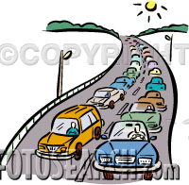
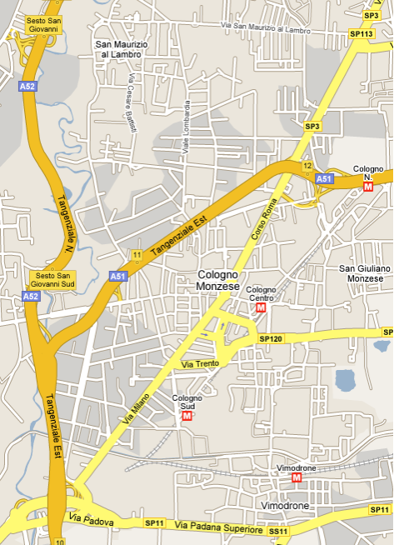


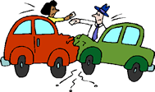

Information Dissemination
Motivation & Scenario
Two cars crash while traveling southbound on a highway, nearby vehicles cooperate to:
  inform the closest ambulance and
  police stations
  alert approaching vehicles telling them to slow down
  notify the highway entrances north of the accident
Messages should ideally propagate
  towards specific target areas
  along the routes where the vehicle density is higher

Slide 7
Applications of Vehicular Network
Safety
    - Intersection warning
Vehicle probe
  - Travel time estimation
  - Environmental data collection
  - Road surface data collection
Emergency vehicle
  - Preemptive traffic control
Navigation
- Finding shortest and appropriate route
Multimedia Transmission
- Video-on-demand
- Multimedia Streaming

Slide 8
What ‘s there in Vehicular Network
Vehicles (on-board unit)
Road side unit/equipment
Communication protocols
  Vehicle to vehicle
  Vehicle to road side
  Vehicle to handheld device
Network infrastructure
GPS
Back-end system

Slide 9
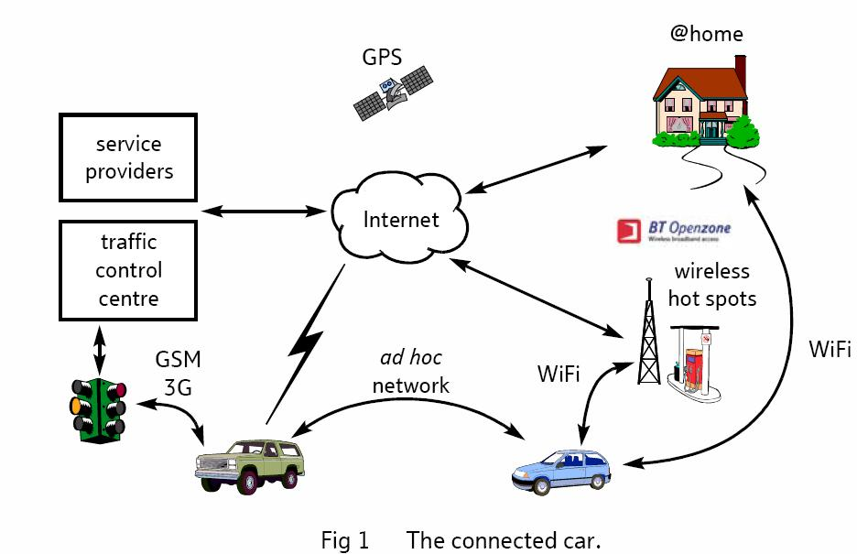
Connected Car Scenario

Slide 10
Vehicular Telematics v/s. ITS
Telematics
  The integrated use of telecommunications and informatics within road vehicles
ITS (intelligent transportation system)
  add information and communications technology to transport infrastructure and vehicles

Slide 11
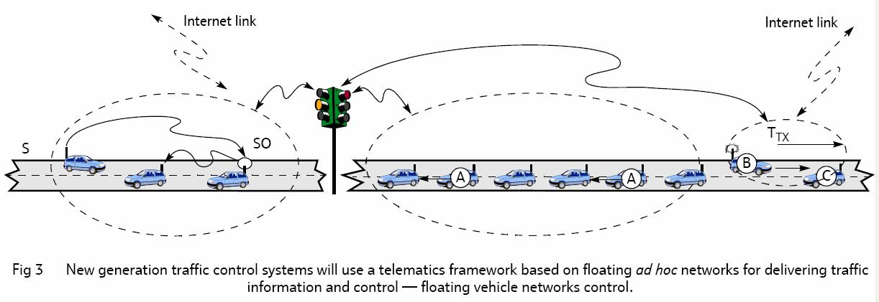
Intelligent Traffic Control with Telematics

Slide 12
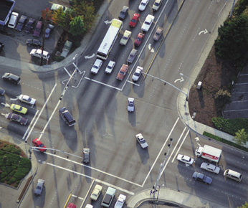
Traffic Control
Intersection
Approach
Too long….
Vehicle
Traffic Light
Too short….

Slide 13

TrafficView
: Controller

Slide 14
Outline
Scope
MANET and VANET
802.11p, DSRC and WAVE
Protocols in Vehicular Networks
Research Issues
Standard Projects

Slide 15
Mobile Ad Hoc Networks
Formed by wireless hosts which may be mobile
Without (necessarily) using a pre-existing infrastructure
Routes between nodes may potentially contain multiple hops

Slide 16
MANETs - I
May need to traverse multiple links to reach a destination
A
B

Slide 17
MANETs - II
Mobility causes route changes
A
B

Slide 18
Why MANETs ?
Ease of deployment
Speed of deployment
Decreased dependence on infrastructure

Slide 19
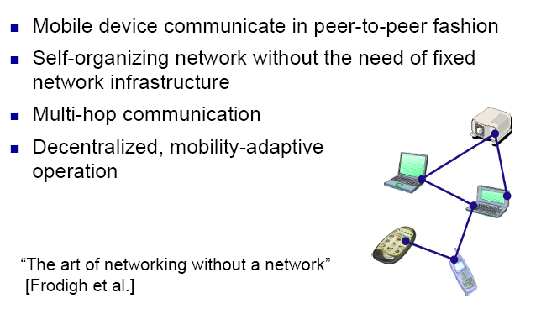
MANETs in Summary

Slide 20
VANET vs. MANET
VANET can be considered a subset of MANET
Nodes do not move in any random direction
Nodes are powered (energy not an issue)
    Node contact time is limited
    - Intermittent connectivity might occur
    Node speed is bounded
    - Mostly high speed, but occasionally slow moving

Slide 21
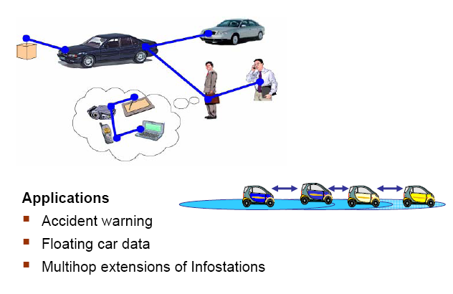
Applications: Vehicular Ad-hoc Network

Slide 22
Comparison of Different Schemes
 | DSRC/WAVE | Wi-Fi | Cellular | LTE and LTE-Adv
Data rate | 3-27Mbps | 6-54Mbps | < 2 Mbps | 1-32 Mbps
Latency | < 50ms | Seconds | Seconds | ?
Range | < 1km | < 100m | < 10km | < 15km
Mobility | > 60 mph | < 5mph | > 60 mph | > 60 mph
Nominal Bandwidth | 10MHz | 20MHz | < 3MHz | < 10MHz
Operating Band | 5.86-5.92GHz (ITS-RS) | 2.4GHz, 5.2GHz (ISM) | 800MHz, 1.9GHz | Evolving
IEEE std. | 802.11p (WAVE) | 802.11a | N/A | LTE-Ad

Slide 23
Outline
Scope
MANET and VANET
802.11p, DSRC and WAVE
Protocols in Vehicular Networks
Research Issues
Standard Project
Our Work

Slide 24
802.11p
WAVE (Wireless Access in Vehicular Environment)
Based on 802.11a
5.9GHz
Data rate: 6-27Mbps
Designed for general Internet access, can be used for ETC as well
7 licensed channels
Use open off-the-shelf chipset and software
Vehicle-to-roadside and vehicle-to-vehicle
Command-response and peer-to-peer
Critical Safety of Life
High Power Public Safety
Control Channel
Ch 172
Ch 174
Ch 176
Ch 178
Ch 180
Ch 182
Ch 184
5.850
5.860
5.870
5.880
5.890
5.900
5.910
5.920
Service Channels
Frequency (GHz)
Service Channels

Slide 25
WAVE
WAVE – Wireless Access in Vehicular Environment
Intended to support a full range of existing uses for IEEE 802.11p
Includes a number of new classes of applications
  roadway safety (vehicle collision avoidance)
  emergency services (police, ambulances, etc.)
New requirement in WAVE
  reliability of the data communications
  extremely low latencies required

Slide 26
DSRC
DSRC (dedicated short-range communication)
  Apply to many forms of short-range low-latency radio
  5.85 to 5.925GHz in North America
OBU: a device performs the functions of 802.11 station with additional WAVE functions
RSU: a device performs the functions of 802.11 access point with additional WAVE functions
WBSS (WAVE basic service set):
- Set of OBUs operating in WAVE mode by an RSU
WIBSS (WAVE independent basic service set):
- Set of OBUs operating in WAVE mode that forms a self-contained network

Slide 27
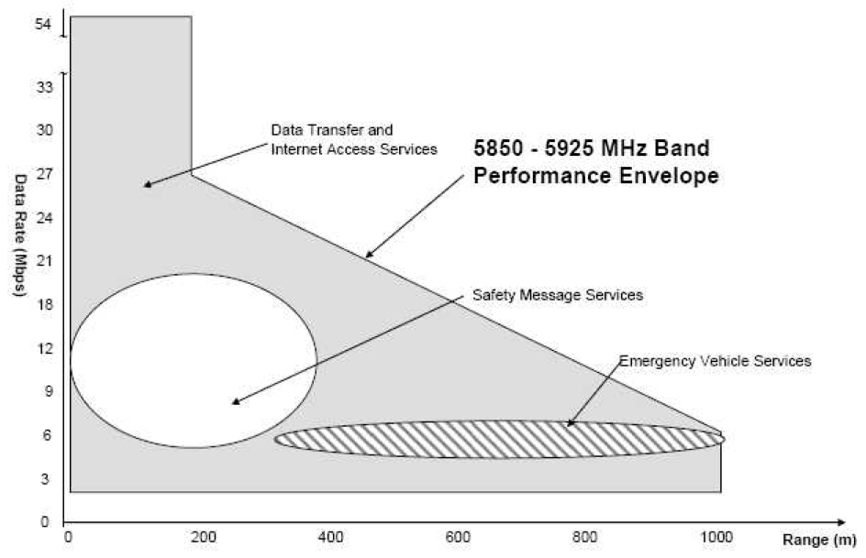
Multiple Applications over DSRC

Slide 28
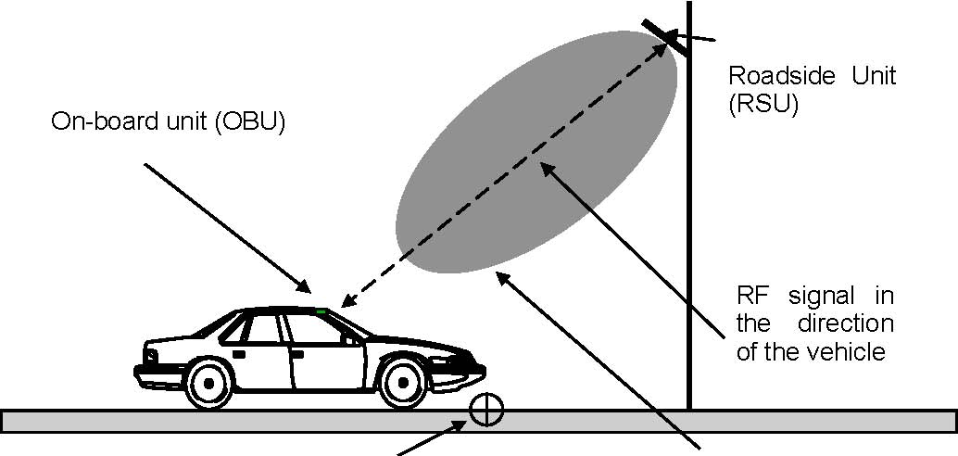
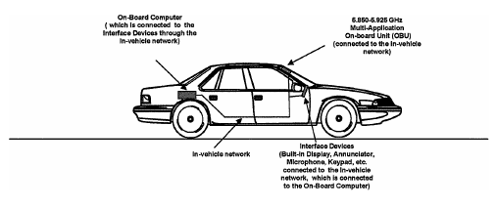
Power Control in DSRC
Pubic safety application are allowed higher power transmission than private application
The reference point for RF power is the center of front bumper of the vehicle

Slide 29
Outline
Scope
MANET and VANET
802.11p, DSRC and WAVE
Routing Protocol
Research Issues
Projects

Slide 30
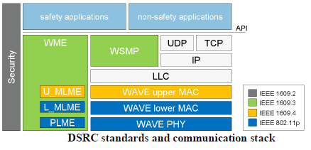

A wireless access in vehicular environment (WAVE) : 802.11p
  Intended to standardize DSRC (Dedicated Short Range Communications)
  Designed for general Internet access but not limited to
  Supports both vehicle-to-vehicle and roadside-to-vehicle communications

Slide 31
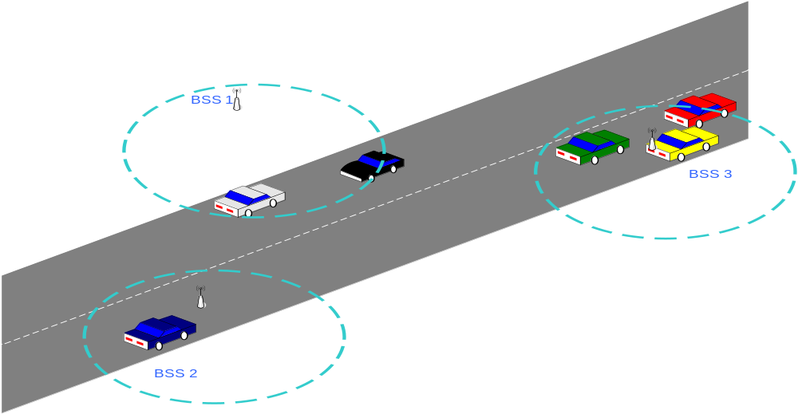
WAVE Configurations
Communication between RSUs and OBUs

Slide 32
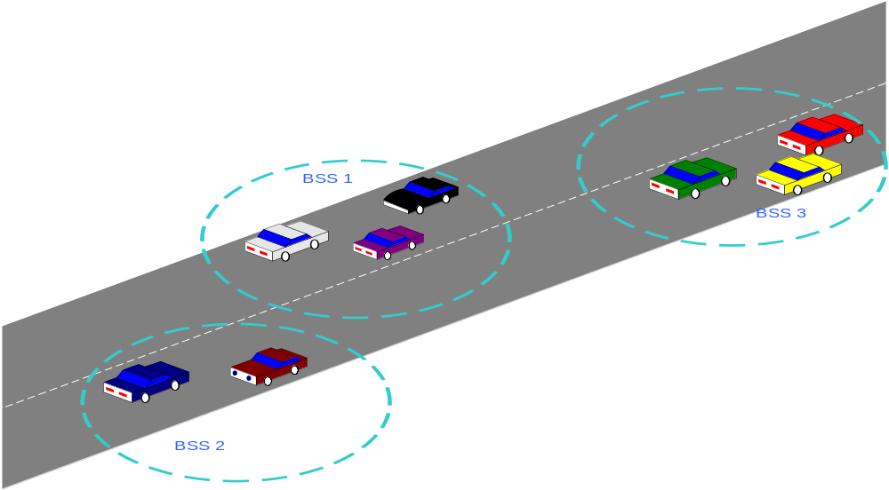
WAVE Configurations - II
Communication between OBUs only

Slide 33
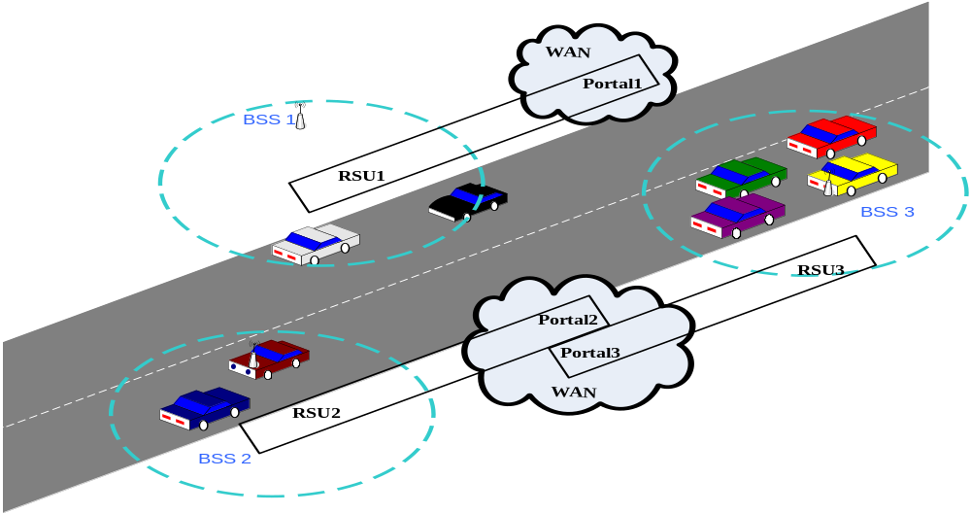
WAVE Configurations - III
Hybrid communication model – RSU to OBU and between OBUs

Slide 34
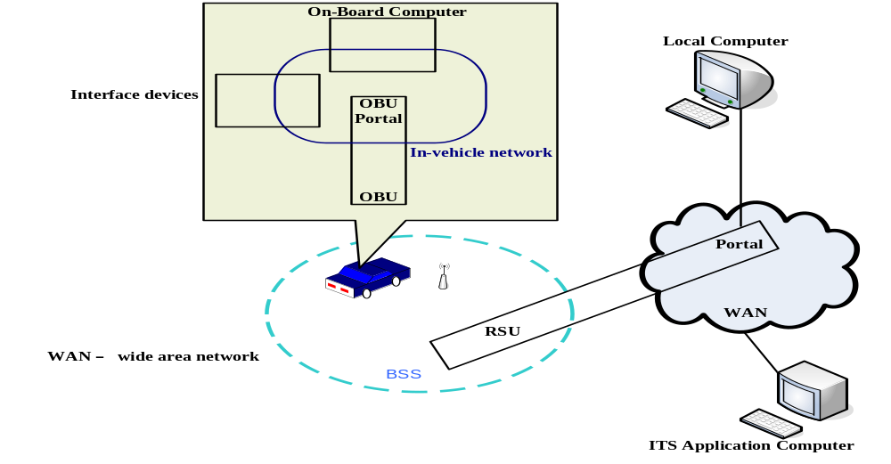
WAVE Configurations - IV
BSS Connects Onboard Computer Through the WAN to ITS Application

Slide 35
Channel Access
Control Channel
  used for broadcast transmissions and to establish communications.
Service Channels
  between Roadside Units
  between Onboard & Roadside
  between OBUs.
Only RSUs can broadcast on the Control Channel.
All IEEE 802.11 frame may be used on Service Channels.

Slide 36
Thank you

