Slide 1
Global Weather Trend Forecasting and Climate Analysis
Data Science - Technical Assessment
Rahul Pandey
Role Applied: Data Scientist
GitHub: github.com/rahul-9k
LinkedIn: linkedin.com/in/rahulpandey9k

Slide 2

PM Accelerator Mission
PM Accelerator focuses on providing training, education, and career opportunities for aspiring and experienced Product Managers.
Their mission is to make industry-leading tools, education, and AI-focused learning accessible to individuals from all backgrounds.
By creating access to industry leaders, practical experience, and the right professional ecosystem, PM Accelerator helps prepare future technology and product leaders.

Slide 3

Project Overview
Analyzed global weather and environmental data
Performed exploratory and advanced climate analysis
Built multiple forecasting models for temperature prediction
Conducted anomaly detection and spatial analysis
Compared forecasting performance using multiple metrics

Slide 4

Dataset Overview
Dataset: Global Weather Repository (Kaggle)
Total Records: ~140,000
Features: 50+ weather and environmental variables
Time Range: May 2024 – May 2026
Global coverage across multiple countries and cities
Feature Categories:
Weather Features: Temperature, Humidity, Wind, Pressure
Environmental Features: PM2.5, PM10, Ozone, CO
Geographical Features: Country, Latitude, Longitude
Temporal Features: Month, Season, Day, Hour

Slide 5
Data Cleaning and Preprocessing
Preprocessing Steps:
Checked missing values and duplicates
Converted timestamps into datetime format
Extracted temporal features
Performed outlier analysis
Created seasonal indicators
Generated lag and rolling features for forecasting
Key Insight:
Extreme environmental observations were retained because weather data naturally contains meaningful anomalies such as storms, pollution spikes, and heavy rainfall events.
Raw Data
Cleaning
Feature Engineering
EDA & Analysis
Forecasting Models

Slide 6
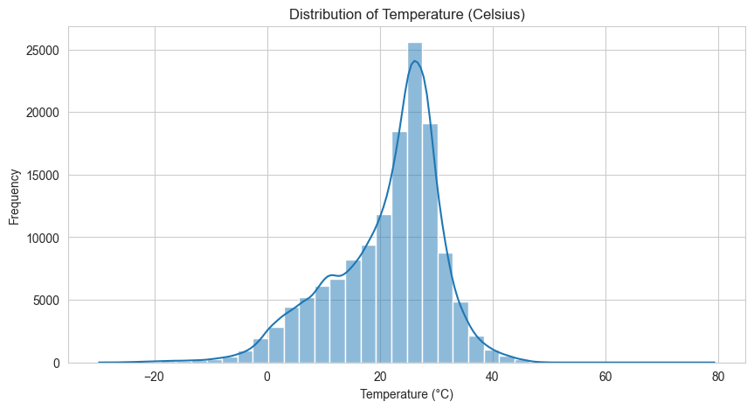
Temperature Distribution Analysis
Most temperature observations fall between 15°C and 30°C
Distribution shows moderate skewness
Extreme high and low temperatures are present
Global dataset captures diverse climatic conditions
Temperature variability supports forecasting analysis
Key Insight:
The dataset exhibits strong climatic diversity across global regions.

Slide 7
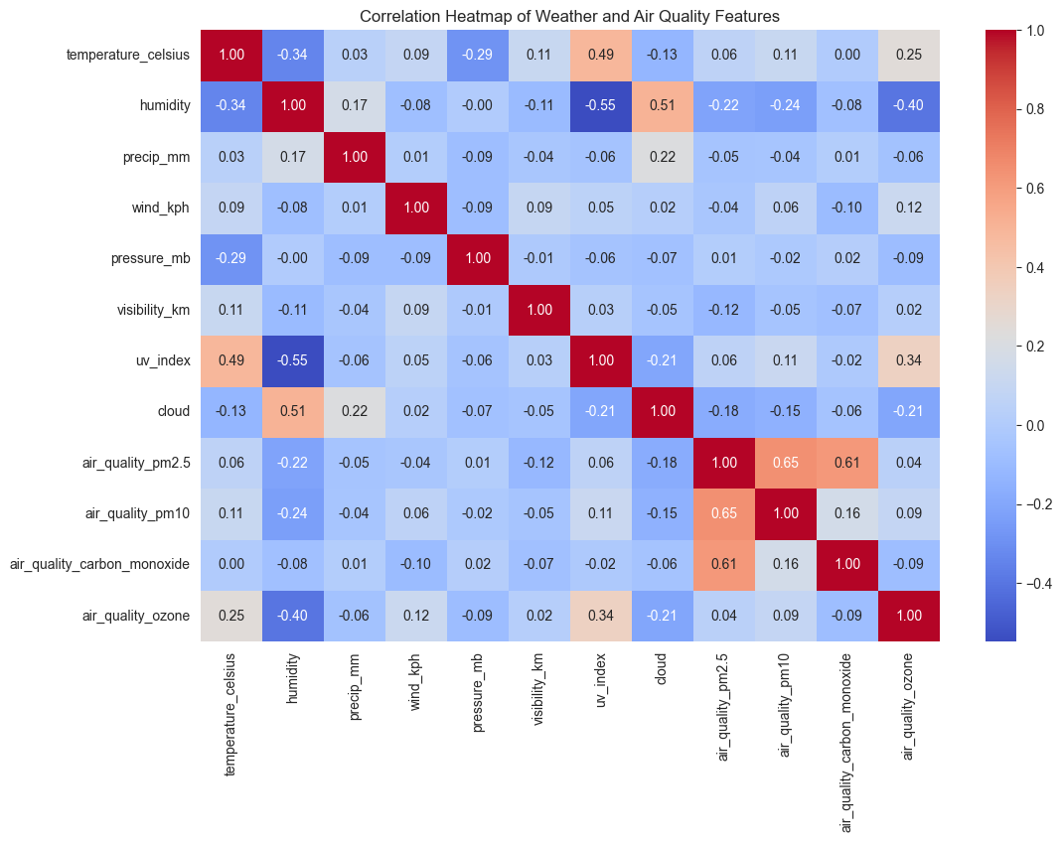
Correlation Analysis
PM2.5 and PM10 show strong positive correlation
Temperature positively correlates with UV Index
Humidity negatively correlates with UV exposure
Air quality indicators exhibit meaningful relationships
Weather and environmental variables are interconnected
Key Insight:
Environmental and atmospheric variables show meaningful interactions useful for forecasting and analysis.

Slide 8
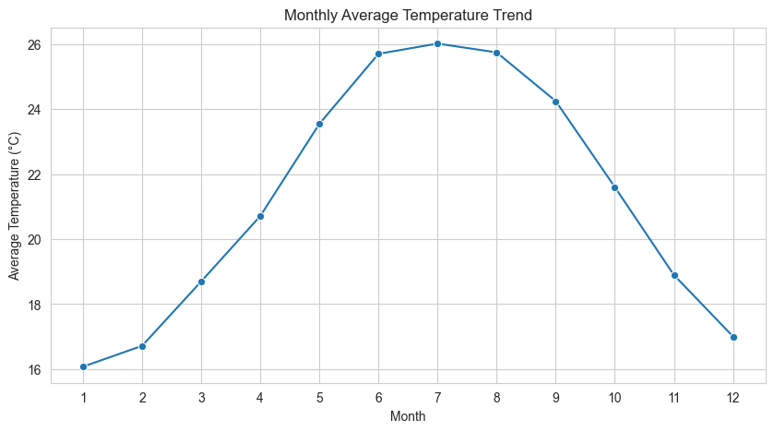
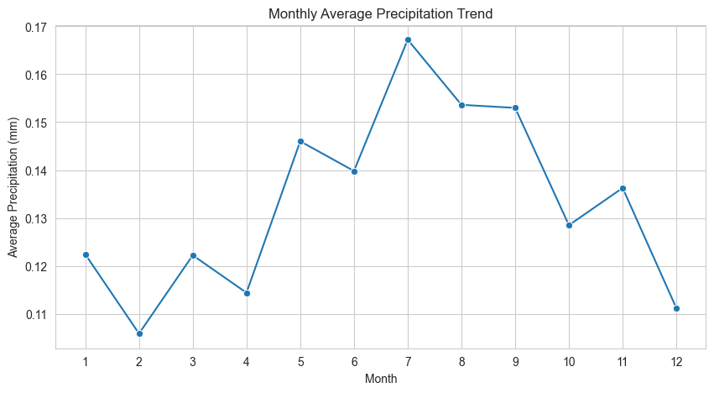
Monthly Temperature and Precipitation Trends
Temperature follows a clear seasonal cycle
Mid-year months exhibit peak temperatures
Precipitation patterns are more irregular
Seasonal rainfall patterns are visible
Temporal structure supports time-series forecasting

Slide 9
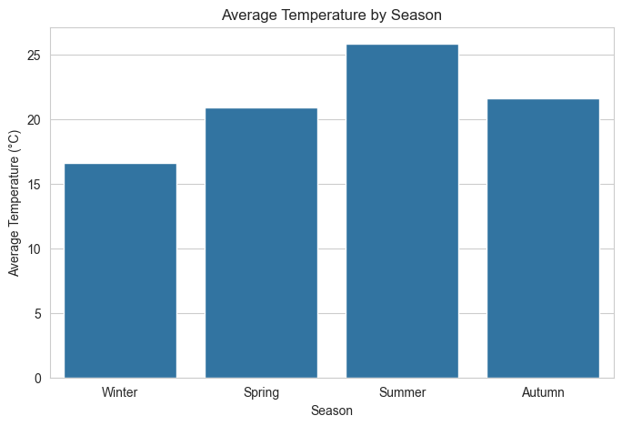
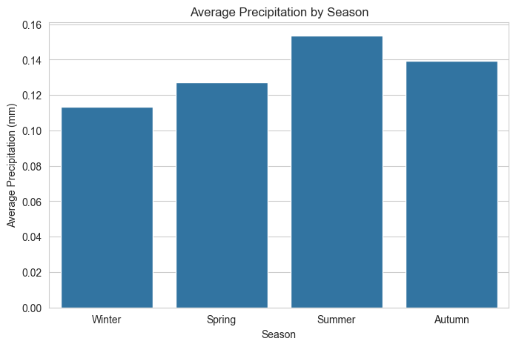
Seasonal Climate Analysis
Summer exhibits highest temperature and precipitation
Winter shows lowest temperature levels
Strong seasonal climatic variation is present
Seasonal trends confirm annual climate cycles
Seasonality is important for forecasting accuracy

Slide 10
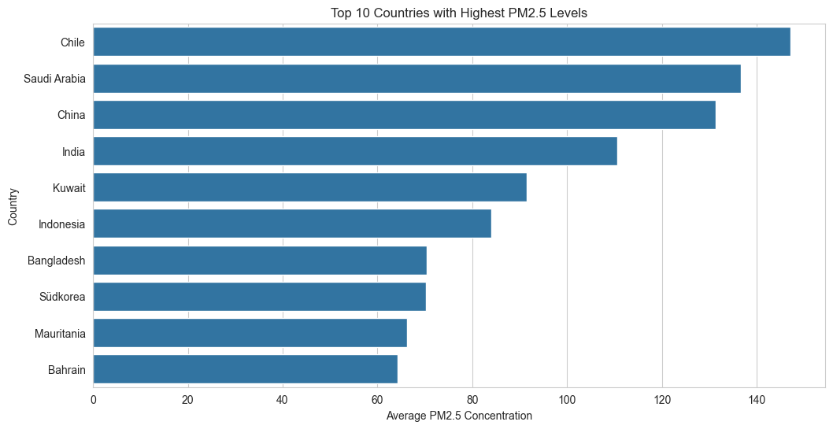
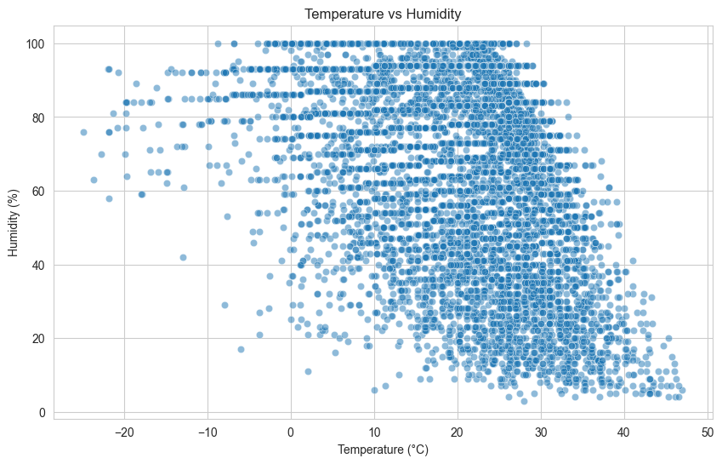
Environmental Impact Analysis
Significant variation exists in global PM2.5 levels
Several regions exhibit elevated pollution concentrations
Pollution indicators correlate with weather conditions
Air quality analysis provides environmental insights
Environmental variables contribute to forecasting behaviour

Slide 11
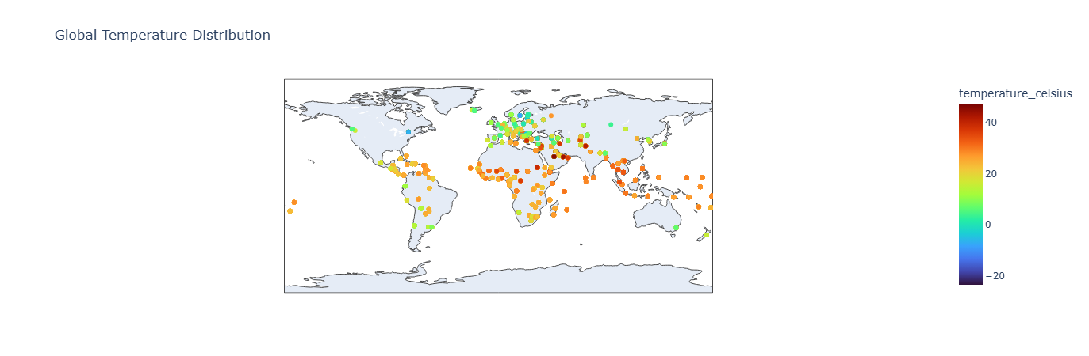
Geographical and Spatial Weather Analysis
Warmer regions cluster around tropical and desert areas
Cooler conditions appear at higher latitudes
Spatial weather patterns vary significantly worldwide
Geography strongly influences climatic behaviour
Spatial visualization improves regional climate understanding

Slide 12
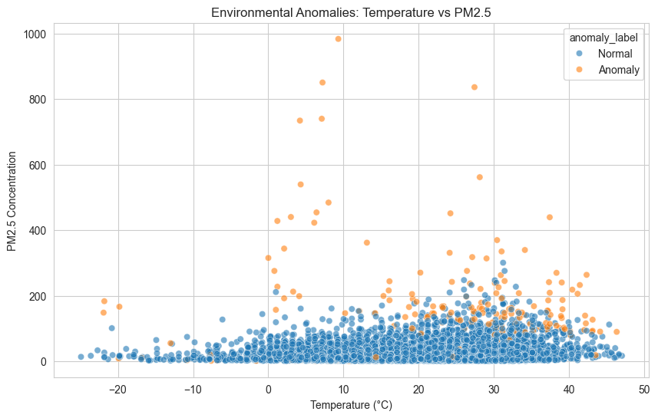
Environmental Anomaly Detection
Method Used: Isolation Forest
Features Used:
Temperature
Humidity
PM2.5
PM10
Pressure
Wind Speed

Slide 13
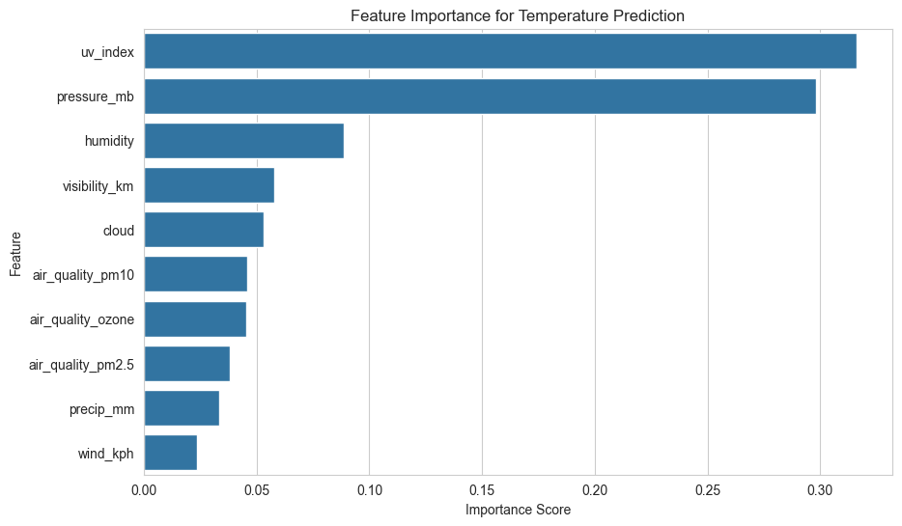
Feature Importance Analysis
UV Index was the strongest predictor
Pressure and humidity strongly influenced temperature
Visibility and cloud cover were significant
Environmental indicators contributed to prediction
Weather variables exhibit interconnected behavior

Slide 14
Forecasting Pipeline
Forecasting Target: Temperature (°C)
Forecasting Features:
Lag Features
Rolling Means
Month
Day of Year
Time-series forecasting was performed using chronologically ordered weather observations from Tokyo.
Tokyo Weather Data
Daily Aggregation
Feature Engineering (Lag + Rolling Features)
Train/Test Split
Forecasting Models
Evaluation & Comparison

Slide 15
Forecasting Models Implemented
Model | Purpose
Baseline Moving Average | Simple temporal benchmark
Random Forest Regressor | Nonlinear ML forecasting
XGBoost Regressor | Advanced boosting model
Ensemble Model | Combined multi-model prediction
Evaluation Metrics
MAE
RMSE
R² Score
MAPE
Multiple forecasting approaches were compared to evaluate predictive performance and robustness.

Slide 16
Forecasting Model Performance Comparison
Model | MAE | RMSE | R² | MAPE
Baseline | 2.47 | 3.00 | 0.67 | 18.66
Random Forest | 2.68 | 3.28 | 0.60 | 19.93
XGBoost | 2.79 | 3.51 | 0.54 | 21.11
Ensemble | 2.50 | 3.12 | 0.64 | 18.81
Insights:
Baseline model achieved best performance
Strong seasonality dominated the signal
Ensemble improved robustness over ML models
Simpler temporal methods performed effectively
Key Insight:
Strong temporal smoothness in the temperature series allowed simpler forecasting approaches to outperform more complex machine learning models.

Slide 17
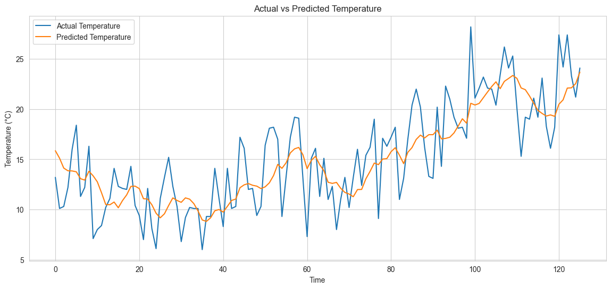
Actual vs Forecasted Temperature
Forecasted temperatures closely followed overall trends
Seasonal movement was captured effectively
Short-term fluctuations were partially captured
Forecasting results demonstrated strong temporal predictability

Slide 18
Key Insights and Learnings
Analytical Insights:
Global weather patterns exhibit strong seasonality
Environmental variables show meaningful correlations
Air quality indicators vary significantly across regions
Spatial analysis revealed geographical climate differences
Modelling Insights:
Time-series features improved forecasting capability
Isolation Forest effectively identified anomalies
Simpler forecasting models performed competitively
Ensemble methods improved prediction robustness

Slide 19
Thank You
Rahul Pandey
GitHub:
github.com/rahul-9k
LinkedIn:
linkedin.com/in/rahulpandey9k
Data Science Technical Assessment
PM Accelerator Internship Program

