Slide 1
CSCI 1300
Vectors
Nov 8th, 2021

Slide 2
Please use the github link for the programing examples and slides.
https://github.com/rahul-aedula95/CSCI-1300-Fall

Slide 3
Vectors
Sequence of values similar to arrays but have some useful properties.
Advantages:
They are of dynamic size, you can add and delete elements on demand unlike arrays which is fixed size.
Deallocation of array memory has to be done explicitly unlike vectors which are done automatically.
Arrays cannot be returned only referenced from a function, but vectors can be returned as values from a function.
The only thing different is how we initialize and insert values; rest works similar to arrays.

Slide 4
Vectors
Requires #include<vector>
syntax:
vector<type> variableName(sizeIfRequired)
example:
vector<int> v(10); // the data type has to be between < and >
You can create an empty vector:
vector<int> v;
Or fill it with values
vector<int> v = {10,20,30};

Slide 5
Some useful built in functions for vectors.
You may access elements exactly same as arrays. v[index]
push_back: element is added to the end of a vector
pop_back: element is removed from the end of a vector
clear: clears the vector
size: returns the size of the vector

Slide 6
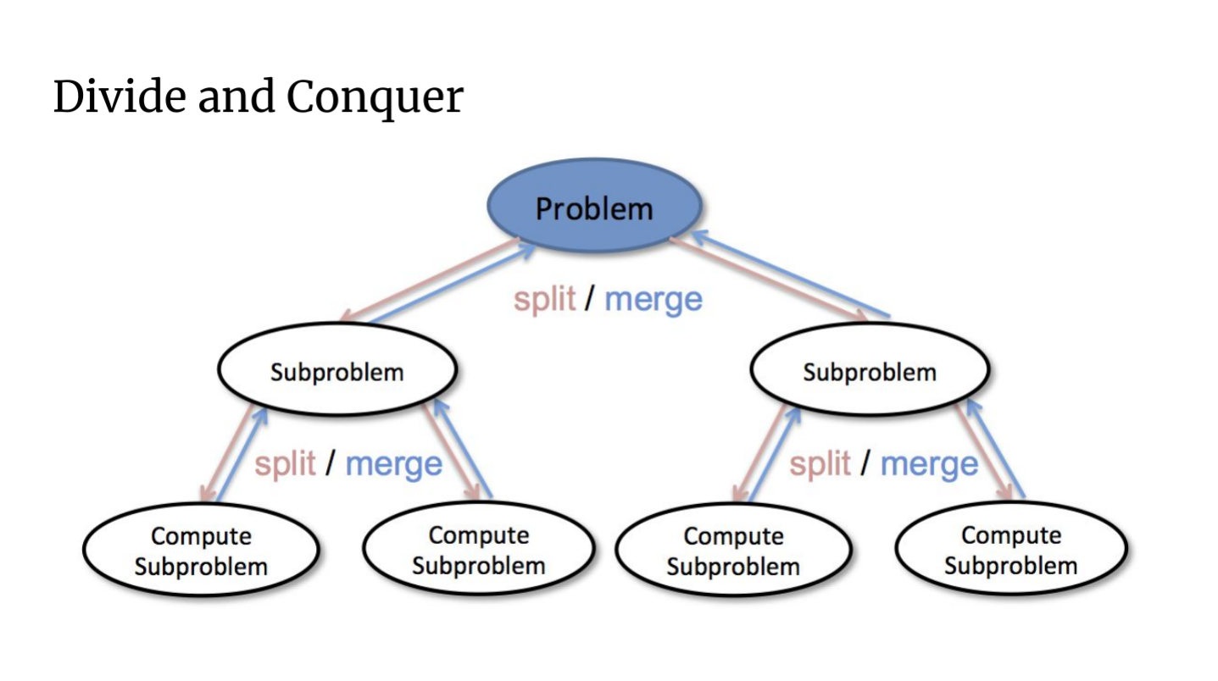
Recursion

Slide 7
Recursion
Break into subproblems
Solve sub problems recursively
Have a base case to assemble the solution together.
It is not the easiest solution to think of many times.
Almost always you can solve it with some iterative method.

