Slide 1
CSCI 1300
Setting up the environment
August 23rd, 2021

Slide 2
Introduction: Rahul Aedula
I’m a current CS PhD student at CU Boulder.
My work centers around applied machine learning.
Past TA experiences: 1300, 1320, 4253/5253 and 6502
Office hours: Please look at google calendar (subject to change)
Github link for recitation material: https://github.com/rahul-aedula95/CSCI-1300-Fall

Slide 3
Course and recitation expectations
Recitations will compose of two parts:
Lecture (which lasts for about 20 to 30 mins) which focuses more on the practical use of code.
Working session (for the remainder of the time) which focuses on solving the assignment or going through some examples.
Failing to attend recitations will incur a penalty of 30% on HW (unless it is an emergency or you have notified me in advance)
You will also have Problem sets (weekly homeworks) which is due on Sundays.
Please make sure to go through the syllabus.

Slide 4
Course and recitation expectations
Classroom Etiquette
In Person Section:
In person students, please always wear a mask in class (at least until a new policy is announced by the university)
To ensure safety and distancing during the work session please log in to the zoom link to receive help from me in private breakout rooms.
Remote section (If applicable):
Remote students please turn your cameras on if possible.
Since this is a Hybrid class, remote students please preferably use the chat to type your questions during the lecture portion of the recitation as audio will not be very clear. However during the work session you may all use your audio (we’ll see how this goes and make adjustments on the fly).

Slide 5
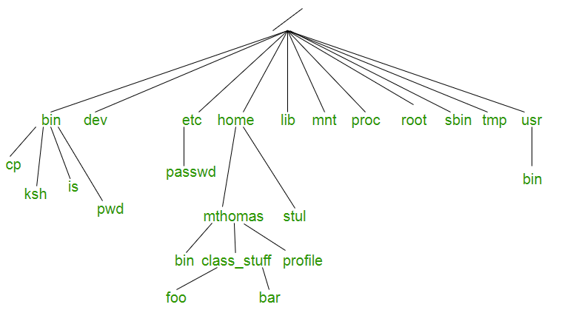
Introduction to UNIX
ref:Geeks for Geeks

Slide 6
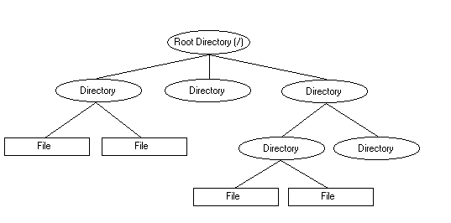
Introduction to UNIX

Slide 7
Unix terminal commands
Terminal commands tend to be faster than GUI (Graphical User Interface), so make it a habit of using them whenever possible.
pwd - print working directory - shows current location in the file structure of the terminal
ls - list files and directories in the present directory.
cd - change directory - changes location and moves down the file structure.
touch - creates a new file.
mv - move - moves a file to a certain destination described

Slide 8
Unix terminal commands
cp - copy - copies a file to a certain destination
rm - remove - permanently deletes a file from a certain location.
mkdir - make directory - creates a new directory
cat - concatenate - will append files together and can also make a new file.

Slide 9
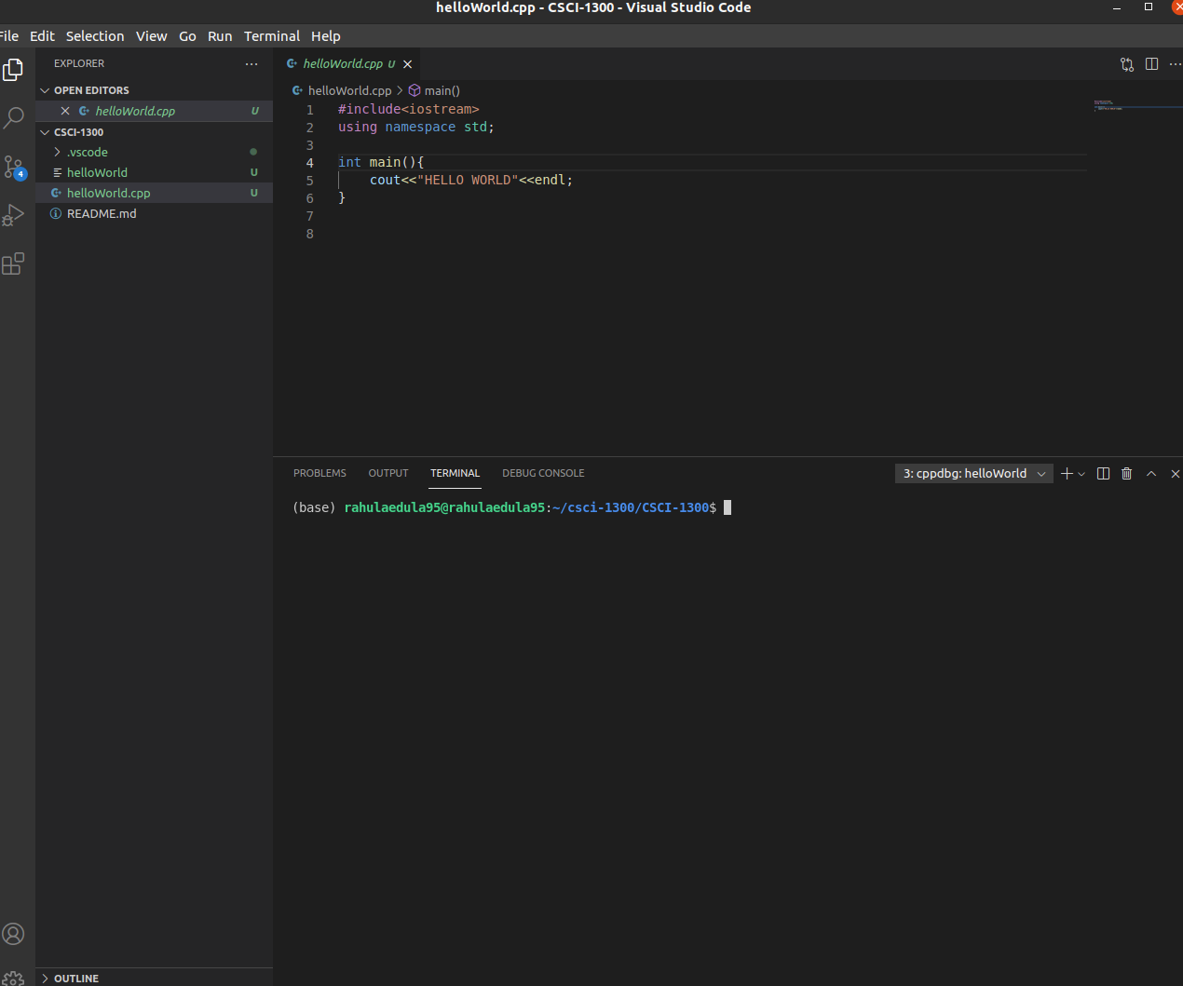
VS code editor

