Slide 1
CSCI 1300
Introduction to C++
Aug 30, 2021

Slide 2
Please use the github link for the programing examples and slides.
https://github.com/rahul-aedula95/CSCI-1300-Fall

Slide 3
Recap
What is a computer?
Electronic device that is programmable to solve problems
What is an operating system?
Software which takes care of basic functionality of the computer.
example: Windows, Unix, Linux etc
What is a Graphical User Interface (GUI)?
Way of interacting with the computer using graphical elements like mouse, icons etc.
What is a command line interface (CLI) (also known as terminal)?
Way of interacting with computer using text.

Slide 4
Algorithm vs Pseudocode
Algorithm : Sequential steps which solves the problem within finite time using finite resources.
Pseudocode: Informal way of writing code (in english) that highlights the key elements but leaves the implementation.
It is independent of the language you use.
Refer to the pseudo code document in our github under week 2

Slide 5
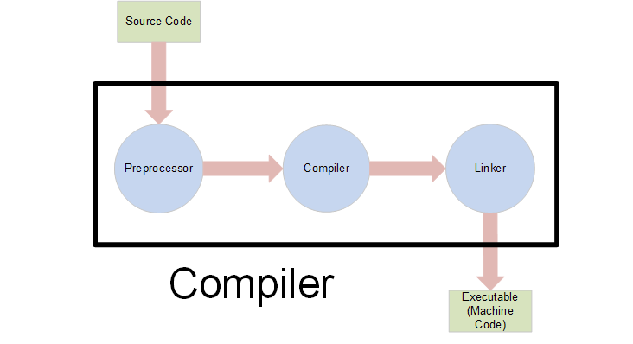
Compilation flow of a C++ program

Slide 6
Compilation flow of a C++ program
Source code - This is the C++ program file written by you. They have file extension of (.cpp) which stands for c++.
Preprocessor - Removes all the preprocessor directives (which are just statements referring to other snippets of code which get used in the program) and returns a c++ file.
Compiler - Goes through line by line to check for errors and converts the c++ you wrote into machine code.
Linker - creates a single executable file that can be used to run.
Note: This is an advanced subject in itself, however I wanted you to know the gist of it.

Slide 7
Key components of C++
Preprocessor directives - gives instruction to the preprocessor perform a certain task.
Most common one we use is #include which tells the preprocessor to include snippets of code from somewhere else.
#define is a also a common one which can be used to replace values inside variables (we will talk about this at a later point)
Namespaces - used to avoid variables with same name. Creates a profile as such. We will primarily be using the namespace std.
main function - The first function to be looked at when compilation of a file begins. (We will also talk more about functions at a later point)
; (semicolon) used to indicate the end of a statement ( with a few exceptions)
{ (curly brackets are used to signify scope)

Slide 8
Output in a C++ program
Let us to refer helloWorld.cpp program in our week 2 github page.
Output:
The purpose of having outputs is so that we can send messages to the so called user of the program ( we will refer to this as user).
In c++ the most common way of sending standard output to your unix terminal is to use the statement cout which is a part of the std namespace.
Syntax: cout << “ Message you want to send to terminal inside quotes” << endl;
endl here is end line

Slide 9
Variables in a c++ program
Let us to refer example2.cpp and example 3.cpp program in our week 2 github page.
Think of them as named memory locations which can hold value based on a certain type.
C++ is an older language so what type of value a variable can hold should be explicitly mentioned.
These are the few common types which are used, there are more which I haven’t mentioned
int - integer numbers
char - characters like letters
float - numbers which have decimal
double - same as float but can store bigger numbers.
We can perform numerous operations on them.

