Slide 1


Cryptocurrency trend Analysis And Forecasting
Marathwada Mitra Mandal College of Engineering
Department of Computer Engineering
By,
Rahul Agrawal
Shreyash Arali
Prathamesh Chatala
With Guidance From ,
Mrs. Girija Chiddarwar

Slide 2
Problem Statement
Analyse and Visualize trends based on past prices
Predict Future Performance
Using ARIMA

Slide 3
Introduction
rapid development of digital currencies every year
Most of the people thinks crypto as an investment
Introduction to WEB 3.0 and Metaverse

Slide 4
Requirements
Hardware having 4 GB of RAM and 64 GB ROM , Active internet connection
Python with V3.8 or greater

Slide 5
About Dataset
Yfinance
Request
Response
pandas Data Frame consist of data
API from Yahoo Finance
interval
ticker
start and end date

Slide 6
Libraries requirement
Yfinance
For data collection
Pandas
For Data processing
Seaborn And MatplotLib
For Data Visualization
StreamLit
For Dashboard
BeautiFulSoup and request
For Web Scraping

Slide 7




Working Methodology
Yahoo server
API Request
API Response
Input parameters
Compute
Web Page with desired Output

Slide 8
About ARIMA
Stands For Autoregressive Integrated Moving Average
statistical analysis model that uses time series data to predict future trends
Also Known As ARIMA(p,d,q)
p is number of autoregressive terms
d is the number of term differences needed for stationarity
q is the number of lagged forecast errors in the prediction equation

Slide 9
Actual Output Screenshots

Slide 10
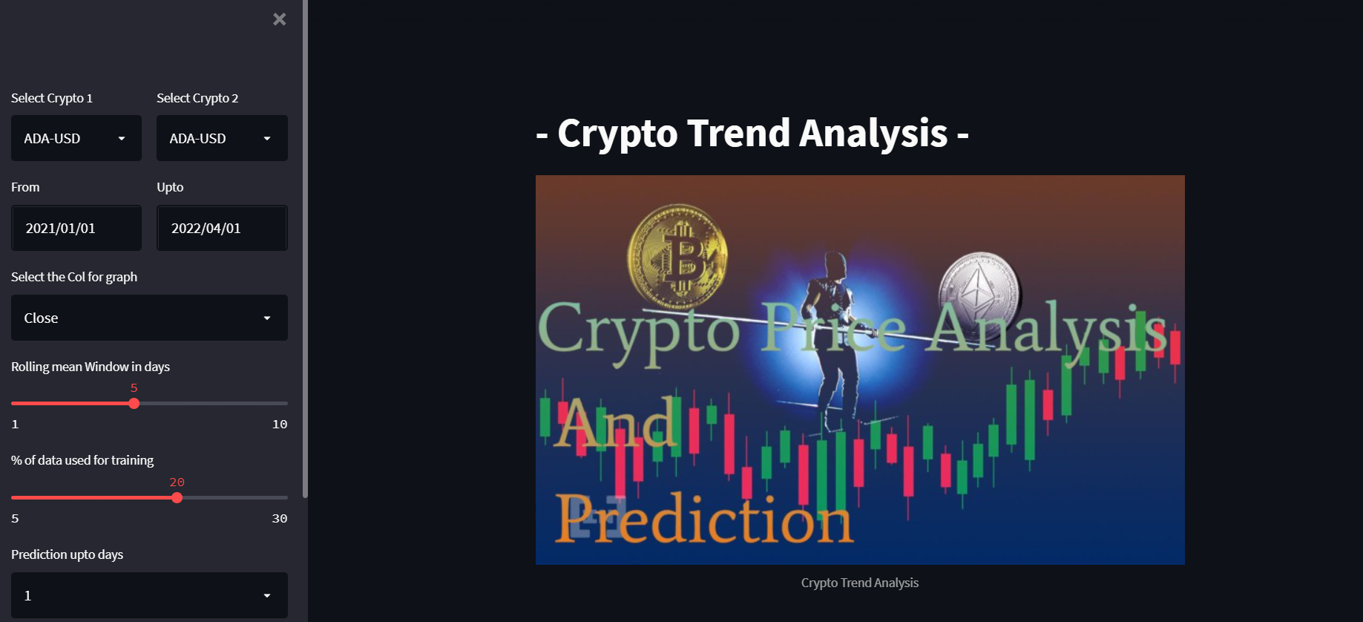
Input Sidebar

Slide 11
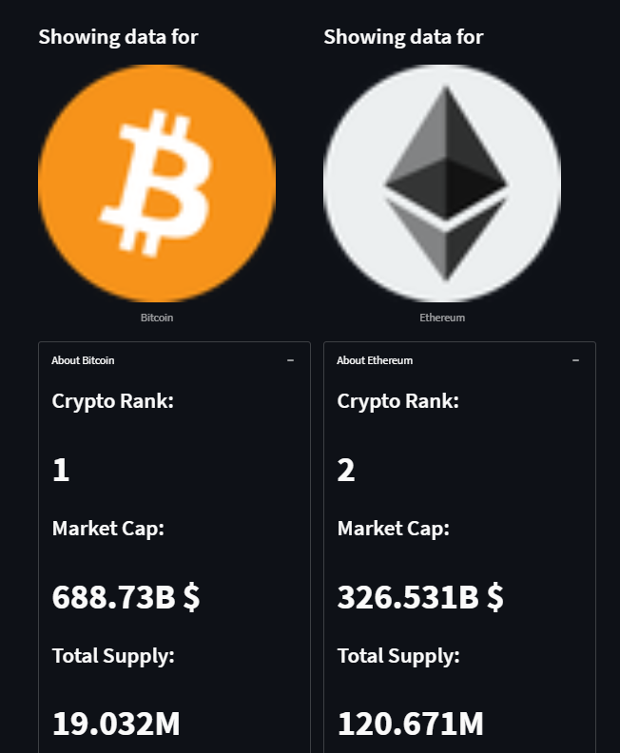
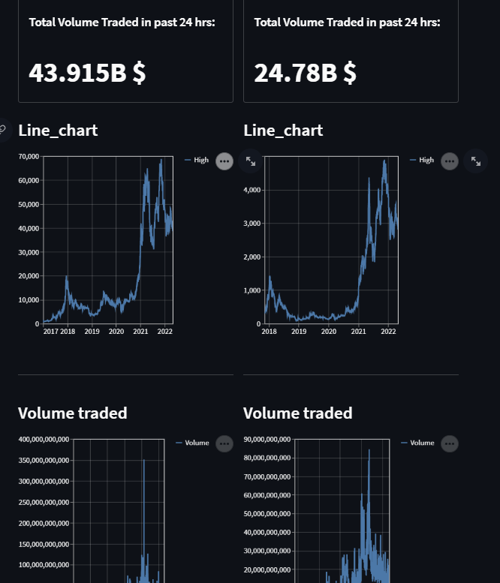
Visualization

Slide 12
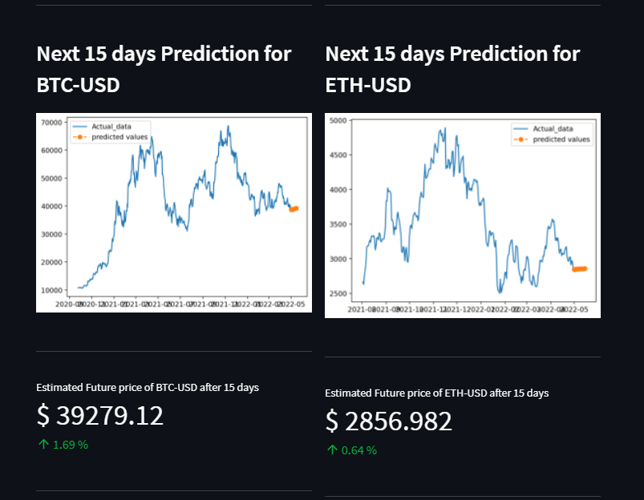
Prediction

Slide 13
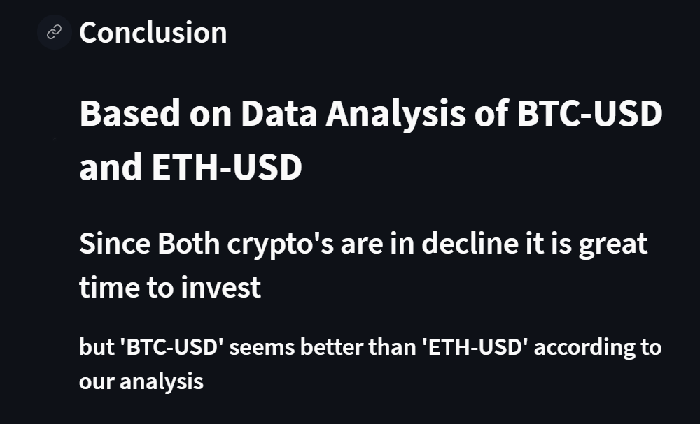
Suggestion based on past and future values

Slide 14
Real Life Applications
Comparison based analysis
prediction with good accuracy
Learning platform for beginner's

Slide 15
Future Work
Adding more crypto options
More Visualization techniques
Live predictive Analysis
Options for Share market stocks

