Slide 1
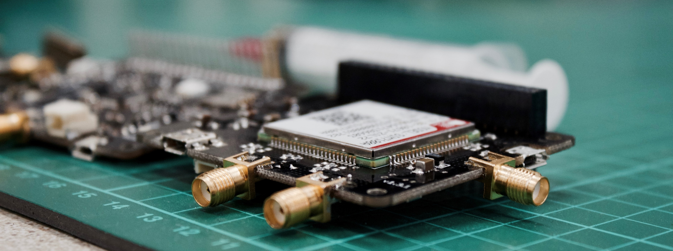
Smart Plantation Monitoring System
By:
Manvith Rai G : 4NM19CS410
Prateek Bhat : 4NM19CS411
Rahul : 4NM19CS412

Slide 2

Functional Requirement To Working
Soil moisture sensor is required for sensing the moisture content in the soil
sensor=analogRead(A0);
When moisture is low an appropriate notification will be sent to the user’s application
if (sensorState == 1 && lastState == 0) {
Blynk.notify("Water your plants"); }
Rain detector sensor is required for detecting the rain
rainState = digitalRead(rainPin);
When rain is detected an appropriate notification will be sent to the user’s application
if (rainState == 0 && lastRainState == 0) {
Blynk.notify("Its Raining!"); }

Slide 3
Functional Requirement To Working
PIR Motion sensor is required to detect motion in the field and when the motion is detected an appropriate notification will be sent to the user’s application
if (pirValue) {
Blynk.notify("Motion detected"); }
Temperature and humidity sensor is required to know about the current temperature and humidity. This data will be sent to user’s application
float h = dht.readHumidity();
float t = dht.readTemperature();

Slide 4
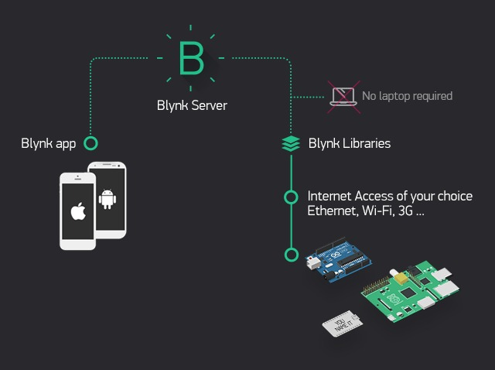
Functional Requirement To Working
The Relay module is required to turn ON/OFF the solenoid valve
ESP8266 Wi-Fi Module is required to connect the hardware to blynk android application using the blynk libraries
char auth[] = "";
char ssid[] = “wifi1";
char pass[] = “12345";
Notification
Blynk.notify(“Notification");
To display value in the app
Blynk.virtualWrite(Virtualpin,sensor);

Slide 5
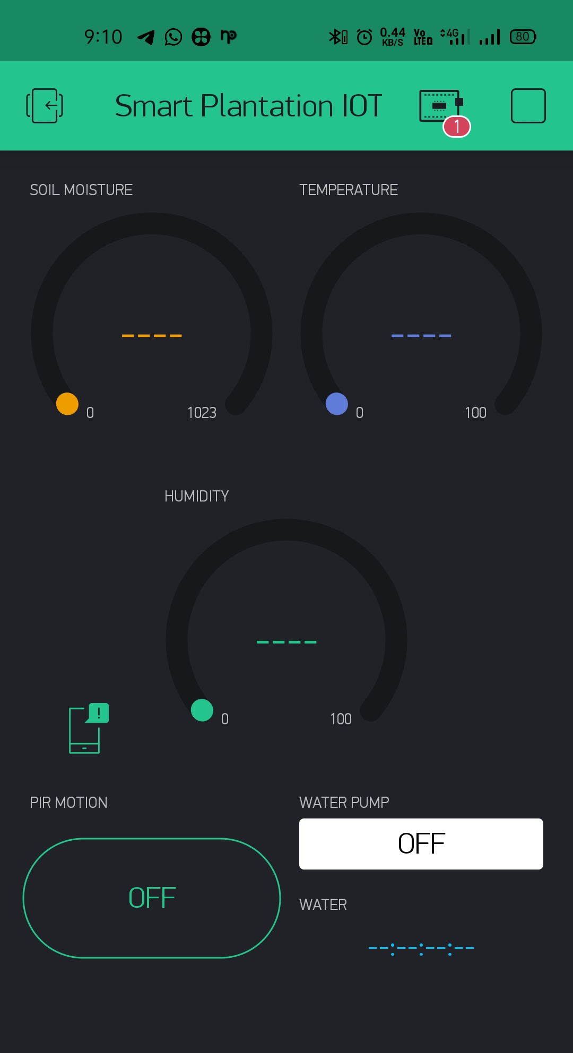
User Interface

Slide 6
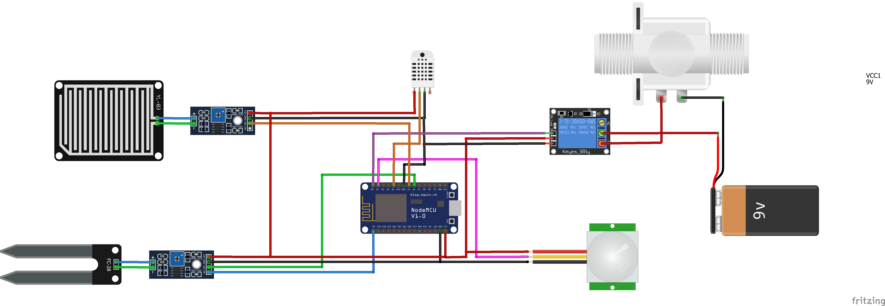
Circuit Diagram

Slide 7
Future Enhancement
Using a solar panel for the power consumption of the system so that the system is going to be eco-friendly
Based on the soil moisture value the functioning of the pump can be done automatically

Slide 8
THANK YOU

