Slide 1
Capstone Project
Student Performance Using Machine Learning
Comprehensive Analysis And Model Development
- Presented by Rahul Bhutekar, Data Science Enthusiast

Slide 2
Introduction
Overview of the project: Develop predictive models to forecast students' final grades based on given features. Importance of the Student Performance Machine Learning Model:
Personalized education: By understanding the factors that influence student performance, educators can tailor teaching methods and interventions to meet individual student needs, leading to more effective education strategies.
Early intervention: Identifying students at risk of poor performance allows for timely interventions, such as tutoring or counseling, to help them improve and succeed academically.
Resource allocation: Schools and policymakers can allocate resources more efficiently by focusing on areas that significantly impact student performance, such as additional support for students with specific needs.
Policy making: Insights gained from the model can inform educational policies and programs designed to enhance overall student performance and reduce dropout rates.
Parental involvement: Understanding the influence of parental background and involvement can encourage more effective parental engagement in their children's education.
Objective: To develop a machine learning regression model that accurately predicts student's final grades (G3) based on various features related to their personal, familial, and academic backgrounds.

Slide 3
Data Collection
Source of data:
The dataset is from the UCI machine learning repository and is commonly referred to as the "Student Performance" dataset. It was created by Paulo Cortez and Alice Silva and is publicly available for educational and research purposes.
Link to the dataset: UCI Student Performance Dataset
Data Description:
The dataset includes various attributes related to student performance in secondary education (high school) in Portugal. There are two datasets available: one for students of a math course and one for a Portuguese language course. Both datasets have the same features but different target variables (G3 - final grade in math or Portuguese).

Slide 4
Exploratory Data Analysis (EDA) AND Preprocessing
The data consists of following types:
16 features with integer(int64) data type
17 features with object data type
memory used by the data is 167.4+ KB
Encode categorical values
For Mjob, Fjob feature we have used label encoder.
For rest of the categorical features we have used python map() function

Slide 5
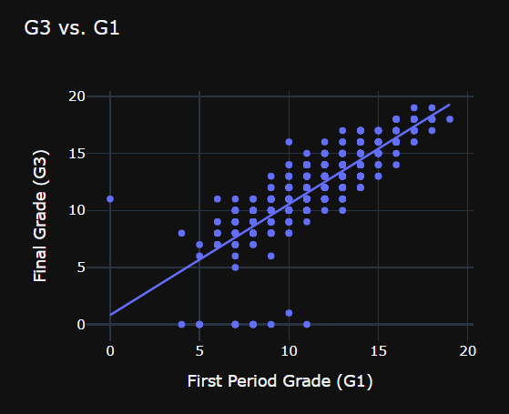
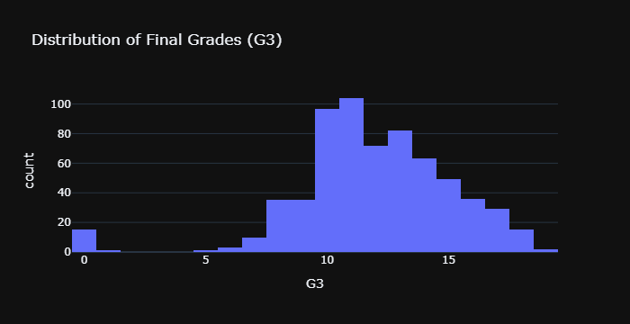
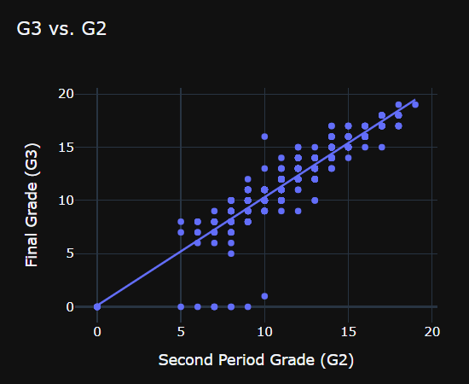
Data Visualization

Slide 6
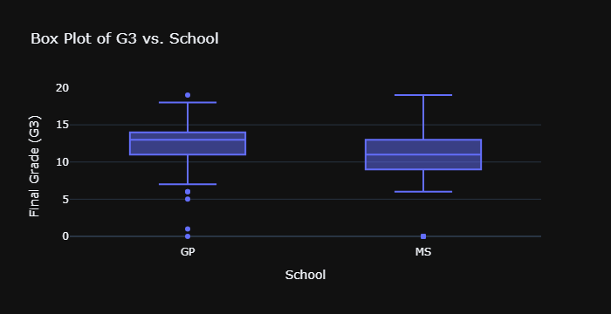
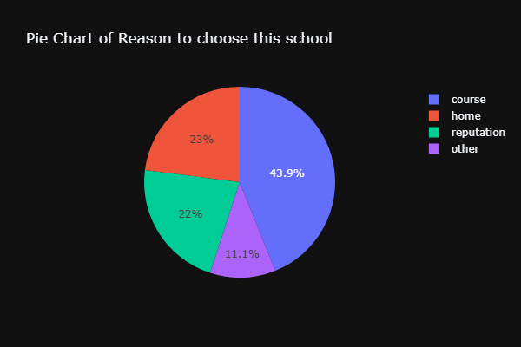
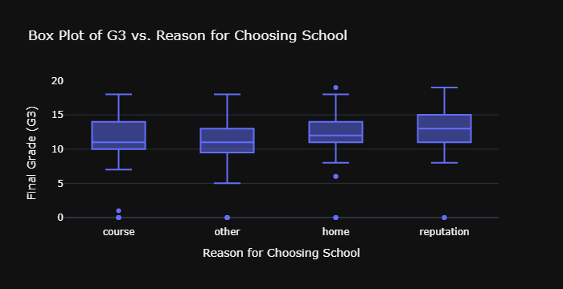

Slide 7
Machine Learning Models
List of different models tried
Linear Regression - A linear approach to modeling the relationship between a dependent variable and one or more independent variables by fitting a linear equation to observed data.
Decision Tree Regressor - A non-linear model that predicts the target value by learning simple decision rules inferred from the data features.
Random Forest Regressor - An ensemble learning method that combines multiple decision trees to improve predictive accuracy and control overfitting by averaging their predictions.
Gradient Boosting Regressor - An ensemble technique that builds models sequentially, with each new model correcting the errors of the previous ones to optimize performance.
Support Vector Regressor - A type of support vector machine (SVM) that finds a hyperplane in a high-dimensional space to predict continuous outcomes, balancing model complexity and prediction error.
Approach:
Exploratory Data Analysis, Data Preprocessing.
Hyperparameter tuning using GridSearchCV.
Evaluation of model performance on test data.

Slide 8
Model Performance and Evaluation
Performance metrics: Mean Square Error, Mean Absolute Error, R-Square Error.
Comparison of models:
We have tried multiple ML models, as listed in the previous slide. Out of those, the following two models have performed the best:
Linear Regession with default parameters
SVR with hyperparameter tuning (using GPU)
Final chosen model and reasons for selection: upon evaluating the attached performance reports, we observed:
Linear Regression is the best model as it has the
Lowest Mean Squared Error (MSE),
A relatively low Mean Absolute Error (MAE), and
The highest R-squared (R²) value.

Slide 9
Conclusion and Future Work
Summary of findings
During the training of various models for this problem statement, we observed that:
Hyperparameter tuning does not always result in a model with higher accuracy.
Models trained using NVIDIA Rapid’s significantly reduce training time.
Benefits of the model
Early Identification of At-Risk Students
Personalized Education Plans
Resource Allocation
Policy and Decision Making
Parental Engagement
Continuous Improvement
Future improvements and next steps
Implement a feedback loop where predictions are monitored and compared to actual outcomes. Use this feedback to continually refine and improve the model.
Continuously update the model with new data to keep it relevant and accurate. This could include new student cohorts or additional features that become available over time.
Notes:
Early Identification of At-Risk Students:
The model can help identify students who are likely to struggle academically. This allows for early interventions, such as additional tutoring, counseling, or parental involvement, to help improve their performance.
Personalized Education Plans:
By understanding the factors that most influence student performance, educators can create personalized education plans that cater to individual student needs, optimizing their learning experience and outcomes.
Resource Allocation:
Schools can use the model's insights to allocate resources more effectively. For example, they can prioritize extra support for students who are predicted to perform poorly, ensuring that help is directed where it is most needed.
Policy and Decision Making:
The model can provide data-driven insights that inform school policies and decisions. For instance, understanding the impact of extracurricular activities or internet access on student performance can guide policy adjustments.
Parental Engagement:
The model's predictions can be shared with parents to keep them informed about their child's potential academic trajectory. This can encourage greater parental involvement and support at home.
Continuous Improvement:
Schools can continuously improve their teaching methods and programs by analyzing which factors most significantly affect student performance and adjusting their strategies accordingly.

