Slide 1
Capstone Project
Credit Card Fraud Transaction Detection Using Machine Learning
Comprehensive Analysis And Model Development
- Presented by Rahul Bhutekar, Data Scientist Enthusiast

Slide 2
Introduction
Overview of the project:
Develop a machine learning model for credit card transaction fraud detection using historical transaction data.
Importance of detecting credit card fraud:
Credit card fraud leads to significant financial losses for both consumers and financial institutions.
Fraudulent transactions can severely impact consumer trust in financial institutions. Quick detection and prevention of fraud can enhance customer satisfaction and trust.
Objective:
To develop A machine learning model that can accurately detect fraudulent credit card transactions.

Slide 3
Data Collection
Sources of data:
The data is been collected from the kaggle. Please click here for the source of the data.
Types of data collected:
The data is available in two sets (fraudtest and fraudtrain) of csv file.
Volume and timeframe of data:
Both the files consists of 23 features.
Fraudtest.csv is of size 150.35 MB, having 555719
Fraudtrain.csv is of size 351.24 MB, having 1296675 rows
Key features: merchant, category, amt, city, state, zip, mechant_lat, merchant_long, is_fraud

Slide 4
Preprocessing and Exploratory Data Analysis (EDA)
The data consists of following types:
11 integers/float
12 objects
0 null values
Out of 23 features we will be using 8 key features - merchant, category, amt, city, state, zip, merchant_lat, merchant_long, is_fraud.
Encode categorical values
For merchant feature we have used target_encode because of high-cardinality.
For category, city, state we have used label encoder.

Slide 5
The training dataset is imbalanced. We have 1,289,169 non-fraudulent transactions and only 7,506 fraudulent transactions.
To address this, we have used a combination of Synthetic Minority Over-sampling Technique (SMOTE) and Edited Nearest Neighbors (ENN), which is known as SMOTEENN.
SMOTEENN helps balance the dataset by generating synthetic samples for the minority class and then cleaning the dataset by removing samples that are difficult to classify.

Slide 6
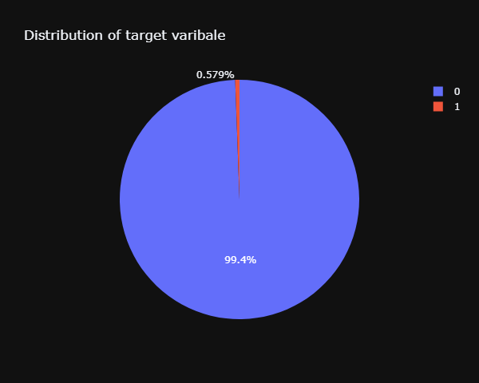
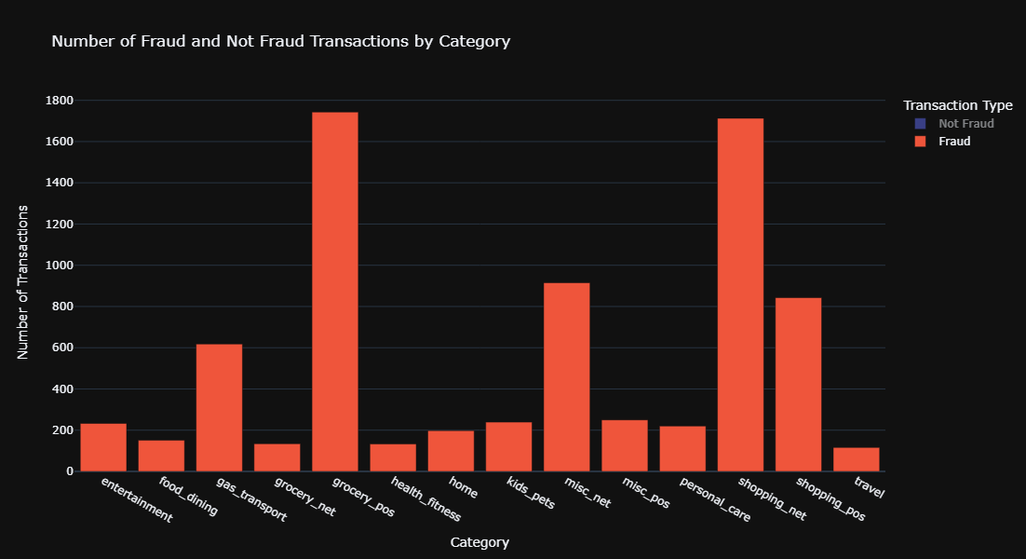
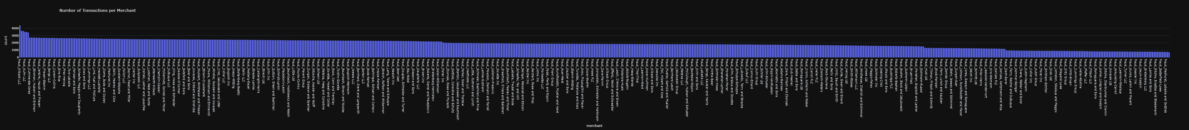
Data Visualization

Slide 7
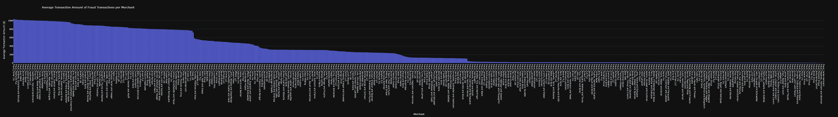
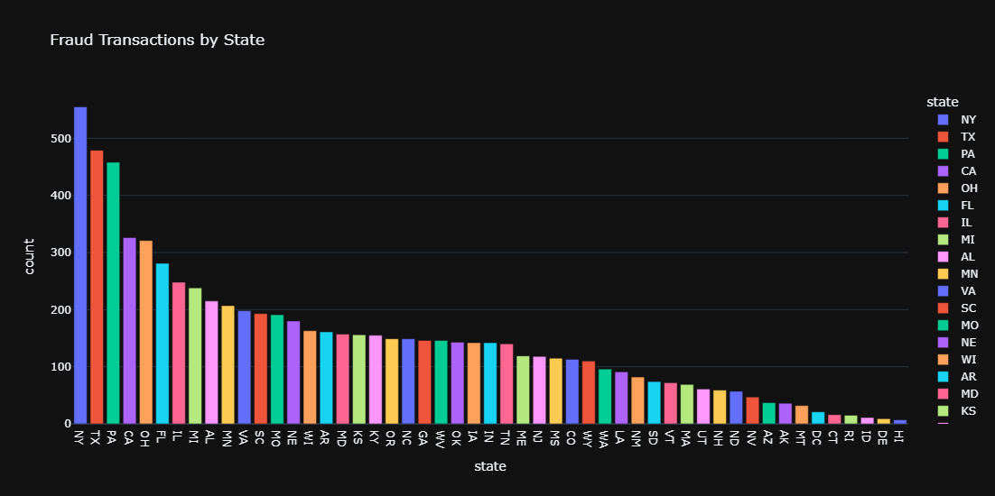
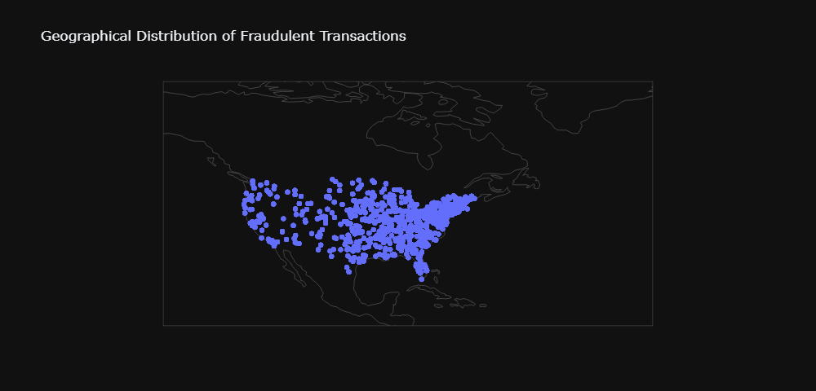

Slide 8
Machine Learning Models
List of different models tried
Logistic Regression - A linear model used for binary classification that estimates the probability of A binary outcome based on one or more predictor variables
Decision Tree - A predictive model that uses A tree-like structure of decisions and their possible consequences
Random Forest - an ensemble learning method that uses multiple decision trees to improve predictive performance and control overfitting.
Gradient Boosting Machine - an ensemble technique that builds models sequentially, each one correcting errors of the previous one, to improve accuracy.
Xgboost - an optimized gradient boosting library designed for speed and performance, widely used for structured or tabular data.
Approach:
Data preprocessing and normalization using MinMaxscaler
Hyperparameter tuning using GridSearchCV
Evaluation of model performance on test data

Slide 9
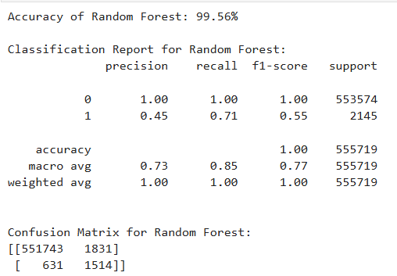
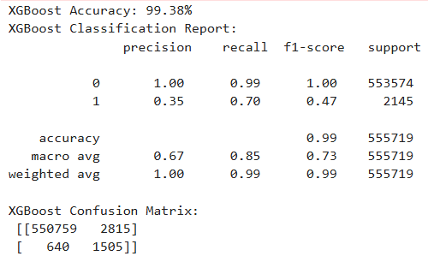
Model Performance and Evaluation
Performance metrics: accuracy score, classification report, and confusion matrix.
Comparison of models:
We have tried multiple ML models, as listed in the previous slide. Out of those, the following two models have performed the best:
Random Forest with default parameters
XGBoost with hyperparameter tuning (using GPU)
Final chosen model and reasons for selection: upon evaluating the attached performance reports, we observed:
An accuracy score of 99.56%
The least number of missed fraudulent transactions (fns), which is crucial for minimizing financial losses
A lower number of legitimate transactions flagged as fraud (fps), enhancing customer experience and reducing operational costs.
Based on these evaluations, we can conclude that the Random Forest model with default parameters is the most accurate and suitable model for this ML classification problem.

Slide 10
Challenges and Solutions
Challenges faced
Upload & fetch data from A remote SQL server
Computation time
Solutions implemented
Used neon.tech for uploading and fetching the data from the PostgreSQL database.
To decrease the computation time installed NVIDIA Rapids library which enables us to use the GPU instead of CPU for machine learning model.
Key learnings and takeaways
Neon.Tech provides a robust platform for managing PostgreSQL databases, offering features that streamline the process of uploading and fetching data.
Large-scale machine learning tasks, such as training models on millions of rows, can be computationally intensive and time-consuming, especially when using traditional CPU-based processing.
Integrating GPU-based processing through libraries like NVIDIA Rapids can lead to significant improvements in performance

Slide 11
Conclusion and Future Work
Summary of findings
During the training of various models for this problem statement, we observed that:
- Hyperparameter tuning does not always result in a model with higher accuracy.
- Models trained using GPU’s can significantly reduce training time. However, the trained models can sometimes decrease their efficiency/performance.
Benefits of the model to the client
- The trained model will serve as an effective tool for detecting fraudulent credit card transactions in real-time, thereby preventing financial losses and enhancing security for both the credit card company and its customers.
- By accurately identifying fraudulent transactions, the model can trigger alerts or take preventive actions to mitigate potential risks.
Future improvements and next steps
- This model will be continuously monitored and updated with new data to ensure its performance and adaptability to emerging fraud patterns.

