Slide 1
PROJECT NAME-Generation of a closed isothetic polygon with minimum cost
MENTOR-Apurba Sarkar,Lecturer,Department of Computer Science and Technology,Bengal Engineering and Science University,Shibpur.

Slide 2
TEAM MEMBERS:
Rahul Chowdhury(exam roll-111205007)
Shreyasee De(exam roll-111205027)
Siddharth Kumar(exam roll-111205048)

Slide 3
PROBLEM STATEMENT:
Generate a closed isothetic polygon in a 2-dimensional plane with minimum cost where its vertices are given.
Here cost refers to the addition or deletion of points.
One addition or deletion=1 unit of cost.

Slide 4
PROJECT OBJECTIVES:
To generate a closed unique isothetic polygon in a two dimensional plane each time the program is invoked. The polygons may be nested inside one another but they may not intersect or share vertices.
Take care of all boundary conditions(intersecting points,separated polygons).
Optimize the cost of generation of the polygon.

Slide 5
DESIGNING OF THE BASIC LAYOUT
Let a set of vertices be V.
Index set of vertices on a particualr horizontal line is from 1 to m,m must be even.
Same for all other horizontal and vertical lines.
All the horizontal and vertical edes of the polygon may be reconstructed by joining the alternate pairs of dots.

Slide 6
SET OF VERTICES:

Slide 7
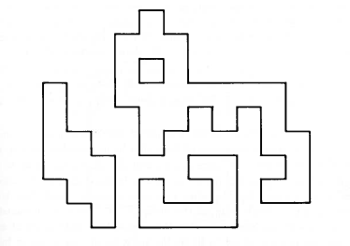
THEORITICAL POLYGON :

Slide 8
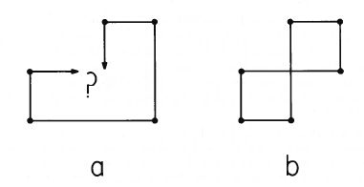
ILLEGAL CASES:

Slide 9
ILLEGAL CASES
1.Intersecting line segments-In the generated polygon,various cases of intersecting line segments could be seen.This led to intersecting polygons,which was against our goal.
2.Disjoint polygons-Since alternate points were joined,sometimes disjoint polygons could be observed.

Slide 10
PROPOSED METHOD TO SOLVE POLYGONS WITH SHARED VERTICES:

Slide 11
INTERSECTION OF 2 LINE SEGMENTS:
Input : a pair of line segments
Output : yes – if they intersect
no – otherwise
How do we know that intersection(x,y) exits between two lines?
(x, y)

Slide 12
FOR n LINE SEGEMENTS:
Input: a set of n line segments in the plane.
Output: all intersections and for each intersection the involved
segments. .

Slide 13
A BRUTE-FORCE ALGORITHM
Simply take each pair of segments, and check if they intersect.
If so, output the intersection.
2
Running time Θ(n ).
Most segments do not intersect, or if they do,
only with a few other segments.
Need a faster algorithm that deals with such situations!

Slide 14
THE PLANE SWEEP ALGORITHM:
Avoid testing pairs of segments that are far apart.
Idea: imagine a vertical sweep line passes through the given
set of line segments, from left to right.
Sweep
line

Slide 15
SWEEP LINE STATUS:
The set of segments intersecting the sweep line.
It changes as the sweep line moves, but not continuously.
endpoints
Updates of status happen only at event points.
intersections
A
G
C
T
event points

Slide 16
ORDERING SEGMENTS:
A total order over the segments that intersect the current
position of the sweep line:
B
B > C > D
(A and E not in
the ordering)
A
C
E
C > D
(B drops out of
the ordering)
D
At an event point, the sequence of segments changes:
♦ Update the status.
♦ Detect the intersections.

Slide 17
STATUS UPDATE (1)
Event point is the left endpoint of a segment.
A new segment L intersecting
the sweep line
K
O
L
Check if L intersects with the
segment above (K) and the
segment below (M).
M
Intersection(s) are new
event points.
N
new event
point
K, M, N
K, L, M, N

Slide 18
STATUS UPDATE(2)
Event point is an intersection.
The two intersecting segments
(L and M) change order.
K
O
L
Check intersection with new
neighbors (M with O and L with
N).
M
Intersection(s) are new
event points.
N
O, L, M, N
O, M, L, N

Slide 19
STATUS UPDATE (3)
Event point is a lower endpoint of a segment.
The two neighbors (O and L)
become adjacent.
K
O
L
Check if they (O and L) intersect.
M
Intersection is new event point.
N
O, M, L, N
O, L, N

Slide 20
SPECIAL CASE:
Assume segments in L are vertical (blue) or horizontal (red),
and each intersection is between a red-blue pair.

Slide 21
SPECIAL CASE:
Sweep-line
d
d
c
D
a
a
e
b
b
Plane Sweep Method: vertical sweep-line moving left-to-right.
Active segments: horizontal segments that intersect the sweep-line.
Sweep event schedule: x-sorted segment endpoints.
Sweep Status: y-ordering of the active horizontal segments maintained in an efficient binary search tree.

Slide 22
SPECIAL CASE:
Sweep-line
d
d
e₂
c
e₂
c
a
D
e
a
b
e₁
b
e₁

Slide 23
THE ALGORITHM:
FindIntersections(S)
Input: a set S of line segments
Ouput: all intersection points and for each intersection the
segment containing it.
1. Q ←∅ // initialize an empty event queue
2. Insert the segment endpoints into Q // store with every left endpoint
// the corresponding segments
3. T ←∅ // initialize an empty status structure
while Q ≠ ∅
do extract the next event point p
6. Q ← Q – {p}
7. HandleEventPoint(p)

Slide 24
TIME COMPLEXITY REDUCTION
The Plane Sweep Algorithm gave us a significant improvement in the time complexity of the problem as compared to the brute force approach. The Plane Sweep Algorithm has a time complexity of O(n log n) much effective as compared to the O(n²) time of the brute approach. This made the program significantly efficient for large data.

Slide 25
CURRENT STATUS:
Basic layout has been designed and programmed
the polygon points are being written to a file which is being plotted by a graph creator.
the intersection points,found by using the PLANE SWEEP algorithm, are being written to a separate file
removing boundary conditions(intersection point removal) and cost Optimization is under process.

Slide 26
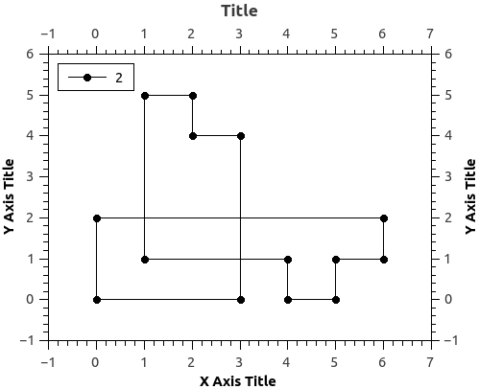
CURRENT STATUS
Plot for a particular set of randomly generated coordinates.(intersection points have not yet been removed)

Slide 27
BENIFITS
got to learn new concepts such as binary search tree,priority queue,PLANE SWEEP algorithm to name a few
got to learn many interesting oncepts regarding computational geometry from professor apurba sarkar
enhanced algorithm development and programming skills while doing the project

Slide 28
THANK YOU!!

