Slide 1
GENERATION OF OUTER COVER,CONVEX HULL AND INNER COVER OF A 2D DIGITAL OBJECT
MENTOR- Apurba Sarkar
Assistant Professor,
Department of Computer Science and Technology,
Indian Institute of Engineering Science and Technology,Shibpur

Slide 2
GROUP MEMBERS
Rahul Chowdhury(Exam roll-111205007)
Shreyasee De(Exam roll-111205027)
Siddharth Kumar(Exam roll-111205048)

Slide 3
OBJECTIVES
To create an isothetic outer cover of a digital 2D object.
To remove the concavity of the outer cover, that is, create the convex hull.
To create the isothetic inner cover of that single connected object for different grid sizes depending on the user input.
INPUTS:
A PGM image as a file.
Grid-size of the covers as user input.

Slide 4

(a sample pgm imag
(a sample pgm image)
File format of this image:
P2
# feep.pgm
24 7
15
0 0 0 0 0 0 0 0 0 0 0 0 0 0 0 0 0 0 0 0 0 0 0 0 0 3 3 3 3 0 0 7 7 7 7 0 0 11 11 11 11 0
0 15 15 15 15 0 0 3 0 0 0 0 0 7 0 0 0 0 0 11 0 0 0 0 0 15 0 0 15 0 0 3 3 3 0 0 0 7 7 7 0
0 0 11 11 11 0 0 0 15 15 15 15 0 0 3 0 0 0 0 0 7 0 0 0 0 0 11 0 0 0 0 0 15 0 0 0 0 0 3
0 0 0 0 0 7 7 7 7 0 0 11 11 11 11 0 0 15 0 0 0 0 0 0 0 0 0 0 0 0 0 0 0 0 0 0 0 0 0 0 0 0
0 0 0 0

Slide 5
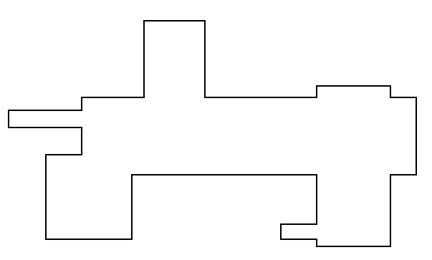
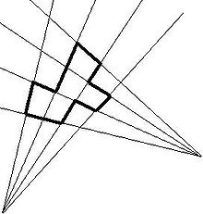
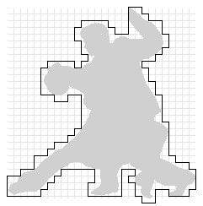
TERMS AND CONVENTIONS USED
1.ISOTHETIC POLYGON:
2.OUTER COVER:

Slide 6
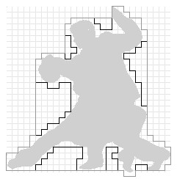
TERMS AND CONVENTIONS USED (CONTD.)
3.CONVEX HULL:

Slide 7
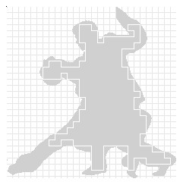
TERMS AND CONVENTIONS USED (CONTD.)
4.INNER COVER:
5.CELL:
C4 | C1
C3 | C2

Slide 8
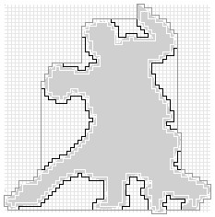
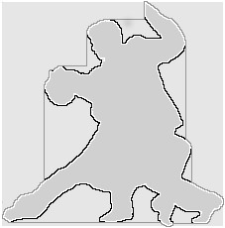
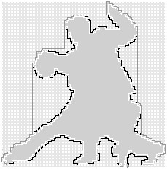
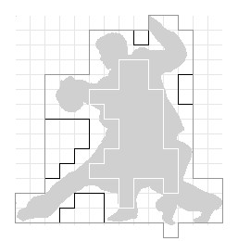
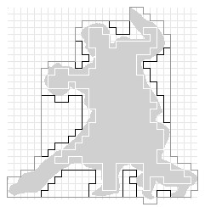
TERMS AND CONVENTIONS USED(CONTD.)
6.GRID-SIZE (symbol g):
g=4
g=1
g=2
g=16
g=8

Slide 9
TERMS AND CONVENTIONS USED (CONTD.)
7.OCCUPIED CELL:
8.UNOCCUPIED CELL:
9.POINT:
Occupied cells
Unoccupied cells
Point

Slide 10
TERMS AND CONVENTIONS USED (CONTD.)
10.VERTEX:
Vertices

Slide 11
TERMS AND CONVENTIONS USED (CONTD.)
11.VERTEX TYPES:
a)for outer cover:
b)for inner cover:
TYPE 1
TYPE 2
TYPE 3
TYPE 1
TYPE 2
TYPE 3

Slide 12
TERMS AND CONVENTIONS USED (CONTD.)
12.DIRECTION (symbol d):
d=1
d=2
d=0
d=3

Slide 13
TERMS AND CONVENTIONS USED (CONTD.)
13.OCCUPANCY(symbol t):
a)for outer cover:
b)for inner cover:
t=1
t=0
t=-1
t=-1
t=0
t=-1

Slide 14
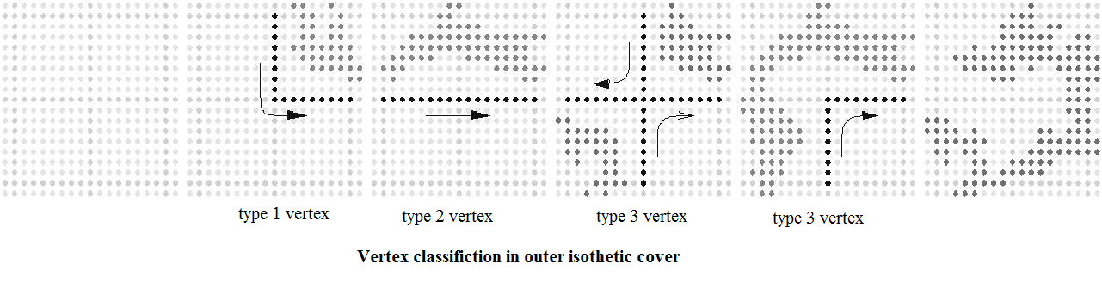
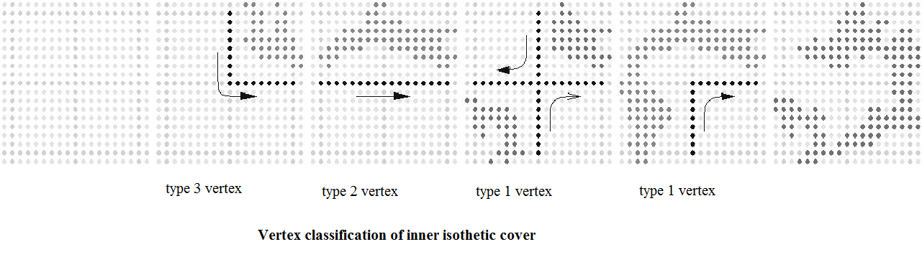
HOW TO FIND DIRECTION
D_{i+1}=( t_{i} + d_{i} ) modulo 4

Slide 15
PROPOSED SOLUTION
Outline of algorithm
step 1: input PGM image as a file and grid-size from the user
step 2: generate outer cover
step 3: generate convex hull
step 4: generate inner cover
step 5: output an image file which contains the original image along with grid-lines and the covers

Slide 16
IMAGE NOISE REMOVAL
What is image noise?
Image noise, in this case, refers to the unwanted pixels, which distort the original image and hamper the generation of the covers.
Noise removal
Step 1: Add the values at each pixel where the gray-scale value is less than the scale of the image
Step 2: Find the average value by dividing the total value by the total number of pixels that have gray-scale value less than the scale
Step 3: Add an adjustment factor(say 50) to the average value. This is the new average
Step 4: If the value of a pixel is less than the average value, make the value of the pixel= average value, otherwise make it equal to the image scale
Step 5: If pixel value is less than average, make it equal to average, otherwise make it equal to the image scale

Slide 17



NOISE REMOVAL-DEMONSTRATION
ORIGINAL IMAGE
NOISE HIGHLIGHTED
NOISE REMOVED
Total value of pixels which have value less than scale = 4352880
Total number of pixels which have value less than scale = 23113
Adjustment factor = 20
AVERAGE VALUE = 4352880/23113 + 20= 208

Slide 18
OUTER COVER
Determination of the starting vertex:
Step 1: traverse image from top to bottom, from left to right
Step 2: Taking each point, we observe the conditions of its containing cells. If the cell c2 is occupied and c1,c3 and c4 are
unoccupied, then the first such point becomes the starting vertex
cover generation:
Step 1: start from starting vertex
Step 2: assume initial d=2
Step 3: find occupancy t
Step 4: calculate (d + t) modulo 4 and assign it to d

Slide 19
OUTER COVER (CONTD.)
Step 5: move in the direction ,according to d, g units to get the new vertex
Step 6: join the initial and new vertex
Step 7: the new vertex becomes the initial vertex
Step 8: check if the new vertex=starting vertex
Step 9: if result of step 8 is false, go to step 3
Step 10: if result of step 8 is true, the outer cover is completed

Slide 20

DEMONSTRATION(OUTER COVER)
d=1
D_{i+1}=( t_{i} + d_{i} ) modulo 4
1
2
d=2
d=0
1
2
1
2
3
3
3
d=3

Slide 21
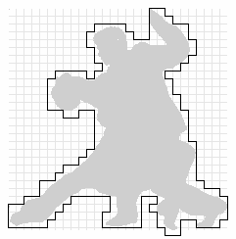
IMAGE WITH OUTER COVER

Slide 22
CONVEX HULL
Determination of the starting vertex
The starting vertex of outer cover is the starting vertex of the convex hull.
Cover generation
Step 1: start from starting vertex
Step 2: push vertex into a stack
Step 3: if the stack has more than or equal to 5 elements, pop the top 4 elements
Step 4: if the popped 2nd,3rd,4th and 5th elements are 1,3,3,1 or 3,3,3,1 respectively, add and/or remove vertices to remove concavity

Slide 23
CONVEX HULL(CONTD.)
Step 5: push the new set of vertices into the stack
Step 6: go to step 3
Step 7: push 2 vertices from stack
Step 8: join the vertices
Step 9: check if stack is empty
Step 10: if result of step 9 is false ,go to step 7
Step 11: if result of step 9 is true, the convex hull is completed

Slide 24
DEMONSTRATION(CONVEX HULL)
D_{i+1}=( t_{i} + d_{i} ) modulo 4
d=1
1
1
d=2
d=0
1
3
3
1
3
3
d=3

Slide 25
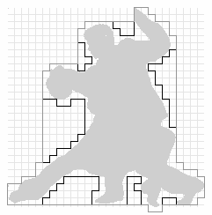
IMAGE WITH OUTER COVER AND CONVEX HULL

Slide 26
INNER COVER
Determination of starting vertex:
Step 1: traverse image from top to bottom, from left to right
Step 2: Taking each point, we observe the conditions of its containing cells. If 1 cell is uncovered and the remaining 3 are covered, the first such point becomes the starting vertex
Cover generation:
Step 1: start from starting vertex
Step 2: initial d is determined by the position of the unoccupied cell
Step 3: find occupancy t
Step 4: calculate (d + t) modulo 4 and assign it to d

Slide 27
INNER COVER(CONTD.)
Step 5: move in the direction ,according to d, g units to get the new vertex
Step 6: join the initial and new vertex
Step 7: the new vertex becomes the initial vertex
Step 8: check if the new vertex=starting vertex
Step 9: if result of step 8 is false, go to step 3
Step 10: if result of step 8 is true, the inner cover is completed

Slide 28
DEMONSTRATION(INNER COVER)
d=1
D_{i+1}=( t_{i} + d_{i} ) modulo 4
d=2
d=0
d=3

Slide 29
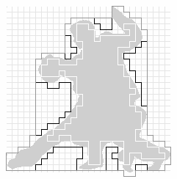
IMAGE WITH OUTER COVER,CONVEX HULL AND INNER COVER

Slide 30


SAMPLE IMAGES

Slide 31
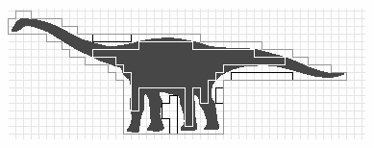

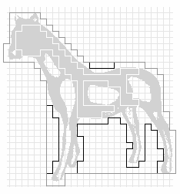
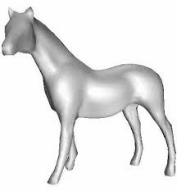
SAMPLE IMAGES(CONTD.)

Slide 32

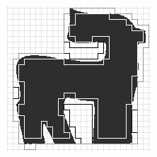

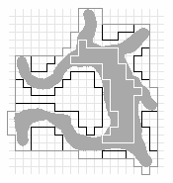
SAMPLE IMAGES(CONTD.)

Slide 33
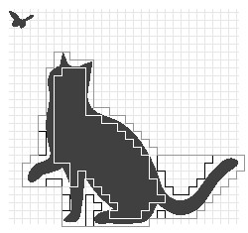

SHORTCOMINGS
1. Covers cannot be generated for multiple distinct objects in the same image file.
NO COVER

Slide 34
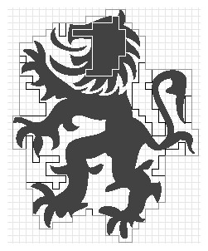

SHORTCOMINGS(CONTD.)
NO INNER COVER IN THIS PART
2.P5(raw) image files cannot be processed.
3.the adjustment factor in the noise elimination algorithm is different for different images.

Slide 35
APPLICATIONS
An isothetic cover of a digital object not only specifies a simple representation of the object but also provides an approximate information about its structural content and geometric characteristics, hence it is useful in shape analysis.
It can be used in VLSI layout design.
In robotics this structural and geo-metric relation with the concerned object can be used for robot-grasping and navigation.
In rough sets.
Approximation of polotypes.

Slide 36
THANK YOU!

