Slide 1


Transformations and Actions
http://training.databricks.com/visualapi.pdf
A Visual Guide of the API
Notes:
To-do:

Slide 2

LinkedIn
Blog: data-frack
Databricks would like to give a special thanks to Jeff Thomspon for contributing 67 visual diagrams depicting the Spark API under the MIT license to the Spark community.
Jeff’s original, creative work can be found here and you can read more about Jeff’s project in his blog post.
After talking to Jeff, Databricks commissioned Adam Breindel to further evolve Jeff’s work into the diagrams you see in this deck.

Slide 3

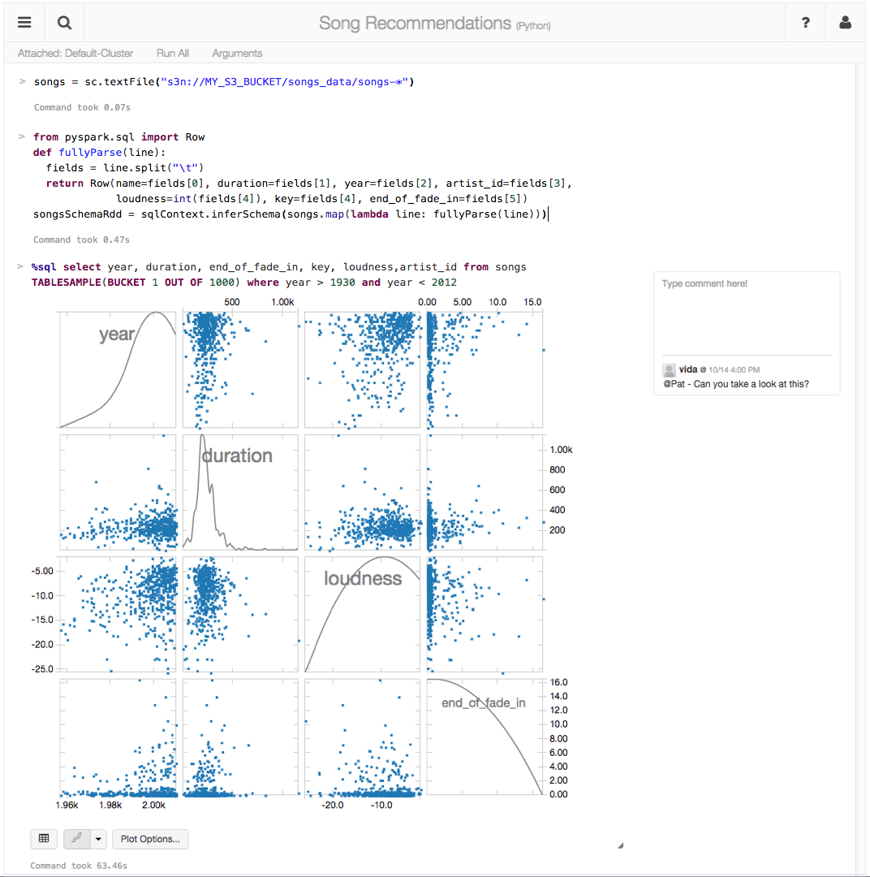
making big data simple
Founded in late 2013
by the creators of Apache Spark
Original team from UC Berkeley AMPLab
Raised $47 Million in 2 rounds
~55 employees
We’re hiring!
Level 2/3 support partnerships with
Hortonworks
MapR
DataStax
(http://databricks.workable.com)
Databricks Cloud:
“A unified platform for building Big Data pipelines – from ETL to Exploration and Dashboards, to Advanced Analytics and Data Products.”
Notes:
Apache Spark is an open-source cluster computing framework originally developed in 2009 in the UC Berkeley AMPLab. Spark makes it easy to get value from big data. It can read from any data source (relational, NoSQL, file systems, etc) and offers one unified API for batch analytics, SQL queries, real time analysis, machine learning and graph processing. Developers no longer have to learn separate processing engines for different tasks. Spark is 10x-100x faster than older systems such as Hadoop MapReduce with proven scalability (the largest Spark cluster has over 8,000 nodes). Spark had over 450 contributors in 2014, making it the most active open source project in the Big Data space. The core Spark team is now at Databricks. With over 50 employees and $47 million in funding, Databricks is the main steward of the Spark project. As a Trainer for Databricks and Spark, you will work closely with this team to understand Spark’s internals and then teach it to engineers around the world.

Slide 4


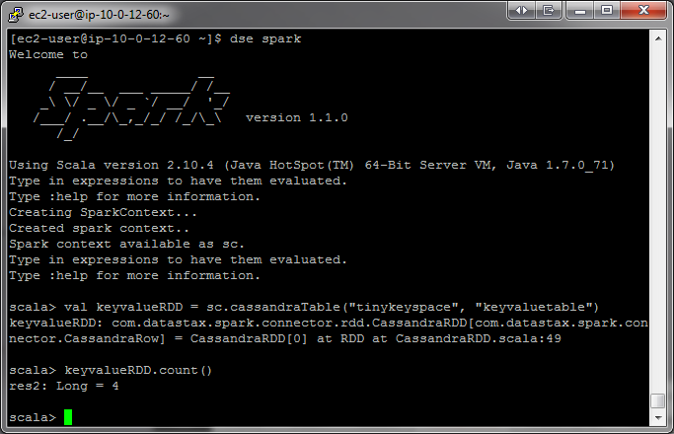
RDD
RDD Elements
Legend
key
original item
B
transformed type
partition(s)
A
object on driver
user input
user functions
emitted value
input

Slide 5
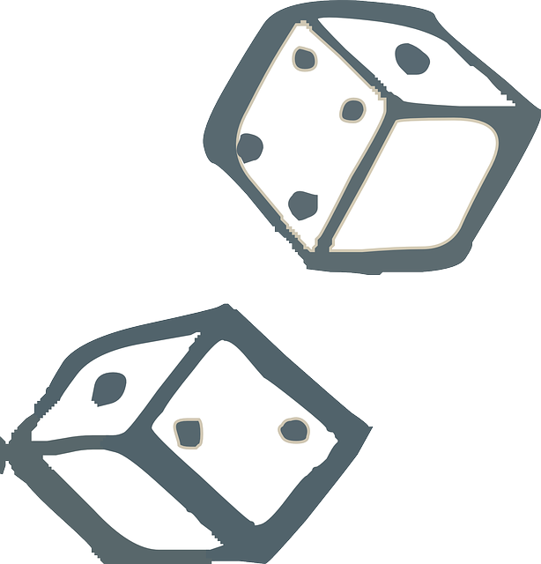
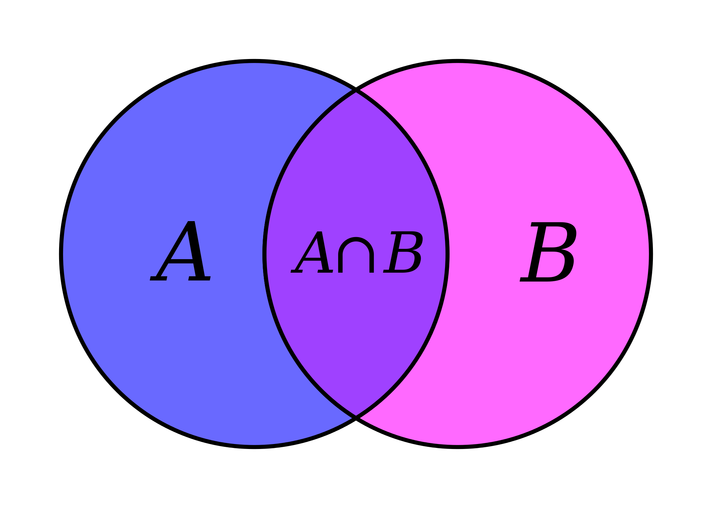
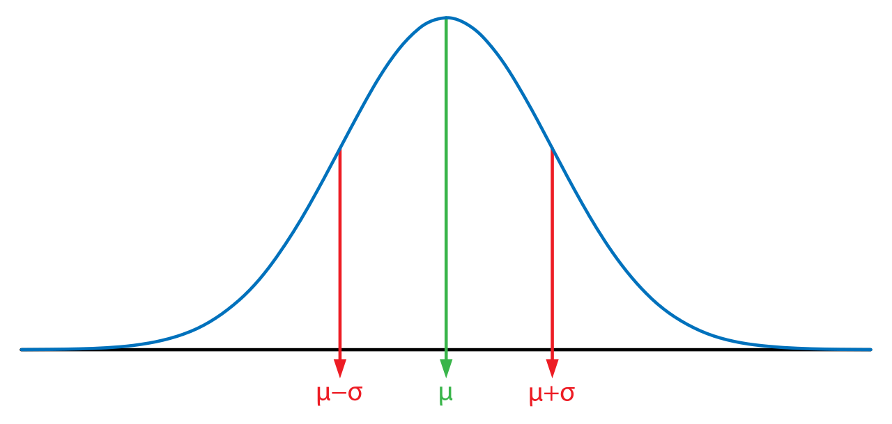
Legend
Randomized operation
Set Theory / Relational operation
Numeric calculation

Slide 6


Transformations
Operations =
+
Actions

Slide 7


= easy
= medium
Essential Core & Intermediate Spark Operations
General
Math / Statistical
Set Theory / Relational
Data Structure / I/O
map
filter
flatMap
mapPartitions
mapPartitionsWithIndex
groupBy
sortBy
sample
randomSplit
union
intersection
subtract
distinct
cartesian
zip
keyBy
zipWithIndex
zipWithUniqueID
zipPartitions
coalesce
repartition
repartitionAndSortWithinPartitions
pipe
Transformations
reduce
collect
aggregate
fold
first
take
forEach
top
treeAggregate
treeReduce
forEachPartition
collectAsMap
count
takeSample
max
min
sum
histogram
mean
variance
stdev
sampleVariance
countApprox
countApproxDistinct
takeOrdered
saveAsTextFile
saveAsSequenceFile
saveAsObjectFile
saveAsHadoopDataset
saveAsHadoopFile
saveAsNewAPIHadoopDataset
saveAsNewAPIHadoopFile
Actions

Slide 8
= easy
= medium
Essential Core & Intermediate PairRDD Operations
General
Math / Statistical
Set Theory / Relational
Data Structure
flatMapValues
groupByKey
reduceByKey
reduceByKeyLocally
foldByKey
aggregateByKey
sortByKey
combineByKey
sampleByKey
cogroup (=groupWith)
join
subtractByKey
fullOuterJoin
leftOuterJoin
rightOuterJoin
partitionBy
Transformations
keys
values
countByKey
countByValue
countByValueApprox
countApproxDistinctByKey
countApproxDistinctByKey
countByKeyApprox
sampleByKeyExact
Actions

Slide 9


vs
narrow
wide
each partition of the parent RDD is used by at most one partition of the child RDD
multiple child RDD partitions may depend on a single parent RDD partition

Slide 10
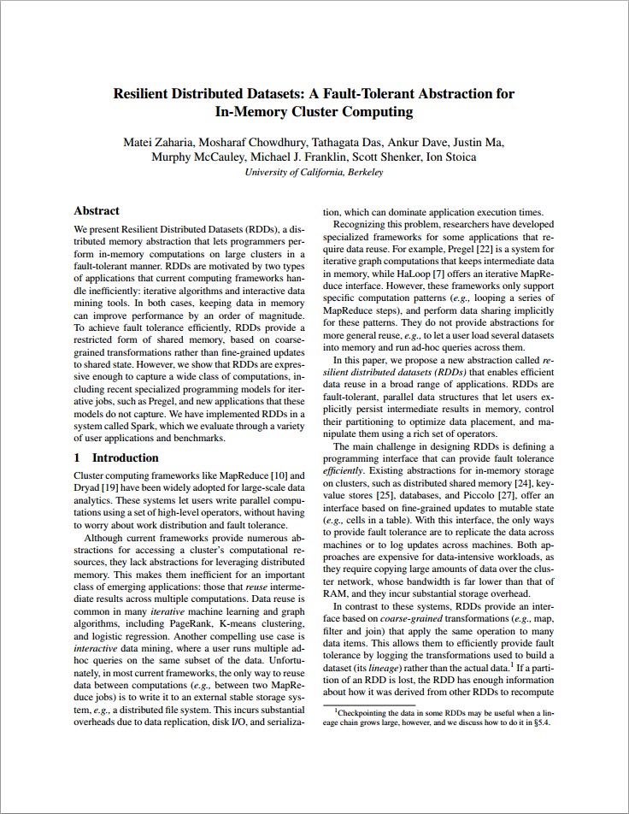
Lineage
“One of the challenges in providing RDDs as an abstraction is choosing a representation for them that can track lineage across a wide range of transformations.”
“The most interesting question in designing this interface is how to represent dependencies between RDDs.”
“We found it both sufficient and useful to classify dependencies into two types:
narrow dependencies, where each partition of the parent RDD is used by at most one partition of the child RDD
wide dependencies, where multiple child partitions may depend on it.”

Slide 11
narrow
wide
each partition of the parent RDD is used by at most one partition of the child RDD
multiple child RDD partitions may depend on a single parent RDD partition
groupByKey
map, filter
union
join w/ inputs
co-partitioned
join w/ inputs not
co-partitioned

Slide 12
Transformations
Core Operations

Slide 13
map
RDD: x
3 items in RDD
(partitions not shown)
Notes:
Return a new RDD by applying a function to each element of this RDD.

Slide 14
map
RDD: x
RDD: y
User function applied item by item

Slide 15
map
RDD: x
RDD: y

Slide 16
map
RDD: x
RDD: y

Slide 17
map
After map() has been applied…
RDD: x
RDD: y
before
after

Slide 18
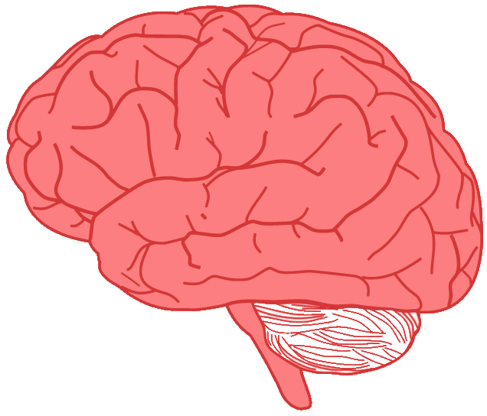

map
RDD: x
RDD: y
Return a new RDD by applying a function to each element of this RDD.

Slide 19



map
RDD: x
RDD: y
map(f, preservesPartitioning=False)
Return a new RDD by applying a function to each element of this RDD
x = sc.parallelize(["b", "a", "c"])
y = x.map(lambda z: (z, 1))
print(x.collect())
print(y.collect())
x:
['b', 'a', 'c']
[('b', 1), ('a', 1), ('c', 1)]
y:
val x = sc.parallelize(Array("b", "a", "c"))
val y = x.map(z => (z,1))
println(x.collect().mkString(", "))
println(y.collect().mkString(", "))
b, a, c
(b,1), (a,1), (c,1)
Notes:
preservesPartitioning indicates whether the input function preserves the partitioner, which should be false unless this is a pair RDD and the input function doesn’t modify the keys.
http://apache-spark-user-list.1001560.n3.nabble.com/preservesPartitioning-td10019.html
preservesPartitioning

Slide 20
filter
RDD: x
3 items in RDD
(partitions not shown)

Slide 21
filter
RDD: x
RDD: y
Apply user function: keep item if function returns true
True
emits

Slide 22
filter
RDD: x
RDD: y
False
emits

Slide 23
filter
RDD: x
RDD: y
True
emits

Slide 24
filter
After filter() has been applied…
RDD: x
RDD: y
before
after

Slide 25
filter
RDD: x
RDD: y
filter(f)
Return a new RDD containing only the elements that satisfy a predicate
x = sc.parallelize([1,2,3])
y = x.filter(lambda x: x%2 == 1) #keep odd values
print(x.collect())
print(y.collect())
x:
[1, 2, 3]
[1, 3]
y:
val x = sc.parallelize(Array(1,2,3))
val y = x.filter(n => n%2 == 1)
println(x.collect().mkString(", "))
println(y.collect().mkString(", "))
1, 2, 3
1, 3
Notes:
Idiomatic Scala might write this filter as _%2==1 using _ to stand for the input param
file = "/input/sample"
logData = sc.textFile(file, 2)
EmptyLines = logData.filter(lambda line : len(line.strip()) != 0).count()
ValidLines = logData.filter(lambda line : len(line.strip()) == 0).count()
print("The number of empty lines = ", EmptyLines )
print("The number of valid lines = ", ValidLines )

Slide 26
flatmap
RDD: x
3 items in RDD
(partitions not shown)

Slide 27
flatmap
RDD: x
RDD: y

Slide 28
flatmap
RDD: x
RDD: y

Slide 29
flatmap
RDD: x
RDD: y

Slide 30
flatmap
After flatmap() has been applied…
RDD: x
RDD: y
before
after

Slide 31
flatmap
RDD: x
RDD: y
Return a new RDD by first applying a function to all elements of this RDD, and then flattening the results

Slide 32
Flatmap
RDD: x
RDD: y
flatMap(f, preservesPartitioning=False)
Return a new RDD by first applying a function to all elements of this RDD, and then flattening the results
x = sc.parallelize([1,2,3])
y = x.flatMap(lambda x: (x, x*100, 42))
print(x.collect())
print(y.collect())
x:
[1, 2, 3]
[1, 100, 42, 2, 200, 42, 3, 300, 42]
y:
val x = sc.parallelize(Array(1,2,3))
val y = x.flatMap(n => Array(n, n*100, 42))
println(x.collect().mkString(", "))
println(y.collect().mkString(", "))
1, 2, 3
1, 100, 42, 2, 200, 42, 3, 300, 42

Slide 33
groupBy
RDD: x
4 items in RDD
James
Anna
Fred
John
(partitions not shown)

Slide 34
groupBy
RDD: x
RDD: y
James
Anna
Fred
John
J
[ “John” ]
‘J’
emits

Slide 35
groupBy
RDD: x
RDD: y
James
Anna
Fred
F
[ “Fred” ]
John
J
[ “John” ]
‘F’
emits

Slide 36
groupBy
RDD: x
RDD: y
James
A
[ “Anna” ]
Anna
Fred
F
[ “Fred” ]
‘A’
John
J
[ “John” ]
emits

Slide 37
groupBy
RDD: x
RDD: y
James
A
[ “Anna” ]
Anna
Fred
F
[ “Fred” ]
‘J’
emits
John
J
[ “John”, “James” ]

Slide 38
groupby
RDD: x
RDD: y
groupBy(f, numPartitions=None)
Group the data in the original RDD. Create pairs where the key is the output of a user function, and the value is all items for which the function yields this key.
x = sc.parallelize(['John', 'Fred', 'Anna', 'James'])
y = x.groupBy(lambda w: w[0])
print ([(k, list(v)) for (k, v) in y.collect()])
x:
['John', 'Fred', 'Anna', 'James']
[('A',['Anna']),('J',['John','James']),('F',['Fred'])]
y:
val x = sc.parallelize(
Array("John", "Fred", "Anna", "James"))
val y = x.groupBy(w => w.charAt(0))
println(y.collect().mkString(", "))
x: org.apache.spark.rdd.RDD[String] = ParallelCollectionRDD[4] at parallelize at <console>:29
y: org.apache.spark.rdd.RDD[(Char, Iterable[String])] = ShuffledRDD[6] at groupBy at <console>:31
(J,CompactBuffer(John, James)), (F,CompactBuffer(Fred)), (A,CompactBuffer(Anna))
Notes:
Order in output not guaranteed Point out that most wide transformations support an optional argument with the number of partitions in the output RDD

Slide 39
groupbykey
Pair RDD: x
5 items in RDD
B
5
B
4
A
3
A
2
A
1
(partitions not shown)

Slide 40
groupbykey
Pair RDD: x
RDD: y
B
5
B
4
A
3
A
2
A
1
A
[ 2 , 3 , 1 ]
Notes:
Point out that results are not necessarily ordered, and that order is not guaranteed consistent between executions

Slide 41
groupbykey
Pair RDD: x
RDD: y
B
5
B
4
A
3
B
[ 5 , 4 ]
A
2
A
1
A
[ 2 , 3 , 1 ]

Slide 42
groupbykey
RDD: x
RDD: y
groupByKey(numPartitions=None)
Group the values for each key in the original RDD. Create a new pair where the original key corresponds to this collected group of values.
x = sc.parallelize([('B',5),('B',4),('A',3),('A',2),('A',1)])
y = x.groupByKey()
print(x.collect())
print(list((j[0], list(j[1])) for j in y.collect()))
x:
[('B', 5),('B', 4),('A', 3),('A', 2),('A', 1)] [('A', [2, 3, 1]),('B',[5, 4])]
val x = sc.parallelize( Array(('B',5),('B',4),('A',3),('A',2),('A',1)))
val y = x.groupByKey()
println(x.collect().mkString(", "))
println(y.collect().mkString(", "))
y:
Notes:
Order in output not guaranteed Point out that most wide transformations support an optional argument with the number of partitions in the output RDD
print(list((j[0], list(j[1])) for j in y.glom().collect())) → Will give error – list out of range
print(list((j[0], list(j[1])) for j in y.glom().collect()[0])) → looping through the first partition
print(list((j[0], list(j[1])) for j in y.glom().collect()[1]))

Slide 43
ReduceByKey vs Groupbykey
val words = Array("one", "two", "two", "three", "three", "three")
val wordPairsRDD = sc.parallelize(words).map(word => (word, 1))
val wordCountsWithReduce = wordPairsRDD
.reduceByKey(_ + _)
.collect()
val wordCountsWithGroup = wordPairsRDD
.groupByKey()
.map(t => (t._1, t._2.sum))
.collect()
Notes:
Let's look at two different ways to compute word counts, one using reduceByKey and the other using groupByKey…
While both of these functions will produce the correct answer, the reduceByKey example works much better on a large dataset. That's because Spark knows it can combine output with a common key on each partition before shuffling the data.

Slide 44
ReduceByKey
(a, 1)
(a, 1)
(a, 1)
(a, 1)
(a, 1)
(a, 1)
(a, 2)
(a, 3)
(b, 1)
(b, 1)
(a, 1)
(b, 1)
(b, 2)
(b, 2)
(b, 1)
(b, 1)
(b, 1)
a
b
(a, 1)
(b, 1)
(a, 2)
(a, 6)
(b, 2)
(b, 5)
(a, 3)
(b, 2)
Notes:
Look at the diagram below to understand what happens with reduceByKey. Notice how pairs on the same machine with the same key are combined (by using the lamdba function passed into reduceByKey) before the data is shuffled. Then the lamdba function is called again to reduce all the values from each partition to produce one final result.

Slide 45
GroupByKey
(a, 1)
(a, 1)
(a, 1)
(a, 1)
(a, 1)
(b, 1)
(a, 1)
(b, 1)
(b, 1)
(b, 1)
(b, 1)
a
b
(a, 1)
(a, 1)
(b, 1)
(a, 1)
(b, 1)
(a, 1)
(a, 6)
(b, 1)
(b, 5)
(a, 1)
(b, 1)
(a, 1)
(b, 1)
Notes:
On the other hand, when calling groupByKey - all the key-value pairs are shuffled around. This is a lot of unnecessary data to being transferred over the network.
To determine which machine to shuffle a pair to, Spark calls a partitioning function on the key of the pair. Spark spills data to disk when there is more data shuffled onto a single executor machine than can fit in memory. However, it flushes out the data to disk one key at a time - so if a single key has more key-value pairs than can fit in memory, an out of memory exception occurs. This will be more gracefully handled in a later release of Spark so the job can still proceed, but should still be avoided - when Spark needs to spill to disk, performance is severely impacted.
You can imagine that for a much larger dataset size, the difference in the amount of data you are shuffling becomes more exaggerated and different between reduceByKey and groupByKey.
Here are more functions to prefer over groupByKey:
- combineByKey can be used when you are combining elements but your return type differs from your input value type.
- foldByKey merges the values for each key using an associative function and a neutral "zero value".

Slide 46
mapPartitions
RDD: x
RDD: y
B
partitions
B
A
A
Notes:
mapPartitions() can be used as an alternative to map() & foreach(). mapPartitions() is called once for each Partition unlike map() & foreach() which is called for each element in the RDD. The main advantage being that, we can do initialization on Per-Partition basis instead of per-element basis(as done by map() & foreach())
As I have mentioned ; the map() & foreach() iterates through all the elements. whereas in mapPartitions() you get an iterator ; and it is your responsibility to iterate through all the elements. So as you have the iterator, it becomes possible for y.
map will not change the number of elements in an RDD, while mapPartitions might very well do so.

Slide 47
mapPartitions
B
B
A
A
mapPartitions(f, preservesPartitioning=False)
Return a new RDD by applying a function to each partition of this RDD
x = sc.parallelize([1,2,3,4,5,6,7,8,9,10], 2)
def f(iterator): yield sum(iterator);
y = x.mapPartitions(f)
# glom() flattens elements on the same partition
print(x.glom().collect())
print(y.glom().collect())
x:
[[1, 2, 3, 4, 5], [6, 7, 8, 9, 10]]
[[15], [40]]
y:
Notes:
Point out that the result of the mapping is an iterator (with unspecified size), so m items in the original partition can map to n items in the resulting new partition. So the new partition can have more items, the same number of items, or fewer items than the original.
“glom” on spark rdd allows you to treat a partition as an array rather as single row at time. This allows you speed up some operations with some increased memory usage.
As a note, a presentation provided by a speaker at the 2013 San Francisco Spark Summit (goo.gl/JZXDCR) highlights that tasks with high per-record overhead perform better with a mapPartition than with a map transformation. This is, according to the presentation, due to the high cost of setting up a new task.
http://stackoverflow.com/questions/21185092/apache-spark-map-vs-mappartitions
https://bzhangusc.wordpress.com/2014/06/19/optimize-map-performamce-with-mappartitions/

Slide 48
mapPartitions
B
B
A
A
mapPartitions(f, preservesPartitioning=False)
Return a new RDD by applying a function to each partition of this RDD
val x = sc.parallelize(Array(1,2,3,4,5,6,7,8,9,10), 2)
def f(i:Iterator[Int])={ (i.sum,1).productIterator }
//The 1 is just a number so that we can
//use productIterator
val y = x.mapPartitions(f)
// glom() flattens elements on the same partition
val xOut = x.glom().collect()
val yOut = y.glom().collect()
xOut: Array[Array[Int]] = Array(Array(1, 2, 3, 4, 5),
Array(6, 7, 8, 9, 10))
yOut: Array[Array[Any]] = Array(Array(15, 1), Array(40, 1))
Notes:
Point out that the result of the mapping is an iterator (with unspecified size), so m items in the original partition can map to n items in the resulting new partition. So the new partition can have more items, the same number of items, or fewer items than the original.
mapPartitions() can be used as an alternative to map() & foreach(). mapPartitions() is called once for each Partition unlike map() & foreach() which is called for each element in the RDD. The main advantage being that, we can do initialization on Per-Partition basis instead of per-element basis(as done by map() & foreach()) Consider the case of Initializing a database. If we are using map() or foreach(), the number of times we would need to initialize will be equal to the no of elements in RDD. Whereas if we use mapPartitions(), the no of times we would need to initialize would be equal to number of Partitions
We get Iterator as an argument for mapPartition, through which we can iterate through all the elements in a Partition.
http://stackoverflow.com/questions/31137194/what-is-scalas-product-productiterator-supposed-to-do

Slide 49
mapPartitionsWithIndex
RDD: x
RDD: y
B
partitions
B
A
A
input
partition index

Slide 50
mapPartitionsWithIndex
B
B
A
partition index
A
mapPartitionsWithIndex(f, preservesPartitioning=False)
Return a new RDD by applying a function to each partition of this RDD, while tracking the index of the original partition
x = sc.parallelize([1,2,3], 2)
def f(partitionIndex, iterator): yield (partitionIndex, sum(iterator))
y = x.mapPartitionsWithIndex(f)
# glom() flattens elements on the same partition
print(x.glom().collect())
print(y.glom().collect())
B
A
x:
[[1], [2, 3]]
[[0, 1], [1, 5]]
y:

Slide 51
mapPartitionsWithIndex
B
B
A
partition index
A
mapPartitionsWithIndex(f, preservesPartitioning=False)
Return a new RDD by applying a function to each partition of this RDD, while tracking the index of the original partition.
val x = sc.parallelize(Array(1,2,3), 2)
def f(partitionIndex:Int, i:Iterator[Int]) = {
(partitionIndex, i.sum).productIterator
}
val y = x.mapPartitionsWithIndex(f)
// glom() flattens elements on the same partition
val xOut = x.glom().collect()
val yOut = y.glom().collect()
B
A
x:
Array(Array(1), Array(2, 3))
Array(Array(0, 1), Array(1, 5))
y:

Slide 52
sample
RDD: x
RDD: y
5
4
3
1
2
1
3
Notes:
http://www.bigsynapse.com/sampling-large-datasets-using-spark

Slide 53
sample
RDD: x
RDD: y
sample(withReplacement, fraction, seed=None)
Return a new RDD containing a statistical sample of the original RDD
x = sc.parallelize([1, 2, 3, 4, 5])
y = x.sample(False, 0.4, 42)
print(x.collect())
print(y.collect())
x:
[1, 2, 3, 4, 5] [1, 3]
val x = sc.parallelize(Array(1, 2, 3, 4, 5))
val y = x.sample(false, 0.4)
// omitting seed will yield different output
println(y.collect().mkString(", "))
y:
Notes:
Important to point out that the sample size itself will vary, and also that the Python and Scala random number generators will produce different output from the same seed, so that, e.g.,
calling val y = x.sample(false, 0.4, 42) in Scala will not produce the same output shown here on the right (which is the Python output)
This is a good one to demo, to show varying results

Slide 54
union
RDD: x
RDD: y
3
4
2
3
1
B
C
A
4
RDD: z
3
3
2
C
1
B
A

Slide 55
union
Return a new RDD containing all items from two original RDDs. Duplicates are not culled.
union(otherRDD)
x = sc.parallelize([1,2,3], 2)
y = sc.parallelize([3,4], 1)
z = x.union(y)
print(z.glom().collect())
Note: try without glom and check results
x:
[1, 2, 3] [3, 4]
[[1], [2, 3], [3, 4]]
y:
val x = sc.parallelize(Array(1,2,3), 2)
val y = sc.parallelize(Array(3,4,5,1), 2)
val z = x.union(y)
val zOut = z.glom().collect()
z:
Notes:
Point Out: Duplicates are not removed. They can be removed with the more expensive .distinct call, presented shortly

Slide 56
join
RDD: x
RDD: y
B
5
B
2
A
4
A
1
A
3
Notes:
http://stackoverflow.com/questions/29657330/joins-and-cogroup-in-spark

Slide 57
join
RDD: x
RDD: y
B
5
B
2
A
4
A
1
A
3
RDD: z
A
(1, 3)
Notes:
To-do: swap

Slide 58
join
RDD: x
RDD: y
B
5
B
2
A
4
A
1
A
3
RDD: z
A
(1, 4)
A
(1, 3)
Notes:
To-do: swap

Slide 59
join
RDD: x
RDD: y
B
5
B
2
A
4
A
1
A
3
B
(2, 5)
RDD: z
A
(1, 4)
A
(1, 3)
Notes:
To-do: swap

Slide 60
join
Return a new RDD containing all pairs of elements having the same key in the original RDDs
join(otherRDD, numPartitions=None)
x = sc.parallelize([("a", 1), ("b", 2)])
y = sc.parallelize([("a", 3), ("a", 4), ("b", 5)])
z = x.join(y)
print(z.collect())
x:
[("a", 1), ("b", 2)]
[("a", 3), ("a", 4), ("b", 5)]
[('a', (1, 3)), ('a', (1, 4)), ('b', (2, 5))]
y:
val x = sc.parallelize(Array(("a", 1), ("b", 2)))
val y = sc.parallelize(Array(("a", 3), ("a", 4), ("b", 5)))
val z = x.join(y)
println(z.collect().mkString(", "))
z:
Notes:
Point out that this is an inner join, but that duplicate keys in the respective source RDDs result in a Cartesian join of those key-value pairs.
https://www.safaribooksonline.com/library/view/high-performance-spark/9781491943199/ch04.html
http://bailiwick.io/2015/07/13/joining-data-frames-in-spark-sql/

Slide 61
distinct
RDD: x
4
3
3
2
1

Slide 62
distinct
RDD: x
RDD: y
4
4
3
3
3
3
2
2
1
1

Slide 63
distinct
RDD: x
RDD: y
4
4
3
3
3
2
2
1
1

Slide 64
distinct
*
¤
*
*
¤
Return a new RDD containing distinct items from the original RDD (omitting all duplicates)
distinct(numPartitions=None)
x = sc.parallelize([1,2,3,3,4])
y = x.distinct()
print(y.collect())
x:
[1, 2, 3, 3, 4]
[1, 2, 3, 4]
y:
val x = sc.parallelize(Array(1,2,3,3,4))
val y = x.distinct()
println(y.collect().mkString(", "))
Notes:
Need to check whether distinct retains the original partitions or not???????

Slide 65
coalesce
RDD: x
C
B
A

Slide 66
coalesce
RDD: x
RDD: y
C
B
A
AB

Slide 67
coalesce
RDD: x
RDD: y
C
C
B
A
AB

Slide 68
coalesce
C
C
B
AB
A
Return a new RDD which is reduced to a smaller number of partitions
coalesce(numPartitions, shuffle=False)
x = sc.parallelize([1, 2, 3, 4, 5], 3)
y = x.coalesce(2)
print(x.glom().collect())
print(y.glom().collect())
x:
[[1], [2, 3], [4, 5]]
[[1], [2, 3, 4, 5]]
y:
val x = sc.parallelize(Array(1, 2, 3, 4, 5), 3)
val y = x.coalesce(2)
val xOut = x.glom().collect()
val yOut = y.glom().collect()
Notes:
Point out…
In some cases, running a shuffle is desirable if the coalesced partitions would be too unevenly distributed to get good parallelism
To increase the number of partitions (and trigger a shuffle), call repartition
In Scala API (but not Python API), you can call coalesce with a larger number of partitions, and shuffle=true, and achieve a repartition

Slide 69
KeyBy
RDD: x
RDD: y
James
Anna
Fred
John
J
“John”
‘J’
emits

Slide 70
KeyBy
RDD: x
RDD: y
James
Anna
Fred
F
“Fred”
John
J
“John”
‘F’

Slide 71
KeyBy
RDD: x
RDD: y
James
Anna
A
“Anna”
Fred
F
“Fred”
‘A’
John
J
“John”

Slide 72
KeyBy
RDD: x
RDD: y
James
J
“James”
Anna
A
“Anna”
‘J’
Fred
F
“Fred”
emits
John
J
“John”

Slide 73
keyby
RDD: x
RDD: y
keyBy(f)
Create a Pair RDD, forming one pair for each item in the original RDD. The pair’s key is calculated from the value via a user-supplied function.
x = sc.parallelize(['John', 'Fred', 'Anna', 'James'])
y = x.keyBy(lambda w: w[0])
print(y.collect())
x:
['John', 'Fred', 'Anna', 'James']
[('J','John'),('F','Fred'),('A','Anna'),('J','James')]
y:
val x = sc.parallelize(
Array("John", "Fred", "Anna", "James"))
val y = x.keyBy(w => w.charAt(0))
println(y.collect().mkString(", "))
Notes:
Firstly, we will try to understand the definitions of both functions:
Definition of KeyBy Function:
def keyBy(f: (T) ⇒ K): RDD[(K, T)] //Here keyBy function takes another function f:(T)=>K(f takes T(here T is original RDD's element Type) as argument and returns K(here K is Resultant RDD's key Type) as argument and returns RDD of key-value tuples RDD[(K,T)]
Definition of map Function:
def map(f: (T) ⇒ U): RDD[U] //Here map function takes another function f:(T)=>U(f takes T(here T is original RDD's element Type) as argument and returns U(here U is Resultant RDD's element Type) as argument and returns RDD of U Type elements RDD[U]
From definitions of both functions one can easily come to the conclusion that keyBy function returns paired RDD whereas map returns simple RDD. Although it is correct, you can pass a function to map so that it returns paired RDD, in fact you can achieve the same results of keyBy with map function. Look at the example below where keyBy and map both produce same results:
val rdd = sc.parallelize(List(1,2,3)) def keyByF(t:Int) = t*t val keyByRDD = rdd.keyBy(keyByF) keyByRDD.collect def mapF(t:Int) = (t*t, t) val mapRDD = rdd.map(mapF) mapRDD.collect
itversity-2.png857x394 20.5 KB
You can find full code of keyBy function(I just extracted important line and provided below) in Spark Source Code here8:
map(x => (f(x), x))
Which One to Use?
When you have straightforward requirement to create simple pairs then it's better to use keyBy because it is very intuitive than map ( expecting (key, value) pairs as output of map function? isn't it ODD?)
Although expecting (key,value) pairs as output from map function is confusing, but it is very flexible and can be useful in many cases unlike keyBy .
Hope it helps!

Slide 74
partitionby
RDD: x
J
“John”
A
“Anna”
F
“Fred”
J
“James”

Slide 75
partitionby
RDD: x
RDD: y
RDD: y
J
“John”
A
“Anna”
J
“James”
F
“Fred”
J
“James”
1

Slide 76
partitionby
RDD: x
RDD: y
RDD: y
J
“John”
A
“Anna”
J
“James”
F
“Fred”
J
“James”
F
“Fred”
0

Slide 77
partitionby
RDD: x
RDD: y
RDD: y
J
“John”
A
“Anna”
J
“James”
F
“Fred”
A
“Anna”
J
“James”
F
“Fred”
0

Slide 78
partitionby
RDD: x
RDD: y
RDD: y
J
“John”
J
“John”
A
“Anna”
J
“James”
F
“Fred”
A
“Anna”
1
J
“James”
F
“Fred”

Slide 79
partitionby
Return a new RDD with the specified number of partitions, placing original items into the partition returned by a user supplied function
partitionBy(numPartitions, partitioner=portable_hash)
x = sc.parallelize([('J','James'),('F','Fred'),
('A','Anna'),('J','John')], 3)
y = x.partitionBy(2, lambda w: 0 if w[0] < 'H' else 1)
print (x.glom().collect())
print (y.glom().collect())
x:
[[('J', 'James')], [('F', 'Fred')],
[('A', 'Anna'), ('J', 'John')]]
[[('A', 'Anna'), ('F', 'Fred')],
[('J', 'James'), ('J', 'John')]]
y:
Notes:
Point out…
In some cases, running a shuffle is desirable if the coalesced partitions would be too unevenly distributed to get good parallelism
To increase the number of partitions (and trigger a shuffle), call repartition
In Scala API (but not Python API), you can call coalesce with a larger number of partitions, and shuffle=true, and achieve a repartition

Slide 80
partitionby
Return a new RDD with the specified number of partitions, placing original items into the partition returned by a user supplied function.
partitionBy(numPartitions, partitioner=portable_hash)
import org.apache.spark.Partitioner
val x = sc.parallelize(Array(('J',"James"),('F',"Fred"),
('A',"Anna"),('J',"John")), 3)
val y = x.partitionBy(new Partitioner() {
val numPartitions = 2
def getPartition(k:Any) = {
if (k.asInstanceOf[Char] < 'H') 0 else 1
}
})
val yOut = y.glom().collect()
x:
Array(Array((A,Anna), (F,Fred)),
Array((J,John), (J,James)))
Array(Array((F,Fred), (A,Anna)),
Array((J,John), (J,James)))
y:

Slide 81
zip
RDD: x
RDD: y
3
9
2
4
1
1
B
B
A
A

Slide 82
zip
RDD: x
RDD: y
3
9
2
4
1
1
B
B
A
A
4
RDD: z
1
1
A
Notes:
To-do: swap

Slide 83
zip
RDD: x
RDD: y
3
9
2
4
1
1
B
B
A
A
4
RDD: z
2
4
1
1
A
Notes:
To-do: swap

Slide 84
zip
RDD: x
RDD: y
3
9
2
4
1
1
B
B
A
A
4
RDD: z
3
9
2
4
1
1
B
A
Notes:
To-do: swap

Slide 85
zip
Return a new RDD containing pairs whose key is the item in the original RDD, and whose value is that item’s corresponding element (same partition, same index) in a second RDD
zip(otherRDD)
x = sc.parallelize([1, 2, 3])
y = x.map(lambda n:n*n)
z = x.zip(y)
print(z.collect())
x:
[1, 2, 3] [1, 4, 9]
[(1, 1), (2, 4), (3, 9)]
y:
val x = sc.parallelize(Array(1,2,3))
val y = x.map(n=>n*n)
val z = x.zip(y)
println(z.collect().mkString(", "))
z:
Notes:
Point out that the two source RDDs should have the same partitions and the same counts within partitions. Typically, one is a mapped version of the other.

Slide 86
Actions
Core Operations

Slide 87

vs
distributed
driver
occurs across the cluster
result must fit in driver JVM

Slide 88
getNumPartitions
2
B
partition(s)
A

Slide 89
2
getNumPartitions
B
A
getNumPartitions()
Return the number of partitions in RDD
x = sc.parallelize([1,2,3], 2)
y = x.getNumPartitions()
print(x.glom().collect())
print(y)
x:
[[1], [2, 3]]
2
val x = sc.parallelize(Array(1,2,3), 2)
val y = x.partitions.size
val xOut = x.glom().collect()
println(y)
y:

Slide 90
collect
[ ]
B
partition(s)
A

Slide 91
collect
[ ]
B
A
collect()
Return all items in the RDD to the driver in a single list
x = sc.parallelize([1,2,3], 2)
y = x.collect()
print(x.glom().collect())
print(y)
x:
[[1], [2, 3]]
[1, 2, 3]
val x = sc.parallelize(Array(1,2,3), 2)
val y = x.collect()
val xOut = x.glom().collect()
println(y)
y:

Slide 92
reduce
4
3
2
1
3
emits

Slide 93
reduce
4
3
2
6
1
emits
input
3

Slide 94
reduce
4
3
10
2
10
input
1
6

Slide 95
reduce
***
**
******
*
reduce(f)
Aggregate all the elements of the RDD by applying a user function pairwise to elements and partial results, and returns a result to the driver
x = sc.parallelize([1,2,3,4])
y = x.reduce(lambda a,b: a+b)
print(x.collect())
print(y)
x:
[1, 2, 3, 4]
10
val x = sc.parallelize(Array(1,2,3,4))
val y = x.reduce((a,b) => a+b)
println(x.collect.mkString(", "))
println(y)
y:
Notes:
Explain: function must be commutative and associative, and collection must be closed under the function, allowing maximal parallelism. Refer to fold and aggregate for non-commutative functions or functions whose result is a different type. The Commutative property states that order does not matter. Multiplication and addition are commutative. The associative property states that you can add or multiply regardless of how the numbers are grouped. By 'grouped' we mean 'how you use parenthesis'. In other words, if you are adding or multiplying it does not matter where you put the parenthesis. Add some parenthesis any where you like!. (a + b) + c = a + (b + c)

Slide 96
max
1
4
4
2

Slide 97
max
1
4
4
max
2
max()
Return the maximum item in the RDD
x = sc.parallelize([2,4,1])
y = x.max()
print(x.collect())
print(y)
x:
[2, 4, 1]
4
val x = sc.parallelize(Array(2,4,1))
val y = x.max
println(x.collect().mkString(", "))
println(y)
y:

Slide 98
sum
1
4
7
2

Slide 99
Σ
1
4
7
sum
2
sum()
Return the sum of the items in the RDD
x = sc.parallelize([2,4,1])
y = x.sum()
print(x.collect())
print(y)
x:
[2, 4, 1]
7
val x = sc.parallelize(Array(2,4,1))
val y = x.sum
println(x.collect().mkString(", "))
println(y)
y:

Slide 100
mean
1
4
2.33333333
2

Slide 101
x
1
4
2.3333333
mean
2
mean()
Return the mean of the items in the RDD
x = sc.parallelize([2,4,1])
y = x.mean()
print(x.collect())
print(y)
x:
[2, 4, 1]
2.3333333
val x = sc.parallelize(Array(2,4,1))
val y = x.mean
println(x.collect().mkString(", "))
println(y)
y:

Slide 102
stdev
1
4
1.2472191
2

Slide 103
σ
1
4
1.2472191
stdev
2
stdev()
Return the standard deviation of the items in the RDD
x = sc.parallelize([2,4,1])
y = x.stdev()
print(x.collect())
print(y)
x:
[2, 4, 1]
1.2472191
val x = sc.parallelize(Array(2,4,1))
val y = x.stdev
println(x.collect().mkString(", "))
println(y)
y:

Slide 104
countbykey
J
“John”
A
“Anna”
F
“Fred”
{'A': 1, 'J': 2, 'F': 1}
J
“James”

Slide 105
{A: 1, 'J': 2, 'F': 1}
countbykey
countByKey()
Return a map of keys and counts of their occurrences in the RDD
x = sc.parallelize([('J', 'James'), ('F','Fred'),
('A','Anna'), ('J','John')])
y = x.countByKey()
print(y)
x:
[('J', 'James'), ('F','Fred'),
('A','Anna'), ('J','John')]
{'A': 1, 'J': 2, 'F': 1}
val x = sc.parallelize(Array(('J',"James"),('F',"Fred"),
('A',"Anna"),('J',"John")))
val y = x.countByKey()
println(y)
y:

Slide 106

saveastextfile

Slide 107
saveastextfile
saveAsTextFile(path, compressionCodecClass=None)
Save the RDD to the filesystem indicated in the path
x = sc.parallelize([2,4,1])
x.saveAsTextFile(“PATH")
y = sc.textFile(“PATH")
print(y.collect())
x:
[2, 4, 1]
[u'2', u'4', u'1']
val x = sc.parallelize(Array(2,4,1))
x.saveAsTextFile(“PATH")
val y = sc.textFile(“PATH")
println(y.collect().mkString(", "))
y:

Slide 108

Lab
Notes:
The state-of-the-art in Big Data is "simple things complex, complex things impossible." We think the future should be "simple things easy, and complex things possible."

Slide 109

Q&A
Notes:
https://spark.apache.org/docs/1.6.0/api/java/org/apache/spark/rdd/package-tree.html
https://spark.apache.org/docs/1.6.0/api/java/org/apache/spark/rdd/package-summary.html

