Slide 1

GIS MINIPROJECT
Optimum number of ambulance station location for Seethampeta mandal, Andhra Pradesh
Guided by: presented by:
Prof. raaj ramsankaran Rahul harod-193040066
anushriya Jain-19304T001

Slide 2
Problem statement
To find optimal ambulance stations which can provide service to 390 villages with 15minutes response time.
DATA PROVIDED :The road network and villages.
ASSUMPTION :15km/hr speed (SINCE it is a hilly region).
Extend distance = 20m.
Snapping distance for villages = 30m.
Minimum village to village distance = 400m.

Slide 3
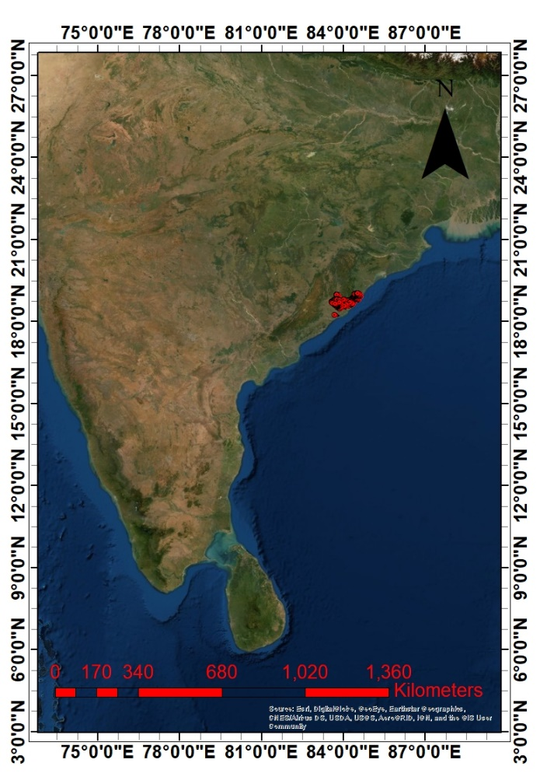
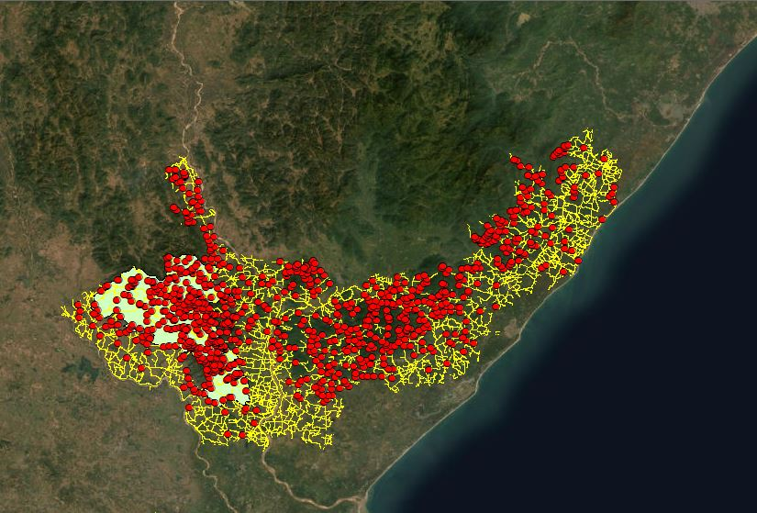
Study Area

Slide 4
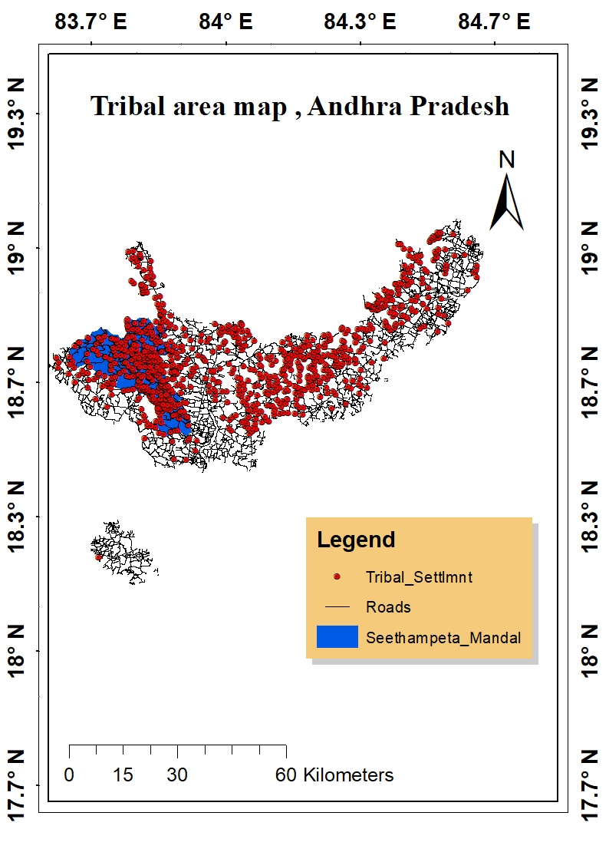
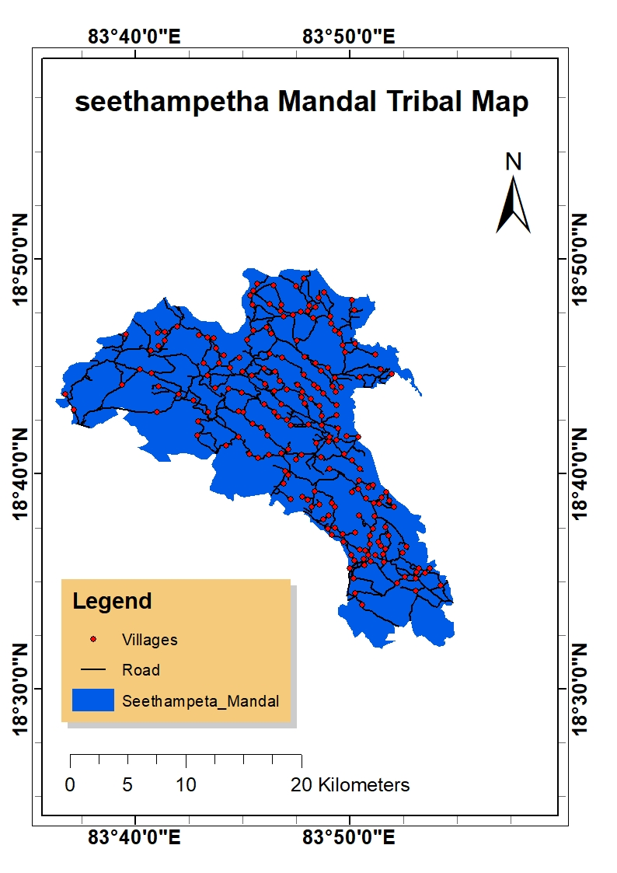

Slide 5
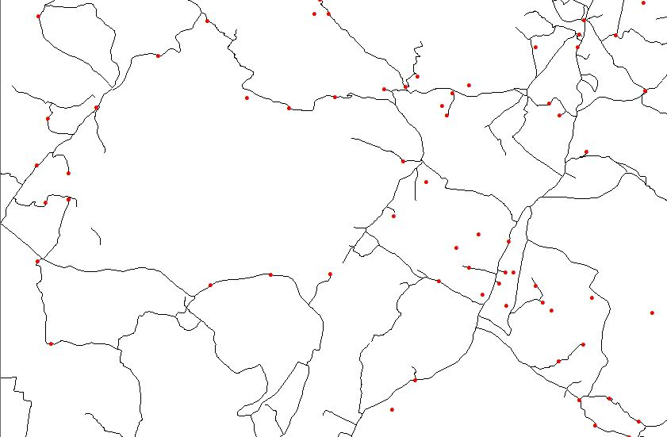
Procedure:
I. Defining the area :Clipping Seethampeta mandal with 390 villages.
II. Network Cleaning:
(i) Removing discontinuities in roads by extending the ends EXTEND Tool.
(ii) Connecting villages to the nearest road boundary by SNAPPING.
(iii) Manually removing the villages which are within 400m : Search the villages which are within 400m using POINT DISTANCE TOOL. And, deleting all the villages except one village.
(iv) Finally, 201 villages are obtained which are considered for further network analysis.

Slide 6
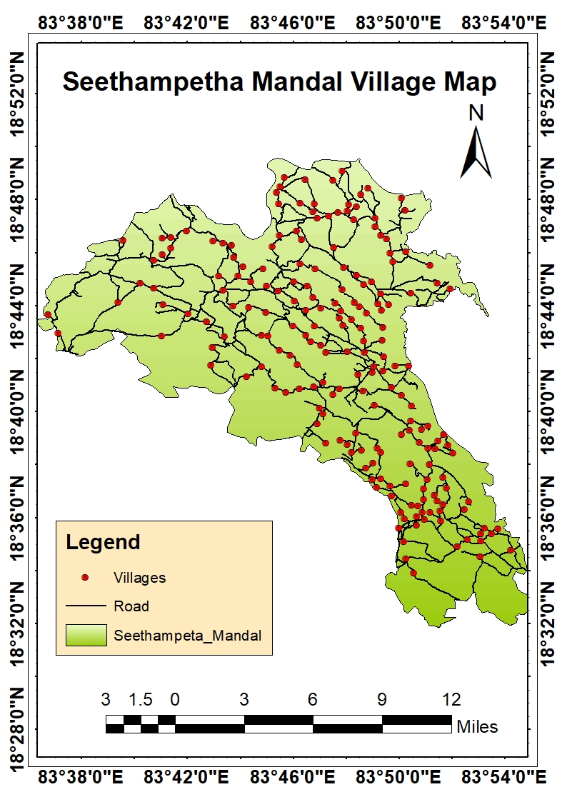
III. NETWORK ANALYSIS:
(i) Create geodatabase > import> Feature class> Villages & Roads.
(ii) In road shapefile> new network dataset.
(iii) Impedance = Length
IV. To generate the potential ambulance locations:
Assumed Average speed of ambulance in hilly region = 15Km/hr.
(i) Distance covered within 15minutes = 3750m
(ii)Hence, potential point should be at max 3750m from any village.
(iii)Using SERVICE AREA tool create the polygon of 3750m on roads.
(iv)Convert polygon to polyline using POLYGON TO LINE tool.

Slide 7
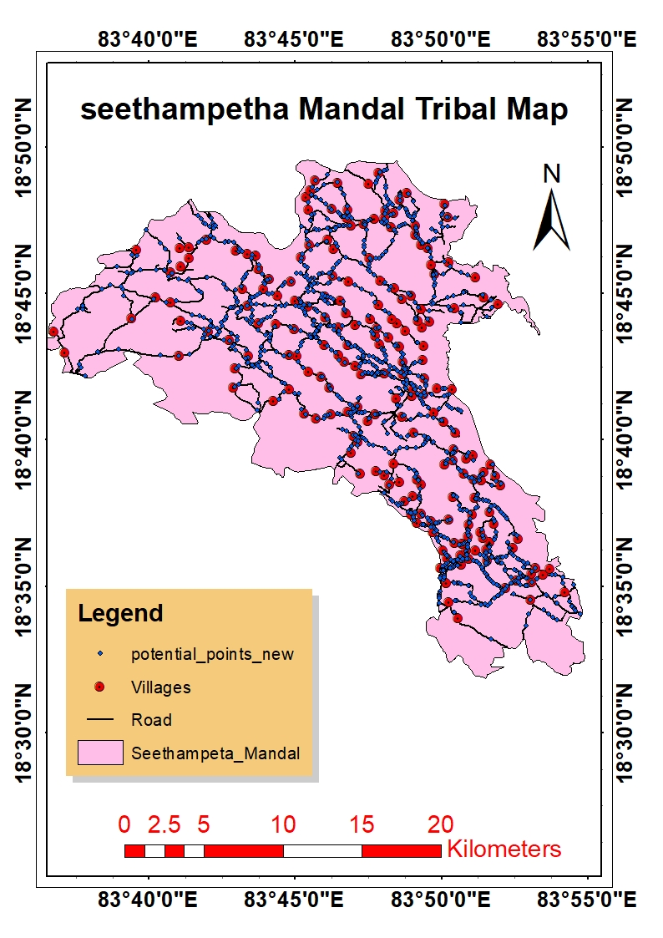
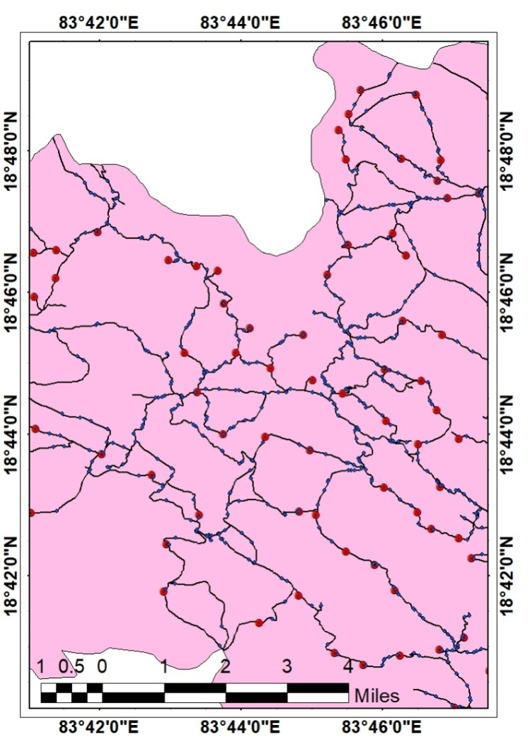
(v)Find the intersection points of these lines and roads in QGIS using Line Intersection tool. And 1529 potential locations are generated.
V. Run the location allocation network on the data, using potential points as the facilities and villages as demand points.
VI. Give the condition of minimize the facilities and impedance as 3750m.

Slide 8
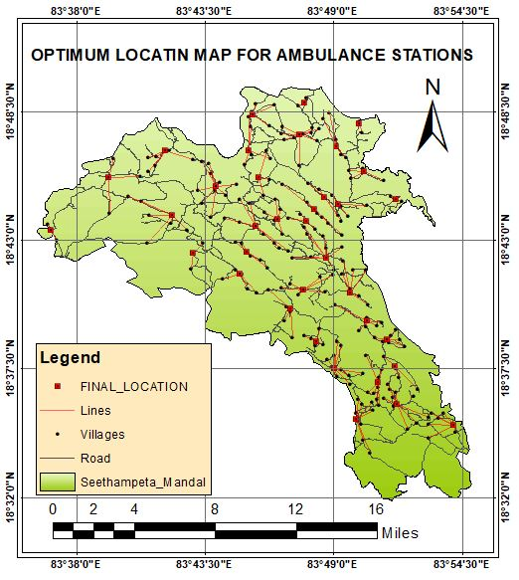
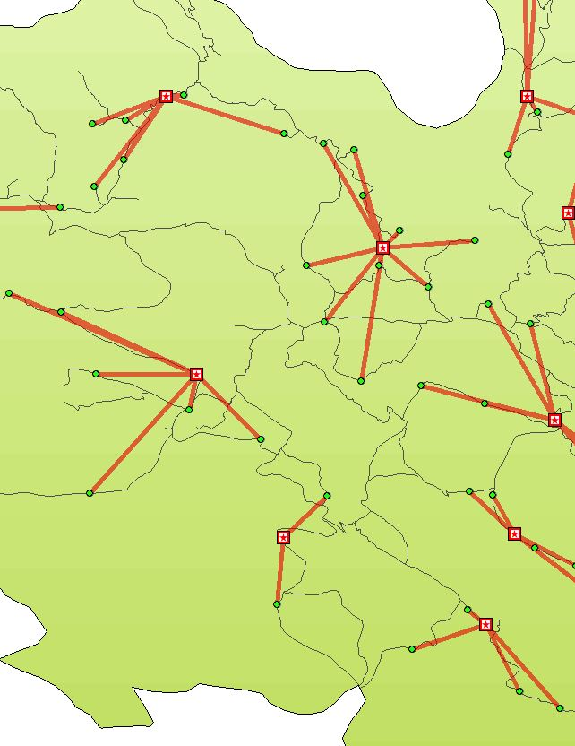
Map showing locations of ambulance stations

Slide 9
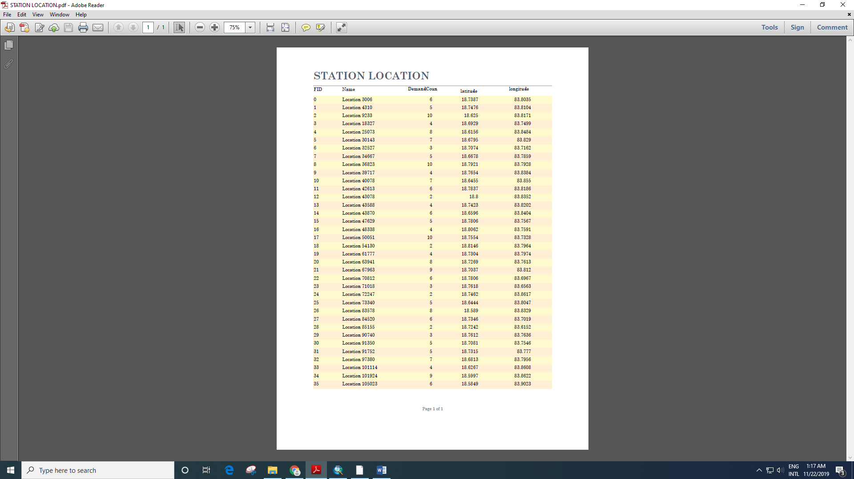
CONCLUSION
The number of ambulance station location for Seethampeta mandal, with 15 minutes response time and 15km/hr speed is 36.
Results showed that all villages are served by at least one station.
DemandCoun column is showing how many villages are being served by that particular ambulance station.

Slide 10
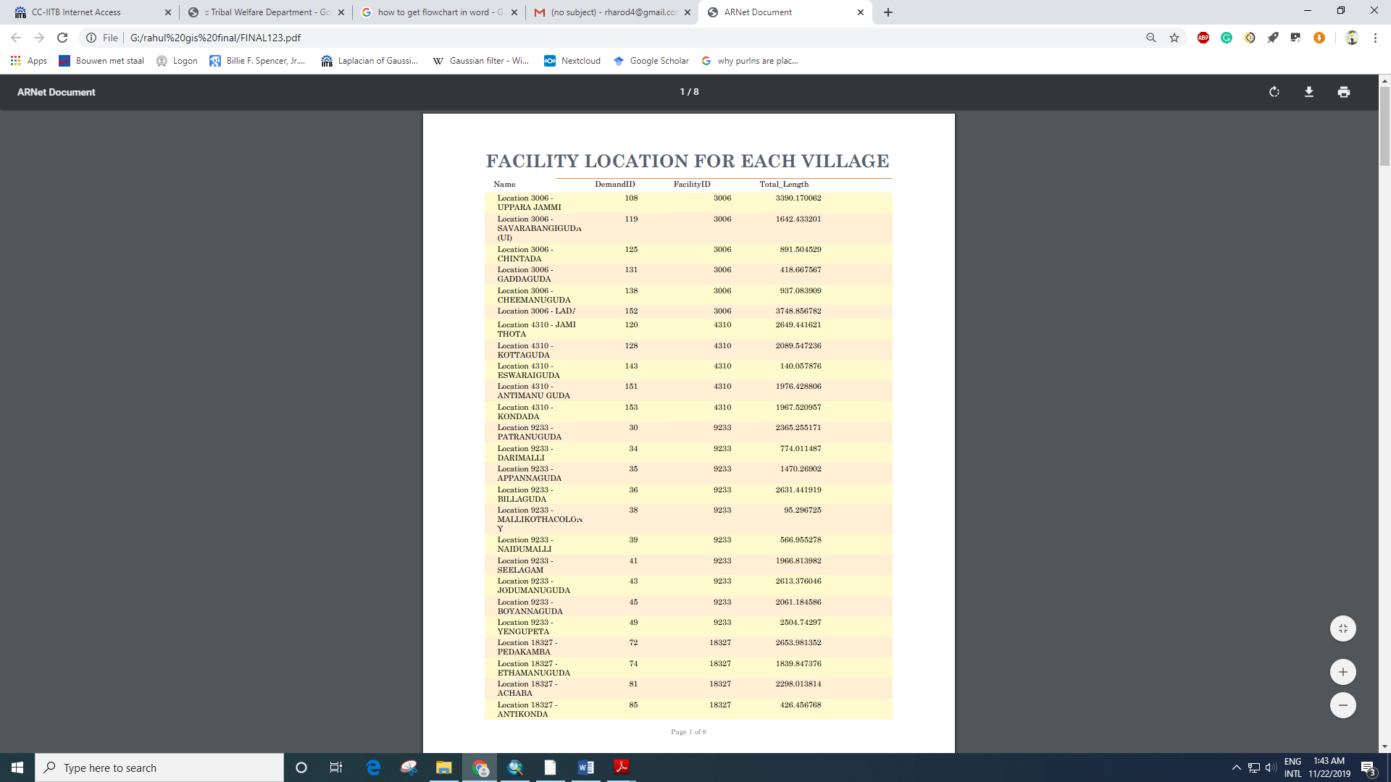
Table is showing the name of the villages which are connected to which facility. DemandID – showing villages ID. FacilityID – showing ambulance station ID. Total_Length – Length of road from facility to demand.

Slide 11
FUTURE SCOPE OF STUDY
Using population data and other factors like economical condition, health issues, etc. the number of ambulance required at each station can be find out.

Slide 12
ACKNOWLEDGEMENT
We would like to express our deep and sincere gratitude to our Supervisor Prof. Raaj Ramsankaran and PhD scholar Sathya Kumar V for giving us this opportunity to apply our theoretical knowledge in a real life problem and providing invaluable guidance throughout this project.

Slide 13
THANK YOU

