Slide 1
StackHack 2.0 - Office Cafeteria App
P R Rahul Hebbar

Slide 2

Technologies Used
Front End
React - For UI -> https://reactjs.org/
Axios - for HTTP requests -> https://github.com/axios/axios
Recoil.js - for state management -> https://recoiljs.org/
Reactstrap - for UI bootstrap components -> https://reactstrap.github.io/

Slide 3



Backend
Express.js - server side -> http://expressjs.com/en/api.html
Database
NeDB - API is a subset of MongoDB's -> https://github.com/louischatriot/nedb

Slide 4
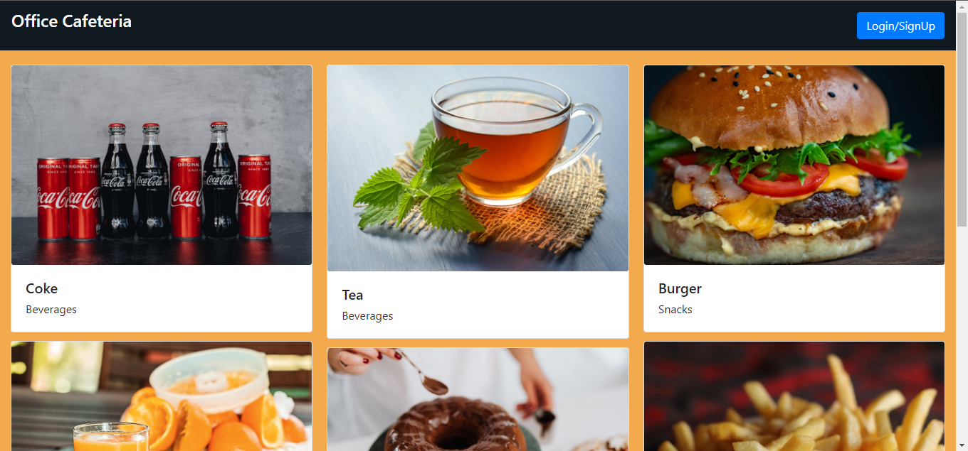
Photos
Menu

Slide 5
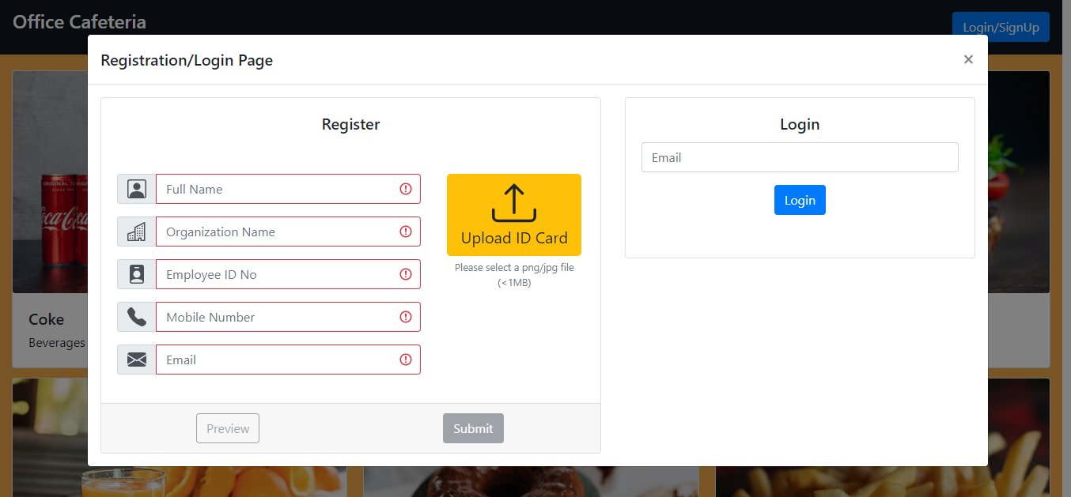
Login/Register Page

Slide 6
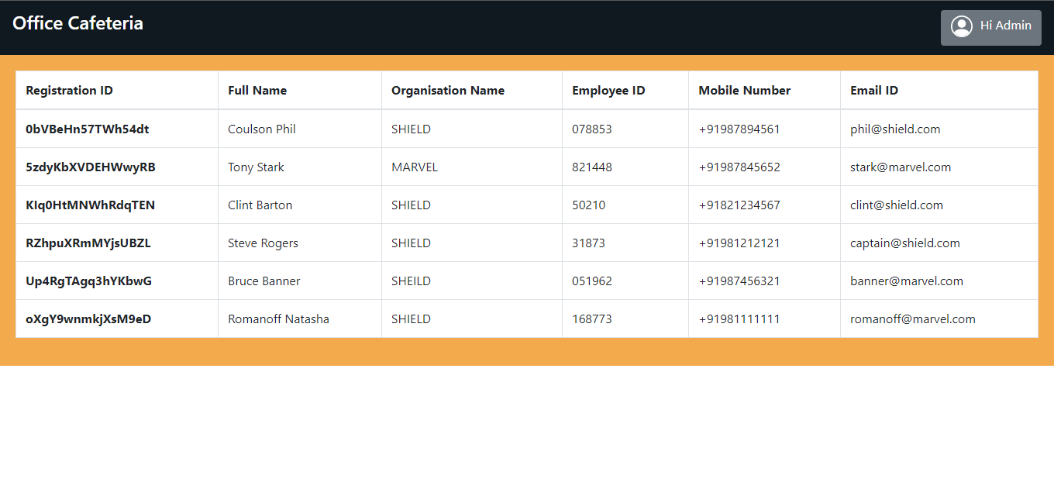
Admin Dashboard - accessed by login email - admin@admin.com

Slide 7
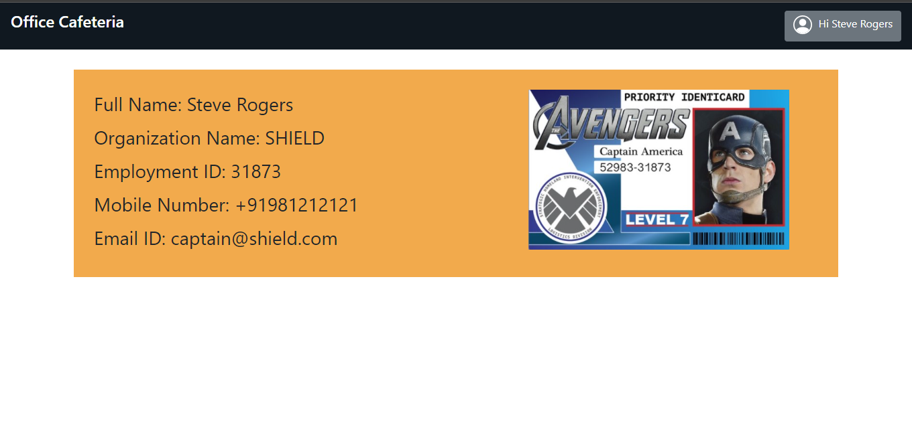
Profile Page accessed by using registered email id

Slide 8
Find Project At…..
Heroku -> https://officecafeteria.herokuapp.com/menu
Github - > https://github.com/rahul-hebbar/Office_Cafeteria_App

Slide 9
Thank You !!

