Slide 1
Jukestapose
Playing Music By Detecting Human Poses
Catherine Cao, Ryan Rosich, Rahul Kulkarni
UCB - W261 Fall 2019

Slide 2
Overview
Jukestapose is a Pose Controlled Jukebox built using Neural Networks
A human poses in front of a camera, Jukestapose then:
Detects the pose using 25 points mapped to a human skeleton
Classifies these points into labelled poses
Plays a song based on a specific Pose (Y pose for YMCA)
Based upon an existing model called OpenPose to detect Body Positions
We label a set of Poses and train the model on a neural network using our label data
Predict the Poses using our trained Model and based on the Pose prediction use a cloud plugin API to play a song (YouTube)

Slide 3
System Flow
JETSON TX2
GRAB CAMERA FRAME
DETECT BODY POINTS USING OPENPOSE
DETECT LABELLED POSES USING JUKESTAPOSE MODEL
INVOKE API TO PLAY A SONG FOR SPECIFIC POSES
PLAY SONG ON YOUTUBE

Slide 4
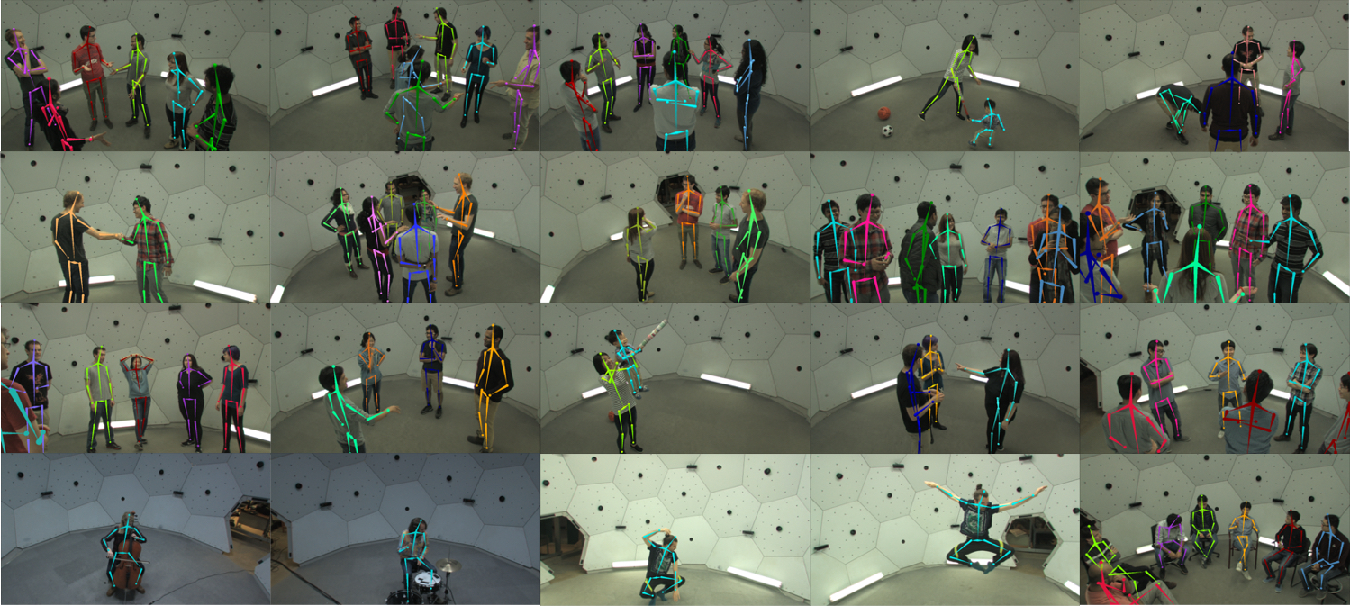
Dataset
CMUs Panoptic Dataset
Massively Multiview System
480 VGA camera views
30+ HD views
10 RGB-D sensors
Scenes with Labels
3D Body Pose
Multiple people
1.5 Million 3D Skeletons and 65 sequences

Slide 5
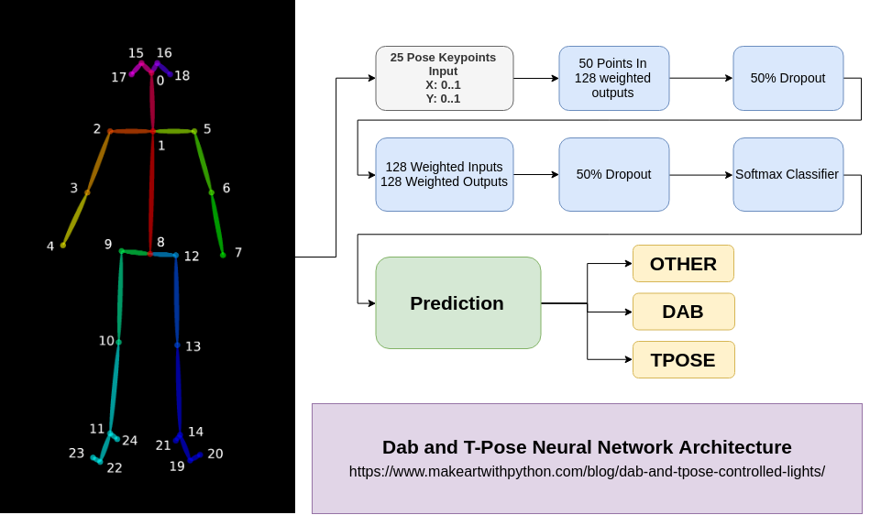
Model Training

Slide 6
Model Details
25 known body point locations as 3 dimensional data of X, Y and Confidence
One hot encoded, normalized and flattened to 50 points
2x128 layer sequential model with a Relu Activation
End with a Softmax Classifier
Adam Optimizer using a categorical cross entropy loss function
2000 epochs

Slide 7
Challenges and Future
Installation and Deploying the Model dependencies was quite painful on the Jetson TX2
Dependency issues and resolving install failures
LLVM compatibility
No container available
Making this a general purpose JukeBox using a Cloud Music Plugin model that can interface with online music portals
Tying together a sequence of moves instead of a single pose to play a song

Slide 8
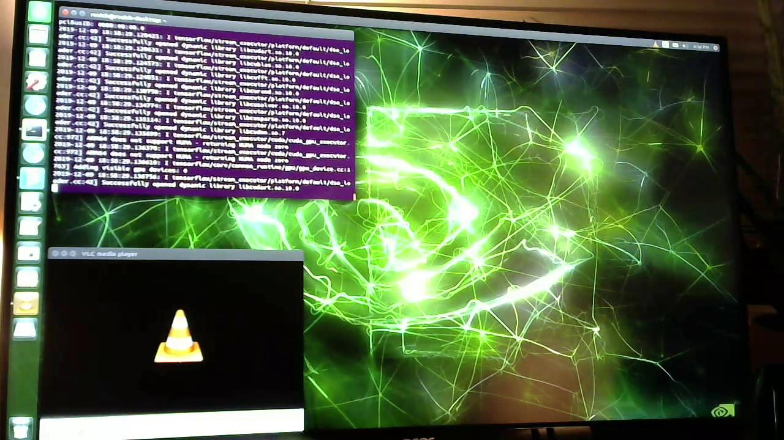
Demo Video

Slide 9
References
https://github.com/CMU-Perceptual-Computing-Lab/openpose
https://github.com/CMU-Perceptual-Computing-Lab
https://www.makeartwithpython.com/blog/dab-and-tpose-controlled-lights/

