Slide 1
Borrowed or Real
When a tariff hits, does the business come back?
Rahul Reddy Mandadi + Raunaksingh Khalsa
DS 5500 Data Science Capstone | Presentation 2 | November 2026
For importers and lenders who depend on one supplier country.
github.com/rahul-mandadi/tariff-rush
Notes:
SPEAKER SPLIT: suggest Rahul 1-6, Raunak 7-12. Both must speak.
Target under 10 minutes.
Open with one line: a tariff is a tax on imports.
The story: copper looks like it came back, but only the untaxed part did. Across hundreds of antidumping cases, where the duty becomes permanent the targeted country loses about a third of its position and does not get it back within 18 months; nearly six in ten targeted products fall and stay down.

Slide 2
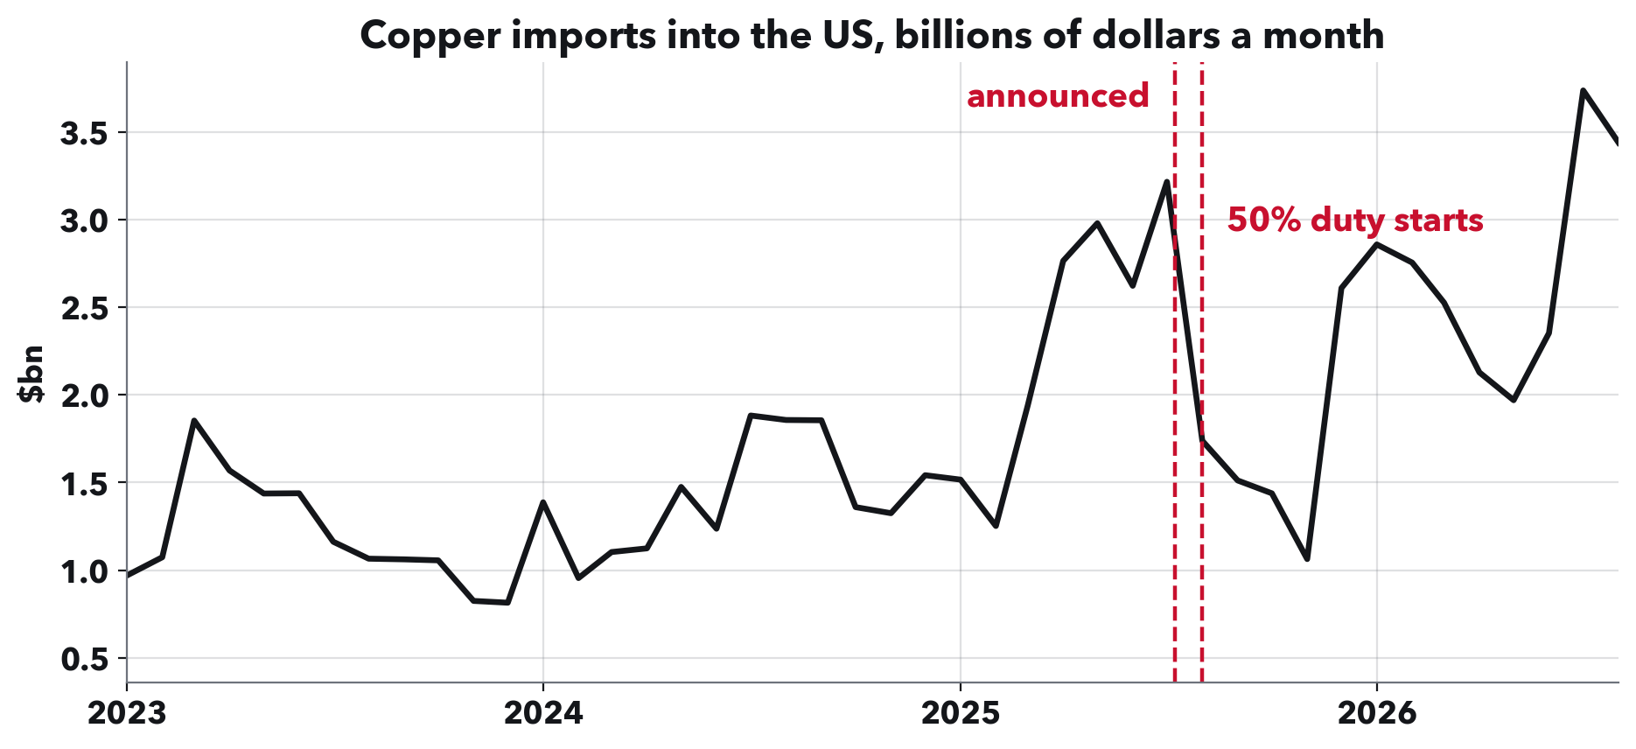
RAHUL REDDY MANDADI + RAUNAKSINGH KHALSA
Copper rushed in, crashed, then came back.
When a tariff is announced, importers often buy early, then imports drop. Is that drop borrowed, meaning they bought ahead and will be back, or real, meaning the business has left? Copper looks borrowed: total imports came back.
Notes:
This is the question in the title. Borrowed means bought early and comes back. Real means gone.
Copper is our running example because the answer is not what it looks like. Hold that thought for two slides.

Slide 3
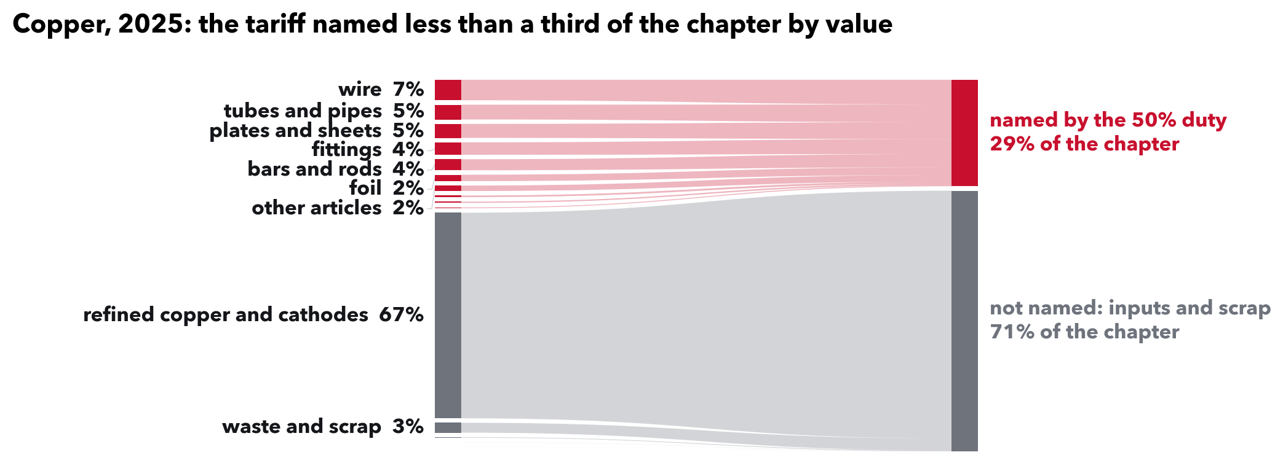
RAHUL REDDY MANDADI + RAUNAKSINGH KHALSA
But most copper was outside this duty.
The 50% duty named wire, tubes and sheets: 29% of copper imports by value. Refined cathodes, copper sold as a raw input and 67% of the total, were outside it. That is typical: a tariff usually names about 5 dollars of every 100 its category imports.
Notes:
Say this, it answers Kylie's note '1% coverage means ...': 1% coverage means the products a tariff names made up one dollar in every hundred that the category imported. The other ninety-nine were in products outside that tariff's list.
A category here is a broad product group, what the customs schedule calls a chapter, like copper or pharmaceuticals.
How it is built, Kylie's 'same for Fig 5': for each pairing of a tariff list with a category, add up imports of the products the list names, from all countries, and divide by the whole category. Across 1,350 pairings the median is 5.4%, and a third are under 1%. We use 2017 trade, before the 2018 tariffs, so the shares are not already shaped by them. It does not hinge on the year: 5.4% with 2016, 5.4% with 2017, 6.7% with 2024.

Slide 4
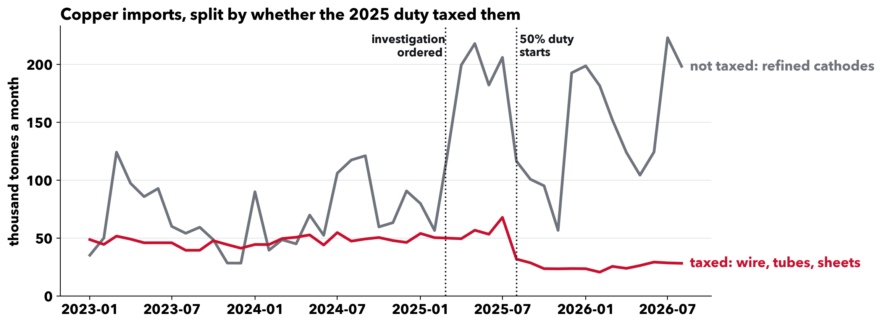
RAHUL REDDY MANDADI + RAUNAKSINGH KHALSA
Split it, and the answer appears.
The duty's main taxed products fell to about half their old level and stayed there. Untaxed cathodes are what came back. For the products the duty hit, the drop looks real. One material and one tariff, so an example; the next slides test it across hundreds.
Notes:
Numbers if asked, thousand tonnes a month: the taxed group ran 49 before, peaked at 68, settled at 27. Cathodes ran 89, peaked at 218, settled at 154.
The two lines are the main taxed group (headings 7407 to 7413: bars, wire, plates, foil, tubes, fittings) and refined cathodes, not every copper product. Which is taxed comes from the proclamation's own paragraphs; its product annex is not in the Federal Register text we hold, so groups are assigned by what each heading covers.
Both lines rose before the list of taxed products came out at the end of July. After it, only the taxed group stayed down.

Slide 5
RAHUL REDDY MANDADI + RAUNAKSINGH KHALSA
How we measure it, product by product.
One product from one country, every month, using the eight-digit product codes tariff orders are written in: 15.9 million rows of Census trade data, 2015 to 2026.
Compared with other countries selling the same product that month, with months of no trade counted as zero. A change shared by all of them cancels out.
Checked against a fake date. The same calculation on the same cases two years earlier. A real effect has to beat the fake one.
707 preliminary notices form 507 country cases; 384 have a full 18 months, 286 a fake date. Values are nominal dollars (not inflation-adjusted); shared price changes cancel.
Notes:
This is the method Kylie asked us to explain.
Why compare countries within a product: 2020 to 2025 moved every trade series at once. A before-and-after on one country cannot tell that apart from the duty. Comparing with other suppliers of the same product in the same month removes what they share.
Each case gets its own small panel: its products, the targeted country, and every country that sold those products before the case, for the 18 months before and after. Who is in the panel is fixed from before the case, and a month with no trade stays in as zero, so a supplier that stops selling is counted, not dropped. Rivals that face a case of their own on the product around the same time are left out of the comparison.
We read every decision notice: 21 of 728 did not start a duty (negative findings, side notices, reviews of old orders) and are out. Uncertainty is computed over whole investigations, because one petition often names several countries.

Slide 6
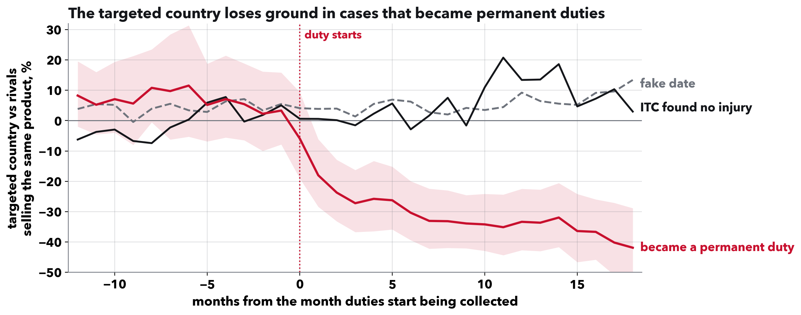
RAHUL REDDY MANDADI + RAUNAKSINGH KHALSA
Losses persist in cases that become orders.
These duties tax one product from one named country. Where the duty became permanent (329 cases), that country's imports fell about 31% against rival suppliers over the 18 months we see. Where the trade commission found no injury (45 cases), no lasting fall.
Notes:
Define both on the way in: an antidumping duty answers a complaint that a foreign producer sells below its home price; a countervailing duty answers a complaint that it is subsidised. Both name one product and one country, and there are hundreds of them.
How a case ends: a few months after the duty starts, the US International Trade Commission votes on whether the imports hurt US producers. Yes, and the duty becomes a permanent order; no, and it is lifted and the deposits are refunded.
Reading the chart: zero is the country's position against rival suppliers a year and a half before the duty (the average of months 18 to 13 before). We find no clear average surge before the duty; individual cases may differ. The red line breaks at the duty and keeps falling; the shading is its 95% range.
Numbers if asked: minus 0.37 log points (standard error 0.065), minus 0.46 in months 13 to 18; the chance the product is traded at all falls 9 points. All cases pooled: minus 0.19 (standard error 0.11).
Be careful with the black line: the commission's vote looks at the imports themselves, and that group is small and mostly the 2024 aluminum extrusions cases. It describes the two groups; it does not prove the duty caused the gap, and 18 months is not proof the business left for good.
If asked what changed since last time: we rebuilt this estimate on a fixed set of products with zero months kept. The earlier '42% above its usual level' came from how the old comparison was set up, not from a surge before the case.

Slide 7
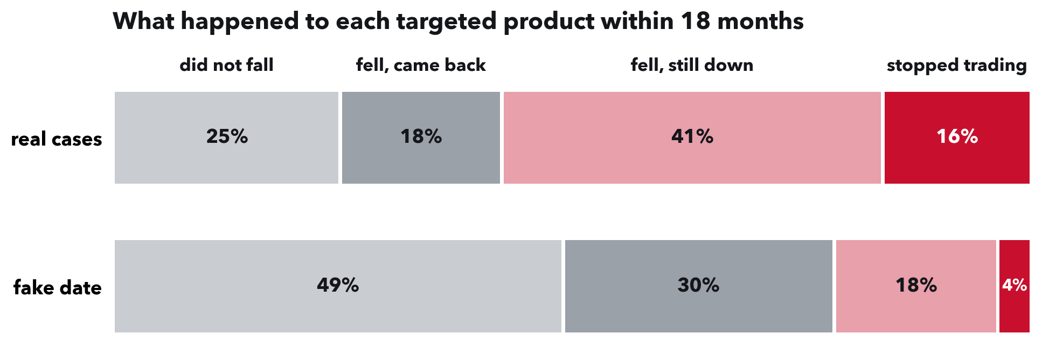
RAHUL REDDY MANDADI + RAUNAKSINGH KHALSA
Six in ten fall and do not recover.
384 cases, each counted once. 25% did not fall, 18% fell and recovered, 41% stayed down while trading, 16% had no imports in months 13 to 18 (fake date: 4%).
Notes:
This is what a buyer of one of these products can expect.
Definitions: fell means the country's share of the product's imports dropped at least a fifth below its level before the case, within six months of the duty. Came back means back at or above that level for three months in a row. Stopped trading means no imports at all in months 13 to 18. Each case counts once, and only cases with a full 18 months are in the shares.
Counting from the month of the fall, about one in four products was back within 18 months of falling, against six in ten on the fake date. Where the commission confirmed the duty, nearly one in five stopped trading.
Robust: with a 10% or 30% definition of a fall, 16% still stop trading. On just the 282 cases that also have a fake date, 13% stop trading against 4%. And built only from earlier cases, these rates beat a blind guess on later cases in five of six years.

Slide 8
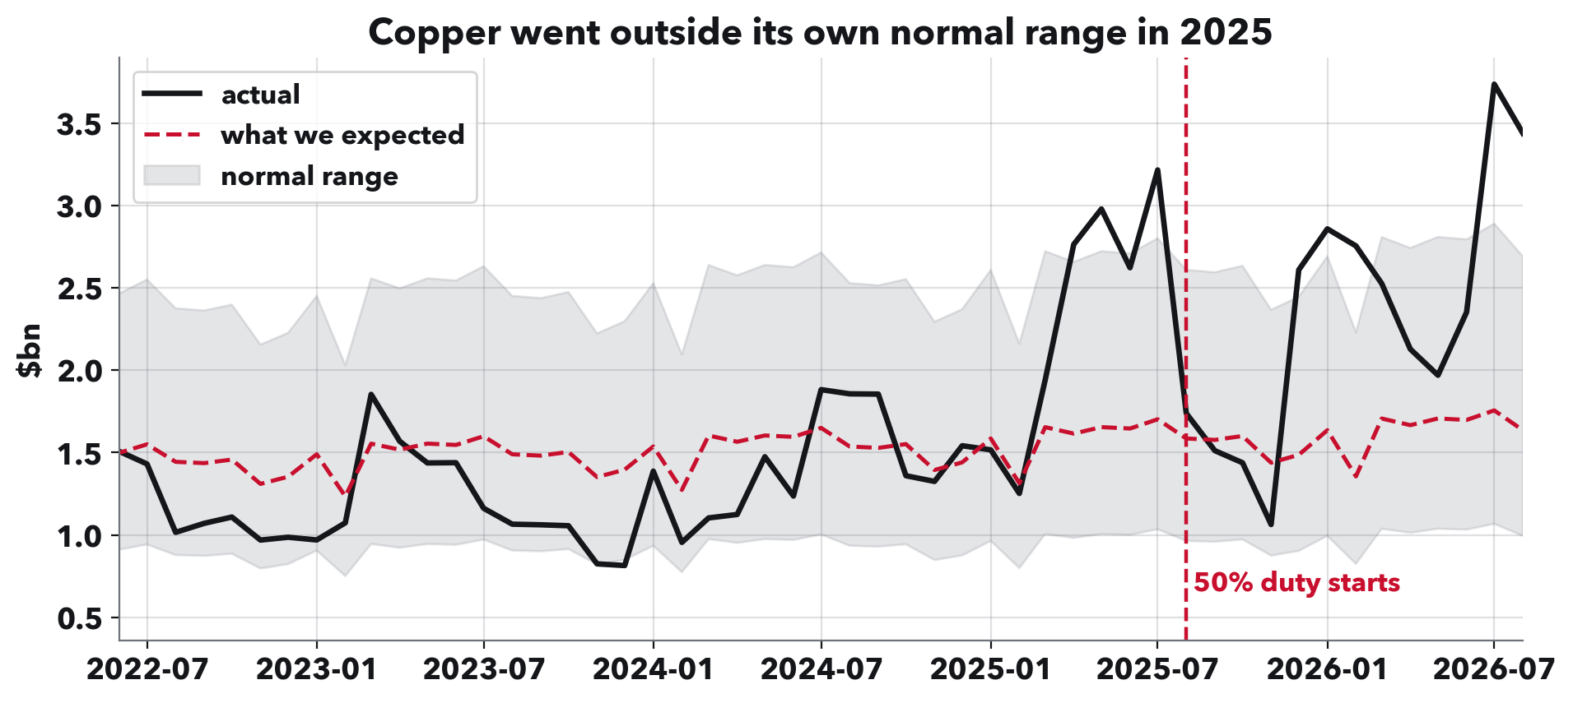
RAHUL REDDY MANDADI + RAUNAKSINGH KHALSA
How we spot an unusual month.
Three steps. Draw an expected line from the category's past: recent trend plus usual seasonal pattern. Shade a normal range from how much it usually wobbles. Score each month of 2025 by its gap above the line as a share of the range: 1.0 reaches the top edge. The category keeps its highest month.
Notes:
This answers Kylie's note on Fig 4: explain the transformation and the choices.
The choices: the trend uses the last three years, so the line reflects recent growth rather than the pre-2020 pace. The wobble is measured over the whole decade, which gives a wider, more cautious range; using only three years would flag 28 of 96 categories instead of 10. Gaps are on a log scale so a doubling counts the same for a small category as a large one. The range is 1.96 times the usual wobble. The window is January to August 2025, the one Presentation 1 used. It is a historical benchmark, not a tested forecast.
Copper here went above its range in spring 2025, before the duty.

Slide 9
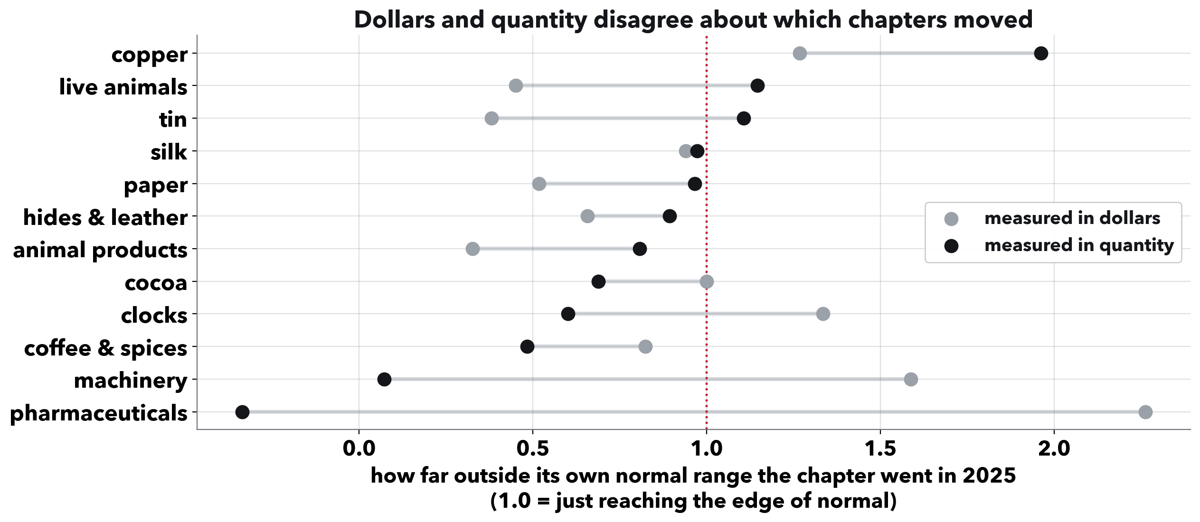
RAHUL REDDY MANDADI + RAUNAKSINGH KHALSA
Dollars alone can fool you.
One category per row, scored in dollars and in physical quantity. Cocoa looked unusual in dollars because its price per kilo roughly doubled. Pharmaceuticals barely moved in tonnes but jumped in dollars in March 2025, led by Swiss medicines at about $5,000 a kilo.
Notes:
The takeaway: a category's dollar total alone can mislead, in both directions.
Cocoa's import value per kilo went from about $4 in 2022 to about $9 in 2025.
Pharmaceuticals scores 2.26 on dollars (first of 63 categories) and minus 0.34 on tonnes (62nd). In the medicine line with the biggest March jump, Swiss shipments ran about $5,185 a kilo against $183 for Indian ones, so a shift toward Swiss product lifts dollars far more than tonnes.
This check applies to the category rankings. The antidumping result holds in physical quantity: among months with trade, quantity and value estimates are similar (minus 0.31 and minus 0.30 log points). Both ranges include zero, so this is consistent with lower volume but does not rule out price changes.

Slide 10
RAHUL REDDY MANDADI + RAUNAKSINGH KHALSA
What this means.
For an importer tied to one country: weigh qualifying another supplier early. In six of ten past cases the product fell without recovering; one in six had no imports a year on.
The earliest warning is history: past rates beat a blind guess on later cases; day-one facts such as the duty rate add no reliable edge.
For anyone measuring tariffs: study the products a tariff names, not the whole category, and check quantities as well as dollars.
Notes:
This is the Discussion. One takeaway for each audience; about a minute.
The first bullet comes from 384 past cases. It is what usually happens, not a promise for any one supplier, and we have not tested it with importers.
We find no clear average surge before these duties, so little buying ahead to pay back. For cases that became orders the answer is closer to real than borrowed, over the 18 months we observe; that is not proof the business left for good.

Slide 11
RAHUL REDDY MANDADI + RAUNAKSINGH KHALSA
What the checks confirmed.
Inflation and price. Shared price changes cancel; in tonnes the fall matches dollars.
Every duty decision read. 707 kept; 21 that started no duty removed.
Finer product codes. The data uses the eight-digit codes tariffs name.
The tariff list. 120 tariff documents, each tagged with the law it rests on.
Unusual-month score. One consistent scale; same top ten categories.
Each check runs from a script in the repository.
Notes:
These answer Kylie's notes from Presentation 1.
Say this about the list, since Kylie flagged it: last time we said 134. Fourteen of those were Labor Department notices about retraining for laid-off workers, not tariffs, so the list is 120.
Inflation, two BLS price indexes: adjusting by all import prices keeps 8 of the top 10 categories (rank correlation 0.97); by non-fuel import prices, 9 of 10 (0.99). Neither touches the antidumping result, where a shared price change cancels, and the tonnes check points to lower volume rather than a price cut, though both ranges include zero.
The 21 notices removed: 4 negative findings, 9 side notices about retroactive duties, 8 reviews of orders that already existed.

Slide 12
RAHUL REDDY MANDADI + RAUNAKSINGH KHALSA
Next: an early warning on the day of a duty.
The question. On the day a duty starts, can we tell which suppliers will not come back?
First result. Past rates beat a blind guess on later cases. A model adding the duty rate, rival count and recent trend gains too little over them to rely on.
Next. Test whether facts public a few months in, like the ITC's vote, sharpen the odds.
The deliverable. For an importer facing a case: what usually happens, how long it takes, and how this case compares.
Final report and presentation, December 11.
Notes:
Close here: where the duty stays, the business does not come back; the next question is whether we can tell which suppliers in advance.
Numbers if asked: trained only on earlier cases whose month 18 had been published by Census, tested on later years, using only notices published by the day the duty started. Brier score 0.246 against 0.250 for the historical rate (lower is better), improvement 0.004 with a 90% range of -0.005 to 0.013, so no reliable gain; it ranks a bad outcome above a good one 61% of the time. Better in three of six test years.
If asked about the rush before tariffs like copper's: we are rebuilding that tariff list document by document before we report anything on it.

