Slide 1
Borrowed or Real
After a U.S. trade duty, does the business come back?
Rahul Reddy Mandadi + Raunaksingh Khalsa
DS 5500 Data Science Capstone | Final presentation | December 2026
For importers who buy a product from a country named in a duty.
github.com/rahul-mandadi/tariff-rush
Notes:
SPEAKER SPLIT: suggest Rahul 1-7, Raunak 8-15. Both must speak.
Target the time Kylie set for the final; about 40 seconds a slide.
Open with one line: a tariff is a tax on imports.
The story: copper looks like it came back, but only the untaxed part did. Across hundreds of antidumping cases, where the duty becomes permanent the targeted country loses about a third of its position and does not get it back within 18 months; more than half of targeted products fall and stay down.

Slide 2
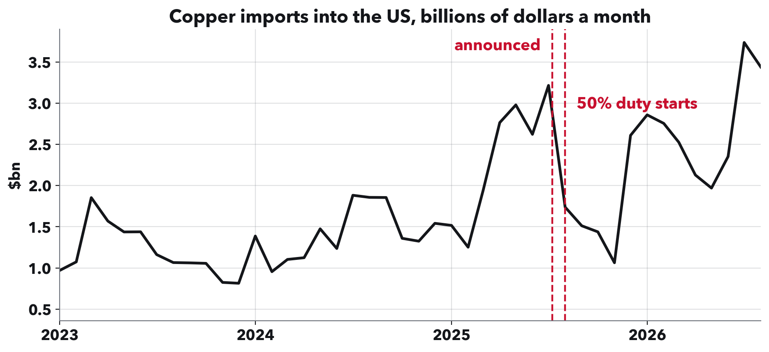
RAHUL REDDY MANDADI + RAUNAKSINGH KHALSA
Copper rushed in, crashed, then came back.
When a tariff is announced, importers often buy early, then imports drop. Is that drop borrowed, meaning they bought ahead and will be back, or real, meaning the business has left? Copper looks borrowed: total imports came back.
Notes:
This is the question in the title. Borrowed means bought early and comes back. Real means gone.
Copper is our running example because the answer is not what it looks like. Hold that thought for two slides.

Slide 3
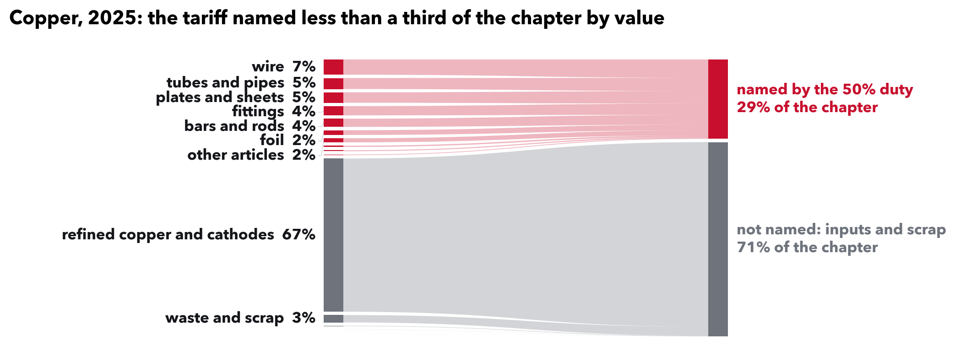
RAHUL REDDY MANDADI + RAUNAKSINGH KHALSA
But most copper was outside this duty.
The 50% duty named wire, tubes and sheets: 29% of copper imports by value. Refined cathodes, copper sold as a raw input and 67% of the total, were outside it. Most of a category outside the tariff is typical: the median list names about 5 dollars in 100.
Notes:
Say this, it answers Kylie's note '1% coverage means ...': 1% coverage means the products a tariff names made up one dollar in every hundred that the category imported. The other ninety-nine were in products outside that tariff's list.
A category here is a broad product group, what the customs schedule calls a chapter, like copper or pharmaceuticals.
How it is built, Kylie's 'same for Fig 5': for each pairing of a tariff list with a category, add up imports of the products the list names, from all countries, and divide by the whole category. Across 1,350 pairings the median is 5.4%, and a third are under 1%. We use 2017 trade, before the 2018 tariffs, so the shares are not already shaped by them. It does not hinge on the year: 5.4% with 2016, 5.4% with 2017, 6.7% with 2024.

Slide 4
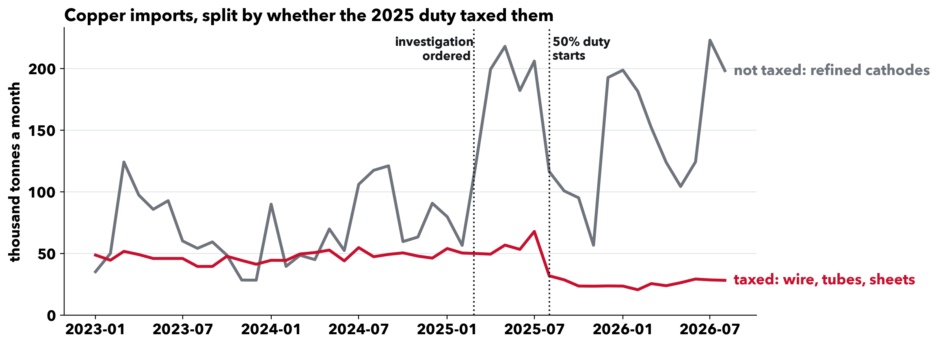
RAHUL REDDY MANDADI + RAUNAKSINGH KHALSA
Split it, and the answer appears.
The duty's main taxed products fell to about half their old level and stayed there. Untaxed cathodes are what came back. For the products the duty hit, the drop looks real. One material and one tariff, so an example; the next slides test it across hundreds.
Notes:
Numbers if asked, thousand tonnes a month: the taxed group ran 49 before, peaked at 68, settled at 27. Cathodes ran 89, peaked at 218, settled at 154.
The two lines are the main taxed group (headings 7407 to 7413: bars, wire, plates, foil, tubes, fittings) and refined cathodes, not every copper product. Which is taxed comes from the proclamation's own paragraphs; its product annex is not in the Federal Register text we hold, so groups are assigned by what each heading covers.
Both lines rose before the list of taxed products came out at the end of July. After it, only the taxed group stayed down.

Slide 5
RAHUL REDDY MANDADI + RAUNAKSINGH KHALSA
Three questions behind one decision.
The decision. A company buys a product from a country just named in a duty: start qualifying another supplier now, or wait for the business to come back?
Q1. Is there a rush to buy before the duty?
Q2. After the duty, does the targeted country's trade fall, and does it stay down?
Q3. How long does recovery take, and how early can we tell?
We answer with history: 704 U.S. antidumping and countervailing duty decisions, 2015 to 2026.
Notes:
This is the analytic problem Kylie asked us to make clearer.
Why these duties: an antidumping duty answers a complaint that a foreign producer sells below its home price; a countervailing duty answers a complaint that it is subsidised. Each names one product and one country, which lets us compare that country with the others selling the same product, and there are hundreds of them.
The timeline matters for the decision: petition, then Commerce opens an investigation, then about six months later the preliminary determination starts the duty. That is the decision day. A few months after, the trade commission votes on whether the duty stays.
We first tried to forecast the level of trade, as the proposal planned. It failed: the year a case happened explained far more than anything about the case. Comparing a country with its rivals in the same month removes the year, which is the design here.

Slide 6
RAHUL REDDY MANDADI + RAUNAKSINGH KHALSA
Importers make this call, and it is slow.
They switch. In the trade commission's own surveys, 27 of 54 aluminum extrusion buyers and 23 of 45 steel nail buyers changed suppliers, mostly for other reasons.
It takes months. Qualifying a new supplier took from days to 18 months; tin mill buyers averaged about seven.
Some move early. Floor & Decor moved its Chinese tile sourcing to other countries after the 2019 preliminary duties.
Waiting can pay. Deposits are refunded if the duty is lifted, so when to act matters.
Sources: USITC final staff reports, Publications 5560, 5370 and 5492; Floor & Decor Form 10-K, February 2020.
Notes:
This is who the answer is for, and the evidence that they make this decision.
The trade commission sends questionnaires to purchasers in every case. In the final staff reports for our own cases, about half of responding purchasers changed suppliers during the investigation period: aluminum extrusions 27 of 54, steel nails 23 of 45, PET resin 17 of 25. Not all of that switching was caused by the duty; shortages and COVID drove some of it, and the reports say so.
Qualifying a new supplier is slow: purchasers reported anywhere from days to 18 months, and tin mill buyers averaged a little over seven. A trade association told the commission 12 to 18 months for regulated products.
Floor & Decor's 10-K says that after Commerce's 2019 preliminary duties on Chinese ceramic tile it sourced from alternative countries and believed it was no longer importing the covered tile from China. Mattress makers left Vietnam within weeks of the 2020 preliminary rates, and our data show the same shift the trade press reported.
So the decision starts early, but finishing it takes months, and deposits are refunded if the duty is lifted, which is why a forecast that sharpens over the first months could help. This shows the decision and its timing exist; it does not validate our forecast or measure what it would save. Only a few purchasers per report tie their switching to the case itself.

Slide 7
RAHUL REDDY MANDADI + RAUNAKSINGH KHALSA
How we measure it, product by product.
One product from one country, every month, using the eight-digit product codes tariff orders are written in: 15.9 million rows of Census trade data, 2015 to 2026.
Compared with other countries selling the same product that month, with months of no trade counted as zero. A change shared by all of them cancels out.
Checked against a fake date. The same calculation on the same cases two years earlier. A real effect has to beat the fake one.
694 preliminary notices (704 country decisions) form 504 country cases; 381 have a full 18 months, 283 a fake date. Values are nominal dollars (not inflation-adjusted); shared price changes cancel.
Notes:
This is the method Kylie asked us to explain.
Why compare countries within a product: 2020 to 2025 moved every trade series at once. A before-and-after on one country cannot tell that apart from the duty. Comparing with other suppliers of the same product in the same month removes what they share.
Each case gets its own small panel: its products, the targeted country, and every country that sold those products before the case, for the 18 months before and after. Who is in the panel is fixed from before the case, and a month with no trade stays in as zero, so a supplier that stops selling is counted, not dropped. Rivals that face a case of their own on the product around the same time are left out of the comparison.
We read every decision notice: 24 of 718 did not start a new duty (negative findings, side notices, reviews of old orders, circumvention findings on old orders) and are out. Uncertainty is computed over whole investigations, because one petition often names several countries.

Slide 8
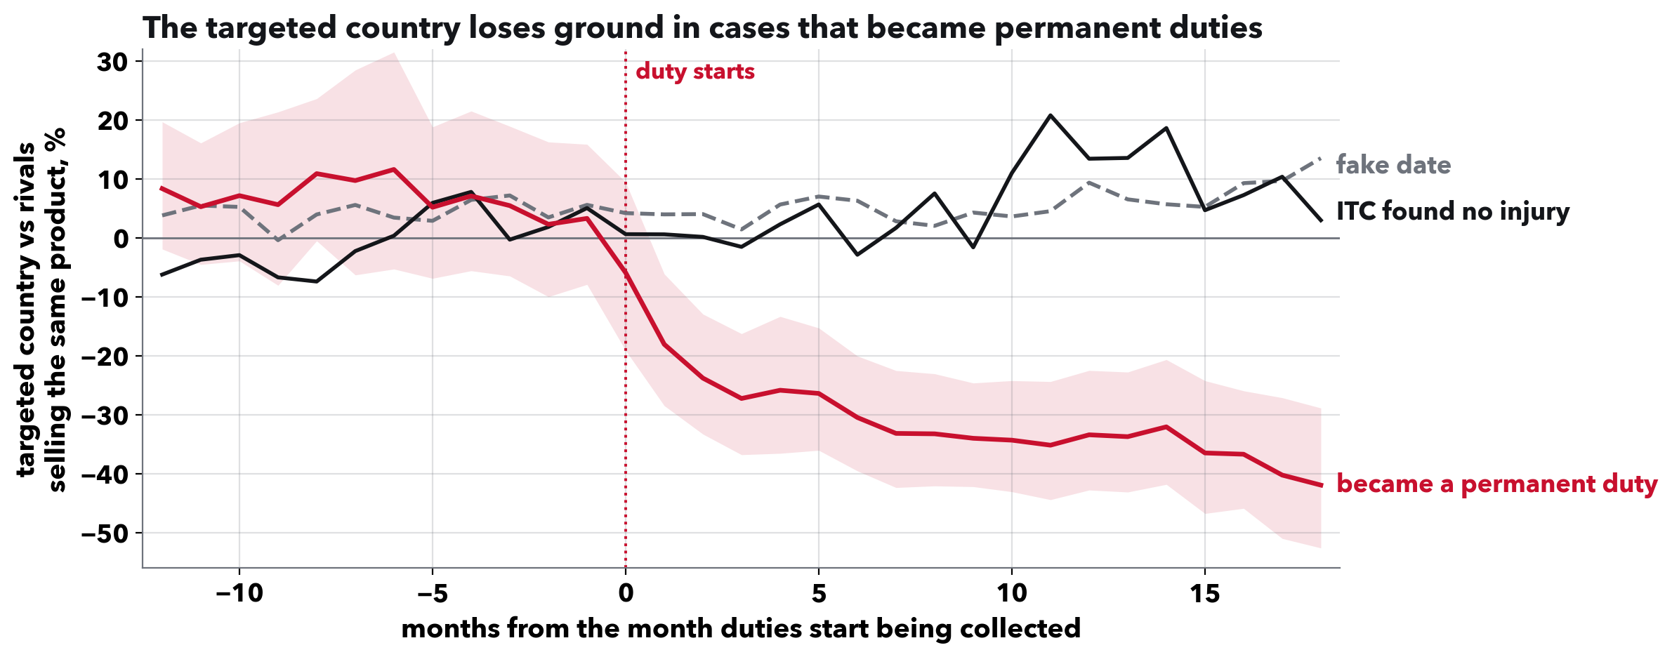
RAHUL REDDY MANDADI + RAUNAKSINGH KHALSA
Losses persist in cases that become orders.
These duties tax one product from one named country. Where the duty became permanent (326 cases), that country's imports fell about 31% against rival suppliers over the 18 months we see. Where the trade commission found no injury (45 cases), no lasting fall.
Notes:
Define both on the way in: an antidumping duty answers a complaint that a foreign producer sells below its home price; a countervailing duty answers a complaint that it is subsidised. Both name one product and one country, and there are hundreds of them.
How a case ends: a few months after the duty starts, the US International Trade Commission votes on whether the imports hurt US producers. Yes, and the duty becomes a permanent order; no, and it is lifted and the deposits are refunded.
Reading the chart: zero is the country's position against rival suppliers a year and a half before the duty (the average of months 18 to 13 before). We find no clear average surge before the duty; individual cases may differ. The red line breaks at the duty and keeps falling; the shading is its 95% range.
Numbers if asked: minus 0.37 log points (standard error 0.065), minus 0.46 in months 13 to 18; the chance the product is traded at all falls 9 points. All cases pooled: minus 0.19 (standard error 0.11).
Be careful with the black line: the commission's vote looks at the imports themselves, and that group is small and mostly the 2024 aluminum extrusions cases. It describes the two groups; it does not prove the duty caused the gap, and 18 months is not proof the business left for good.
If asked what changed since last time: we rebuilt this estimate on a fixed set of products with zero months kept. The earlier '42% above its usual level' came from how the old comparison was set up, not from a surge before the case.

Slide 9
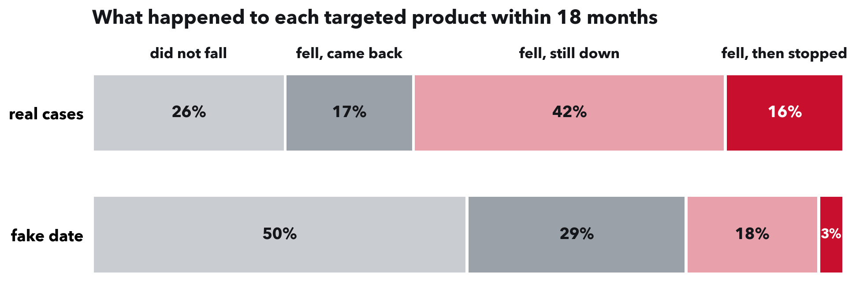
RAHUL REDDY MANDADI + RAUNAKSINGH KHALSA
More than half fall and do not recover.
380 cases, each counted once. 26% did not fall, 17% fell and recovered, 42% stayed down while trading, 16% fell and had no imports in months 13 to 18 (fake date: 3%).
Notes:
This is what a buyer of one of these products can expect.
Definitions: fell means the country's share of the product's imports dropped at least a fifth below its level before the case, within six months of the duty. Came back means back at or above that level for three months in a row. Stopped trading means no imports at all in months 13 to 18. Each case counts once, and only cases with a full 18 months are in the shares.
Counting from the month of the fall, about one in four products was back within 18 months of falling, against 58% on the fake date. Where the commission confirmed the duty, nearly one in five (18%) fell and stopped trading.
Stopped trading is a subset of falling and not coming back. Counting every product, including a few that came back first, 18% had no imports in months 13 to 18.
Robust: with a 10% or 30% definition of a fall, 16% still stop trading. On just the 277 cases that also have a fake date, 13% stop trading, against 3% on the fake date. And built only from earlier cases, these rates beat a blind guess on later cases in five of six years.

Slide 10
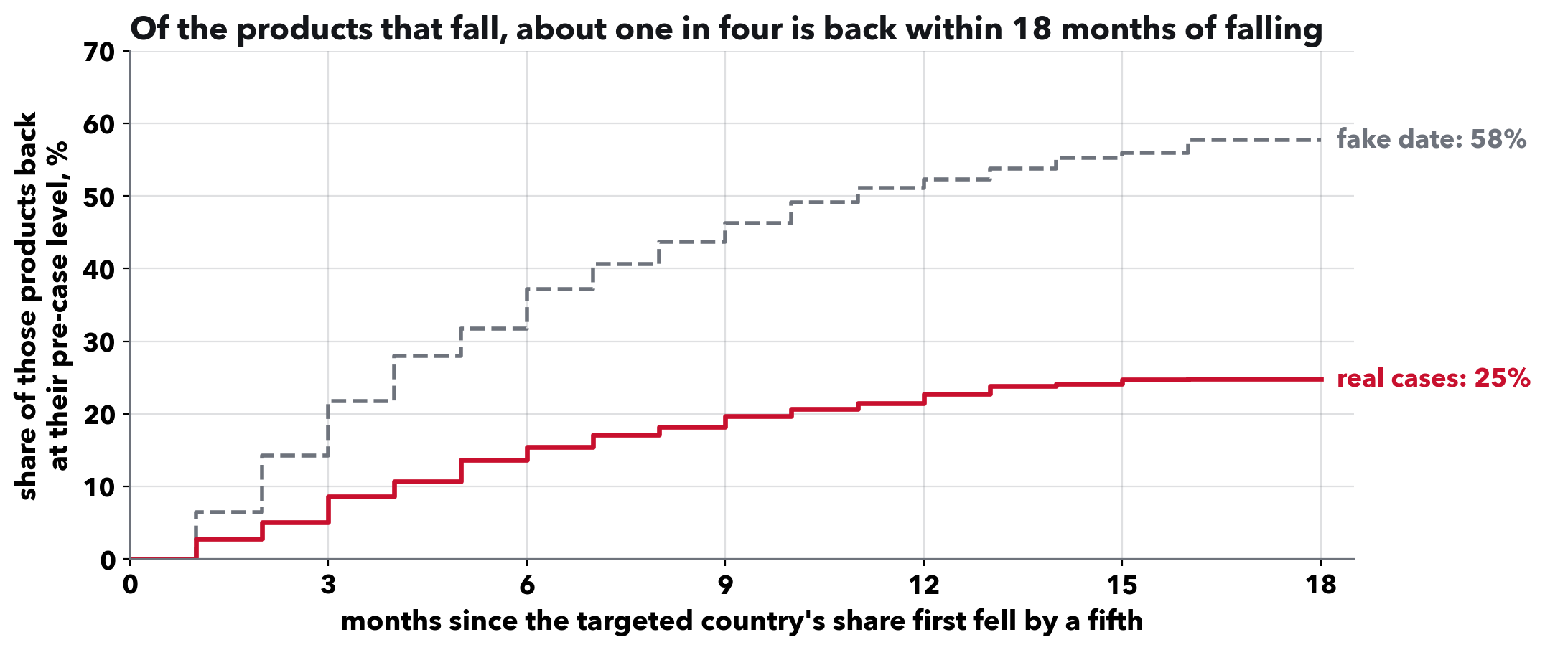
RAHUL REDDY MANDADI + RAUNAKSINGH KHALSA
One in four that falls comes back.
Counting from the month a product's share fell, 25% of products are back at their pre-case level within 18 months of falling. On the fake date, 58%.
Notes:
This is Q3, how long. The curve is a Kaplan-Meier estimate, the standard way to answer how-long questions when some cases are still running: a case that has not recovered yet stays in until our data ends instead of being dropped.
Back means at or above the pre-case share for three months in a row. The real curve rises slowly and flattens; most of the recovery that happens, happens in the first year.
Ranges if asked: 25% (21 to 28); fake date 58% (54 to 62). With a 10% or 30% definition of a fall, 27% and 24%.

Slide 11
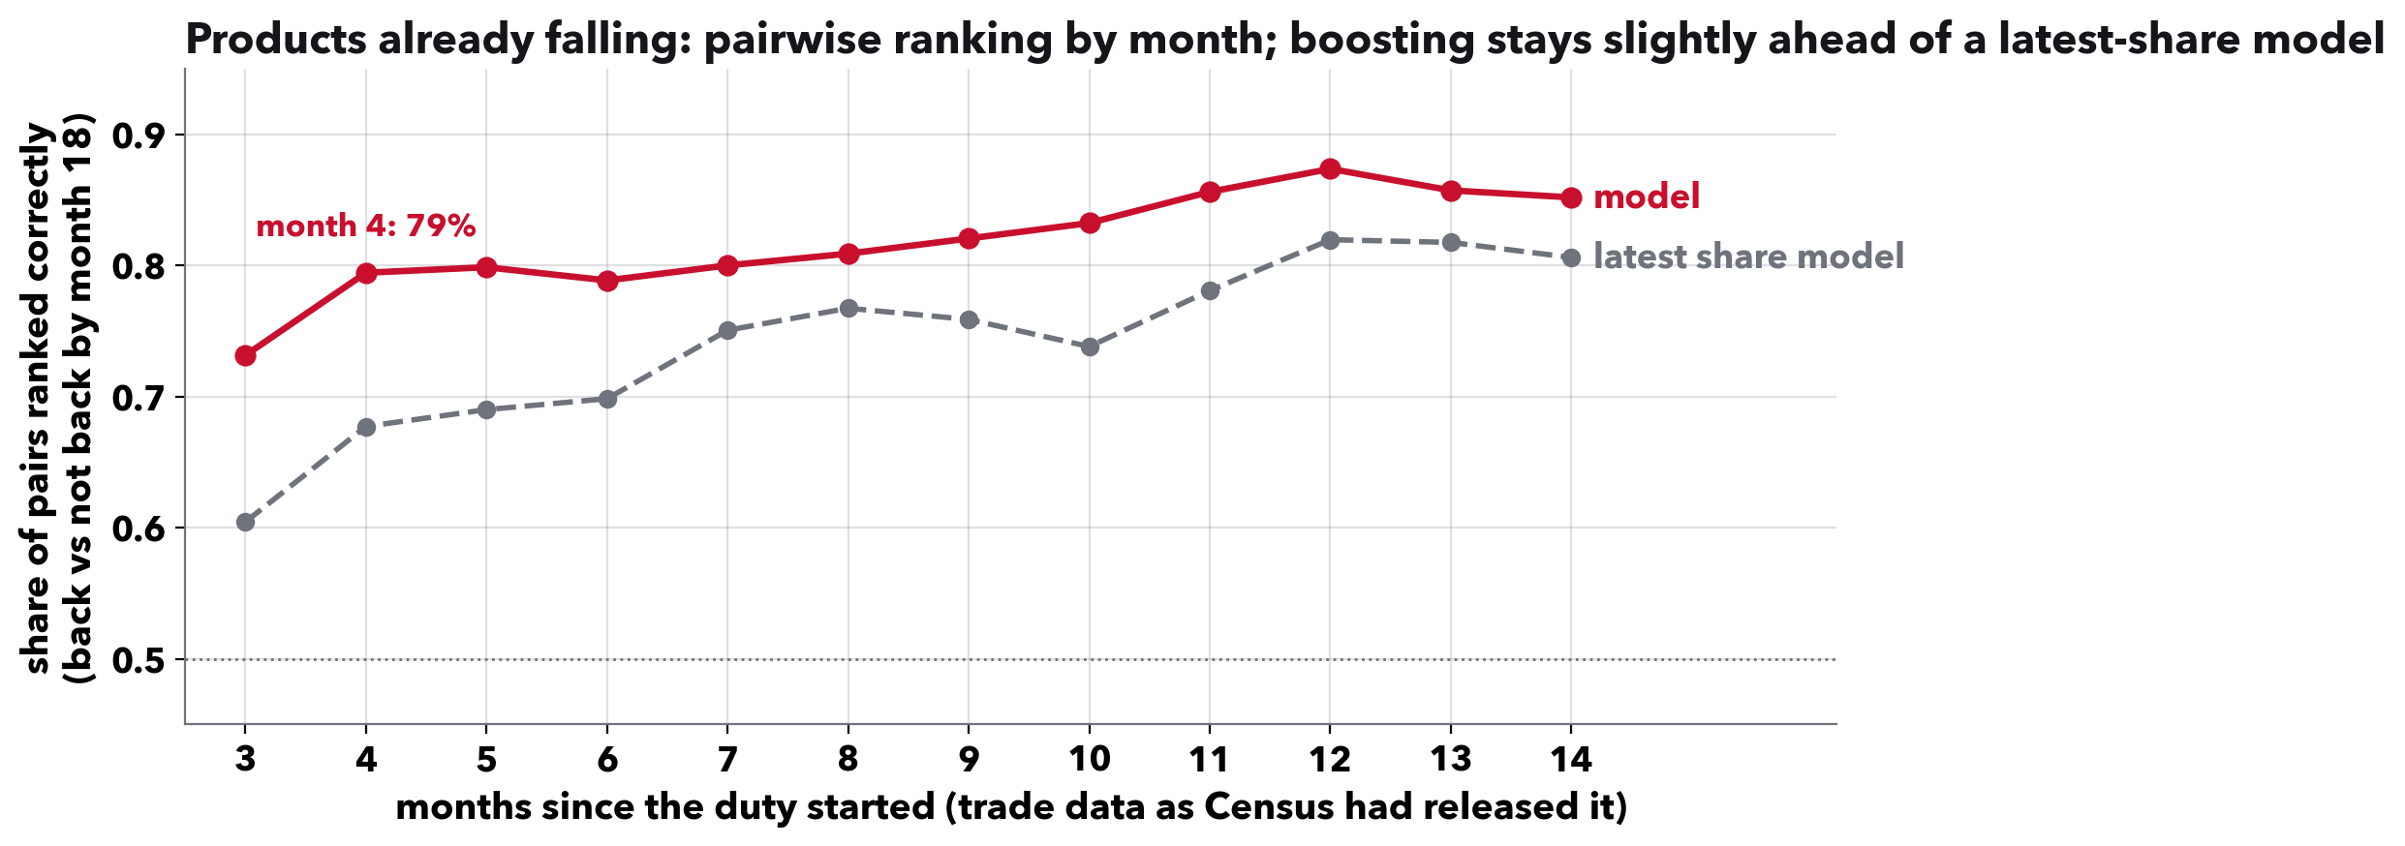
RAHUL REDDY MANDADI + RAUNAKSINGH KHALSA
By month 4, the forecast tells them apart.
Held-out later years, products already falling. Day one: no reliable gain. Month 4: 79% of pairs ranked correctly; month 5: 80%. Boosting stays slightly ahead of a latest-share model.
Notes:
This is the evaluation Kylie's Methods comment asks for: a baseline, a held-out test, and an honest size, re-done every month as a sourcing team would see the data.
Each month after the duty, the model re-scores every product that has visibly fallen and is not yet back, using only trade data Census had published (about five weeks after a month ends), notices published by then, and rivals not yet named in another case. It trains only on earlier cases whose outcomes were already published.
Day one: the gain over history is 0.008 and its range includes zero, so history is the day-one forecast. By month 4 gradient boosting ranks a product that came back above one that did not in 79% of pairs (logistic 75%) and beats that month's historical rate by 0.040 (0.028 to 0.054); by month 5, 80%. Boosting stays ahead of a model of the latest share alone in every month from 3 to 12, by 0.004 to 0.015, but no single month clears a test of all months together. At the ITC vote a logistic model reaches 80%, 0.012 beyond the share model.
Two cautions if asked. These are products already falling and not yet back, and that set changes month to month, so the rising line is not the same products getting easier. And the 16,781 product-month rows come from 1,712 products in 349 cases and 136 investigation groups; the groups are the real sample size.
If asked what changed: outside reviews found timing leaks four times; each fix moved these numbers a little and none changed the conclusion.

Slide 12
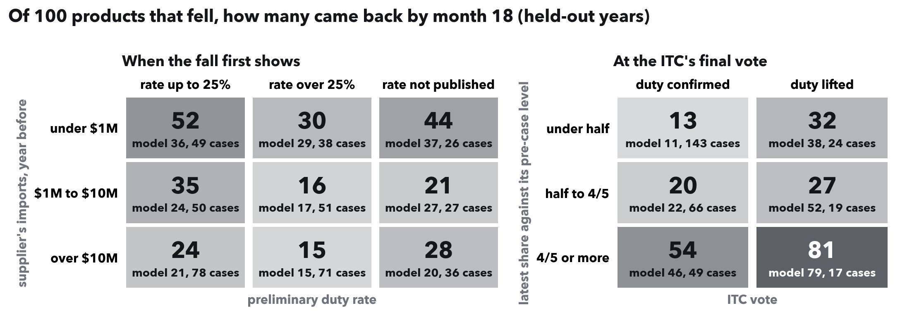
RAHUL REDDY MANDADI + RAUNAKSINGH KHALSA
Under half the old share, few come back.
Held-out years only. Each cell: of 100 products that fell, how many came back by month 18; below it, the model's estimate and the cases behind the cell.
Notes:
This is what a sourcing team would actually read: the model turned into a lookup.
Left, when the fall first shows: smaller suppliers come back more often, and a duty rate over 25% lowers the odds. Right, at the ITC vote: where the duty was confirmed and the published share is under half its old level, 13 in 100 came back; where the duty was lifted and the share is already back to four-fifths, 81.
Calibration, if asked: we tried recalibrating on earlier years whose outcomes were already published; it made the vote-time estimates worse on later years and the fall-time ones slightly better, and we kept the model's own at both, a choice made after seeing those years. We show the outcome first.

Slide 13
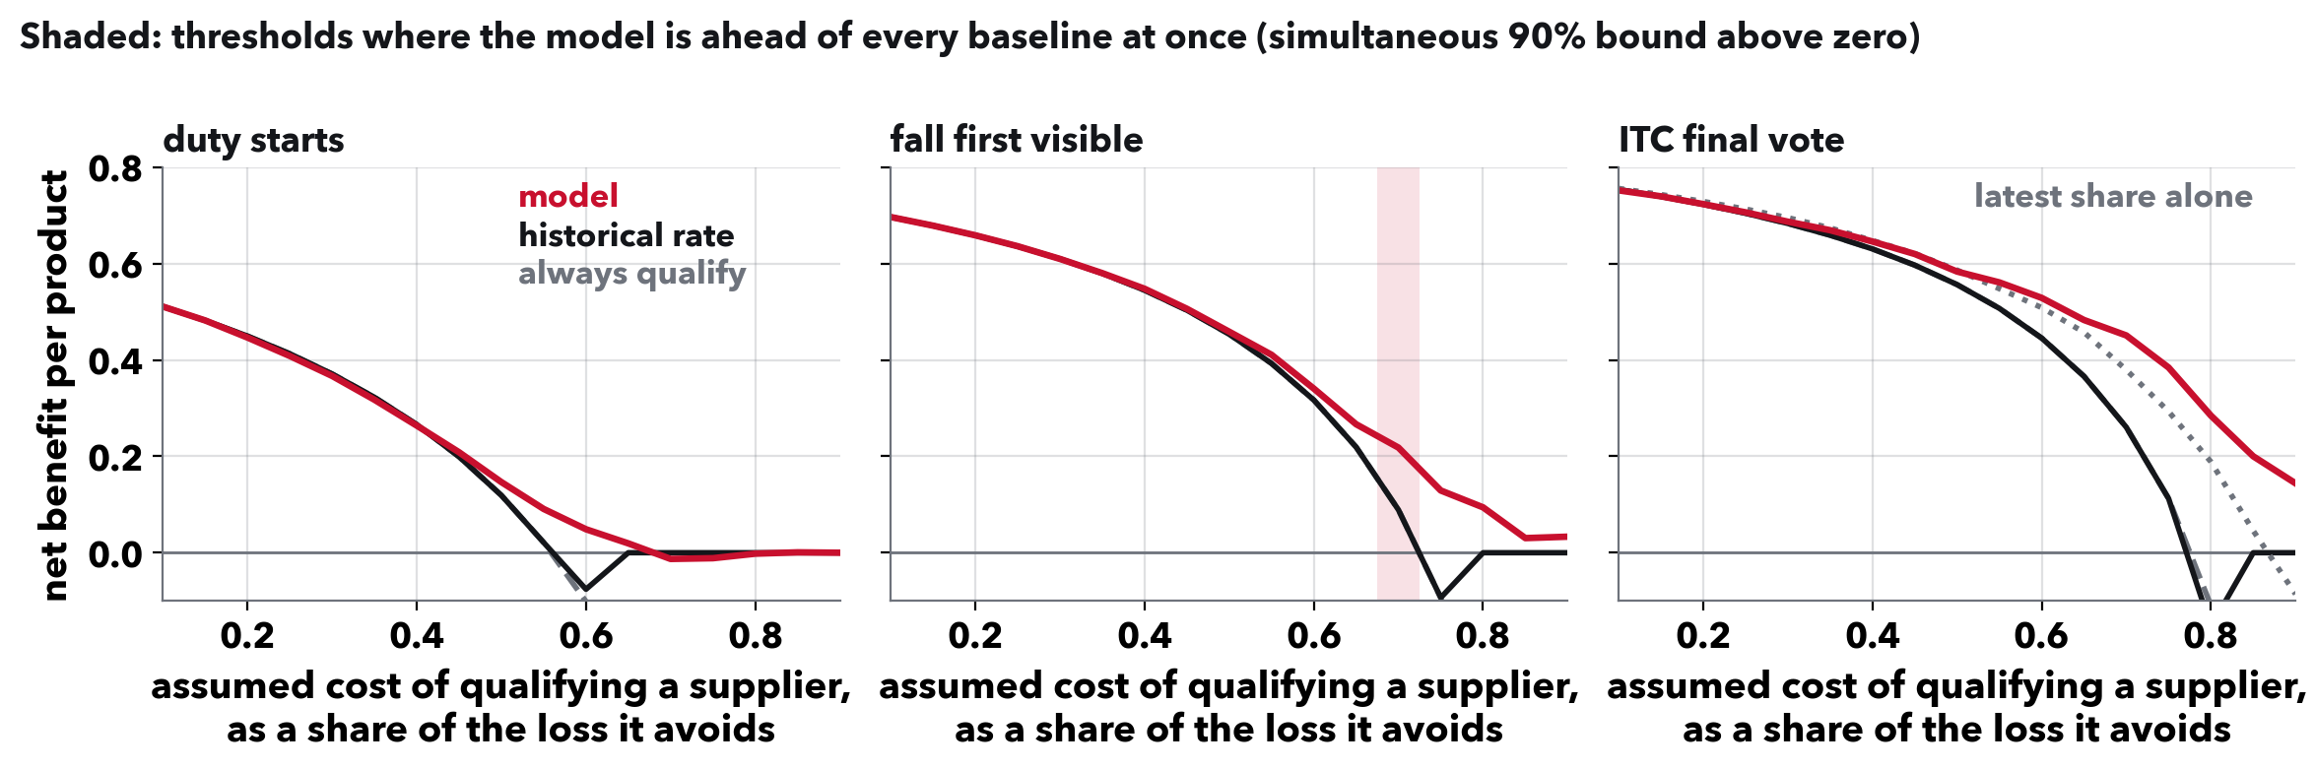
RAHUL REDDY MANDADI + RAUNAKSINGH KHALSA
Ahead of simple rules, not the latest share.
At the ITC vote, simultaneous lower bounds exceed zero against always or never qualifying and the historical rates at cost ratios 0.45 and 0.55 to 0.80; against the latest share, at none.
Notes:
Accuracy is not the question a sourcing team asks; whether acting on the forecast beats their simple options is.
The cost ratio is what qualifying a second supplier costs, as a share of the loss it avoids when the old supplier does not come back. Net benefit counts the bad outcomes you prepared for, minus unneeded qualifications weighted by that ratio. This is decision-curve analysis, standard for judging clinical prediction models.
Logistic regression is the common model at every point, a consistency choice, not preregistered. Every policy is scored on the same resamples, and all 17 thresholds and all baselines are tested together: always and never qualifying, the historical rate, the rate split by vote, and the latest-share model. At the vote the forecast leads all except the latest-share model at cost ratios 0.45 and 0.55 to 0.80, and it never leads that model once all ratios are tested together (one at a time, from 0.70 to 0.90). At the fall it leads every baseline at 0.70; on day one, at none.
This is potential benefit under assumptions, not a measured saving: it treats the country-level outcome as the importer's loss and assumes qualifying at that date could still avoid it. The intervals hold the fitted models fixed.

Slide 14
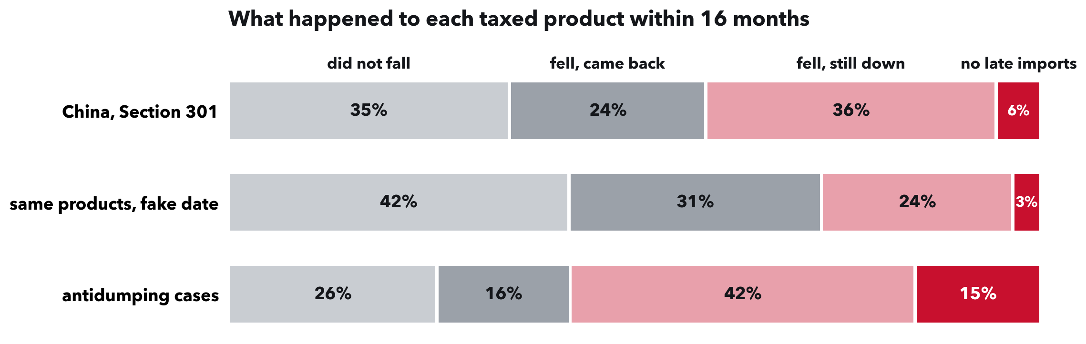
RAHUL REDDY MANDADI + RAUNAKSINGH KHALSA
The model carries over to China's tariffs.
6,844 products on the 2018 Section 301 lists, China against untaxed rivals, to January 2020. A model trained on antidumping cases ranks 66% of pairs correctly; of products that fell, 60% came back where China's share had rushed first, 30% otherwise.
Notes:
This answers the question everyone asks about the antidumping results: does it hold for the tariffs that hit most importers' China spend?
Section 301 taxed China alone, product by product, so China can be compared with untaxed rivals in the same product, the same design as before. Windows stop at January 2020, before China's COVID shutdown, so outcomes run 16 months. China's share of these products fell from 14.9% to 10.4% of imports; on the fake date it rose 6%.
The transfer: the at-the-fall model trained on antidumping cases, minus the China and case-type flags (logistic, the common model), ranks 66% of Section 301 product pairs correctly; a model trained on Section 301 itself gets 73%. It beats even Section 301's own recovery rate by 0.017 (0.011 to 0.023); boosting does a little better. Trained only on the 25 antidumping cases published before September 2018 it ranks as well but expects too few recoveries.
The borrowed part: where China's share ran more than a quarter above normal just before the tariff, 60% came back, against about 30% for the rest. That fall was payback for buying ahead. Each list is one date, so this describes products; it does not estimate a list's effect, and product exclusions are not removed.

Slide 15
RAHUL REDDY MANDADI + RAUNAKSINGH KHALSA
What this means.
For an importer tied to one country: weigh qualifying another supplier early. More than half of targeted products fell without recovering; 16% also had none a year on.
When to look again: on day one, use the historical rates; once a product has fallen, a monthly model tells recoveries apart better.
For anyone measuring tariffs: study the products a tariff names, not the whole category, and check quantities as well as dollars.
Notes:
This is the Discussion. One takeaway for each audience; about a minute.
The first bullet comes from 380 past cases. It is what usually happens, not a promise for any one supplier, and we have not tested it with importers.
We find no clear average surge before these duties, so little buying ahead to pay back. For cases that became orders the answer is closer to real than borrowed, over the 18 months we observe; that is not proof the business left for good.

Slide 16
RAHUL REDDY MANDADI + RAUNAKSINGH KHALSA
What we answered, and what is open.
Q1, a rush before the duty: none on average for antidumping; under China's 2018 tariffs, a rush means the fall is often borrowed.
Q2, borrowed or real: closer to real where the duty becomes an order: about a 31% fall over the 18 months we see.
Q3, how long: most fallen products are still down at 18 months; for those already falling, a monthly model picks out which will come back.
Open: where the lost trade goes. Gains spread across many rival countries.
Code and every number's source: github.com/rahul-mandadi/tariff-rush
Notes:
Close on the answer to the title: for duties that become orders, closer to real than borrowed over the 18 months we observe. Not proof of permanent departure, and the comparison is descriptive, not causal.
Caveats, one line each if asked: the comparison of permanent and lifted duties describes the two groups, it does not prove cause; the no-injury group is small; the importer use is plausible but we have not tested it with importers; copper is one example with no comparison country.
If asked about broad tariffs: the event list for Section 232, 301 and IEEPA actions needs 13 of 19 documents corrected before that rush can be measured.

Slide 17
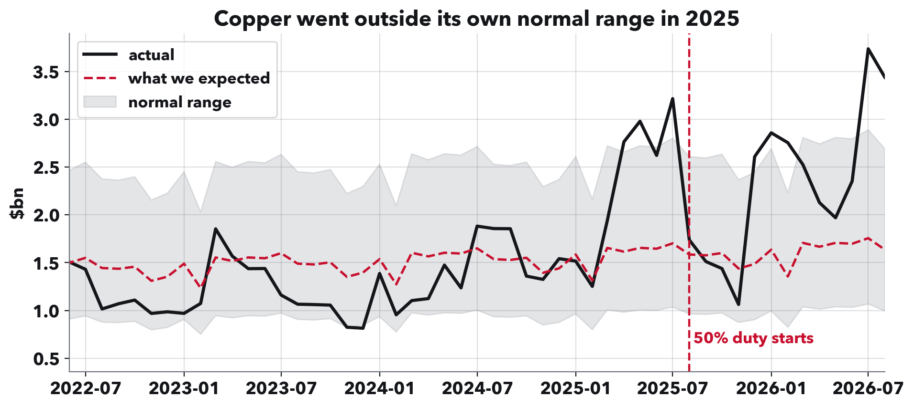
RAHUL REDDY MANDADI + RAUNAKSINGH KHALSA
How we spot an unusual month.
Three steps. Draw an expected line from the category's past: recent trend plus usual seasonal pattern. Shade a normal range from how much it usually wobbles. Score each month of 2025 by its gap above the line as a share of the range: 1.0 reaches the top edge. The category keeps its highest month.
Notes:
BACKUP slide, show if asked about the category scores.
This answers Kylie's note on Fig 4: explain the transformation and the choices.
The choices: the trend uses the last three years, so the line reflects recent growth rather than the pre-2020 pace. The wobble is measured over the whole decade, which gives a wider, more cautious range; using only three years would flag 28 of 96 categories instead of 10. Gaps are on a log scale so a doubling counts the same for a small category as a large one. The range is 1.96 times the usual wobble. The window is January to August 2025, the one Presentation 1 used. It is a historical benchmark, not a tested forecast.
Copper here went above its range in spring 2025, before the duty.

Slide 18
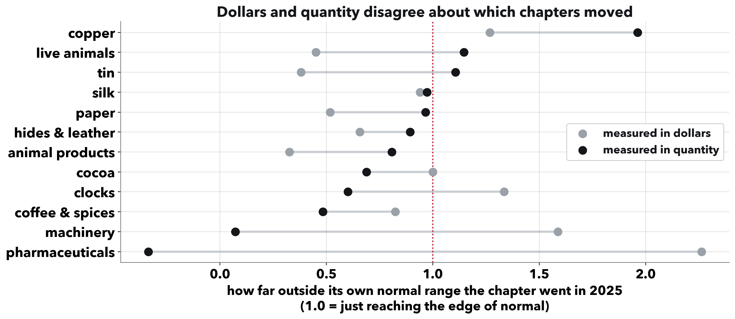
RAHUL REDDY MANDADI + RAUNAKSINGH KHALSA
Dollars alone can fool you.
One category per row, scored in dollars and in physical quantity. Cocoa looked unusual in dollars because its price per kilo roughly doubled. Pharmaceuticals barely moved in tonnes but jumped in dollars in March 2025, led by Swiss medicines at about $5,000 a kilo.
Notes:
BACKUP slide.
The takeaway: a category's dollar total alone can mislead, in both directions.
Cocoa's import value per kilo went from about $4 in 2022 to about $9 in 2025.
Pharmaceuticals scores 2.26 on dollars (first of 63 categories) and minus 0.34 on tonnes (62nd). In the medicine line with the biggest March jump, Swiss shipments ran about $5,185 a kilo against $183 for Indian ones, so a shift toward Swiss product lifts dollars far more than tonnes.
This check applies to the category rankings. The antidumping result points the same way in physical quantity: among months with trade, quantity and value estimates are similar (minus 0.31 and minus 0.30 log points). Both ranges include zero, so this is consistent with lower volume but does not rule out price changes.

