Slide 1
CHANNEL ALLOCATION IN CELLULAR NETWORKS: A SOFT COMPUTING TECHNIQUE
PROJECT WORK -2 (CS-854)

Slide 2
MEMBERS
ROUNAK DE - 14/CS/04
RAHUL MODI – 14/CS/79

Slide 3
INTRODUCTON AND AIM OF PROJECT
Now-a-days, the wireless transmission medium is growing in pace and the no. of mobile hosts (call requests) are increasing day by day. Due to the limited no. of resources(channels), total no. of blocked hosts are increasing. Due to this problem, more calls are getting blocked which is a big issue in mobile communication. So we need to allocate the channels in the cells in such a way so as to reduce the no. of blocked calls and increase the efficiency of the network.
In our project, we have proposed a solution to the problem using Multi Objective Optimization(MOO) Technique.
We have used NSGA-II Multi Objective Optimization algorithm to solve the Channel Allocation Problem in the Cellular Networks.

Slide 4
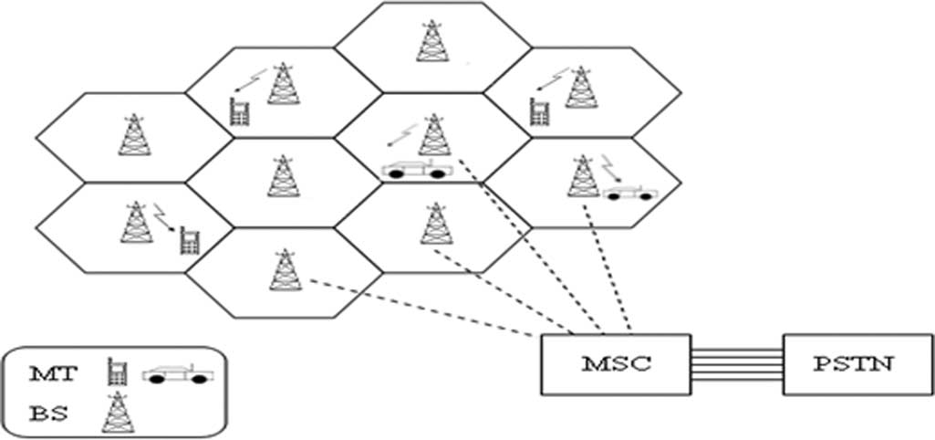
Fig .1 - Cellular System

Slide 5
BASE STATION (BS):
Each cell has a base station which is equipped with radio transmission and reception equipment. The mobile terminals within a cell communicate through wireless links with the base stations associated with the cell.
BASE STATION CONTROLLER (BSC):
Several base stations are connected to the base station controller(BSC) via microwave links or dedicated leased lines. The BSC contains logic for radio resource management of the base stations under its control. It is also responsible for transferring an ongoing call from one base station to another as a mobile user moves from cell to cell.

Slide 6
CHANNEL ALLOCATION PROBLEM
DEFINITION of Channel Allocation
A given radio spectrum is to be divided into a set of disjoint channels that can be used simultaneously, while minimizing interference in adjacent channels, by allocating channels appropriately.
There are especially three schemes in doing so,
Fixed Channel allocation
Dynamic channel allocation
Hybrid Channel Allocation

Slide 7
CAP In Brief
With significant increase in number of mobile users, the number of calls that can’t connect to the destination has also increased.
With the ever-increasing number of mobile users and a pre-assigned communication bandwidth, the problem of efficiently using the radio spectrum for cellular mobile communication has become a critical issue.
The task of assigning frequency channels to the cells that satisfies the frequency separation constraints with a view to avoid channel interference in order to make the mobile network is known as the channel allocation problem (CAP).

Slide 8
Frequency Reuse
The band of frequency allocated for cellular system use can be reused with different CLUSTERS. We mean by cluster here the configuration of cells over which the complete frequency band is divided and this configuration of cells is repeater over and over.
Valid clusters are those that result in 6 cells with the same frequency of a particular cell located at equal distance from it (distance is known as the reuse distance).

Slide 9
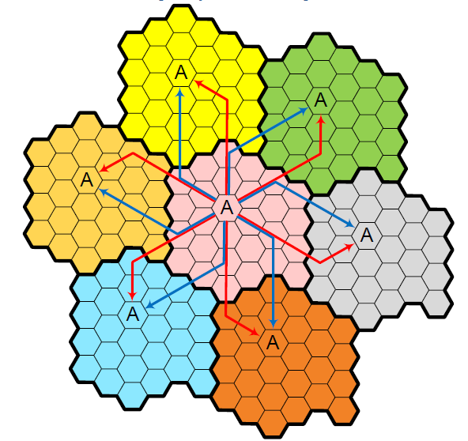
Valid cluster

Slide 10
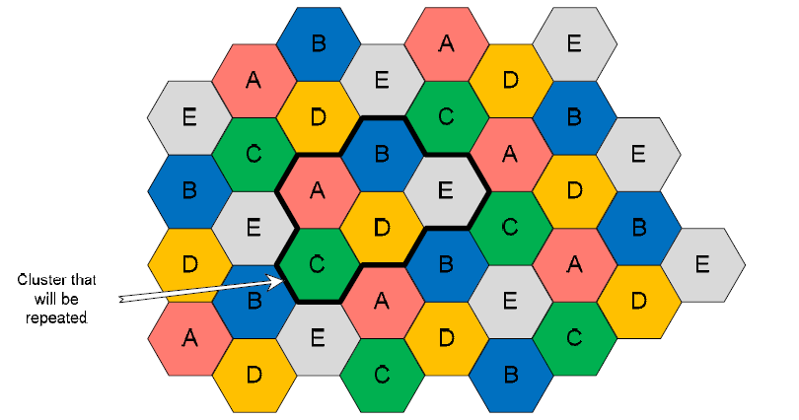
Invalid Clusters

Slide 11
Proposed Model
SCOPE OF THE WORK:
We propose a GA-based fault-tolerant model for channel allocation in this work.
The proposed algorithm is under the resource planning model, i.e., primary channels are initially allocated to each cell. Furthermore, secondary (borrowed) channels must be returned to the cell from which they have been borrowed as soon as the call is over.
The model can be made fault-tolerant by using the concept of borrowing and lending schemes. Cell in which channels are underutilized, lend the extra channels, to the over loaded cells. This borrowing and lending can be done dynamically.

Slide 12
The proposed approach uses the MOO (Multi Objective Optimization) Technique in order to solve the Channel Allocation Problem. The model aims to allocate channels in such a way so as to optimize two objective functions defined as follows.
1) Fitness Function:
Fitness(F) = blocked hosts − reserved channels
2) Reliability:
The reliability of the system is dependent on both of the services of BS and channels over a time t during the communication between the hosts and the corresponding BS.
This Rsys is expressed as follows :
R(SYS) = R(BS) * R(CH)
Rsys denotes the reliability of the BS over time t and it is followed by an exponential distribution as the reliability of such BS is invariable over t.
The fittest chromosome is the one with the lowest first fitness value and the highest second fitness(reliability) value simultaneously.

Slide 13
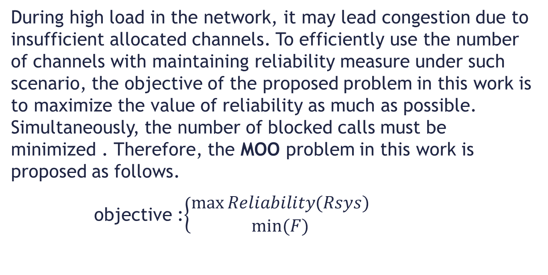
PROBLEM FORMULATION
During high load in the network, it may lead congestion due to insufficient allocated channels. To efficiently use the number of channels with maintaining reliability measure under such scenario, the objective of the proposed problem in this work is to maximize the value of reliability as much as possible. Simultaneously, the number of blocked calls must be minimized . Therefore, the MOO problem in this work is proposed as follows.
objective :$\left\{\begin{aligned}\max{Reliability(Rsys)} \\ min⁡(F)\end{aligned}\right.$

Slide 14
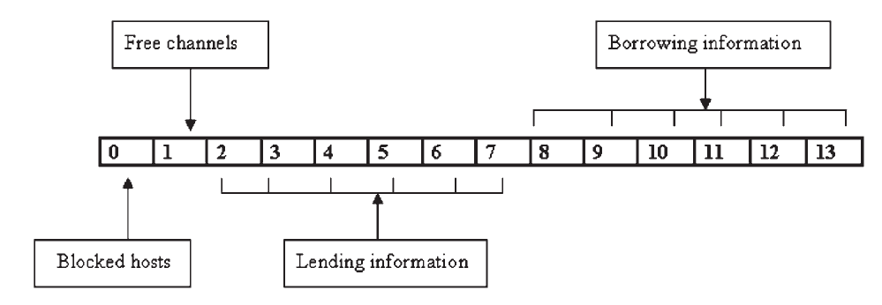
Fig – 2 Chromosome Structure

Slide 15
Proposed Crossover
Matrix 1
1 2 3 | 4 5 6 7
2 3 4 | 3 4 8 7
5 6 7 | 5 6 4 3
Matrix 2
4 5 6 | 5 7 4 6
4 3 5 | 8 7 9 4
1 2 2 | 6 6 3 4
We are assuming here that the cut point is 3

Slide 16
Off Spring 1
4 5 6 | 5 7 4 6
4 3 5 | 3 8 7 4
1 2 2 | 5 6 3 4
Off Spring 2
1 2 3 | 4 8 9 7
2 3 4 | 4 8 9 7
5 6 7 | 6 6 4 3

Slide 17
Explanation of Crossover
This crossover is specially modified for borrowing and lending techniques.
The portion before cut point is swapped i.e., first part of first parent matrix becomes the first part of second offspring, and first part of second parent matrix becomes the first part of first offspring .
Portion After Cut Point:
First Offspring: The portion after the cut point is made in the following way.
Find all the common elements between the corresponding row of the first and second matrix.
The common elements are put in the same order as present in the 2nd parent matrix.
The remaining elements are put in the same positions as present in the 1st parent matrix.

Slide 18
Crossover contd
Second Offspring: The portion after the cut point is made in the following way.
Find all the common elements between the corresponding row of the first and second matrix.
The common elements are put in the same order as present in the 1st parent matrix.
The remaining elements(uncommon) are put in the same positions as present in the 2nd parent matrix.

Slide 19
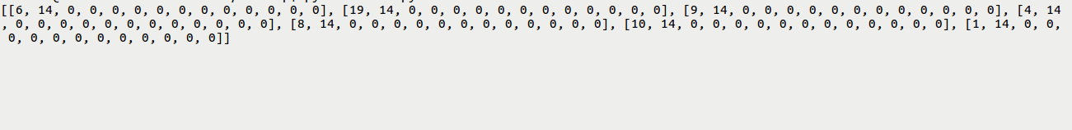
Results
The above figure is our initial chromosome, in which lending and borrowing information were initially zero. The first two number shows the amount of blocked hosts and reserved channels respectively.

Slide 20
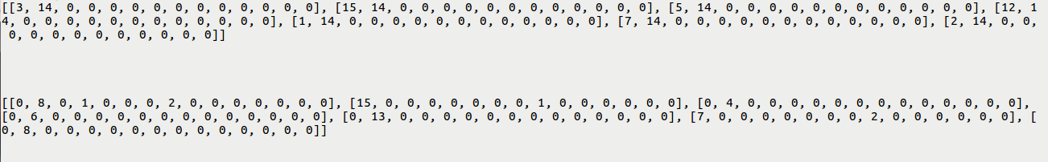
In the above figure we can see that, after crossover the chromosome has evolved and the values in the chromosome is showing that successful lending and borrowing operation has occurred. As a result we can see that many cells has lent some channels and in the chromosome of the corresponding cell the change is also visible.

Slide 21
Conclusion
As the number of generation increases, the program will tend to converge and the final chromosomal structure will depict the channel allocation scheme with the minimized no. of blocked hosts in each cell in the network. So, the NSGA II model provides the fault tolerant solution to the channel allocation problem.
More optimized results would be obtained when the present output is given as input to the SOM (Self Organizing Maps).

