Slide 1
Protein secondary structure Prediction
The problem
Seq: RPLQGLVLDTQLYGFPGAFDDWERFMRE
Secondary Structure Prediction
Seq: RPLQGLVLDTQLYGFPGAFDDWERFMRE
Pred:CCCCCHHHHHCCCCEEEECCHHHHHHCC
H: helix; E: β-strand; C: coil

Slide 2
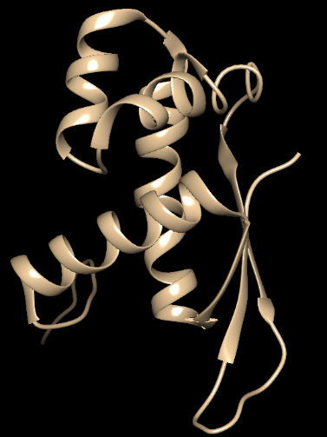
Protein Structure Prediction
The problem
Seq: RPLQGLVLDTQLYGFPGAFDDWERFMRE
Protein Structure Prediction
Atomic protein structure in 3D

Slide 3
Some historical landmarks
1st generation – 70’s (~50-60% accuracy)
single residue statistics, explicit rules
Chou & Fasman 1974, GOR1 1978
2nd generation – 80’s (~60-70% accuracy)
single residue statistics, nearest-neighbors, neural network (more with local interaction)
GOR3 1987, Levin et al. 1986, Qian & Sejnowski 1988, Holly & Karplus, 1989
3rd generation – 90’s (~78% accuracy)
neural network with homologous sequence information
PHD 1993, PSIPRED 1999, SSPRO 2000

Slide 4
Chou-Fasman method
Straight statistical approach
Conformational propensity e.g. helical propensity
Categorize each amino acid
e.g. helix former, helix breaker, helix indifferent
Find nucleation sites
short sequence with high concentration of a category
Extend the nucleation sites till a threshold
Handle overlaps

Slide 5
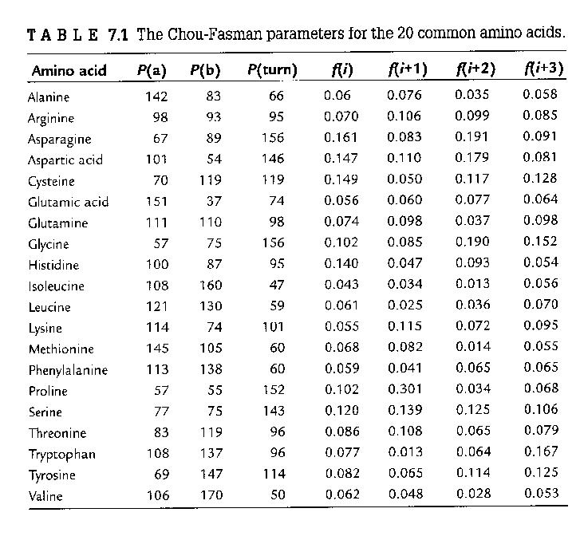
Chou-Fasman method
Conformational parameters
(Table from Krane and Raymer’s book)
What is the drawback of the method?

Slide 6
Basics in neural network
(Kneller et. al. JMB 1990, attached in Resource)
Setup inputs and weights
Calculate activation (a)
Send to threshold function to compute output
Calculate weight adjustment
Minimize error function
Iterative until converge

Slide 7
Protein Folding Problem
A protein folds into a unique 3D structure in physiological condition
What is the protein folding problem?
3D structure is a key to understand function mechanism
Rational drug design
3D structure prediction

Slide 8
Protein Folding Problem
Hard?
Can it be done?
Sampling conformational space
  SS structures offer simplicity
  Side chain filling the space
  May not be random search
Free energy (Δ G) =
  Interaction energy – Entropic energy

Slide 9
Protein Folding Problem
Experimental finding
  Protein does not start folding from the end
  SS seem to fold early
  Hydrophobic aa in the core
  Hydrophilic aa on surface
Energy function approximation
  Physics based (bond length, bond angle, pair interactions)
  Statistics based

Slide 10
Scope of the problem
Majority of the newly solved protein structure share certain level of similarity with a known structure
Certain families of proteins have no or few structures solved
Human genes ~20k
Structure genomics initiative

Slide 11
Protein structure prediction
Comparative modeling
>30% sequence identify
Fold recognition – formally known as threading
twilight zone <25% sequence identity
Ab initio
  new fold

Slide 12
CASP
Compare and rank
Experimentally solved structure
Predicted structure
CASP –
e.g. Skolnick (2003) Proteins: 53:p469-79
Ginalski (2003) Proteins: 53: p410-17
  Zhang, Y. “Template-based modeling and free modeling by I-TASSER in CASP7 (pages 108–117)” Proteins, 69, S8, P108-17 (2007).

Slide 13
Comparative Modeling
http://www.salilab.org/~andras/watanabe/main.html
Sequence identity vs. structure overlap (Fig)
Search for structures
Select templates
Align target sequence with structures
Build model
Evaluate model

Slide 14
Comparative Modeling
Search for structures:
pair-wise sequence alignment with database
multiple sequence alignment -> profile
fold assignment / threading – use structure information in comparison
Select template:
  sequence similarity, evolutionary relationship, environment, resolution
Sequence alignment (target and template)
standard method with tune

Slide 15
Ab Inito Prediction
Ab initio methods do not use structural templates
Challenge:
  Search space
  Energy function
Reduction in search space
use lattice
use simplified amino acids
use building blocks available in nature

Slide 16
Ab inito 3D Structure prediction
An example - ROSETTA
Simons KT, Kooperberg C, Huang E, Baker D; J Mol Biol. (1997) 268, 209-225
Schonbrun J, Wedemeyer W, Baker D; Current Opinion in Structure biology, (2002), 12:348-54
ROSETTA
narrow search - use local structure available
statistical based energy function
one of the top few ab initio methods in CASP4.

