Slide 1
Computer Communication
Hospital Network Design
Aditya Shukla (RA2011003010383)
Rahul Raj (RA2011003010399)
Utkarsh Tripathi (RA2011003010402)
Nikhil Kumar (RA2011003010401)

Slide 2
Introduction
A hospital network design is created using tools like cisco packet tracer. Hospital will have a main block and three wards in the campus. The main block will have 3 floor and the registration of all the new patients will be done here. At the ground floor, there are 10 computers at the billing section. At other floors, there is one computer user each. The farthest distance between the computer on the top most floor and the ground floor is less than 70 meters. The wards have 3 floors each, with 5 computers in the ground floor of each ward.

Slide 3
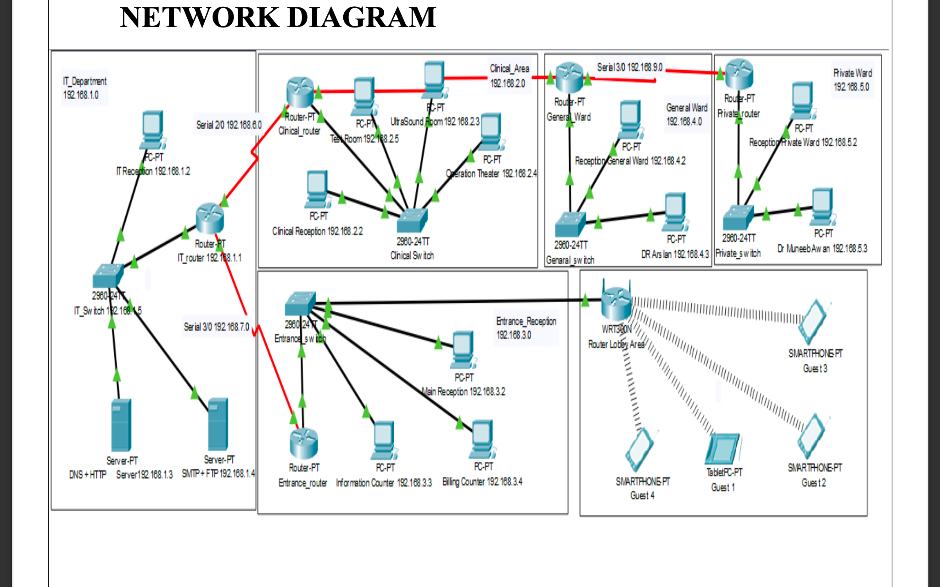
Design of network in hospital

Slide 4
Calculation and Implementation
We have divided the hospital network diagram into 6 segments.
General Ward
Private Ward
Clinical Area
IT Department
Entrance Reception
Lobby Parking

Slide 5
Calculation and Implementation
COST OF NETWORK Cisco Switch
250$ Each
1250$ Cost of 5 Switch
Cisco Router
350$ Each
2100$ Cost of 6 Router
Cisco Server
400$ Each
800$ Cost of 2 Server
Computer Cost
125$ Each
1500$ Cost of 12 Computer
Total Cost = 5650$

Slide 6
Result
The hospital network has been created successfully in cisco packet tracer and now we can set-up the same network throughout the hospital. Now, we know the estimated cost of complete network set-up.

Slide 7
Conclusion
This report describes how we have designed network topology of hospital (Health care Management System). With VLSM for Subnetting, segmented the diagram into 5 segments. This topology can also be implemented on higher level of hospitals.

Slide 8
Reference
Internet sources:
https://www.techtarget.com/
https://www.youtube.com/c/GateSmashers
https://en.wikipedia.org/wiki/Computer_network
Books:
Computer Networking: A Top-Down Approach

