Slide 1
ECE 18-649
Mid-Term Project
Presentation
Oct 28, 2015
Group #11
Rahul Ramesh // rahulram
Daniel Santoro // ddsantor
David Thompson // davidtho
Jialiang Tan // jialiant
Rahul Ramesh // rahulram

Slide 2
Overview
Project Statistics
Complete design of DriveControl
  Scenarios
  Sequence diagrams
  Requirements
  State chart
  Coding
  Testing
Lessons learned
Open Issues
Rahul Ramesh // rahulram

Slide 3
Project Statistics
Number of scenarios/sequence diagrams: 16.
Number of lines of requirements: 43 lines.
Number of state charts: 7
  Total number of states: 23
  Total number of transitions: 29
Number of lines of non-comment code: 1359 lines
Number of test files written:
  7 unit tests & 16 integration tests
Number of revisions (change log entries):
  110 issues patched in issues log.
Number of peer review defects:
  194 issues found in 50 peer reviews
  168 fixed, 14 not a bug, 2 not fixed
Number of defects found via test & other; number fixed
  (found/fixed): 9/9
Rahul Ramesh // rahulram

Slide 4
DriveControl – Scenarios
Use Case 4: Passenger Enters elevator
  Scenario 4A: Level as passenger enters
Use Case 5: Passenger Exits elevator
  Scenario 5A: Level as passenger exits
Use Case 7: Passenger Reads Car Position
  Scenario 7A: DriveSpeed to CarPositionControl
Use Case 9: Car Moves to next floor
  Scenario 9A: Move to next floor and level.
David Thompson // davidtho

Slide 5
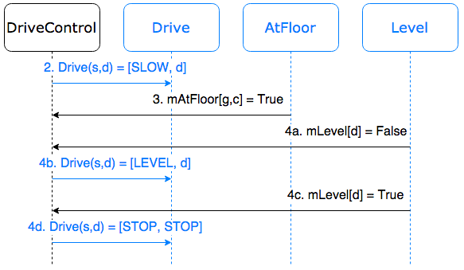
DriveControl – SD9A
David Thompson // davidtho

Slide 6
DriveControl – Requirements
6.6 mDriveSpeed(s,d) shall be set to {CurrentSpeed, CurrentDirection}.
6.7 If DesiredDirection is Stop and LevelDirection is Stop then:
6.7.1 Drive(s,d) shall be set to {Stop,Stop}.
6.7.2 mDrive(s,d) shall be set to {STOP, STOP}.
6.8 If DoorsClosed is True and DesiredDirection is ≠ Stop, then:
6.8.1 Drive(s,d) shall be set to {Slow, DesiredDirection}.
6.8.2 mDrive(s,d) shall be set to {SLOW, DesiredDirection}.
6.9 If mAtFloor[f,b] is true and LevelDirection is ≠ Stop, then:
6.9.1 Drive(s,d) shall be set to {Level, LevelDirection}.
6.9.2 mDrive(s,d) shall be set to {LEVEL, LevelDirection}.
Daniel Santoro // ddsantor

Slide 7
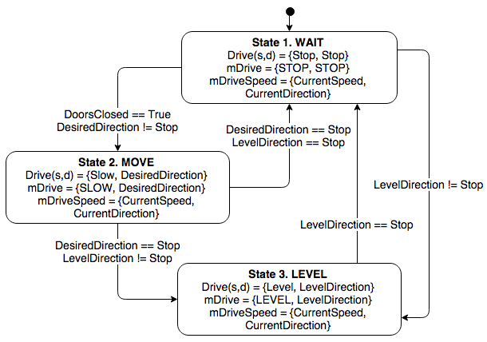
DriveControl – State Chart
Daniel Santoro // ddsantor

Slide 8
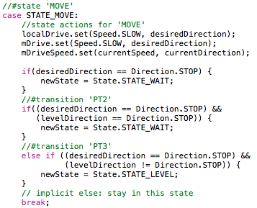
DriveControl – Coding
State “MOVE” behaviors:
Daniel Santoro // ddsantor

Slide 9
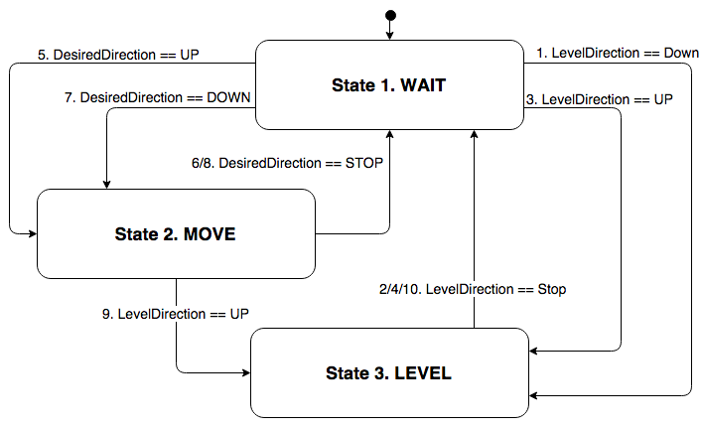
DriveControl – Testing
Daniel Santoro // ddsantor

Slide 10
Lessons Learned
Deep understanding of the benefit of the V
  Traceability links design and implementation
    Before:
    After:
Misbehavior
Code
Misbehavior
Sequence Diagram
State Chart
Code
Jialiang Tan // jialiant

Slide 11
Lessons Learned (cont.)
Importance of peer review
  People don’t usually see their own mistakes
  Others’ perspectives can expose many bugs
Distributed method of elevator control
  Distributed embedded system
  Time triggered behavior
Runtime monitoring
  Using runtime monitor to monitor system
Jialiang Tan // jialiant

Slide 12
Open Issues
Unresolved Problems
  Rigorous hall light design
    All calls dropped when doors are open - at any floor
New Challenges: Caring About Passengers
  Dispatcher Design
    Accommodating various passenger behaviors
    Can no longer trigger from the same signals
    Scheduling passengers
  Drive Control Design
    Implementing high speed
  Prioritizing CAN messages
  Determining additional network interfaces
David Thompson // davidtho

