Slide 1
Researchie – A Research Agent
Presented By:
Rahul Rawat
B.Tech CSE (AI & ML), Lamrin Tech Skills University, Punjab
Capstone Project

Slide 2
Outline
- Problem Statement
- Proposed Solution
- System Development Approach (IBM Cloud)
- Algorithm & Deployment
- Result
- Conclusion
- Future Scope
- References

Slide 3
Problem Statement
In today’s information-driven world, individuals are overwhelmed by the vast amount of text-based content—especially academic and research documents.
Manually extracting important information is time-consuming and inefficient. There is a clear need for an intelligent solution that can automate summarization and comprehension.

Slide 4
Proposed Solution
To solve this problem, we present Researchie, an AI-powered agent developed using IBM Watsonx.ai on IBM Cloud.
It accepts textual queries or documents and returns accurate, AI-generated summaries—enhancing the speed and efficiency of research tasks.

Slide 5
System Development Approach
Platform Used:
- IBM Cloud
- IBM Watsonx.ai
- Prompt-based interaction within the cloud interface
Functionality Implemented:
- Created a cloud-based agent using IBM Watsonx
- Configured with summarization instructions
- Interacts with uploaded text or typed input to generate concise results

Slide 6
Algorithm & Deployment
Model Used:
- IBM Watsonx.ai Large Language Model
Development Steps:
- Used Watsonx prompt lab
- Designed effective prompts to generate accurate summaries
Deployment:
- Entirely built and run within IBM Cloud’s managed environment

Slide 7
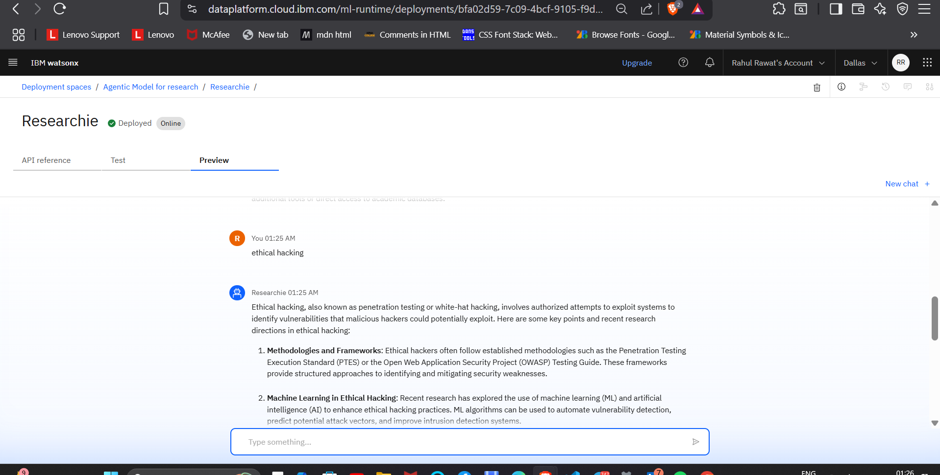
Result
Insert screenshots of your Research Agent interface in IBM Cloud showing:
- Prompt input
- AI-generated summary output

Slide 8
Conclusion
- The AI agent provides fast and high-quality summarization
- Demonstrates how cloud platforms like IBM Watsonx can be leveraged for intelligent research assistance
- No external infrastructure or backend needed for basic implementation

Slide 9
Future Scope
- Integrate with a web-based UI in future (e.g., chat interface)
- Add document upload features for PDF summarization
- Include citations, keywords, and multi-language support
- Extend to voice-based research agents

Slide 10
References
- IBM Watsonx.ai Documentation
- IBM Cloud Tutorials
- NLP Research on Text Summarization

Slide 11
IBM Certifications
Insert Screenshot:
Credly Certificate - Getting Started with AI

Slide 12
IBM Certifications
Insert Screenshot:
Credly Certificate - Journey to Cloud

Slide 13
IBM Certifications
Insert Screenshot:
Credly Certificate - RAG Lab

Slide 14
Thank You
Thank You!
Questions and Feedback Welcome

