Slide 1

Demographic Analysis and Comparative Study of Maharashtra and Uttar Pradesh
Adity BANERJEE
ANJAN SADHUKHAN
AYUSH BARAN SEN
RAHUL GANGULY
VINAYAK TRIPATHI

Slide 2


RESEARCH QUSETION 1:
Is fertility independent of education,wealth and contraception method? Do education, wealth, and contraception explain observed differences in fertility between Uttar Pradesh and Maharashtra?
The study aims to examine whether socio-economic factors explain the variation in fertility levels. Specifically, we test whether a woman’s education level, household wealth, and contraception use have a statistically significant effect on fertility.

Slide 3
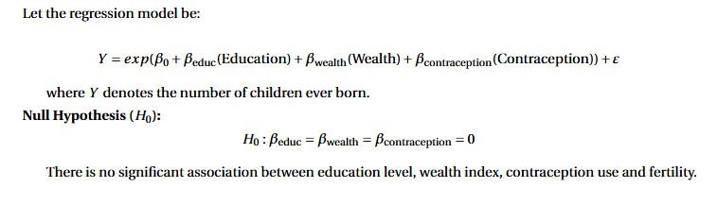
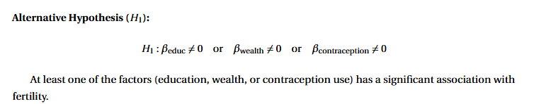
MODEL AND HYPOTHESIS TESTING:
E[ ]

Slide 4

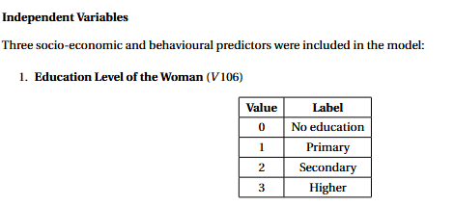
LET'S TALK ABOUT VARIABLES:

Slide 5
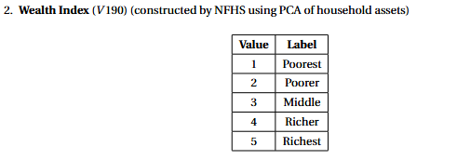


Slide 6
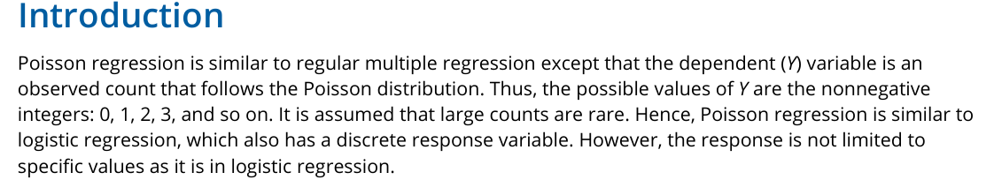
LET'S DISCUSS POISSON REGRESSION MODEL:

Slide 7
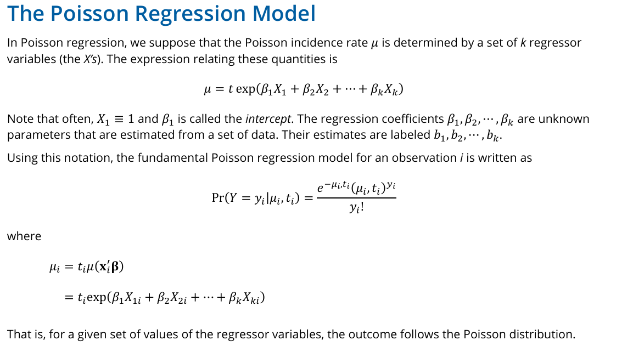

Slide 8
ASSUMPTION:
The dependent variable is a count variable and takes non-negative integers.
The observations are independent to each other.
The response variable follows a Poisson distribution.
The mean and variance of the responses are equal.
There is no multicollinearity among predictors.

Slide 9
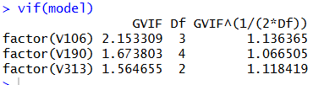
ASSUMPTION VERIFICATION:
The mean of Y variable is 1.69 and the variance is 1.90. Hence poisson regression model is applicable
.The VIF value is less than 5. Hence there does not exist multicollinearity.

Slide 10
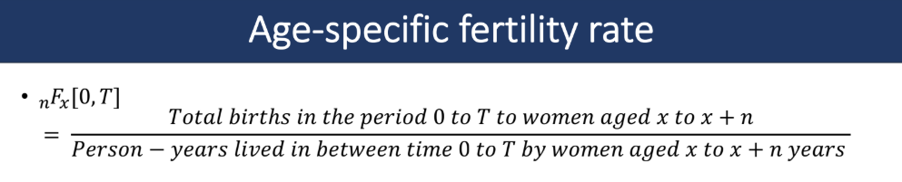

Slide 11
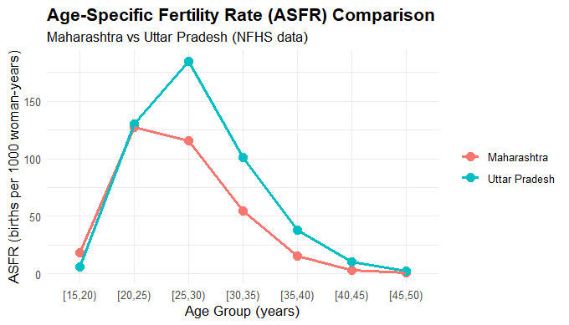
ASFR COMPARISON : MAHARASHTRA VS UP
The ASFR pattern shows that both states have almost identical fertility levels in the
15–19 age group. Maharashtra reaches its peak fertility at age 20, whereas Uttar
Pradesh reaches its peak at age 25. After age 20, Uttar Pradesh consistently shows
higher ASFR values than Maharashtra, indicating that fertility remains higher for
longer ages in Uttar Pradesh.

Slide 12
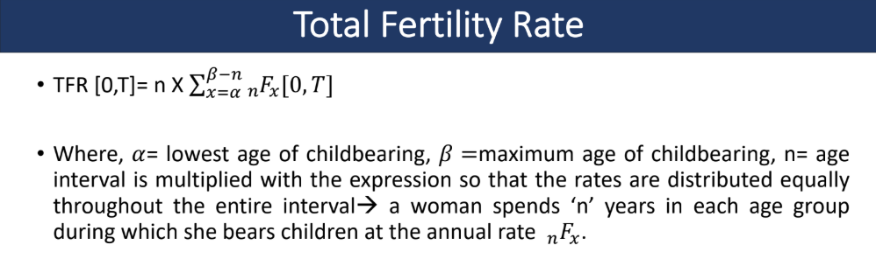

Slide 13
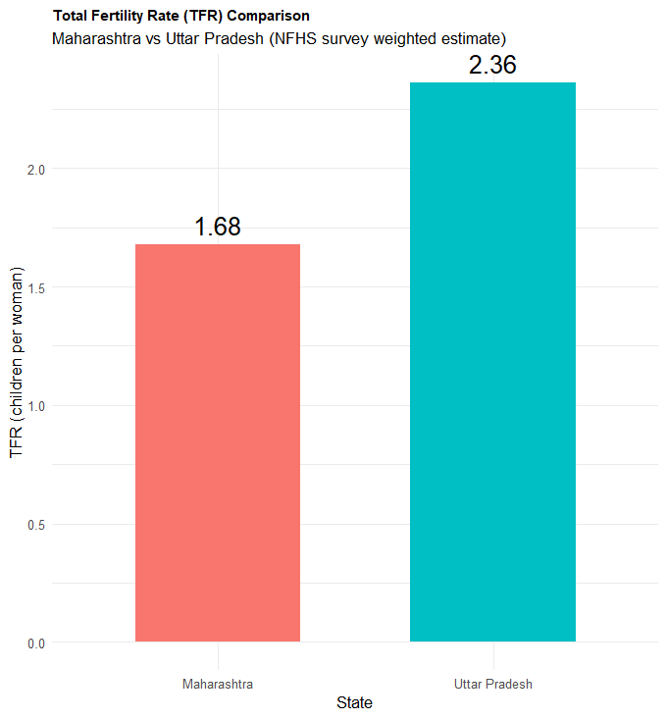
TFR COMPARISON: MAHARASHTRA VS UP
We can observe Uttar Pradesh has higher total fertility rate than Maharashtra.

Slide 14
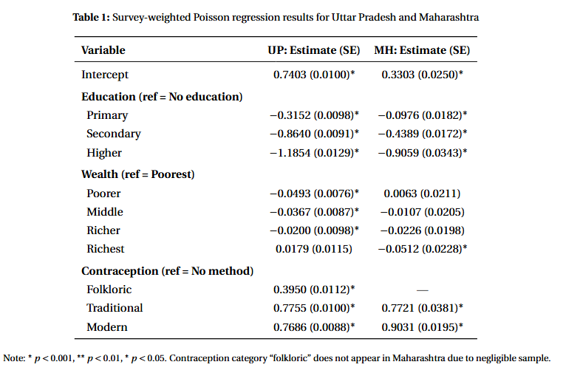
Poisson REGRESSION RESULT:

Slide 15
INTERPRETATION:
For both states, the coefficients for increasing education levels are negative and
statistically significant, indicating that fertility decreases monotonically as
education increases. Wealth shows a weak association in Maharashtra but a stronger,
negative association in Uttar Pradesh. Surprisingly, contraception use is associated
with higher fertility in both states, which may indicate reverse causality:
women tend to adopt contraception after achieving desired parity.

Slide 16
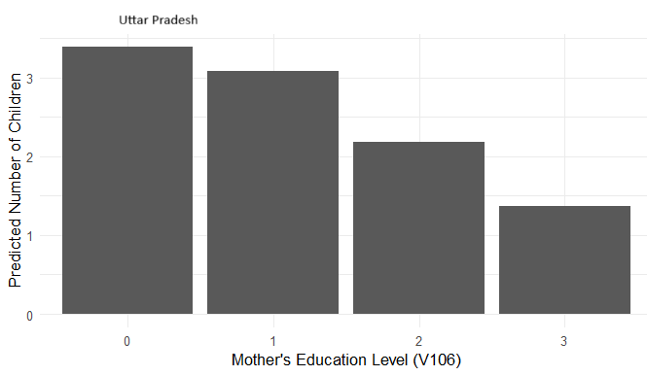
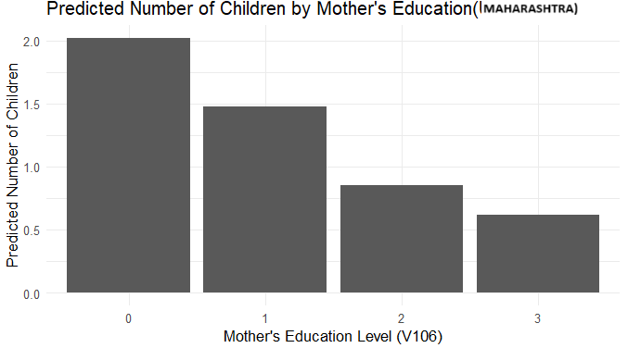
PREDICTER NUMBER OF CHILDREN BY MOTHER EDUCATION:

Slide 17
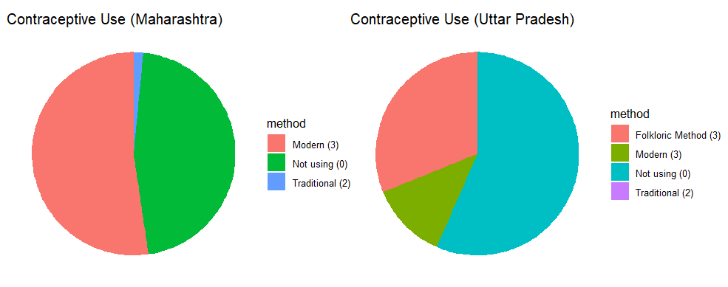
CONTRACEPTIVE USE:

Slide 18
CONCLUSION:
Fertility differences between Maharashtra and UP are not random.
They are strongly associated with education, wealth and contraception use.
Maharashtra is closer to demographic transition; UP is still progressing toward it.
Policy Relevance: Increasing female education, improving access to modern contraception, economic empowerment programs are the key levels of fertility reduction.

Slide 19
RESEARCH QUESTION 2:
How does the prevalence of early childbirth (first birth before age 20) differ between Uttar Pradesh and
Maharashtra?
The study aims to examine the socio-demographic factors (such as education level, wealth index and residence) associated with early childbirth in Uttar Pradesh and Maharashtra.

Slide 20

Weighted prevalence of early childbirth
Adjusted measure showing the proportion of women who had their first birth before age 20.
Uses survey weights to represent the population accurately.
Formula: Weighted Prevalence=
.
where w_i = sample weight, y_i = 1 if early birth, 0 otherwise.

Slide 21
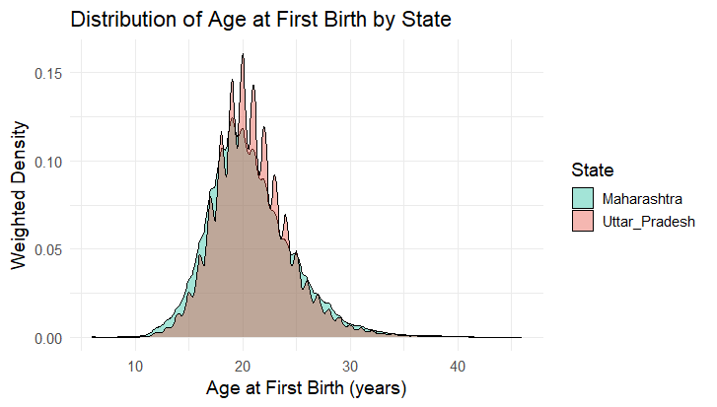
DISTRIBUTION of age at first birth by state
The graph shows the weighted distribution of women’s age at first birth in Maharashtra and Uttar Pradesh.
Both Maharashtra and Uttar Pradesh show left-skewed distributions, indicating that most women have their first birth at younger ages. Both peaks appear between 18-22 years

Slide 22
Hypothesis testing
A weighted two-sample t-test was used to compare the prevalence of early child-birth between the two states. The test was based on the null hypothesis that the prevalence of early childbirth in Maharashtra and Uttar Pradesh is equal, against the alternative that they are significantly different.
Assumptions:
Observations are independent from one another.
The data for each groups are approximately normal distributed.

Slide 23
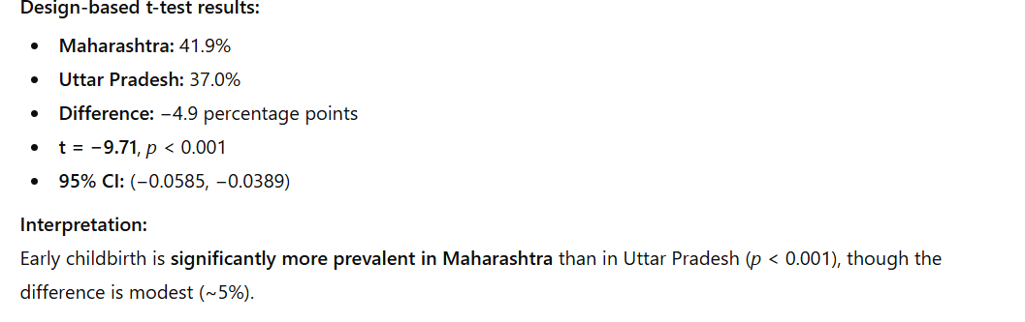
RESULTs AND INTERPRETATION
(hence we reject the null hypothesis that the prevalence is same)

Slide 24
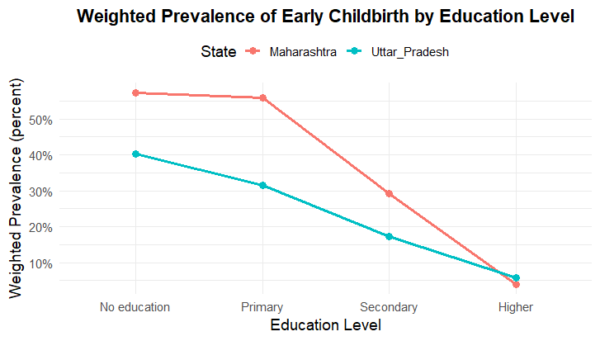
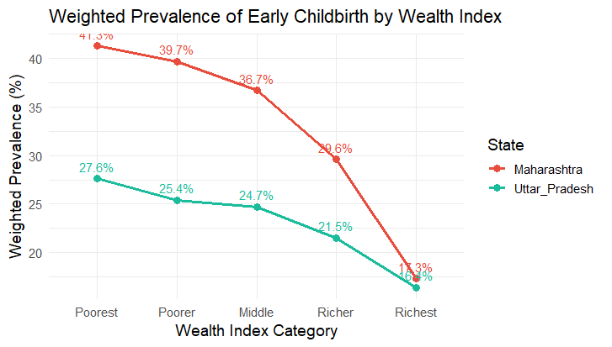
Plots for weighted prevalence comparison grouped by education and wealth

Slide 25
INTERPRETATION FROM PLOTS
It can be observed that the prevalence of early childbirth declines sharply with increasing levels of education and wealth index in both Maharashtra and Uttar Pradesh. Maharashtra consistently shows a higher prevalence across all groups, though it exhibits a steeper rate of decline in both cases. Moreover, for women with higher education, Maharashtra’s prevalence falls slightly below that of Uttar Pradesh, indicating that as education increases, Maharashtra’s relative advantage becomes more evident.
A similar trend is observed when the data are grouped by residence. In Maharashtra, the weighted
prevalence of early childbirth is 23.4% in urban areas and 36.0% in rural areas, whereas in Uttar Pradesh, it is 20.2% in urban areas and 24.6% in rural areas.

Slide 26
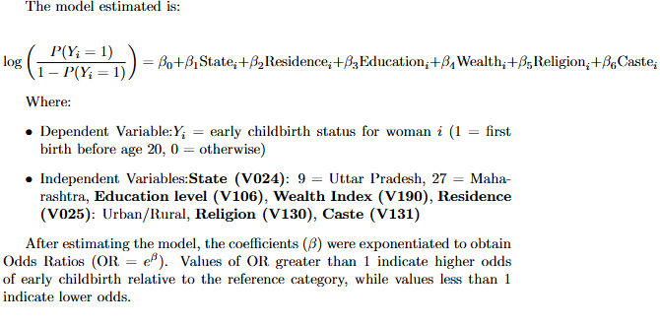
Logistic regression model
Since the dependent variable early_birth is binary (1 = first birth before age 20, 0 = otherwise), a logistic regression model was used to identify socio-demographic factors associated with early childbirth. Moreover, because NFHS follows a complex sampling design, the model was estimated using a survey-adjusted logistic regression (svyglm) to obtain correct standard errors.

Slide 27
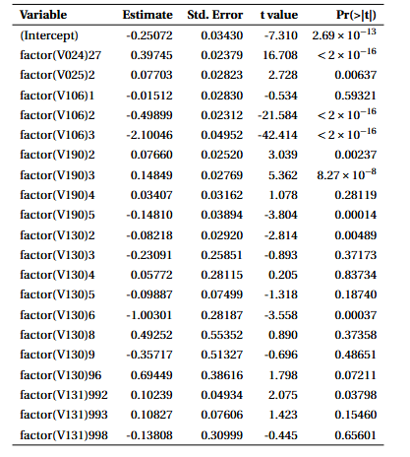
LOGISTIC REGRESSION RESULTS AND INTERPRETATION
Women from Maharashtra (V024 = 27) had
significantly higher odds of early childbirth compared to those from Uttar Pradesh (reference category), as
indicated by a positive and highly significant coefficient (β = 0 . 397, p < 0 . 001). Rural women (V025 = 2) also
showed higher odds relative to urban women. Education (V106) was strongly negatively associated with
early childbirth, with secondary and higher education levels showing substantially lower odds (p < 0 . 001).
Women from poorer wealth quintiles (V190) were more likely to have early births than those from richer
groups. Religion (V130) and caste (V131) displayed weaker and less consistent associations. Overall, the
results indicate that lower education, lower wealth, rural residence, and being from Maharashtra are key risk
factors for early childbirth among women in the sample.

Slide 28
CONCLUSION
Surprisingly, Maharashtra, despite its higher development indicators, exhibits greater early childbirth prevalence than Uttar Pradesh. One possible reason might be: When we define “early childbirth” as having the first birth before age 20, we’re essentially asking: “By the time a woman reaches age 20, has she already had a child?” Now, if we include girls or young women below 20 (say 15–19 years old) in the analysis, some of them might not have had a child yet, but they still could before turning 20.So, treating them as “no early childbirth” is misleading — they haven’t finished the risk period yet.
> sum(UP$V013 == 1, na.rm = TRUE)
[1] 19844
> sum(Maha$V013 == 1, na.rm = TRUE)
[1] 4929
This highlights the need to look beyond economic development and focus on targeted social interventions.

Slide 29
RESEARCH QUESTION 3
After birth within 3 days if food other than breast milk is given like (honey, glucose water , fruit juice , Janam Ghutti) then it can increase infant mortality rate.
Does mother's education level plays a significant role here ?

Slide 30

Research objective
Infant Mortality rate is different in different states. One reason for this is obviously population, but the other thing that might be is that after birth within 3 days if food other than breast milk is given to the child like (honey,glucose water ,fruit juice, JANAM GHUTTI etc. then it might increase infant mortality rate. Also this type of carelessness may occur due to lack of education of the mother. In this study our main aim is to find ifthere is a significant relation between these three thing - Infant mortality rate , food given other than breast milk within some days of birth and mother’s education

Slide 31



Research hypothesis
Infant mortality rate , food given other than breast milk within some days of birth and mother’s education level are significantly correlated

Slide 32




Methodology
Our variable of interest here are as follows....
"B5$01","B5$02",... to "B5$20" indicates whether i th child is alive or death
"B6$01","B6$02",... to "B6$20" indicates when her i th child died
"M55$1",..."M55$6" indicates whether food other than breast milk is given or not to the i th child.
("M55A$1",..."M55A$6");.....("M55O$1",..."M55O$6");("M55X$1",..."M55X$6") indicates names of food
item other than breast milk is given or not to the i th chilld. For ex: A - milk (other than breast milk), B - Plain water, G - Infant Formula, H - tea or infusions etc.
"V107" indicates highest year of education

Slide 33
Methodology
Our main three findings here are as follows....
Calculation of NMR,PNMR,IMR
2) Relation between Infant mortality and foods other than breast milk given within few days of Birth
3) Relation between infant mortality rate , food given other than breast milk within some days of birth and mother’s education level)

Slide 34
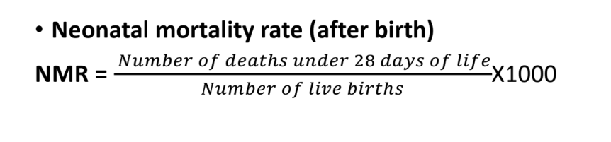
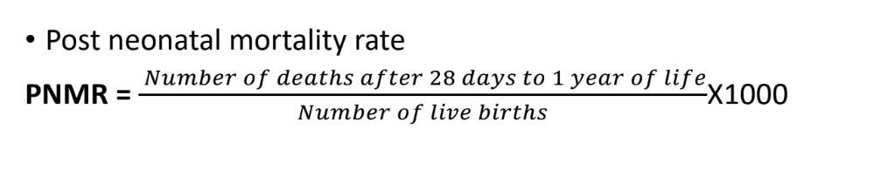
Methodology
First recall some of the definitions :-

Slide 35
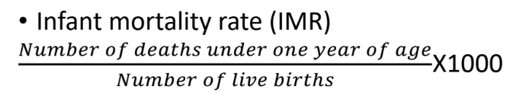
Methodology
First recall some of the definitions:- (Contd.)

Slide 36
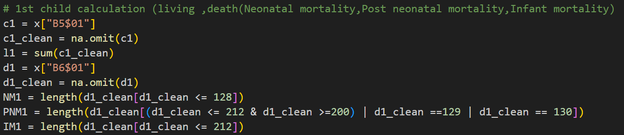
Methodology
Calculation of NMR,PNMR,IMR
We calculate NMR,PNMR,IMR for each ith child separately:-

Slide 37
Methodology
Calculation of NMR,PNMR,IMR (Contd)
• Similarly we calculate (NM2,...NM20);(PNM2,...,PNM20);(IM2,...,IM20) for 2nd,..,20 th child respectively.
• So, total Neo mortal deaths, NM = NM1+NM2+..+NM20
total Post Neo mortal deaths, PNM= PNM1+PNM2+..+PNM20
total Infant deaths, IM = IM1+IM2+..+IM20
total living children, l = l1+l2+..+l20
• So, the NMR = NM/l*1000
the PNMR = PNM/l*1000
the IMR = IM/l*1000
After computing NMR,PNMR,IMR for both the states UP and Maharastra we plot the values in a graph
and compare those.

Slide 38
Methodology
Relation between Infant mortality and foods other than breast milk given within few days of Birth:-
Here our objective is to find if there is any significant relation between Infant mortality and foods other than
breastmilk given within few days of birth. To do that we proceed as following :-
• Find the numbers of food item given to child within 3 days of birth for each individual food item.
• Among them we pick the most 5 consumed food item and then find we find correlation with these with
the child whether alive or dead.
• We done this for the 1st child only as number of other child and relevant food consumed by them - the
number is relevantly very low.

Slide 39

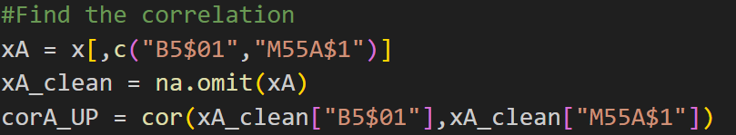
Methodology
Relation between Infant mortality and foods other than breast milk givenwithin few days of Birth:- (Contd)
Let's understand this with the code:

Slide 40
Methodology
Relation between infant mortality rate , food given other than breastmilk within some days of birth and mother’s education level...
Here our objective is to find if there is any significant relation between infantmortality rate , food given other than breastmilk within some days of birth and mother’s education level. To do that we proceed as following :-
• We take the column "B$601", "M55$1" , "V107" and after removing the "NA"s we compute partial
correlation between them.

Slide 41
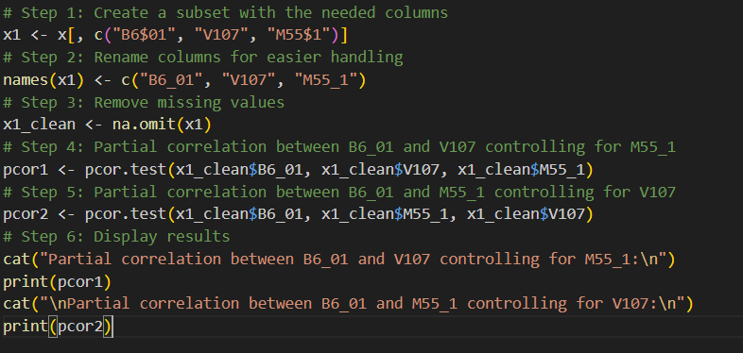
Methodology
Relation between infant mortality rate , food given other than breastmilkwithin some days of birth and mother’s education level...(Contd)
Again have a look into the code:-

Slide 42


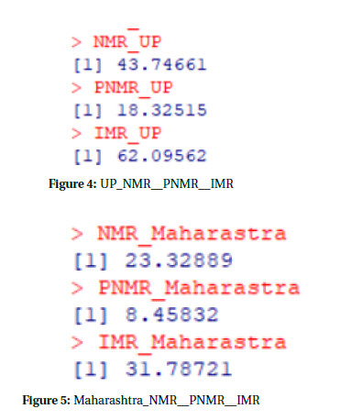
Salient findings
First let us see the value of NMR,PNMR,IMR for UP and Maharashtra separately:-

Slide 43
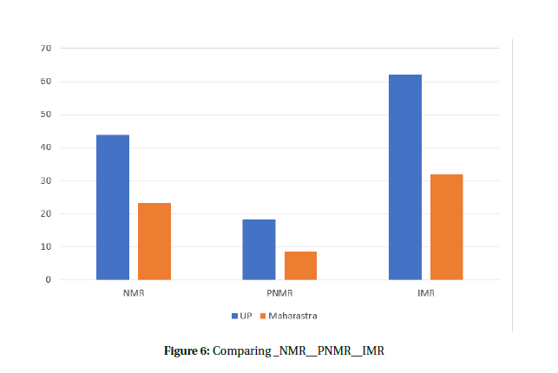
Salient findings
Now compare these results by plotting in a bar plot : -

Slide 44
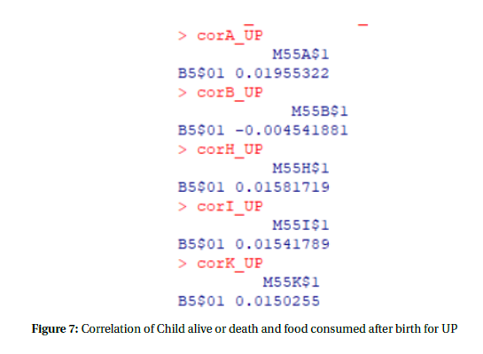
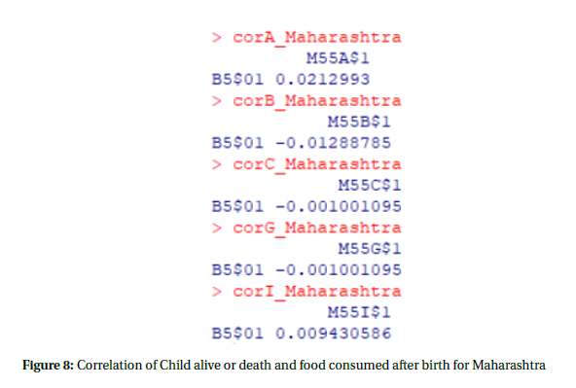
Salient findings
So in all of the infant death rates UP has higher rates than Maharashtra. This may have many reasons but
from the data what suggests is that lack of proper caring of the child after birth may be one reason.A newborn’s stomach
and intestines are still developing. They cannot digest or absorb nutrients from solid or even semisolid foods
efficiently.Introducing other foods too early causes indigestion, diarrhea, and nutrient loss. So ,giving food
other than breast milk may be one cause of this infant mortality rate. So, we check correlation between death
and food consumed ( top 5 food consumed for each state) and got the following results :-

Slide 45

Salient findings
One Natural Question ?
Now after calculating correlation we observe that in all the cases the correlation is too low or negative in
also some cases. So this implies that relation between the child is alive or not and food other than breast milk
given within 3 days is negatively correlated. This means food consumed other than breast milk within 3 days
of birth may cause infant mortality and hence can increase infant mortality rate.
After this the natural question which arise is that why the parents give these type of food to their new
born childrens ? This occurs may be due to mother with low or no formal education often don’t know
that exclusive breastfeeding (only breast milk for 6 months) is scientifically recommended by WHO and
UNICEF. They may believe that babies need water, cow’s milk, or semi-solid food early to grow properly. This
misunderstanding directly leads to unsafe feeding and higher infant illness. So this encourages us to test if
there is a significant relation between Infantmortality rate , food given other than breast milk within some
days of birth andmother’s education level. We obtain the following results : -

Slide 46
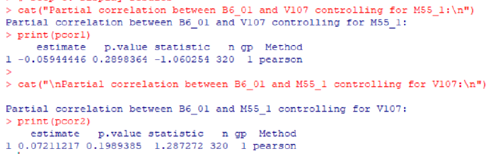
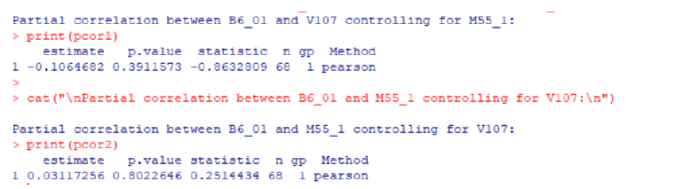
Salient findings

Slide 47


Discussion
So here also we find that partial correlation between deaths of infants and education level of mother given food other than breast milk given within 3 days is negatively correlated which means mother’s education level has significant impact on reducing infantmortality. If a mother has good education then she must know about her child’s proper diet. Also good health means reduction in infant mortality.
Reasons for Higher Infant Mortality in Uttar Pradesh than in Maharashtra:-
1. Healthcare Infrastructure and Access
2. Socioeconomic Factors
3. Cultural and Behavioral Factors
4. Implementation of Government Programs
5. Urbanization and Infrastructure

Slide 48


Conclusion
In summary, the higher infant mortality rate in Uttar Pradesh results from poor healthcare access, lower maternal education and nutrition, inadequate sanitation, and weaker implementation of health programs. To overcome this situation, it is essential to strengthen primary healthcare infrastructure, ensure timely maternal and child health services, and improve access to institutional deliveries and neonatal care. Increasing female education and awareness about hygiene, nutrition, and immunization can significantly reduce infant deaths. Effective implementation andmonitoring of government schemes such as the National Health Mission and POSHAN Abhiyaan are also crucial.
A combined effort of government, community participation, and awareness
campaigns can help Uttar Pradesh achieve lower infantmortality and better overall health outcomes, similar to Maharashtra.

Slide 49
RESEARCH QUESTION 4
How does fertility vary by place of residence (urban vs rural)?
The study aims to examine whether residence factors explain the variation in fertility levels. Specifically, we test whether a woman’s residence has a statistically significant effect on fertility.

Slide 50
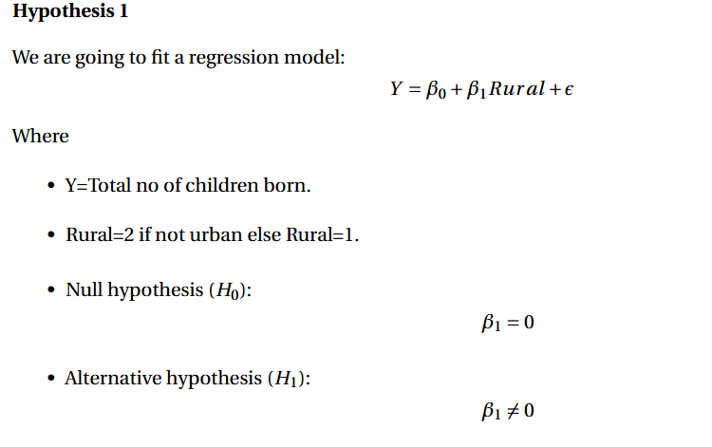
MODEL AND HYPOTHESIS TESTING(regression model)

Slide 51
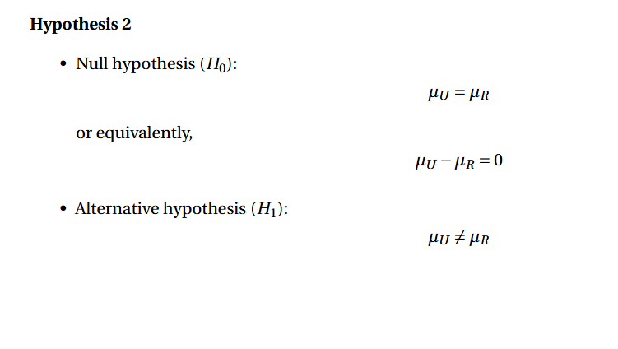
Two-Sided T -TEST

Slide 52
ASSUMPTIONS for regression model
The dependent variable is a count variable and takes non-negative integers.
The response variable follows a Normal distribution.

Slide 53
ASSUMPTIONS for two sided t test
Observations are independent from one another.
The data for each groups are approximately normal distributed.

Slide 54
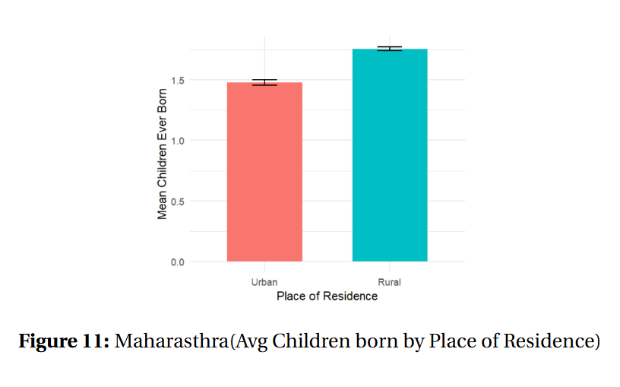
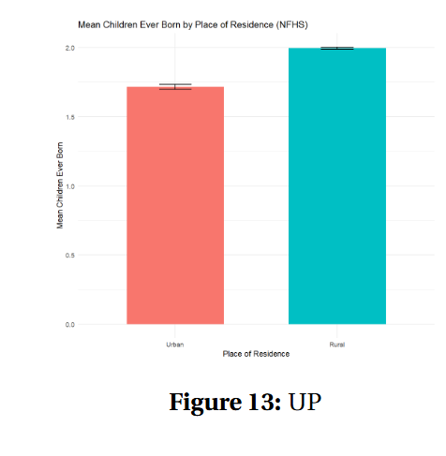
UP AND MAHRASTHRA BOX PLOT AVG CHILDREN BORN BY RESIDENCE

Slide 55
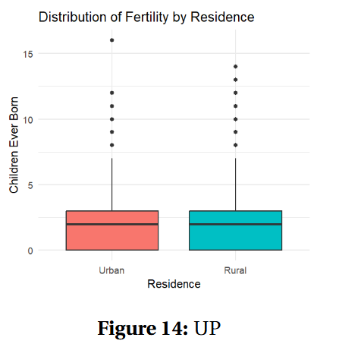
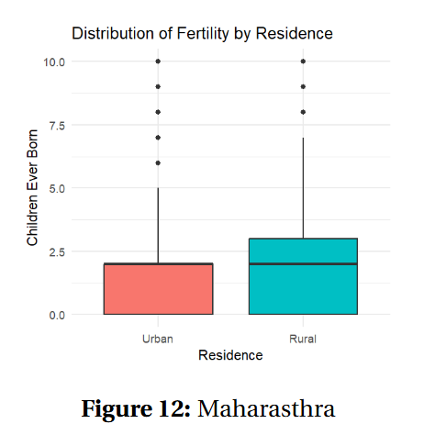
UP AND MAHRASTHRA BOX PLOT DISTRIBUTION OF FERTILITY BY RESIDENCE

Slide 56
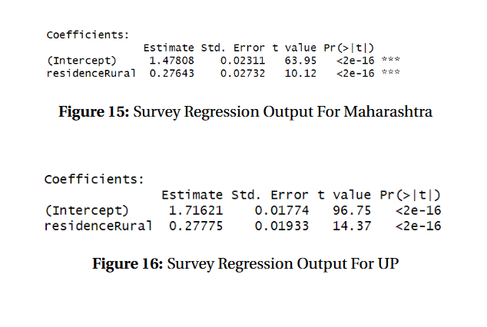
REGRESSION OUTPUT

Slide 57
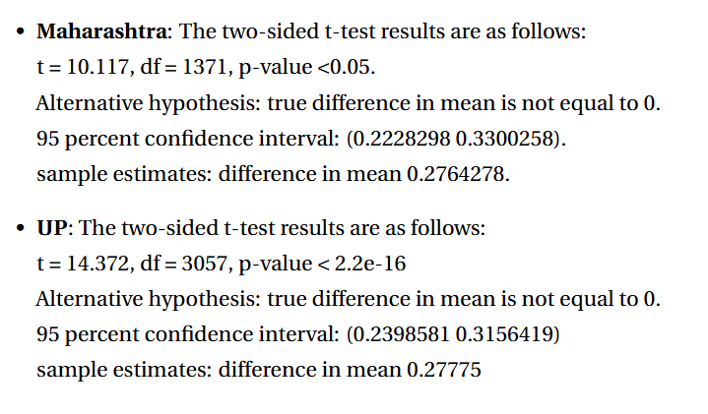
T-test Conclusion

Slide 58
INTERPRETATION
For both states the mean children born by residence is not same.
The distribution of children born remains same for UP in both rural and urban areas.

Slide 59
Conclusion
By changing the place of residence can affect the fertility rate for Maharashtra. But, for UP it does not make much effect. So, there must be other much strong factor that affect fertility rate in UP.

Slide 60
RESEARCH QUESTION 5:
While both Maharashtra and UP have an income gradient from west to east, signifying high spatial variance of income, we want to know that for which state is this variance higher?

Slide 61
REASONS FOR THE INEQUALITY
There is a common agricultural reason for this inequality in both states. In Maharashtra, the western areas receive monsoon rainfall but not the eastern areas as the winds get blocked by the Western Ghats. Similarly, western UP is inclined towards cash crops whereas eastern UP has minimal prevalence of cash crop agriculture.
For Maharashtra, there is also a reason of trade as the western coast has access to the ocean and there are historical reasons such as development of Bombay.
For UP, presence of Delhi NCR in proximity to the western side is also a major reason for this gradient.

Slide 62
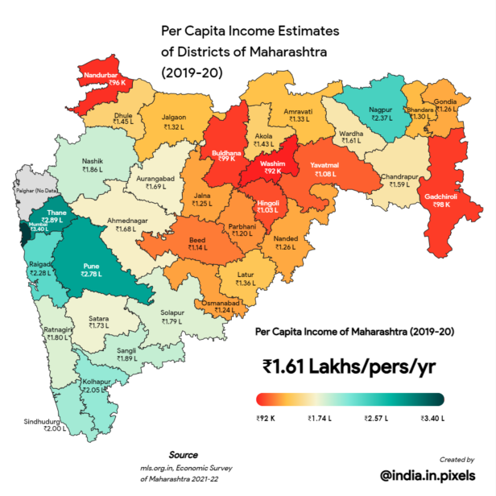
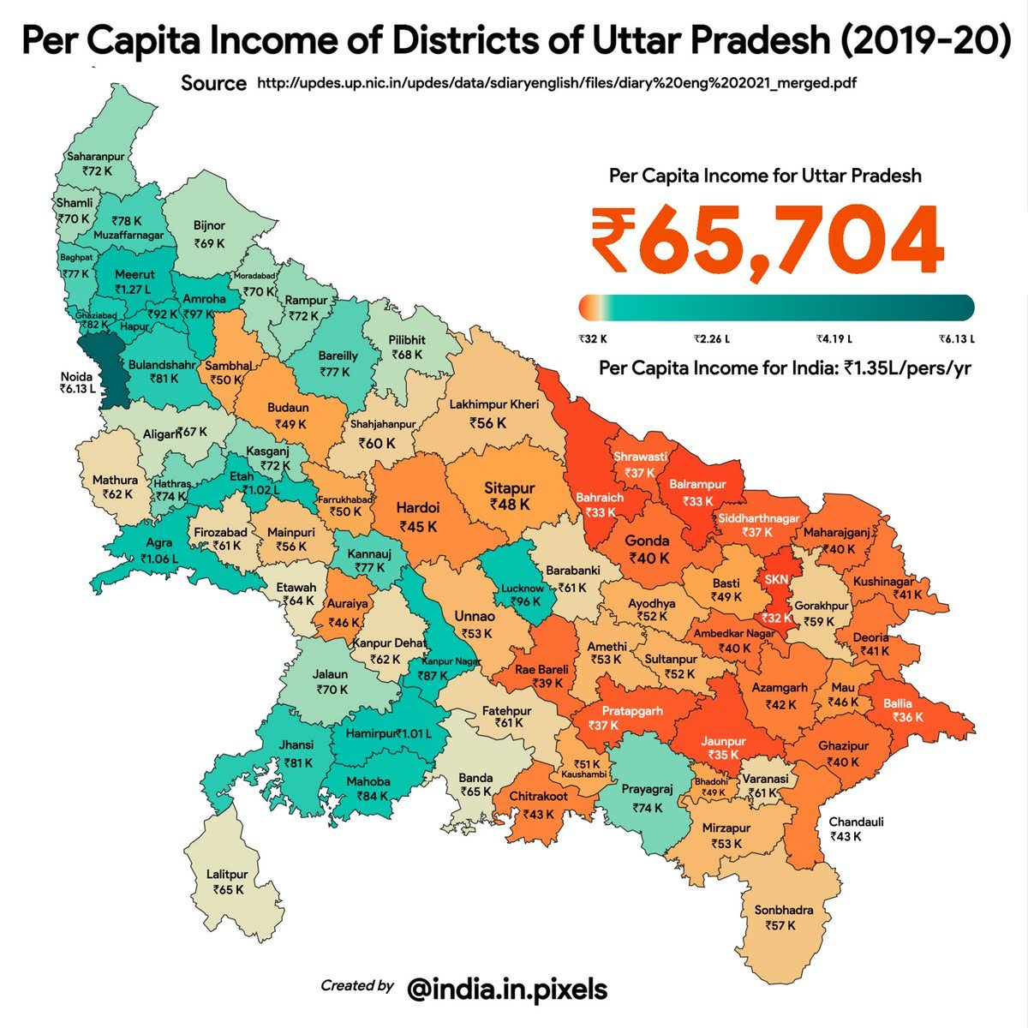
TWO MAPS – data from 2019-20

Slide 63
Structure of the data & Methodology
For both the states, we enlist the districts in alphabetic order alongside their corresponding latitude and longitude which captures the spatial information and also the average income of the districts.
We use a common tool from spatial statistics called a variogram to be able to answer our research question : Which of the two states has higher spatial inequality?

Slide 64
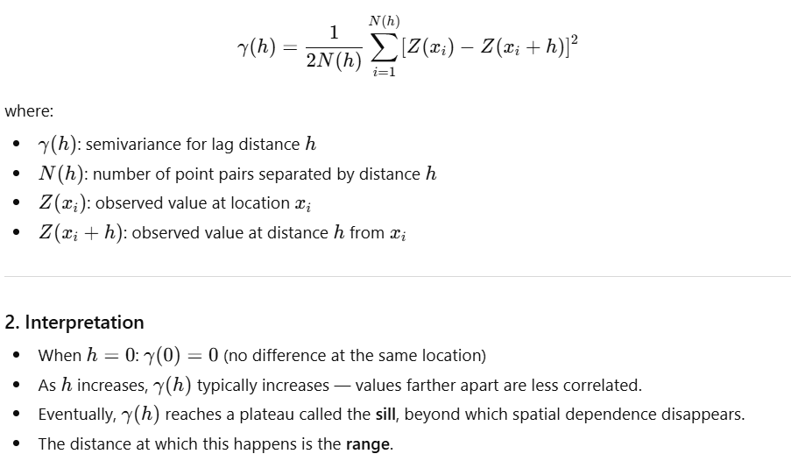
Formula for variogram

Slide 65
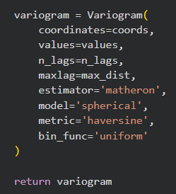
HOW IT'S DONE IN PYTHON?
We use the scikit-gstat python library to get a Variogram function:
From skgstat import Variogram

Slide 66
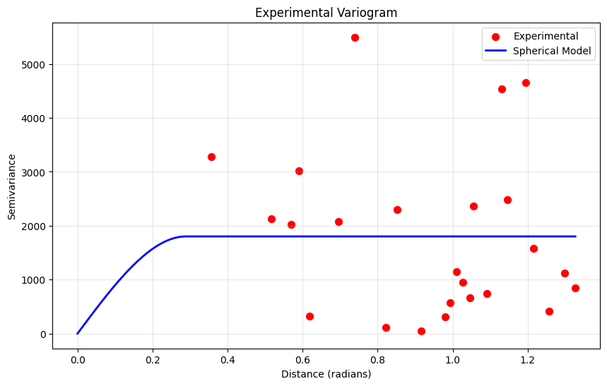
Variogram for maharashtra
Nugget: 0.289
Sill: 1802.005

Slide 67
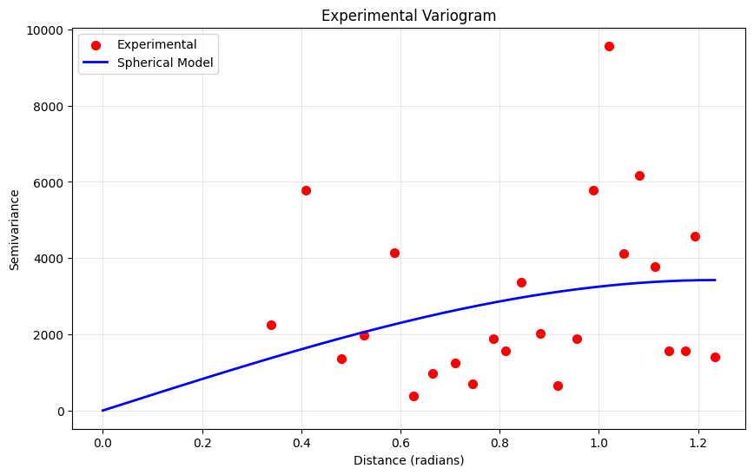
Variogram for up
Nugget: 1.234
Sill: 3423.089

Slide 68
Conclusion and a CAVEAT
The spatial variance is given by SILL – NUGGET value of the variogram which about 1.5 times higher for UP than for Maharashtra. Thus we conclude that UP has a higher spatial variance of income than Maharashtra.
Although there is a caveat that may put the interpretability of this result in question. Variogram is applicable to stationary spatial data having constant mean and variance which is clearly untrue in our case due to the presence of the gradient. For this reason, I transformed the data by taking the square roots of the incomes. But this still leads to non-smoothness of the variogram.

Slide 69



Thank You

