Slide 1



BIRLA INSTITUTE OF TECHNOLOGY,
MESRA
Topic :-
Human Resource Management System
Guided By :-
Developed By :-
Prof. Nagendra Prasad Tiwary
Rahul Kr Chaudhary
MCA/40023/19

Slide 2
INTRODUCTION
Human Resource Management System is a distributed application, developed to maintain the details of employees working in any organization. It maintains the information about the personal details of their employees, also the details about the payroll system which enable to generate the pay slip. The HR Center includes a comprehensive employee information database, work information database, and more for each employee.
The HR center is a powerful application designed to allow companies to streamline their human resource tasks and manage their employees more efficiently (Employee and Company Information, Employee Time, Attendance, and Leave Request HR Documentation Management (i.e. insurance forms, etc.).

Slide 3
OBJECTIVE
To allow the HR of an organization to update the employee details whenever there is a change in the employee profile pertaining to that organization. It also brings onto a string the employee specific suggestions and makes them free to post their requirements to the HR for making the organization more specific regarding the maintenance of the organization.
To develop a software application that supports Specific to the HR Automation in an intranet to a company there by allowing the interaction of all the employees pertaining to that organization to keep track of all the other departments related to that organization like marketing, research etc. and to allow the HR department of an organization to update

Slide 4
Why This Software?
The HR administration fails short of controlling the Employees activities in analysing his/her his strength and weakness. That decision for appraisal of assigning next project to the employee or to train him/her to enhance the skills lies with proper projection. It is not provided with the detailed project information done or to be assigned based on application.
Provide information in a quick time according to the requirements that are to be Fulfilled.
Easier retrieval will be possible as multiple search facilities will be available.
Security of data.
The important process is integrated together for a proper functioning.
Inconsistency of data is removed. The Paper Work would be reduced to a greater extent.

Slide 5
HARDWARE REQUIREMENT
OPERATING SYSTEM | WINDOWS OS
DATABASE SERVER | MySQL
FRAMEWORK SERVER | JAVA
JDK | 1.2.7

Slide 6
SOFTWARE REQUIREMENT
RAM | 500 MB and Above
HARD DISK | 2 GB Hard Disk Space and Above
PROCESSOR | I3 Processor and Above
PRINTER | Laser Printer

Slide 7
Working of Project
Install and JDK set-up.
Need to install Xampp local server to connect to database.
Double click on provided Jar file and that’s it.

Slide 8
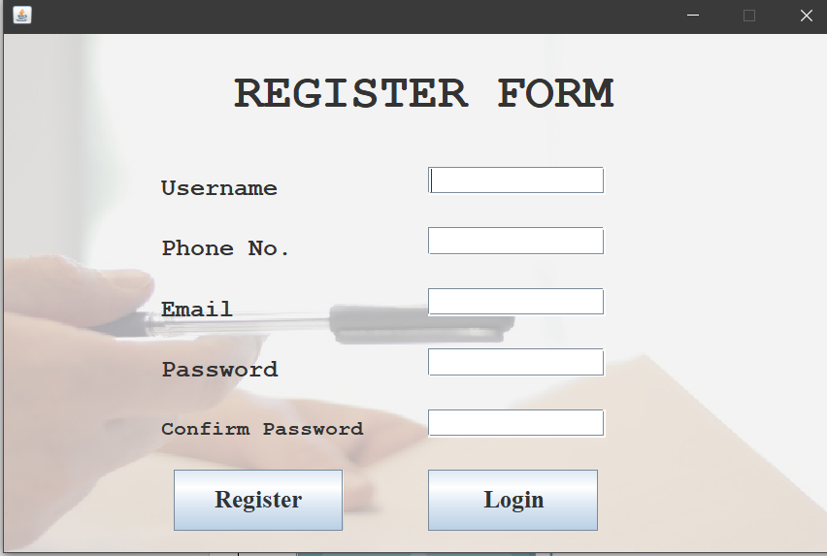
Register Form

Slide 9
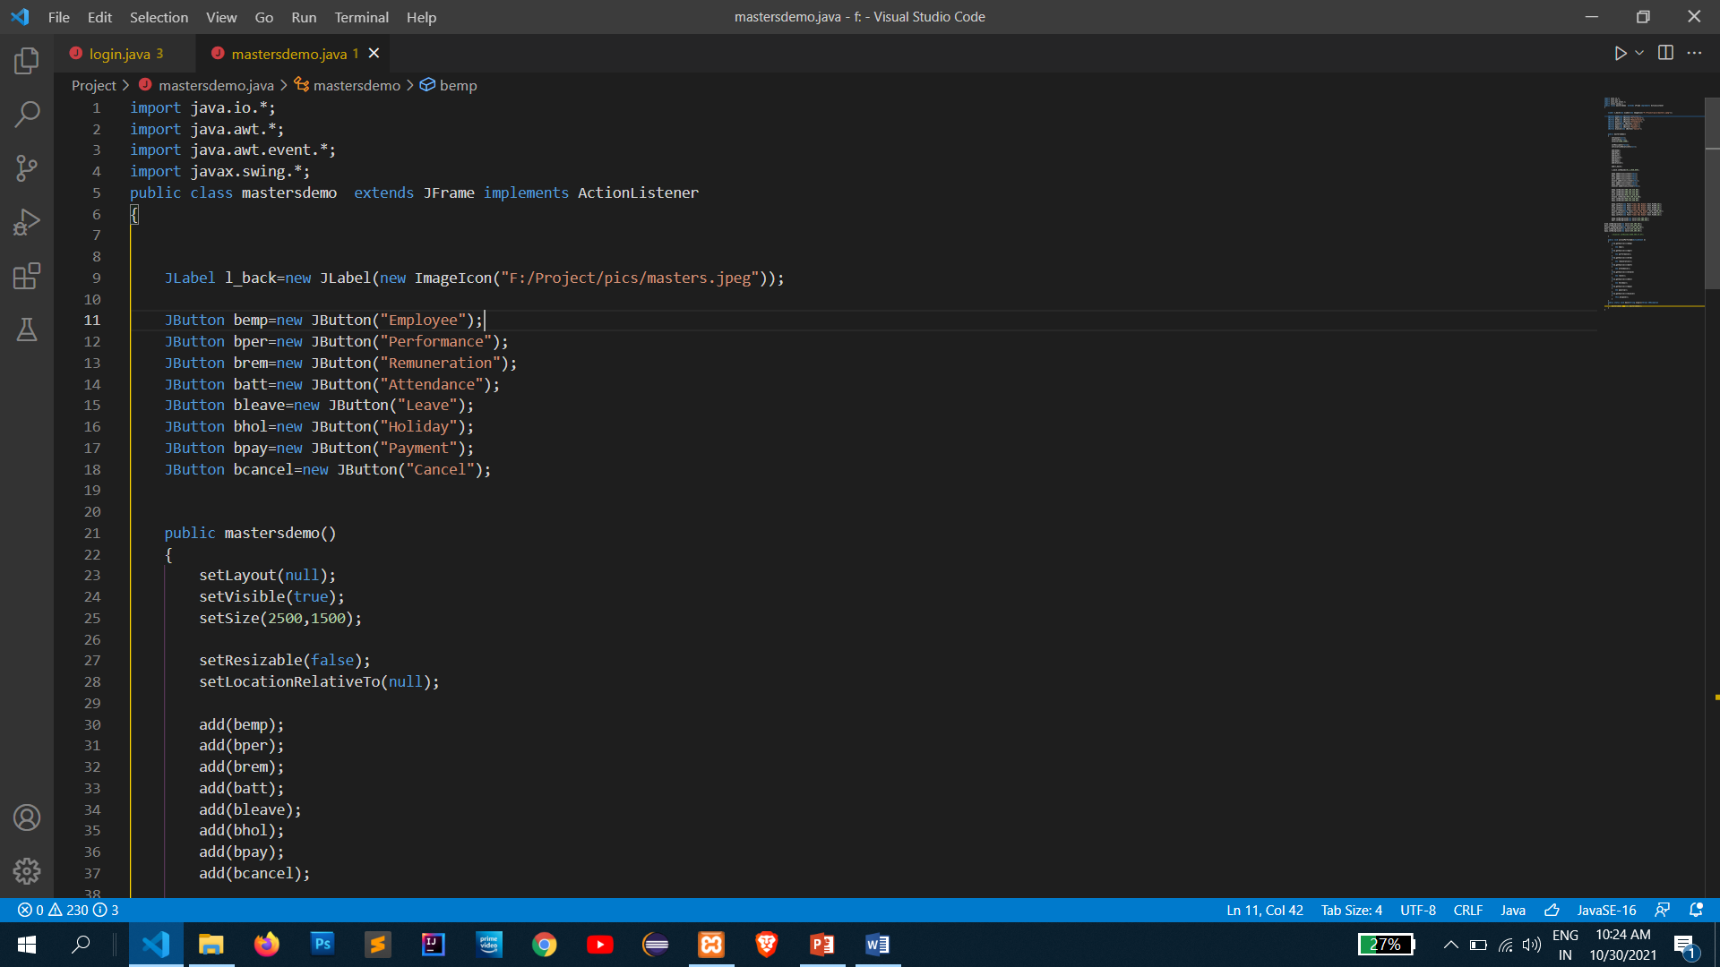
Code Snippet Of Registeration Form

Slide 10
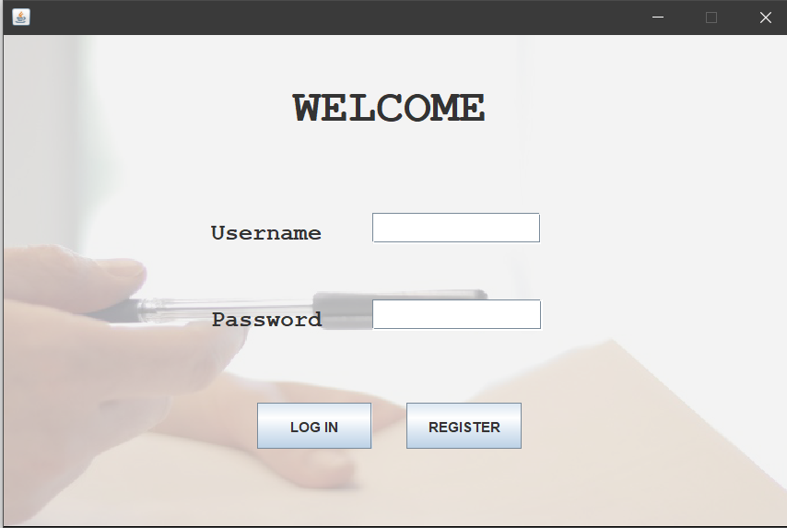
Login Page
Sign-in using your credentials.
If not, then register yourself first and then sign-in there.
Edit the existing record or make a new Record.

Slide 11
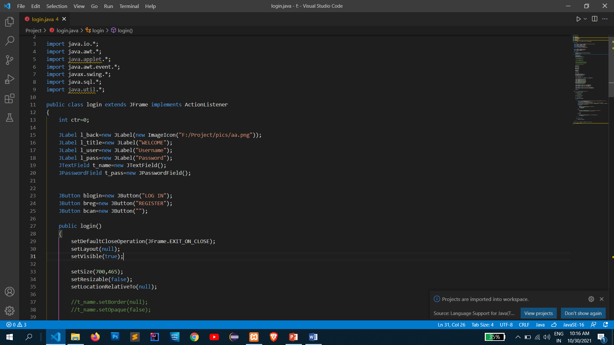
Code Snippet of Login Form

Slide 12
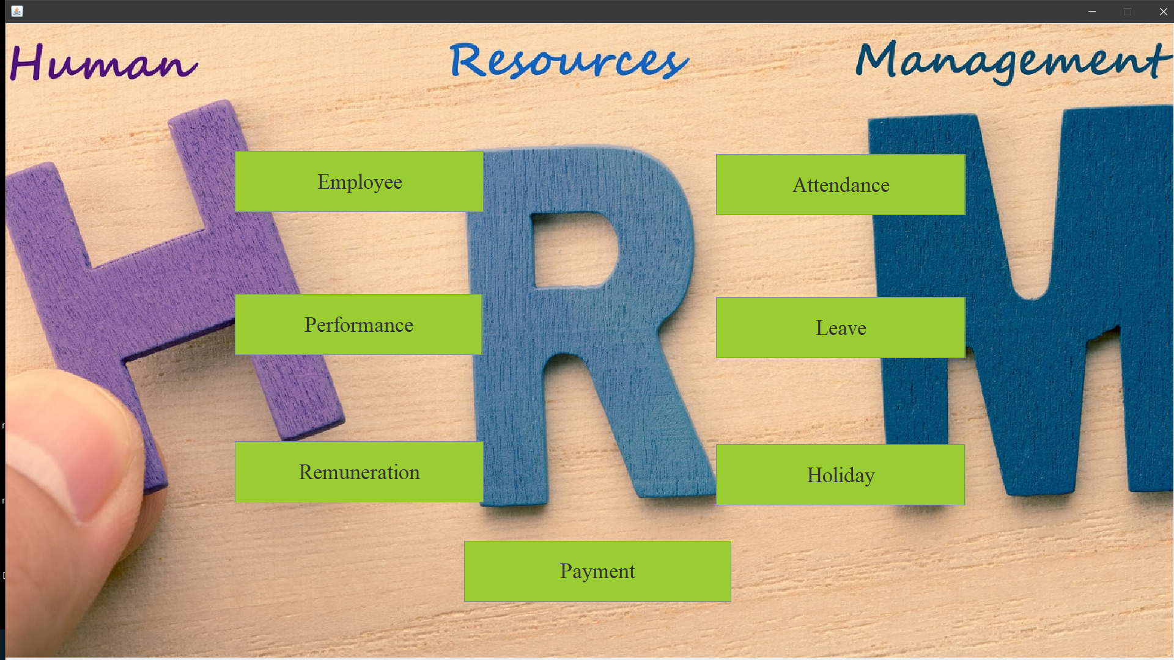
Main Master Form

Slide 13
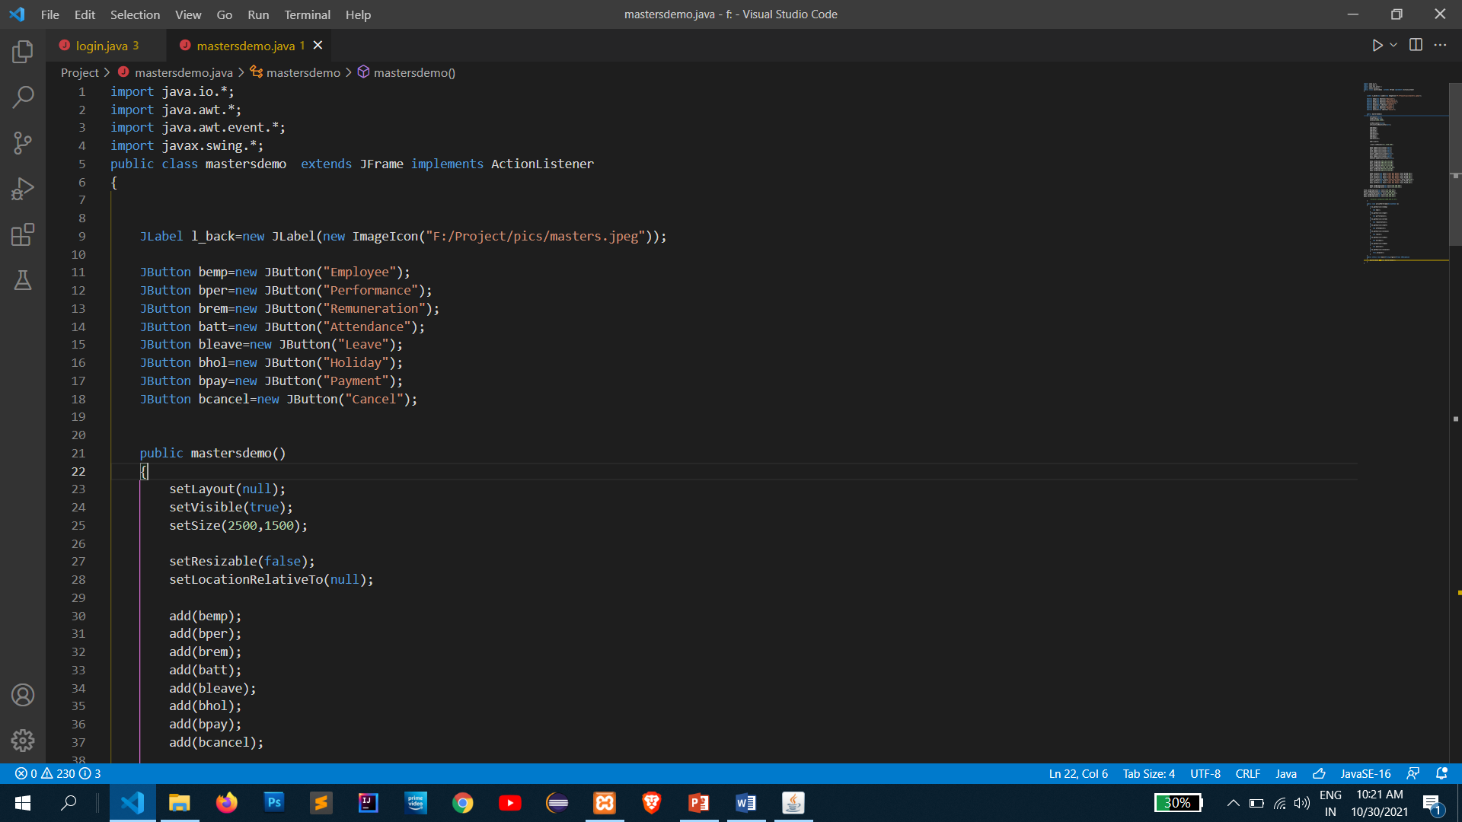
Code Snippet for Master Form

Slide 14
Modules Description
Employee Entry: It is a master record and it is used to maintain all the details of employees, i.e., name, address, basic salary, etc.
Privileges: It is also a master record and it is used to maintain the records of different privileges provided to certain employees, i.e., no. of sick leave, pf, hra, etc.
Performance: This module is also for master handling which details the skills of employees in various fields.
Attendance: This is of transactional level. It maintains records of the daily attendance of the employees.
Leave: This module is of transactional level as well and is used for requesting for leaves by employees.
Holiday: This is also of transactional level. It maintains record of all the holidays.

Slide 15
Conclusion
Our project is a humble venture to satisfy the needs in an institution. The system is developed with much care that is free from errors and at the same time, it is efficient and less time consuming. Our aim is to provide a very user friendly human resource management system which is helpful in managing details of employees, their functions and in various other aspects. In this application only one person has been given access rights and it is restricted up to the functionalities, so that the data is maintained securely and redundant data is prevented.
Several user-friendly coding are adopted. The important thing is that the system is robust. Avoid malfunctioning from outsiders. It goes through all phases of software development cycle. So, product is accurate. Also provision is provided for future development in the system.
A special thanks to our mentor for the guidance and blessing which was provided for the completion of our project. We welcome your cooperation and feedback.

Slide 16
Refrences
BOOKS-
• “SQL, PL/SQL, The Programming Language of Oracle”-Ivan Bayross
• “Data System Concept”-Abraham Silverschatz, Henry K. Forth and D. b
Sudarshan
WEBSITES-
www.slideshare.com
www.scribd.com
www.wikipidiea.com
www.code-project.com

