Slide 1


Slide 2

PROJECT SYNOPSIS SUBMITTED BY:
Rahul Kumar Chaudhary(2121663)
Sabih Ahmad (2122531)
Deep Mukherjee(2121916)
Divyasree Peetala(2121520)

Slide 3
OVERVIEW
Introduction
System requirements
Hardware Requirement Specification
Software Requirement Specification
Application Overview
Use Case Diagram
Data Flow Diagram (Level 0)
Data Flow Diagram (Level 1)
Table Structures
Screenshots

Slide 4
Introduction
This Project “Pharmacy Management System” is a solution to Pharmacy Organizations to take the orders from its distributors who are geographically distributed.
This system is a complete web based application for managing a pharmacy organization’s entire operation.
No need to own any computer for this specific ordering of products, it just requires user to register with the system.
It provides easy to use and user friendly interface for the user. The user, vendor can access the system at any time, because it’s 24-hour availability.

Slide 5
Aim and objectives
Purpose of this document
The purpose of this Pharmacy Management System project is to improve the maintenance and manipulation of the drugs in the medicals. The pharmacy management system will be used to minimize the time and resource by maintaining the details of the drug systemically so that the data can be used in possible quickest time. While the resource which is minimized are workforce, money, papers, etc. The system is user-friendly and will help the pharmacist. This Pharmacy Management System will reduce the burden on pharmacist and will make the system efficient by providing the more accurate details about drugs in the medical.

Slide 6
Main Users Of The System:
1.User
2.Admin
3.Vendor
It is a pharmacy online order application, which allows Customers to login themselves on to the system by filling in the correct details which will provide them with access to the system. Customers can view the product, view order details, view their product which will provide a brief description of our system. They can view or order medicines and can also check the details of their order.
Then there’s Admin who can add or remove new vendors, View products of the vendor, can place order to the vendor, check order status of self-order and check the order of user or can modify them . admin can add the user and product as well. Admin has complete access to the system
And lastly the Vendor can register their product on the application. Vendor can update their profile if they need to and can add product in the application, or can update the information of existing product and lastly they can check or update the order status of the admin.

Slide 7
SYSTEM REQUIREMENTS
System Interface
The software is to be developed in J2EE environment using JSP and JDBC.
User Interface
User interface is built using HTML/ JSP pages.
Communication Interface
The communication between the front-end and the back-end is through JDBC.

Slide 8
Hardware Requirement Specifiaction
For Server System
Pentium IV or above
1GB RAM
160 GB HDD
Display Unit
For Client System
Pentium IV or above

Slide 9
APPLICATION OVERVIEW
Administration module
User interaction module
Vendor Module

Slide 10
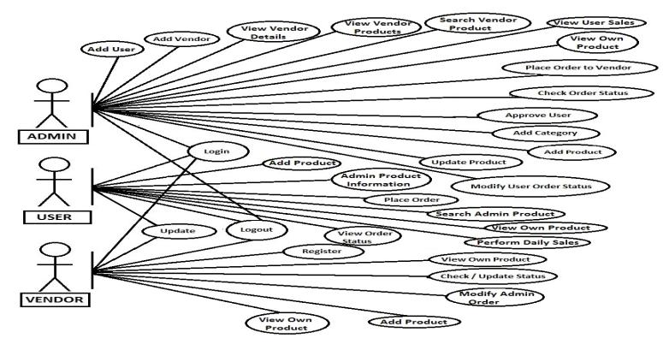
USE CASE DIAGRAM

Slide 11
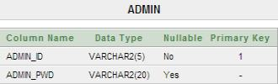
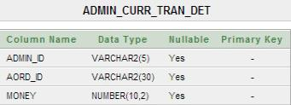
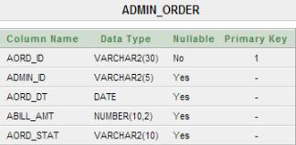
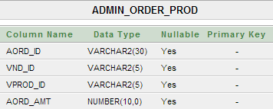
TABLE STRUCTURES

Slide 12
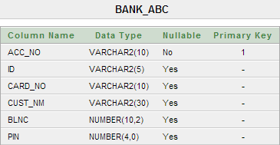
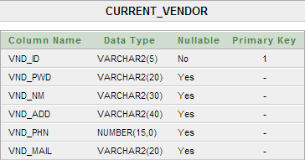
TABLE STRUCTURES

Slide 13
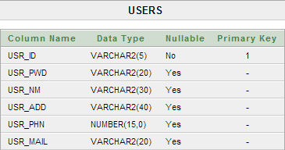
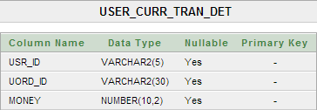
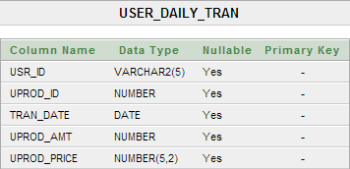
TABLE STRUCTURES

Slide 14
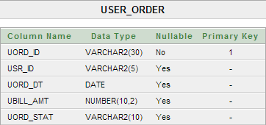
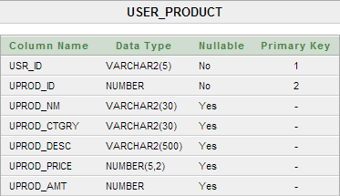
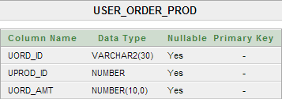
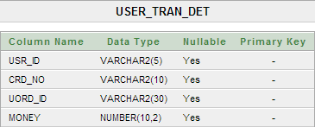
TABLE STRUCTURES

Slide 15
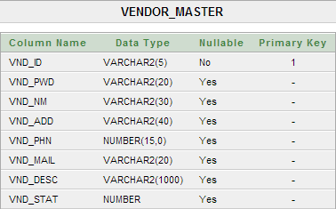
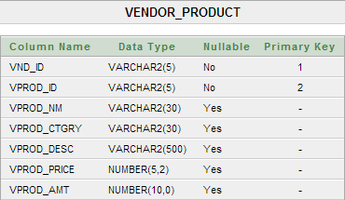
TABLE STRUCTURES

Slide 16
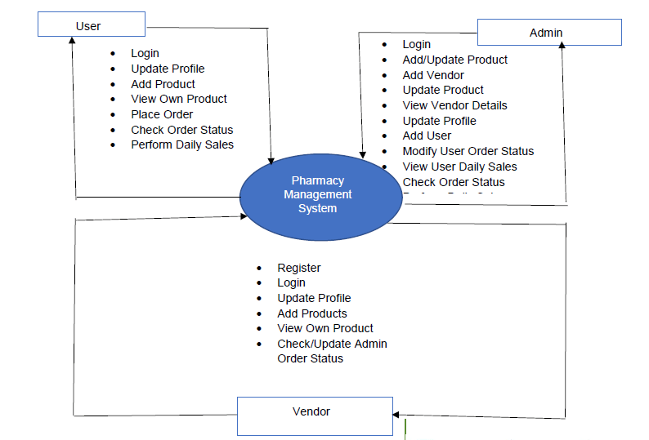
DATA FLOW DIAGRAM(LEVEL 0)

Slide 17
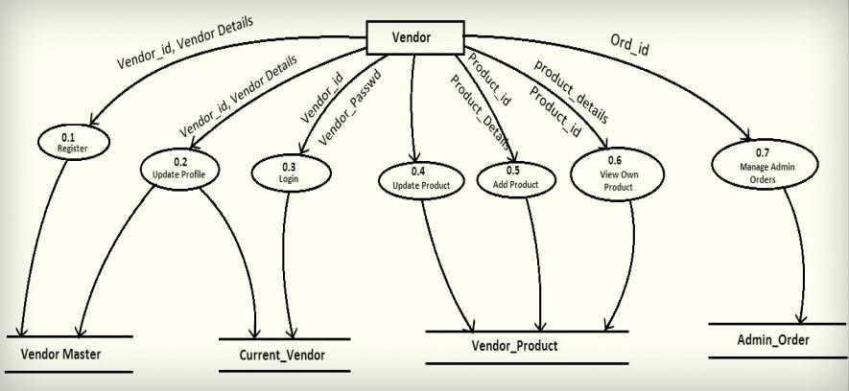
DATA FLOW DIAGRAM(LEVEL 1) VENDOR

Slide 18
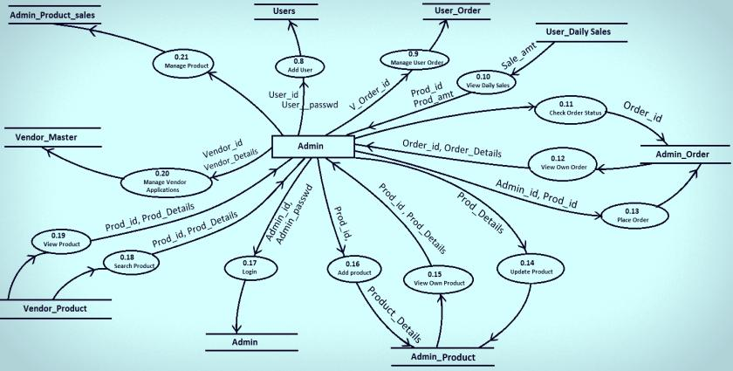
DATA FLOW DIAGRAM(LEVEL 1) ADMIN

Slide 19
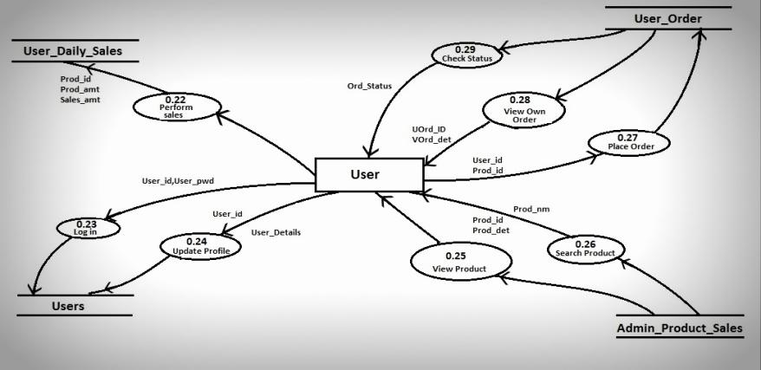
DATA FLOW DIAGRAM (LEVEL 1) USER

Slide 20
Screenshots

Slide 21
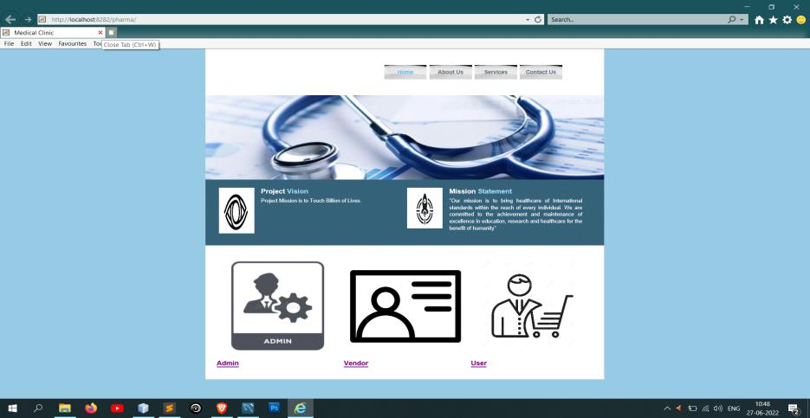
INDEX

Slide 22
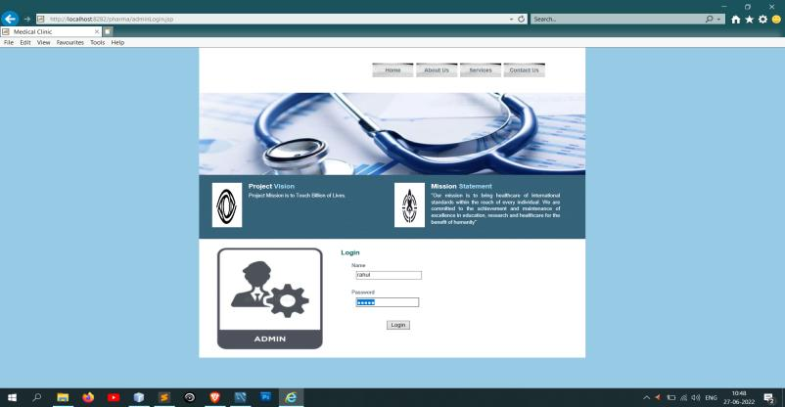
Admin Login

Slide 23
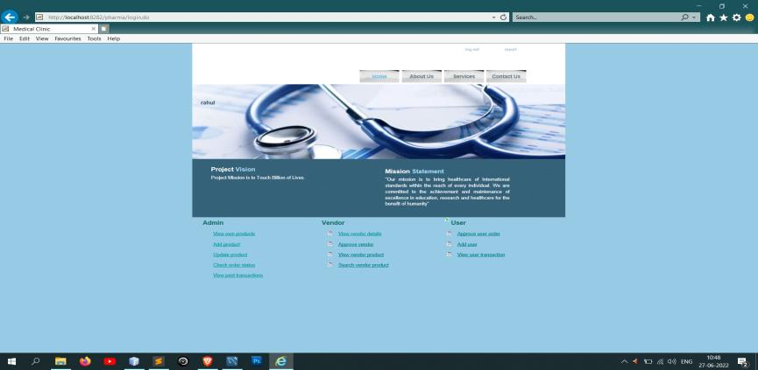
Admin Home

Slide 24
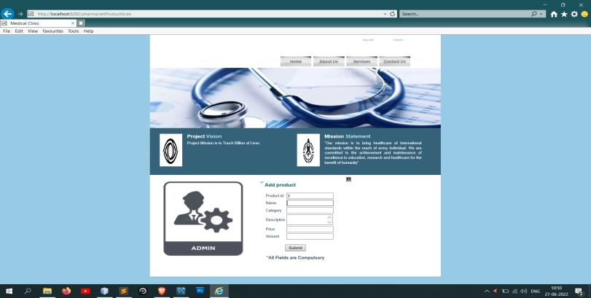
Admin Adds Product to His Cart

Slide 25
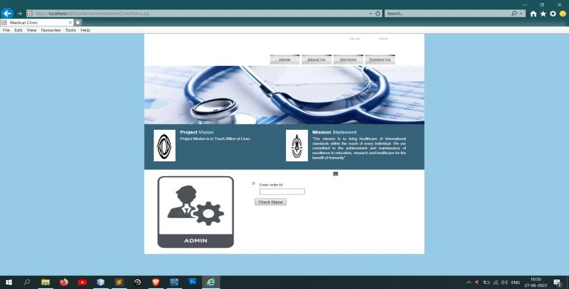
Admin Check order status

Slide 26
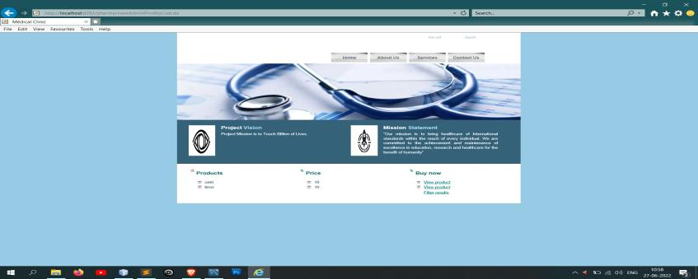
View Admin Product

Slide 27
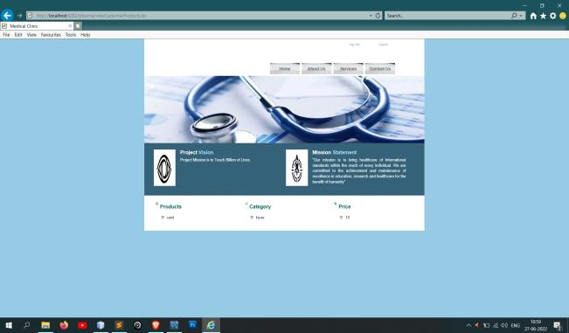
View Customer product

Slide 28
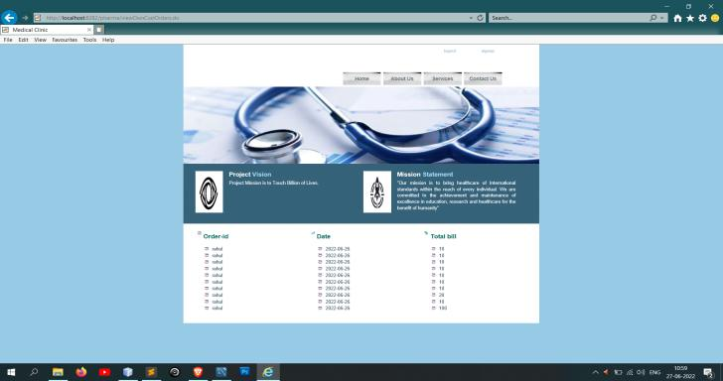
View own Customer order

Slide 29
THANK YOU

