Slide 1

Sass Basics

Slide 2
What is Sass?
Syntactically Awesome Stylesheets
Sass is an extension of CSS3
features that don't exist in CSS
Like nested rules, variables, mixins, selector inheritance, and more

Slide 3
How it works?

Slide 4
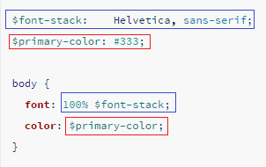
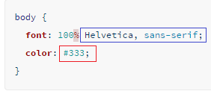
Scss
Css

Slide 5
Where to start?

Slide 6
Require Ruby http://rubyinstaller.org/
Install Sass using command
gem install sass

