Slide 1
Hiring Process Analytics
A Data-Driven Approach

Slide 2
Project Overview
Purpose: Analyze the hiring process of a multinational company by examining hiring trends, salary distributions, departmental structures, and position tiers using advanced data analysis techniques.
Case Studies:
Job Data Analysis – Evaluated hiring trends, gender distribution, and departmental hiring patterns.
Investigating Metric Spikes – Identified outliers in salary data, vacancy trends, and anomalies affecting the hiring process.
Objective: Derive actionable insights to optimize recruitment strategies, improve decision-making, and ensure fair salary distribution across different job roles and departments.

Slide 3
Tech Stack Used & Artifacts
Google Sheets – Used for data cleaning, analysis, and visualization.
Google Slides – Used for creating presentation.
Google Drive – Hosted the final report and Excel sheets for easy access.
Link to Google Sheets → Artifact

Slide 4
Approach
Data Cleaning – Handled missing values by replacing missing salaries with the average salary.
Outlier Detection – Used the IQR method to identify and visualize salary outliers.
Data Analysis – Conducted statistical analysis to determine hiring trends, gender distribution, and department-wise hiring.
Visualization – Used Excel charts and graphs (bar charts, pie charts) to represent key findings.
Final Reporting – Summarized the results and provided insights to improve the hiring process.

Slide 5
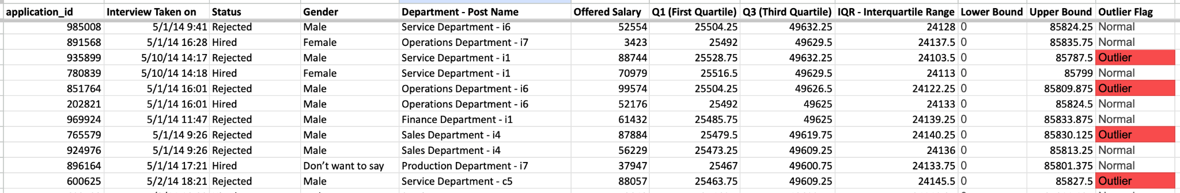
Data Cleaning & Preparation
Handling missing data
Missing data was handled by adding default values for categorical data and average by numerical data.
Identifying and treating outliers
Identified Outliers by statistical techniques like IQR, flagged them in red, since these are genuine values.

Slide 6
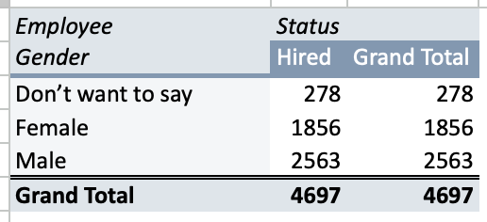
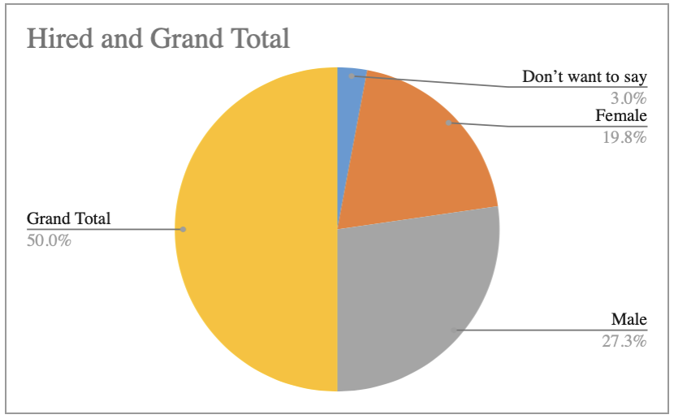
Hiring Analysis
Hiring Analysis: The hiring process involves bringing new individuals into the organization for various roles.
Your Task: Determine the gender distribution of hires. How many males and females have been hired by the company ?

Slide 7
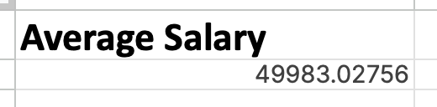
Salary Analysis
Salary Analysis: The average salary is calculated by adding up the salaries of a group of employees and then dividing the total by the number of employees.
Your Task: What is the average salary offered by this company? Use Excel functions to calculate this.

Slide 8
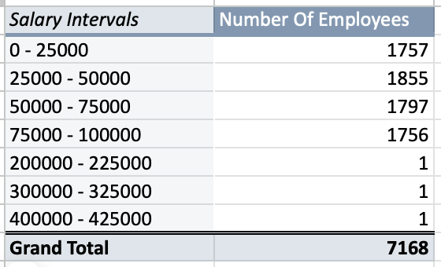
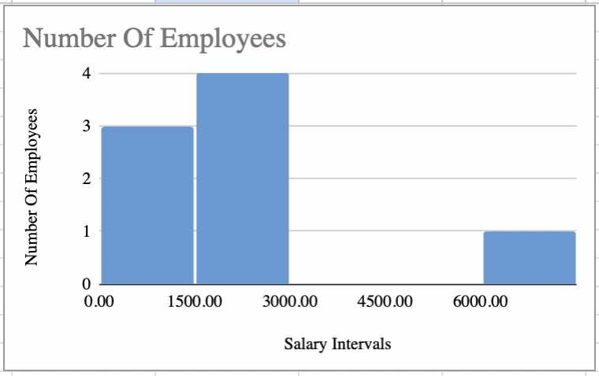
Salary Distribution
Salary Distribution: Class intervals represent ranges of values, in this case, salary ranges. The class interval is the difference between the upper and lower limits of a class.
Your Task: Create class intervals for the salaries in the company. This will help you understand the salary distribution.

Slide 9
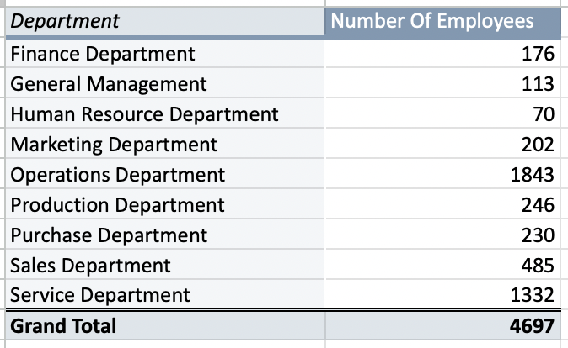
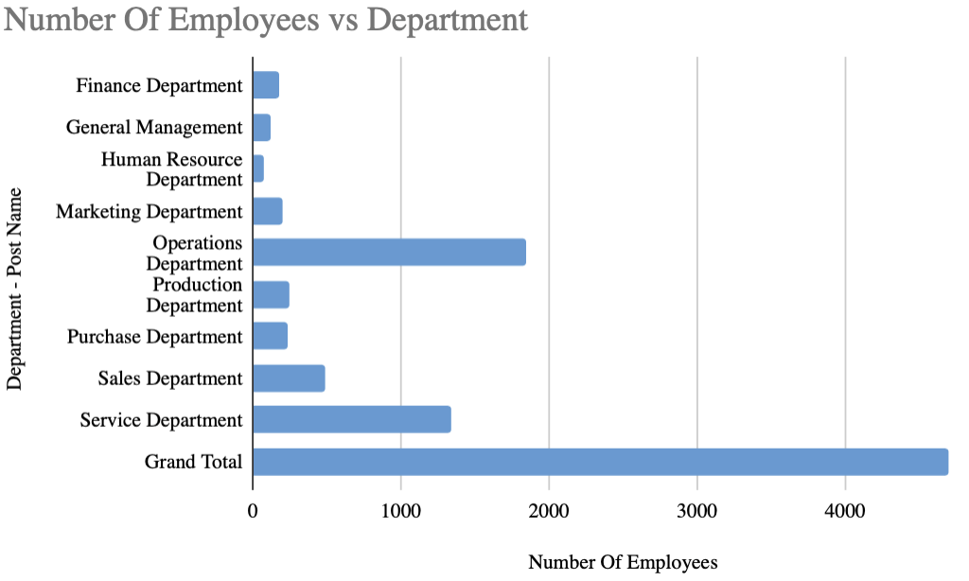
Departmental Analysis
Departmental Analysis: Visualizing data through charts and plots is a crucial part of data analysis.
Your Task: Use a pie chart, bar graph, or any other suitable visualization to show the proportion of people working in different departments.

Slide 10
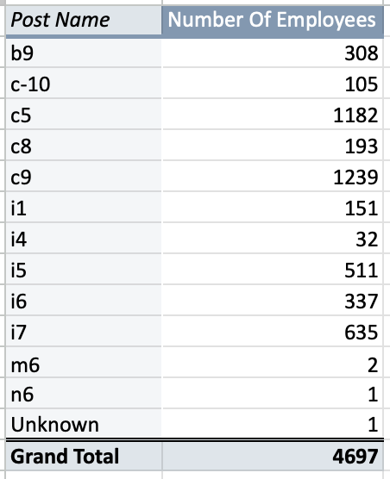
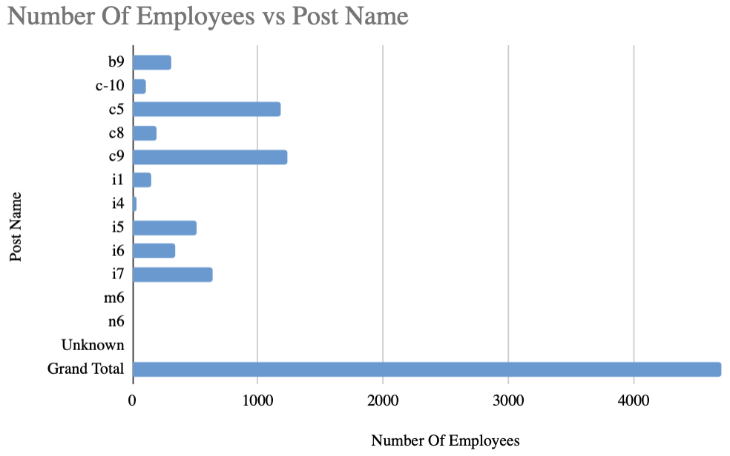
Position Tier Analysis
Position Tier Analysis: Different positions within a company often have different tiers or levels.
Your Task: Use a chart or graph to represent the different position tiers within the company. This will help you understand the distribution of positions across different tiers.

Slide 11
Insights & Results
Insights
Gender Distribution – Identified the proportion of male vs. female hires.
Salary Analysis – Found the average salary and distribution across different levels.
Departmental Hiring Trends – Visualized department-wise hiring trends.
Position Tiers – Analyzed how employees are distributed across various job levels.
Outliers – Detected extreme salary values, which could indicate inconsistencies or negotiation gaps.
Result
Through this project, we successfully identified trends in the hiring process, optimized data visualization, and derived actionable insights. The findings can help the HR team make informed hiring decisions, adjust salary structures, and enhance recruitment strategies for better workforce planning.

Slide 12
Thank you!

