Slide 1
Instagram User Analytics - SQL Project
Using SQL for Marketing and Investor Insights

Slide 2
Project Overview
In this project we aim to analyze Instagram user engagement data using SQL.
The insights derived can be used by the marketing and product teams in making informed decisions.

Slide 3
Approach
1. Database Setup: Created and populated tables using the provided SQL script.
2. Data Analysis: Executed SQL queries for marketing and investor metrics analytics.
3. Results Compilation: Interpreted and visualized insights from the SQL outputs.

Slide 4
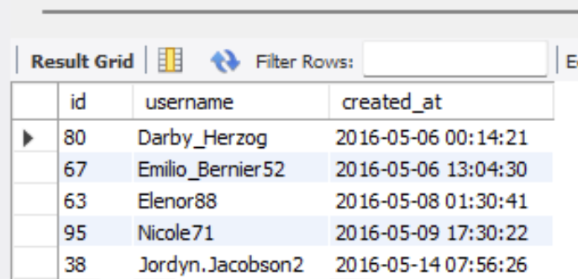
Marketing Analysis - Oldest Users
Loyal User Reward: The marketing team wants to reward the most loyal users, i.e., those who have been using the platform for the longest time.
Query: Identify the five oldest users on Instagram from the provided database.
SQL Query - select id, username, created_at from ig_clone.users order by created_at asc limit 5; | SQL Qutput -

Slide 5
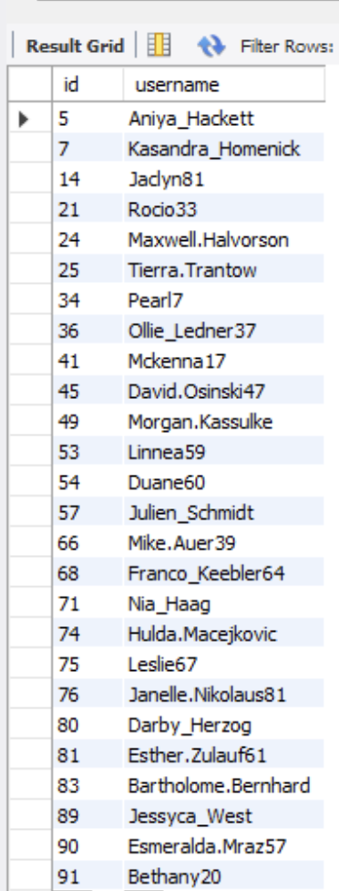
Marketing Analysis - Inactive Users
Inactive User Engagement: The team wants to encourage inactive users to start posting by sending them promotional emails.
Query: Identify users who have never posted a single photo on Instagram.
SQL Query - select id, username from ig_clone.users where id not in (select distinct user_id from photos); | SQL Qutput -

Slide 6
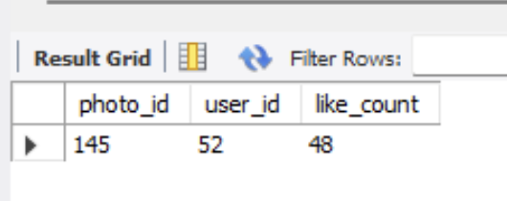
Marketing Analysis - Contest Winner
Contest Winner Declaration: The team has organized a contest where the user with the most likes on a single photo wins.
Query: Determine the winner of the contest and provide their details to the team.
SQL Query - select photos.id as photo_id, photos.user_id, Count(likes.user_id) as like_count from ig_clone.photos join ig_clone.likes on photos.id = likes.photo_id group by photos.id, photos.user_id order by like_count desc limit 1; | SQL Qutput -

Slide 7
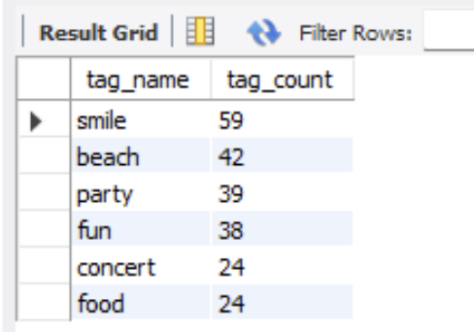
Marketing Analysis - Hashtag Research
Hashtag Research: A partner brand wants to know the most popular hashtags to use in their posts to reach the most people.
Query: Identify and suggest the top five most commonly used hashtags on the platform.
SQL Query - Select tags.tag_name, count(photo_tags.photo_id) as tag_count from ig_clone.tags join ig_clone.photo_tags on tags.id = photo_tags.tag_id group by tags.tag_name order by tag_count desc limit 6; | SQL Qutput -

Slide 8
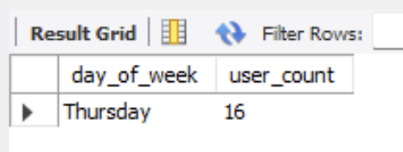
Marketing Analysis - Ad Campaign Timing
Ad Campaign Launch: The team wants to know the best day of the week to launch ads.
Query: Determine the day of the week when most users register on Instagram. Provide insights on when to schedule an ad campaign.
SQL Query - Select dayname(created_at) as day_of_week, count(id) as user_count from ig_clone.users group by day_of_week order by user_count desc limit 1; | SQL Qutput -

Slide 9
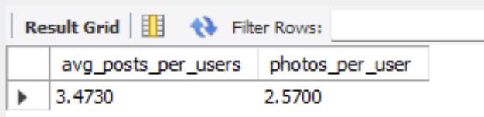
Investor Metrics - User Engagement
User Engagement: Investors want to know if users are still active and posting on Instagram or if they are making fewer posts.
Query: Calculate the average number of posts per user on Instagram. Also, provide the total number of photos on Instagram divided by the total number of users.
SQL Query - Select avg(photo_count) as avg_posts_per_users, (Select count(*) from ig_clone.photos) / (Select count(*) from ig_clone.users) as photos_per_user from ( select user_id, count(*) as photo_count from ig_clone.photos group by user_id ) user_photos; | SQL Qutput -

Slide 10
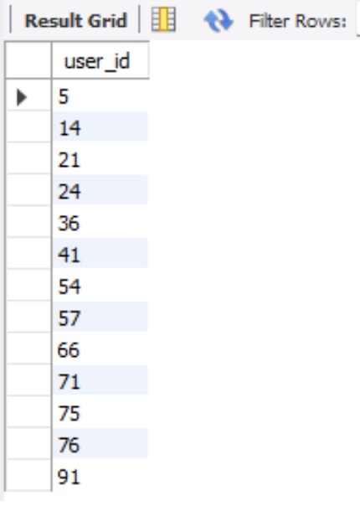
Investor Metrics - Fake Accounts
Bots & Fake Accounts: Investors want to know if the platform is crowded with fake and dummy accounts.
Query: Identify users (potential bots) who have liked every single photo on the site, as this is not typically possible for a normal user.
SQL Query - Select user_id from ig_clone.likes group by user_id having count(photo_id) = (select count(*) from photos); | SQL Qutput -

Slide 11
Tech-Stack Used
1. MySQL Workbench: For executing and managing SQL queries.
2. SQL: To analyze and derive insights from Instagram user data.

Slide 12
Results Achieved & Insights Gained
Oldest Users: These users are likely the most loyal and could be engaged for retention programs.
Inactive Users: A significant number of users have never posted, highlighting the need for re-engagement strategies.
Popular Hashtags: Certain hashtags dominate, showing trends that can shape content strategy.
Registration Trends: Most registrations occur on specific days, making those days ideal for campaign launches.
Engagement Metrics: Average posts and photo ratios give a measure of activity and engagement across users.
Fake Accounts: Unusual patterns, such as liking every post, signal the need for checks to maintain platform credibility.
These findings connect directly to actionable strategies for improving user engagement, marketing efforts, and platform health.

Slide 13
Conclusion
In this project we analyzed Instagram user data to uncover meaningful insights for marketing and investor decisions.
Using SQL, we explored user activity, engagement trends, and content patterns.
The findings provide clear steps to improve strategies for better user engagement and campaign planning.
Future analysis can include exploring user groups and trends over time for further improvements.

Slide 14
Thank you!

