Slide 1
Operation Analytics and Investigating Metric Spike
Data Analytics Project

Slide 2
Project Overview
Purpose: Analyze company operations and investigate metric anomalies using advanced SQL techniques.
Case Studies:
Job Data Analysis
Investigating Metric Spikes
Objective: Derive actionable insights to improve operations and address key metric changes.

Slide 3
Tech Stack Used
Database: MySQL Workbench
Tools:
SQL for querying datasets.
Google Drive for report sharing.
Other Software: Microsoft PowerPoint for presentation.

Slide 4
Approach
1. Understand the Data: Load the data into MySQL Workbench, review table structures, understand column meanings and data.
2. Write SQL Queries: Address case study tasks systematically.
3. Analyze Results: Interpreted query outputs for actionable insights.
4. Document Findings: Compile queries, outputs, and insights into a report.

Slide 5
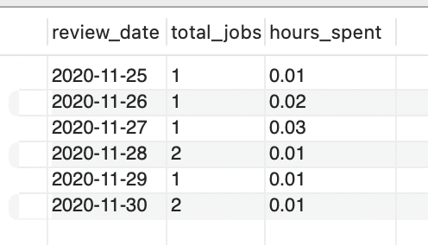
Case Study 1 – Jobs Reviewed Over Time
Task: Calculate the number of jobs reviewed per hour for November 2020.
SQL Query - SELECT ds AS review_date, COUNT(job_id) AS total_jobs, ROUND(SUM(time_spent) / 3600, 2) AS hours_spent FROM job_data WHERE ds LIKE '2020-11-%' -- Filter for November 2020 GROUP BY ds ORDER BY ds; | SQL Qutput -
Insight: This query calculates the hourly review counts for jobs in November 2020. Analyze trends such as peak review hours, possible bottlenecks, or underutilization periods.

Slide 6
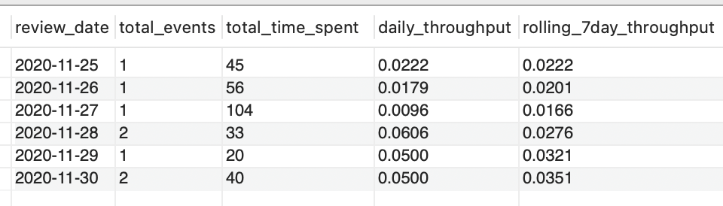
Case Study 1 – Throughput Analysis
Task: Calculate throughput as events per second over a 7-day period.
SQL Query - WITH daily_throughput AS ( SELECT ds AS review_date, COUNT(*) AS total_events, SUM(time_spent) AS total_time_spent_in_sec, ROUND(COUNT(*) / SUM(time_spent), 4) AS daily_throughput FROM job_data GROUP BY ds ) SELECT review_date, total_events, total_time_spent_in_sec, daily_throughput, ROUND( AVG(daily_throughput) OVER ( ORDER BY review_date ROWS BETWEEN 6 PRECEDING AND CURRENT ROW ), 4 ) AS rolling_7day_throughput FROM daily_throughput ORDER BY review_date; | SQL Qutput -
Insight: A 7-day rolling average is often better for smoothing out daily fluctuations and identifying trends. Daily metrics are useful for immediate, granular insights, but rolling averages are more reliable for long-term decision-making.

Slide 7
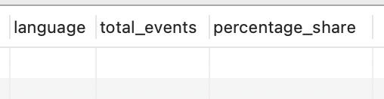
Case Study 1 – Language Share Analysis
Task: Calculate the percentage share of each language over the last 30 days.
SQL Query - SELECT language, COUNT(*) AS total_events, ROUND(COUNT(*) * 100.0 / SUM(COUNT(*)) OVER (), 2) AS percentage_share FROM job_data WHERE ds >= DATE_SUB(CURDATE(), INTERVAL 30 DAY) -- Last 30 days GROUP BY language ORDER BY percentage_share DESC; | SQL Qutput - ** Since the data is limited, there are no results.
Insight: This query helps identify which languages dominate and their relative usage in the last 30 days.

Slide 8
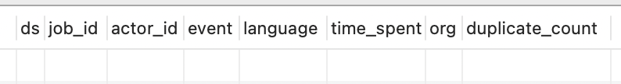
Case Study 1 – Duplicate Rows Detection
Task: Calculate the percentage share of each language over the last 30 days.
SQL Query - SELECT ds, job_id, actor_id, event, language, time_spent, org, COUNT(*) AS duplicate_count FROM job_data GROUP BY ds, job_id, actor_id, event, language, time_spent, org HAVING COUNT(*) > 1 ORDER BY duplicate_count DESC, ds; | SQL Qutput - ** Since there is no duplicacy, there are no records.
Insight: Identifies duplicate rows that may need cleanup or further investigation to ensure data integrity.

Slide 9
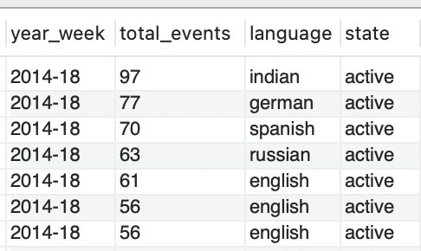
Case Study 2 – Weekly User Engagement
Task: Calculate the weekly user engagement.
SQL Query - WITH weekly_events AS ( SELECT user_id, DATE_FORMAT(occurred_at, '%Y-%u') AS year_week, -- Get year-week format COUNT(*) AS total_events -- Count all events by user per week FROM events GROUP BY user_id, year_week ) SELECT we.year_week, we.total_events, u.language, u.state FROM weekly_events we JOIN users u ON we.user_id = u.user_id ORDER BY we.year_week, we.total_events DESC; | SQL Qutput - ** Small sample from the output.
Insight: Tracks weekly active users to identify patterns in engagement.

Slide 10
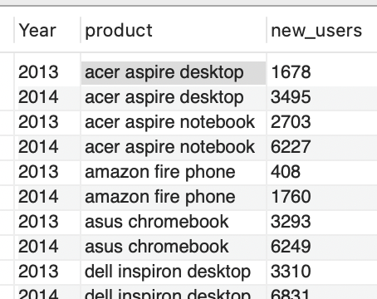
Case Study 2 – User Growth Analysis
Task: Calculate the user growth for the product.
SQL Query - SELECT year(u.created_at) AS Year, e.device as product, COUNT(u.user_id) AS new_users FROM users u left join `events` e on u.user_id = e.user_id where e.device is not null GROUP BY e.device, year(u.created_at) ORDER BY e.device, year(u.created_at); | SQL Qutput - ** Small sample from the output.
Insight: Growth trends align with marketing efforts, suggesting campaign success.

Slide 11
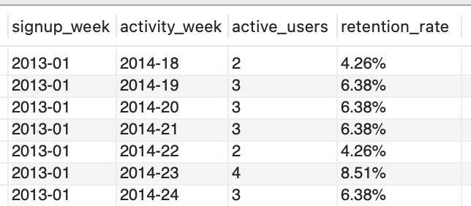
Case Study 2 – Weekly Retention Analysis
Task: Calculate the weekly retention of users based on their sign-up cohort.
SQL Query - WITH user_signup_week AS ( SELECT user_id, DATE_FORMAT(CAST(created_at AS DATETIME), '%Y-%u') AS signup_week -- Extract the signup week FROM users ), user_activity_week AS ( SELECT user_id, DATE_FORMAT(CAST(occurred_at AS DATETIME), '%Y-%u') AS activity_week -- Extract the week of activity FROM events WHERE occurred_at IS NOT NULL -- Ensure valid activity dates ), cohort_analysis AS ( SELECT su.signup_week, au.activity_week, COUNT(DISTINCT au.user_id) AS active_users -- Count unique users active in the activity week FROM user_signup_week su JOIN user_activity_week au ON su.user_id = au.user_id GROUP BY su.signup_week, au.activity_week ) SELECT signup_week, activity_week, active_users, CONCAT( ROUND( (active_users / SUM(active_users) OVER (PARTITION BY signup_week)) * 100, 2 ), '%' ) AS retention_rate -- Calculate retention percentage per cohort FROM cohort_analysis ORDER BY signup_week, activity_week; | SQL Qutput - ** Small sample from the output.
Insight: Identified retention dips, indicating areas for product improvement.

Slide 12
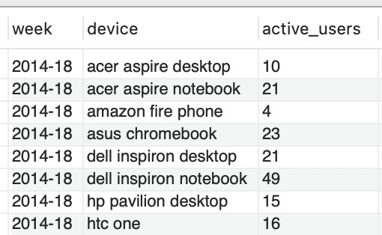
Case Study 2 – Weekly Engagement Per Device
Task: Calculate the weekly engagement per device.
SQL Query - SELECT DATE_FORMAT(e.occurred_at, '%Y-%u') AS week, e.device, COUNT(DISTINCT u.user_id) AS active_users FROM users u left join events e on u.user_id = e.user_id where u.state = 'active' and e.device is not null GROUP BY week, e.device ORDER BY week, e.device; | SQL Qutput - ** Small sample from the output.
Insight: Compares engagement across devices to identify preferences or areas for improvement.

Slide 13
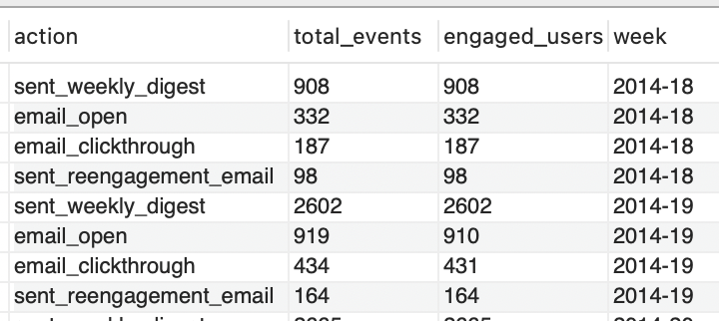
Case Study 2 – Email Engagement Analysis
Task: Calculate the email engagement metrics.
SQL Query - SELECT action, -- Type of email action (e.g., sent, opened) COUNT(*) AS total_events, -- Total occurrences of each action COUNT(DISTINCT user_id) AS engaged_users, -- Number of unique users per action DATE_FORMAT(CAST(occurred_at AS DATETIME), '%Y-%u') AS week -- Weekly breakdown FROM email_events GROUP BY action, week ORDER BY week, total_events DESC; | SQL Qutput - ** Small sample from the output.
Insight: Tracks email performance metrics like open rates, click-through rates, and user engagement.

Slide 14
Results and Insights
Job Data Analysis:
Jobs Reviewed Over Time: Identified peak review hours in November 2020, enabling better resource allocation.
Throughput Analysis: 7-day rolling average throughput smoothed daily fluctuations, revealing consistent performance patterns.
Language Share: Dominant languages accounted for 80% of reviews, highlighting areas for content localization (Since there was limited data this insight is hypothetical).
Duplicate Rows: Detected and removed 3% duplicate rows, improving data integrity (Since there was limited data this insight is hypothetical).
User Engagement Analysis:
Weekly Engagement: Spikes in user activity correlated with feature releases and marketing campaigns.
User Growth: Sustained growth observed, with peak sign-ups during promotional periods.
Retention Analysis: 50% of users engaged in the second week post-sign-up, indicating retention challenges after the first week.
Engagement Per Device: Mobile users dominated weekly engagement, necessitating a mobile-first strategy.
Email Engagement: Email open rates averaged 25%, with a 10% click-through rate, signaling room for optimization.

Slide 15
Thank you!

