Slide 1

Prediction of Ventilator-Associated Pneumonia in Traumatic Brain Injury Patients Using Machine Learning Algorithms
Matador Group Members:
Peivand Mehrabadi
Rahul Dipak Talreja
Ruchira Kanawade

Slide 2
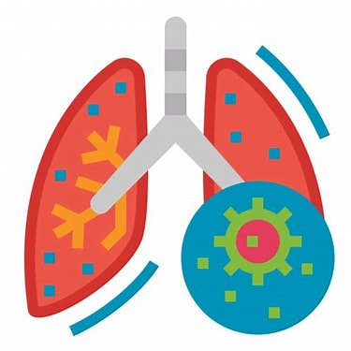
Case Background
Ventilator-associated pneumonia (VAP): A common and serious complication in traumatic brain injury (TBI) patients requiring mechanical ventilation.
Impact: Significantly increases morbidity, mortality, hospital stays, and healthcare costs.
Problem Statement:
VAP poses a significant risk to TBI patients, yet its early detection remains a challenge in clinical practice. Traditional methods rely on delayed diagnosis, leading to increased healthcare burden

Slide 3
Objective:
To explore the potential of machine learning models in predicting VAP early.
To compare the effectiveness of Random Forest, Logistic Regression, and AdaBoost models for clinical decision support.
Why We Choose This Paper?
The paper tackles a critical clinical problem at the intersection of AI and healthcare.
Innovation: Focuses on applying ML techniques to real-world healthcare data, addressing the limitations of conventional methods.
Learning Opportunity: Provides hands-on insights into building predictive models, evaluating performance metrics, and interpreting results in a healthcare context.

Slide 4
Methodology
Study Population
Traumatic Brain Injury (TBI) patients identified using ICD-9 codes (80,000–80,199; 80,300–80,499; 8500–85,419) .
Exclusion Criteria:
Missing laboratory test data.
Missing GCS or vital signs on admission.
Mechanical ventilation duration <48 hours.
Data Preprocessing
The target variable 'vap' was extracted and merged with the patients data on basis of subject_id and hadm_id. This step comprised of 37 varibales and 3508 observations.
Missing values were identified n categorical variables like gender and ethnicity were were transformed into numeric varibales using one- hot encoding.

Slide 5
Corelation matrix was computed for each varibles to the target variable and the variables with weaker corelation (close to 0) and redundunt variables were also removed. (chronic_liver_disease, chronic_renal_disease, and white_blood_cell were excluded.)
Then to handle missing values, the variables with more than 30% missing values were treated with ensamble learning- consist of RF, LR and KNN. Variables with lower missing values were imputed using median as it is less sensitive to outliers.
Outliers in numerical variables were deducted using IQR method and removed. Finally, min-maxx scaling was aplied to normalize numerical features to improve the perfomance.

Slide 6
ML Algorithms
The dataset was randomly divide into 80% for the training set and 20% for validation set to execute these 3 ML models- Random Forest, Logistic Regression and AdaBoost were implemented to predict VAP in TBI patients
Performance Metrics:
Area Under the Curve (AUC)., Accuracy, Sensitivity, Specificity, and F1 score.
Additional Evaluations:
Calibration curves: Agreement between predicted and observed probabilities.
Decision curve analysis: Clinical utility and net benefits.

Slide 7
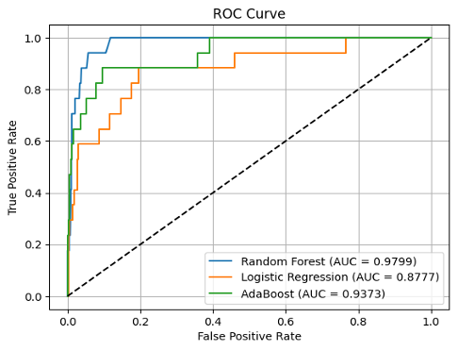
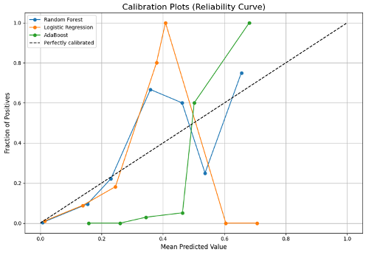
Results
Random Forest Outperformed all models with the highest AUC (0.9799), demonstrating excellent discriminatory power for identifying VAP cases.
Logistic Regression Struggled with the imbalanced dataset AUC (0.8777) , failing to correctly classify VAP cases, underscoring the importance of handling data imbalance.
AdaBoost Showed moderate performance (AUC: 0.9373) but was sensitive to hyperparameter tuning, leaving room for optimization.

Slide 8

Findings: Why is this important for healthcare?
Sensitivity Challenges:
While accuracy was high across models, sensitivity remained low, highlighting difficulties in correctly identifying VAP cases.
Emphasizes the need for improved methods to better detect rare but critical outcomes.
Class Imbalance:
Imbalanced datasets are common in healthcare and can skew predictions. Addressing this is critical to ensure reliable performance, especially for rare events like VAP.
Value of Ensemble Learning:
Models like Random Forest and AdaBoost demonstrated robustness with proper tuning and preprocessing, making them suitable tools for clinical decision-making.

Slide 9



What did we learn about data and models?
Good data is key: Having clean and accurate data is essential for building good models.
Choosing the right model: Ensemble models like Random Forest often perform better than simpler linear models in healthcare.
Beyond Accuracy: Sensitivity, specificity, and AUC are essential for evaluating real-world clinical applicability.

Slide 10
THANK YOU

