Slide 1

Case 2 - Carvana
Predictive Analytics and Classification:
Auction risk of “kicks” – Vehicles unable to be resold to customers

Slide 2
Roadmap
Cull columns
Determine significant features
Dimensionality Reduction
Build transformers and preprocessor
Choose logistic regression classifier
Split into train and test
Fit model to training
Apply model to test
Evaluate performance
Retrain model with full training dataset
Apply model to holdout test data
Submit to Kaggle

Slide 3
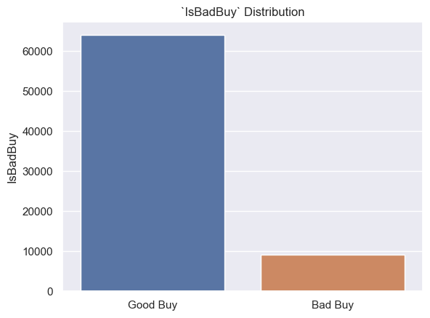

EDA – Target Variable: IsBadBuy
Quite unbalanced
Dumb model (which predicts 0 for all) will perform quite well
87.70% accuracy => should be our minimum accuracy for our model

Slide 4
Cleaning – Column Culling
We want to drop for the following reasons:
Unique IDs
These columns do not impact target variable
Redundancy
Keeping in redundant variables will introduce collinearity
High Cardinality / Many NULLs
Categorical features which have many different values or NULLs will negatively impact performance

Slide 5
Cleaning – Column Culling
dropUID = ['RefId', 'BYRNO', 'VNZIP1', 'VNST','WheelTypeID']
dropRedundancy = ['PurchDate', 'VehYear','Nationality']
dropHighCardinality = ['Model','Trim', 'SubModel']
dropInsignificant = ['Transmission']
dropList = dropHighCardinality + dropUID + dropInsignificant + dropRedundancy + ['IsBadBuy']
Drop UID:
Unique IDs are not needed
Redundancy:
Purchase Date and Vehicle Year are captured by Vehicle Age
Nationality is captured by Make
High Cardinality:
Many options and nulls are contained in Model, Trim, and Submodel

Slide 6
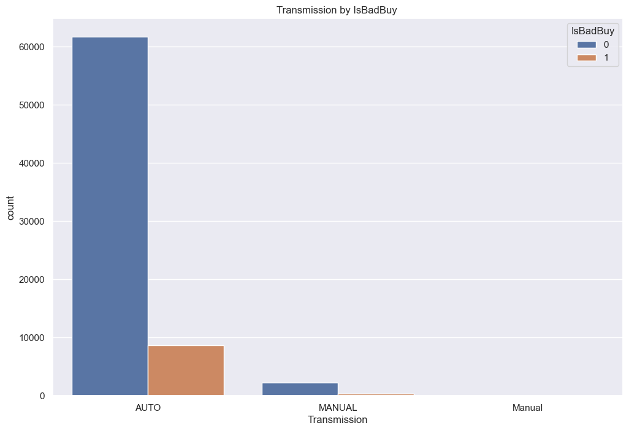
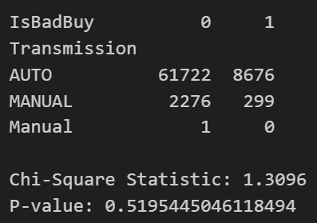
Cleaning – Column Culling
Performed Chi squared test against transmission feature
P-Value = 0.5195
Fail to reject the null hypothesis, transmission does not have a significant effect on target
Removing this feature resulted in slightly better model performance

Slide 7
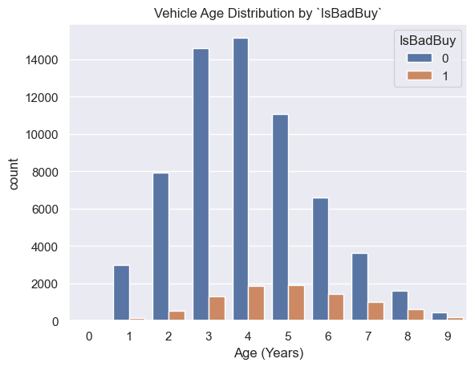
EDA – Feature: VehicleAge
Distributions clearly have different shapes
This will likely be a strong feature for predicting target

Slide 8
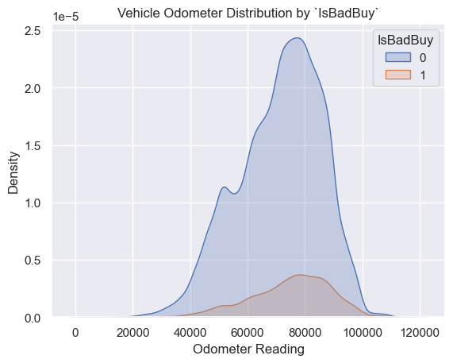
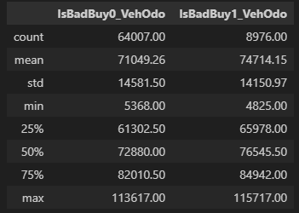
EDA – Feature: VehOdo
It also appears that the odometer feature will also be an important numerical feature for the model

Slide 9
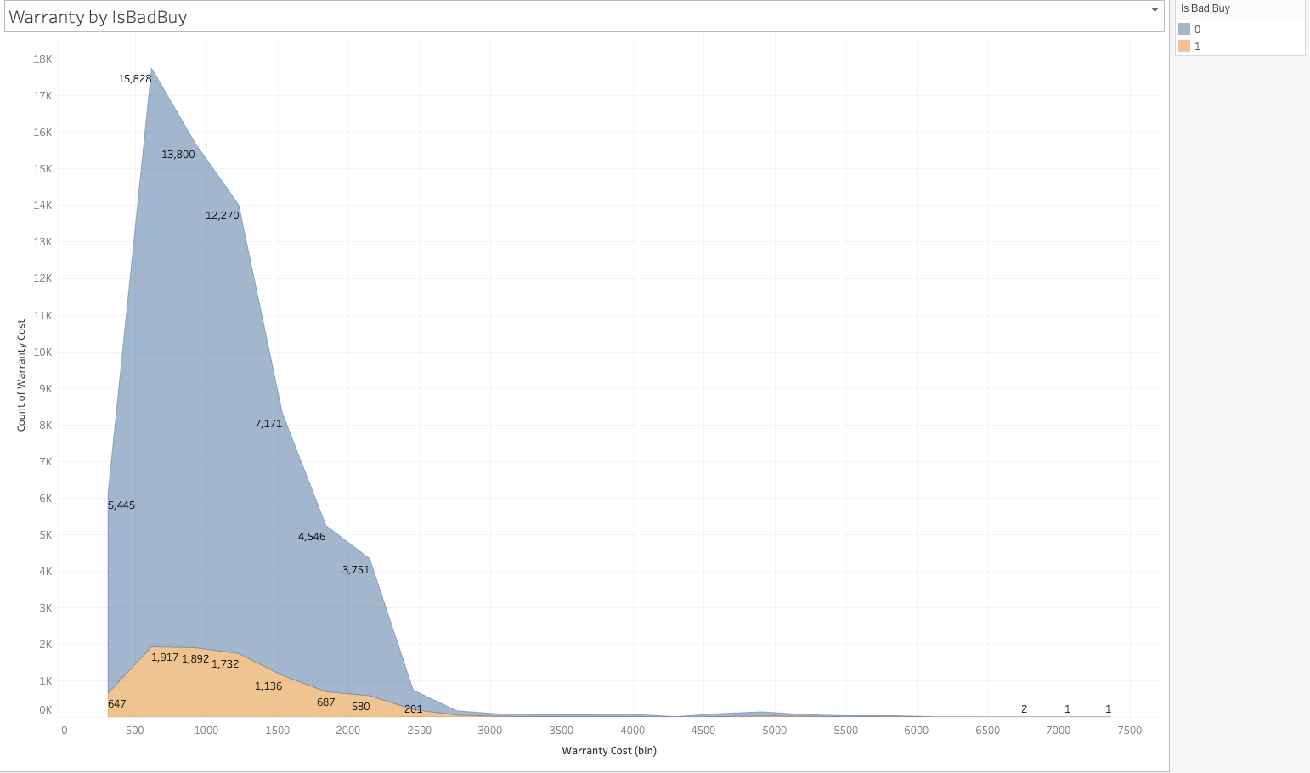
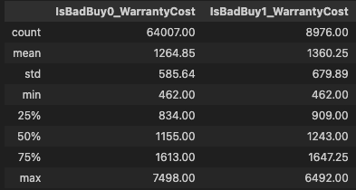
EDA – Feature: WarrantyCost
WarrantyCost contains different distribution when spliced by IsBadBuy, therefore this will also be a relevant feature for the target

Slide 10
EDA – Plan for Categorical Features
We will profile categorical variables by doing the following:
Splicing the variables by `IsBadBuy`
Generating visuals of the above
Getting all dummies and running chi squared tests using scipy.stats => chi2_contingency

Slide 11
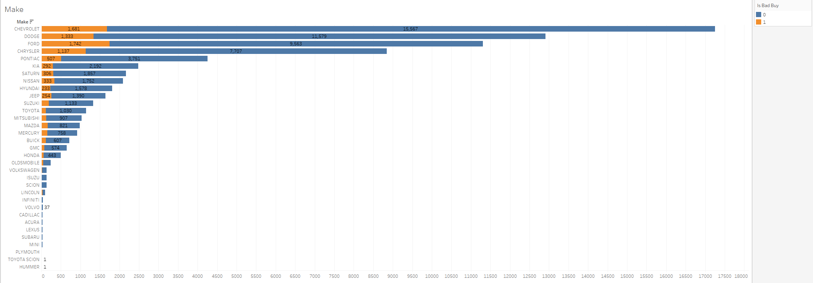
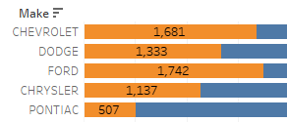
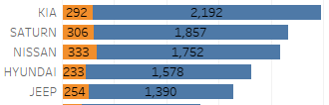
EDA – Feature: Make
Chevy, Dodge, Ford, Chrysler, Pontaic have high amounts of bad buys
Next are Kia, Saturn, Nissan, Hyundai, Jeep

Slide 12
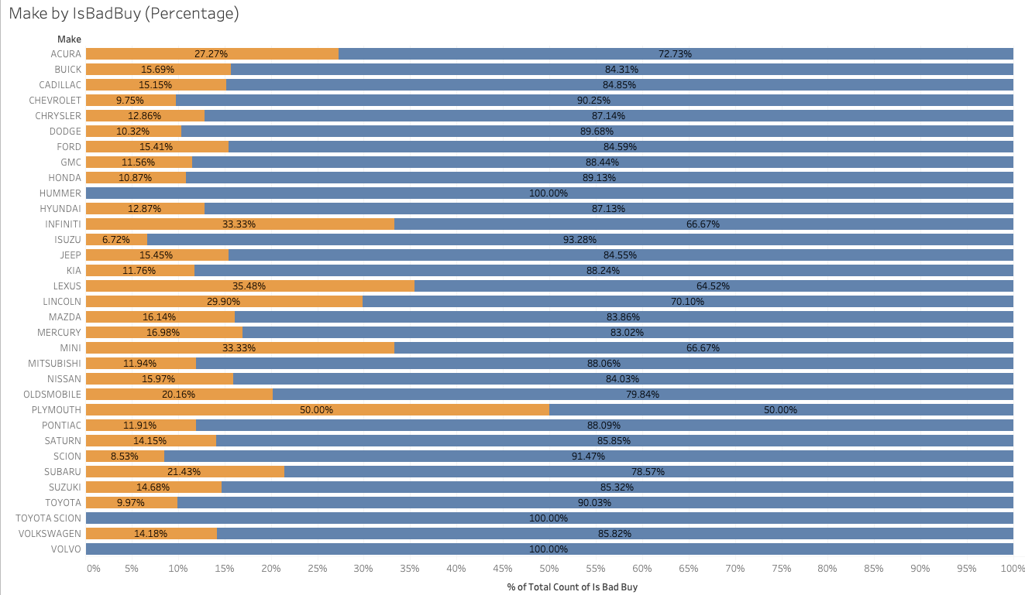
EDA – Feature: Make (Percentages)
When looking at the percentages of IsBadBuy within each Make, we can see that many makes have percentages around 15%

Slide 13
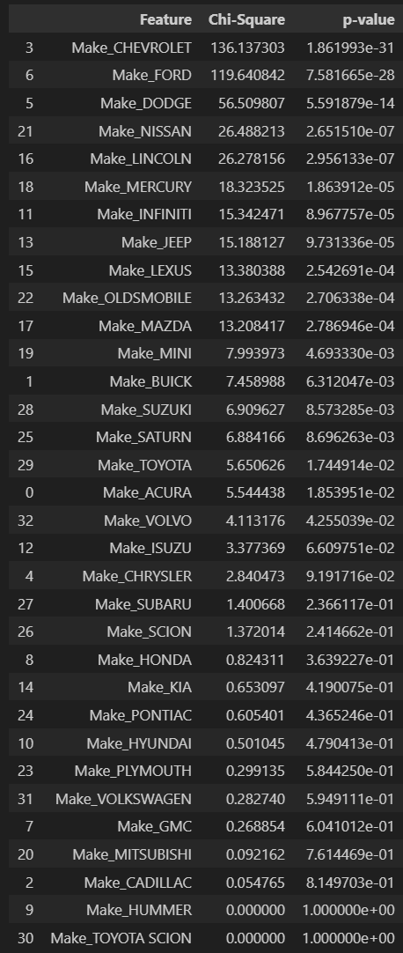
EDA – Feature: Make
Chi squared test results

Slide 14
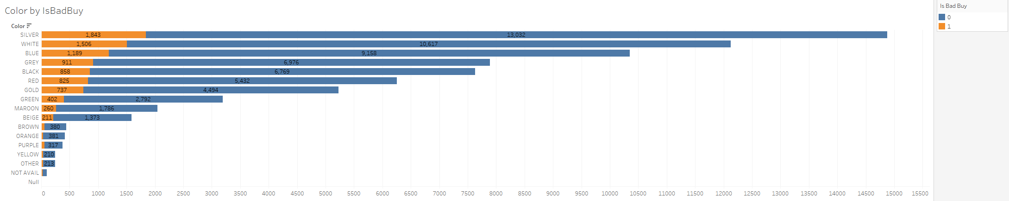
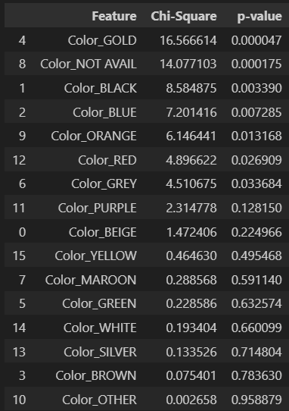
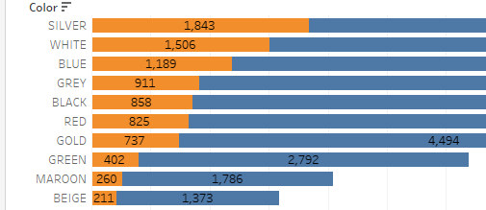
EDA – Feature: Color
The color feature has some good variance amongst the groups; will be good to keep

Slide 15
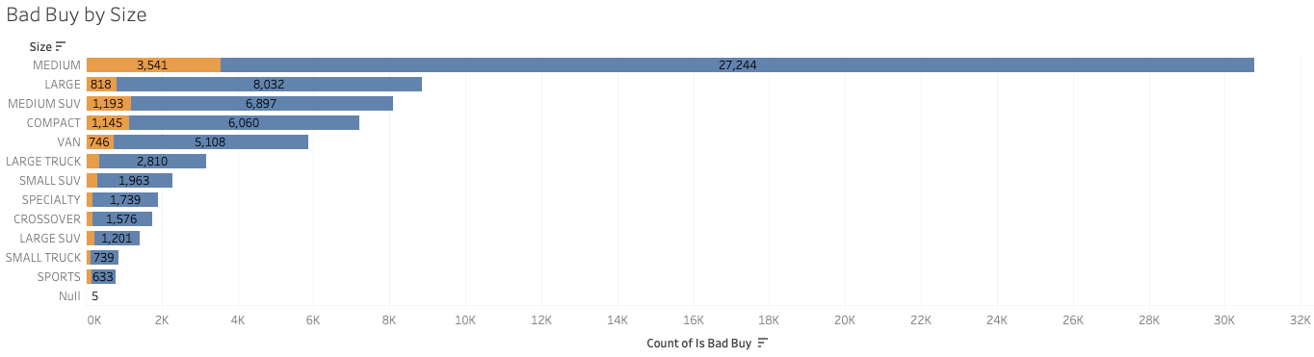
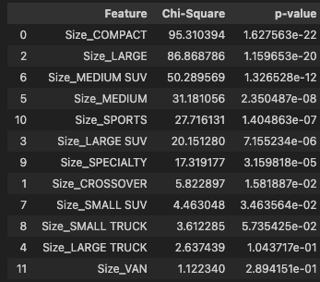
EDA – Feature: Size
Size will also be kept as many p-values are below 0.05

Slide 16
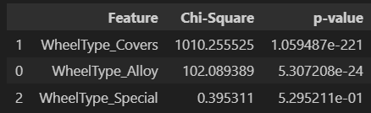
EDA – Feature: Wheel Type
Wheel type will also be a strong variable, based on the chi squared test results

Slide 17
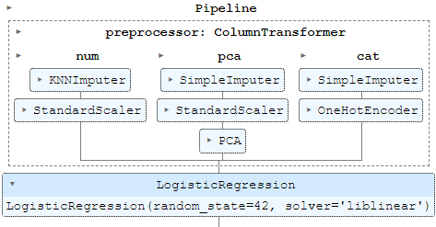
Model Building
We will go through each part (column transformer) of the pipeline design

Slide 18
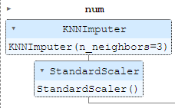
Model Building – Numerical Processor
KNN to fill null values
Should give more accurate values to fill rather than mean imputation
Standardization: removing the mean and scaling to unit variance.
Important for regularization and coefficient interpretability

Slide 19
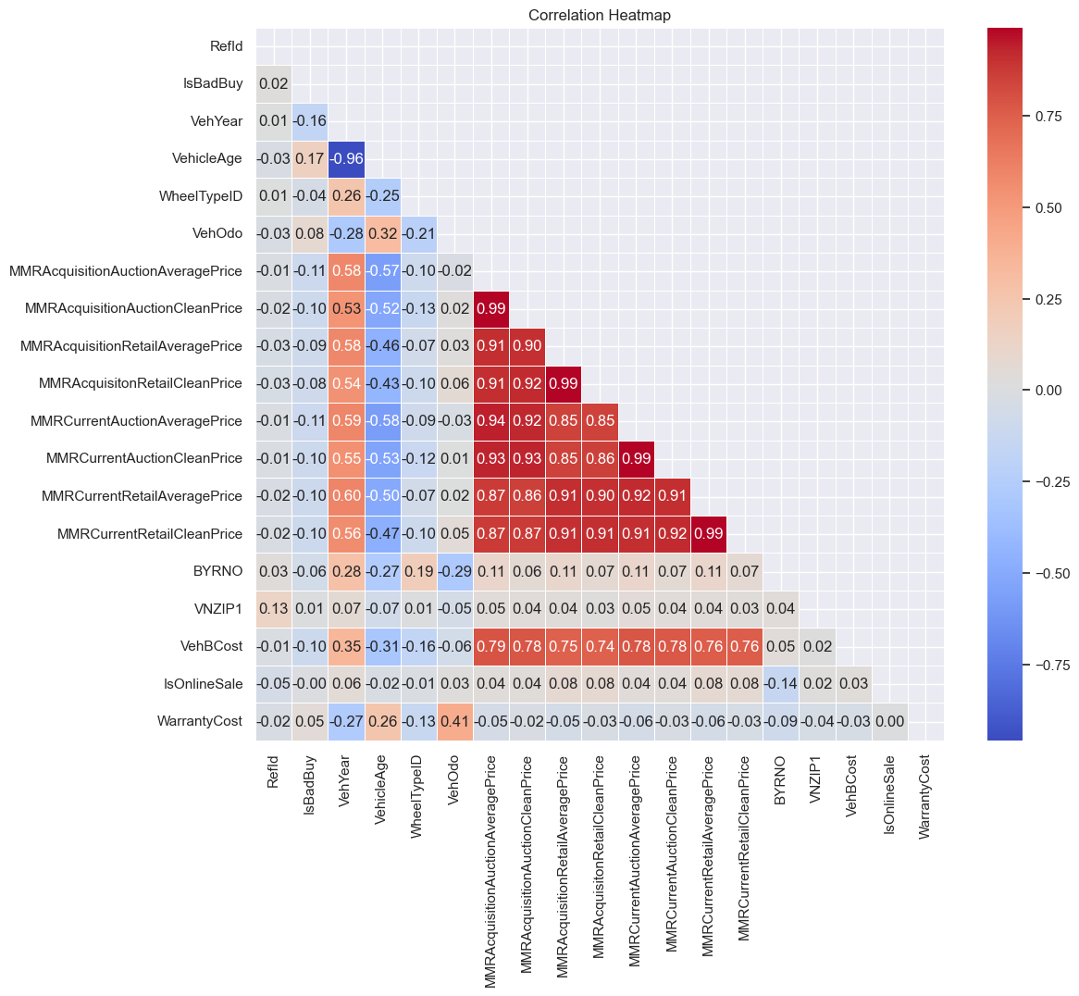
Model Building – Dimensionality Reduction
All MMR numerical features are highly correlated
To avoid collinearity and still capture variability by these features, we use PCA
pca.explained_variance_ratio_.round(3)
>>> array([0.922, 0.037, 0.032, 0.005, 0.004, 0.001, 0. , 0. ])
A large percent of the variance is captured by using 3 components.
pca1, pca2, pca3

Slide 20
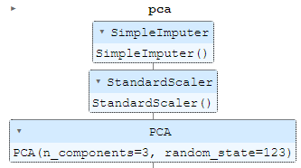
Model Building – Dimensionality Reduction
# Define the columns for PCA
pca_columns = ['MMRAcquisitionAuctionAveragePrice',
'MMRAcquisitionAuctionCleanPrice',
'MMRAcquisitionRetailAveragePrice',
'MMRAcquisitonRetailCleanPrice',
'MMRCurrentAuctionAveragePrice',
'MMRCurrentAuctionCleanPrice',
'MMRCurrentRetailAveragePrice',
'MMRCurrentRetailCleanPrice']
pca1, pca2, pca3
A large percent of the variance is captured by using 3 components.

Slide 21
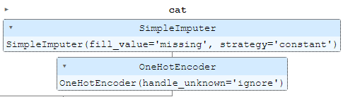
Model Building – One Hot Encoder (Categorical)
Handle null values by filling with string:`missing`
Logit model requires data filled in all cells; `null` will be interpreted as `NaN` so we do this for readability
Apply encoding of categorical values

Slide 22
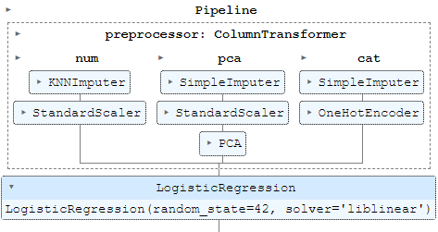
Model Building - Classifier
Finally, choose the logistic regression classifier
Building a ‘pipeline’ allows us to easily configure:
Testing of different features; less refactoring required
Application of different imputation and dimensionality reduction methods

Slide 23
Model Fit – Train Test Split
# Split the data into training and test sets
X_train, X_test, y_train, y_test = train_test_split(X, y, test_size=0.2, random_state=42)
# Define the model
model = Pipeline(steps=[
('preprocessor', preprocessor),
('classifier', LogisticRegression(solver='liblinear', random_state=42))
])
# Fit the model
model.fit(X_train, y_train)
Reserve 0.2 (20%) of training data for model evaluation
Create model
Fit model using training data

Slide 24
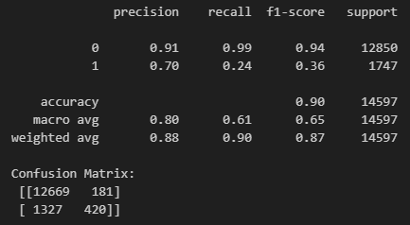
Model Prediction – Training Data
Metric Report Output
# Predict on the test set
y_pred = model.predict(X_test)
# Evaluate the model
conf_matrix = confusion_matrix(y_test, y_pred)
classification_report_str = classification_report(y_test, y_pred)
print(classification_report_str, '\nConfusion Matrix:\n', conf_matrix)

Slide 25
Model Prediction – Evaluation
Metric Report Output
Model performs well in terms of TP and FP
Model performs somewhat inadequately for TN and FN
Recall that we stated the following at the beginning: 87.70% accuracy => should be our minimum for the model
We obtained 90% accuracy, so our model performs better than the dumb model

Slide 26
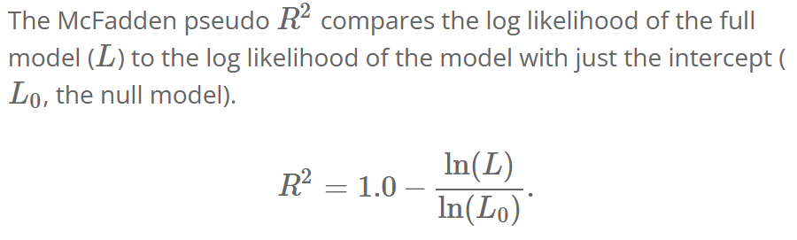
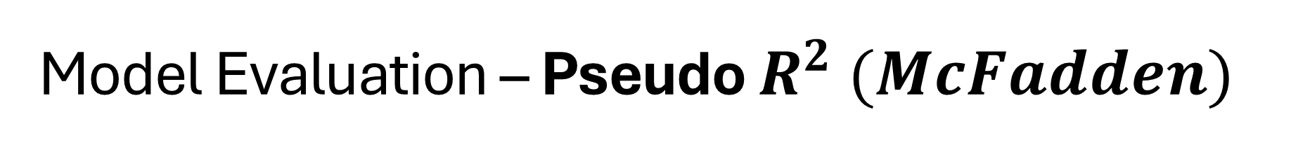
Model Evaluation – Pseudo $R^{2} (McFadden)$
Sci-Kit Learn doesn’t have a function for this, so we shall use the above definition to evaluate it manually

Slide 27

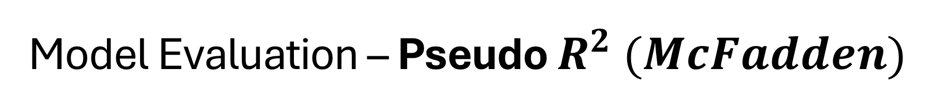
Model Evaluation – Pseudo $R^{2} (McFadden)$
# Preprocess the test set
X_test_preprocessed = model['preprocessor'].transform(X_test)
# Fit the null model
null_model = LogisticRegression(solver='liblinear', random_state=42)
null_model.fit(np.ones((X_train.shape[0], 1)), y_train)
# Get the log likelihood for the null model
null_prob = null_model.predict_proba(np.ones((X_test.shape[0], 1)))[:, 1]
log_likelihood_null_model = np.sum(y_test * np.log(null_prob) + (1 - y_test) * np.log(1 - null_prob))
# Get the log likelihood for the full model
full_prob = model.predict_proba(X_test)[:, 1]
log_likelihood_full_model = np.sum(y_test * np.log(full_prob) + (1 - y_test) * np.log(1 - full_prob))
# Calculate McFadden's pseudo R-squared
pseudo_r_squared = 1 - (log_likelihood_full_model / log_likelihood_null_model)
print(f"McFadden's pseudo R-squared: {pseudo_r_squared}")
Create instance of transformed X_test
Create instance of null model (simply predicts majority class)
Definition of likelihood
Definition of McFadden

Slide 28
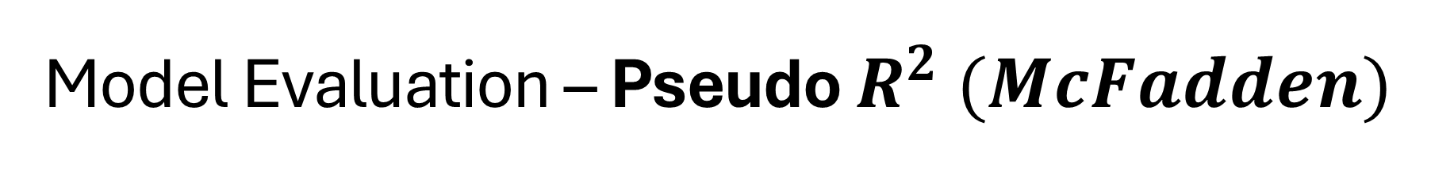
Model Evaluation – Pseudo $R^{2} (McFadden)$
# Preprocess the test set
X_test_preprocessed = model['preprocessor'].transform(X_test)
# Fit the null model
null_model = LogisticRegression(solver='liblinear', random_state=42)
null_model.fit(np.ones((X_train.shape[0], 1)), y_train)
# Get the log likelihood for the null model
null_prob = null_model.predict_proba(np.ones((X_test.shape[0], 1)))[:, 1]
log_likelihood_null_model = np.sum(y_test * np.log(null_prob) + (1 - y_test) * np.log(1 - null_prob))
# Get the log likelihood for the full model
full_prob = model.predict_proba(X_test)[:, 1]
log_likelihood_full_model = np.sum(y_test * np.log(full_prob) + (1 - y_test) * np.log(1 - full_prob))
# Calculate McFadden's pseudo R-squared
pseudo_r_squared = 1 - (log_likelihood_full_model / log_likelihood_null_model)
print(f"McFadden's pseudo R-squared: {pseudo_r_squared}")
>>>
McFadden's pseudo-R-squared: 0.16447019885777303

Slide 29
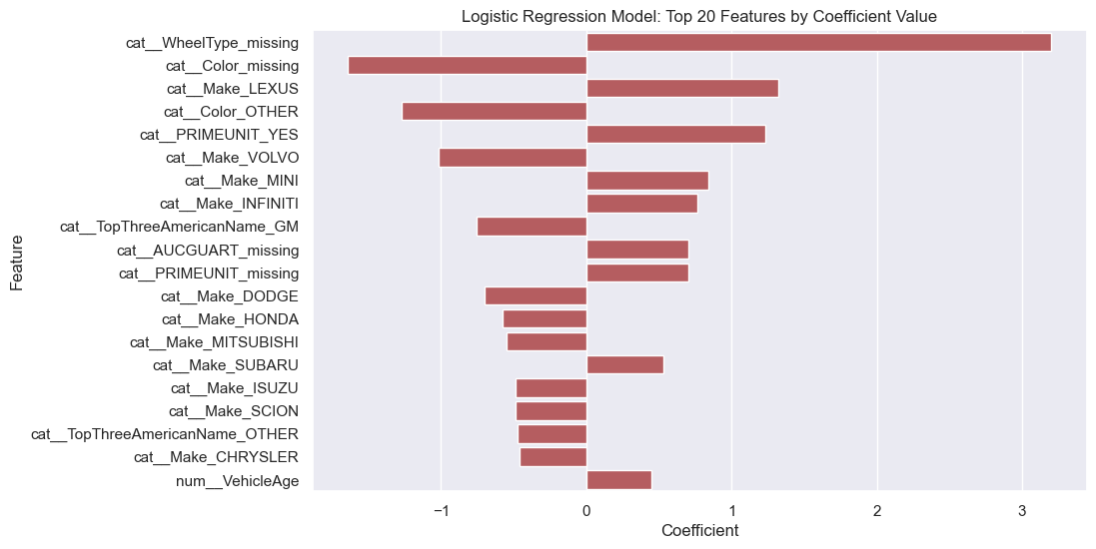
Model Evaluation - Coefficients
Top 20 coefficients by absolute value
Categorical variables are the most important features, specifically
Missing WheelType, Color Missing, and various manufacturers
VehicleAge was the most important numerical feature

Slide 30
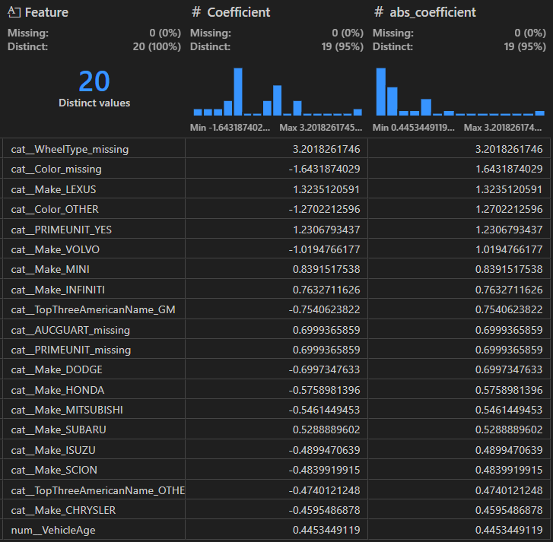
Model Evaluation - Coefficients
Positive => increase log odds
(pulls towards predicting 1)
Negative => decrease log odds
(pulls towards predicting 0)

Slide 31
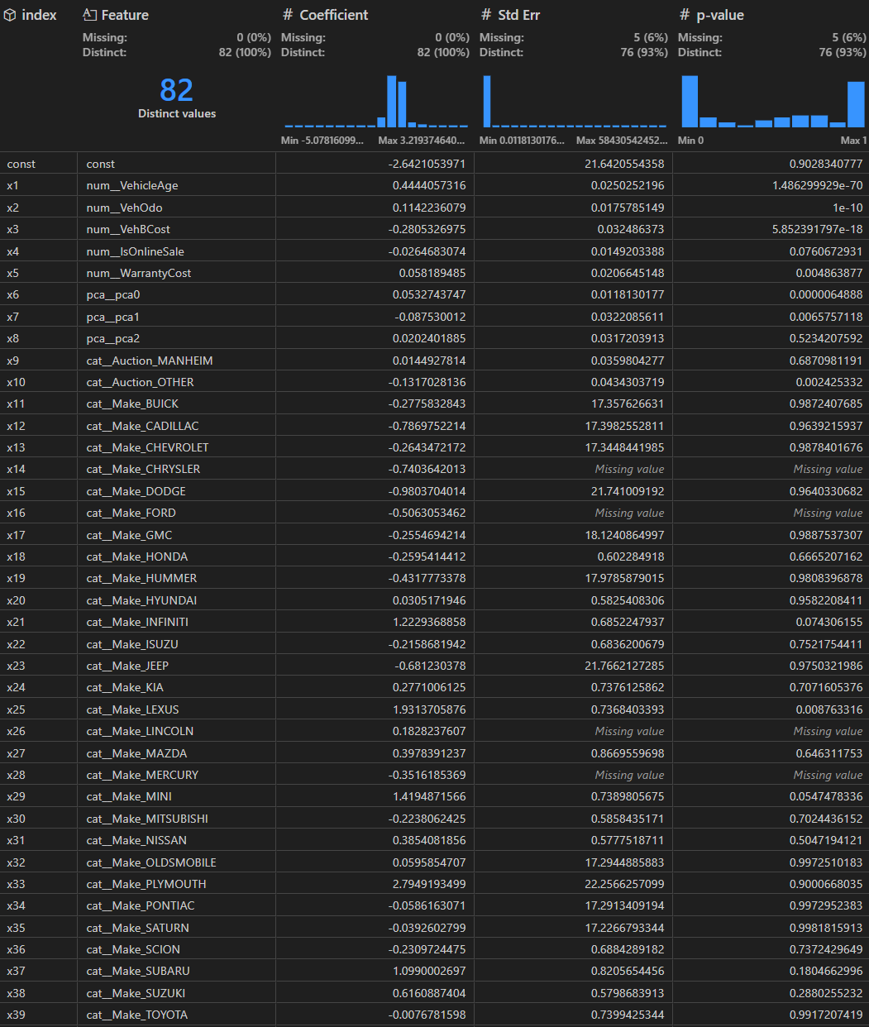
Model Evaluation – All Coefficients (Page 1)
There are a lot of features; we will review this decision in the discussion section
(Predictive Power vs. Statistical Significance)

Slide 32
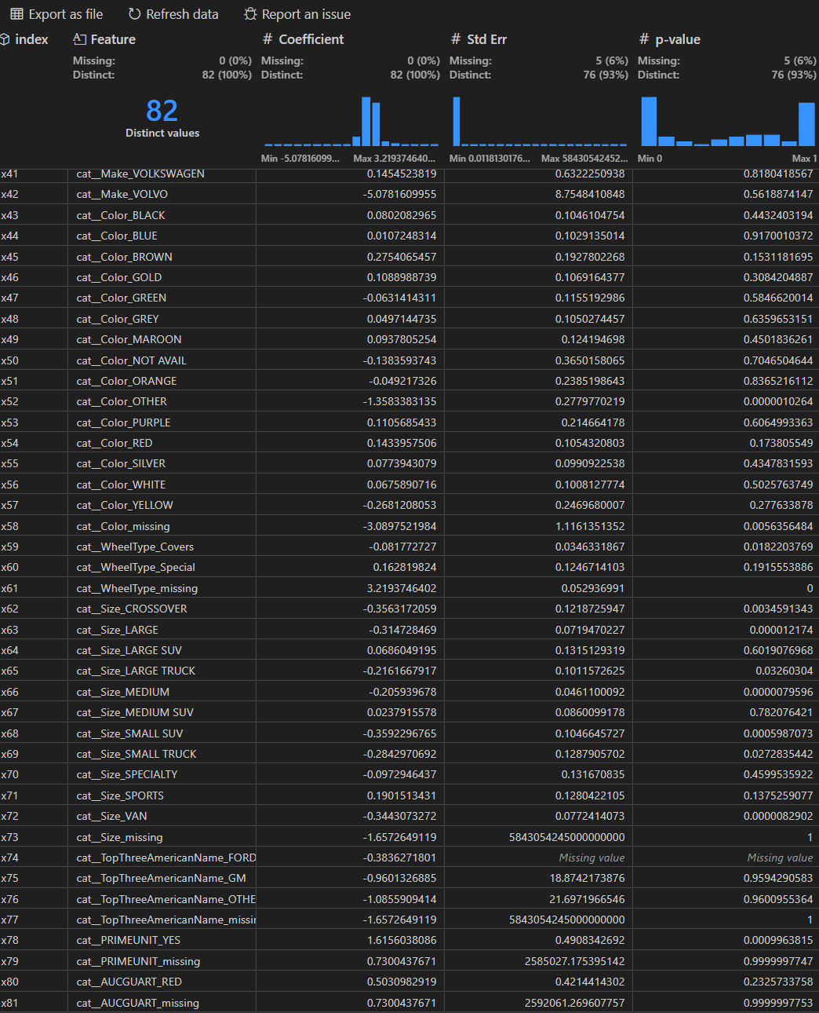
Model Evaluation – All Coefficients (Page 2)
There are a lot of features; we will review this decision in the discussion section (Predictive Power vs. Statistical Significance)

Slide 33
Retrain Model and Create Kaggle Submission
# Train model against full training set and apply model to test holdout (Kaggle)
testFile = r'C:\Users\joshu\OneDrive\Desktop Files\Textbooks and Syllabi\CSUN Semester 6\MRKT 656\Case2\case2\test.csv'
testdf = pd.read_csv(testFile)
X1 = testdf.drop(columns=['RefId',
'PurchDate', 'VehYear',
'BYRNO', 'VNST',
'VNZIP1', 'WheelTypeID',
'Nationality', 'Transmission'])
model.fit(X,y)
y1Pred = model.predict(X1)
y1Preddf = pd.DataFrame(y1Pred)
testOutputdf = pd.concat([testdf['RefId'], y1Preddf], axis=1)
folder = r'C:\Users\joshu\OneDrive\Desktop Files\Textbooks and Syllabi\CSUN Semester 6\MRKT 656\Case2\case2\entryn.csv'
testOutputdf.to_csv(folder)
Drop same columns as performed in training
Retrain model using fill training dataset

Slide 34
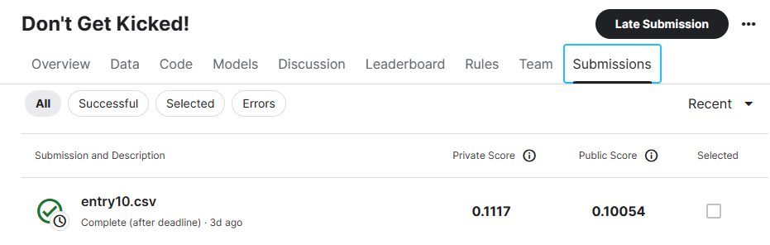
Kaggle Results

Slide 35
Discussion – Agenda
Previous Model Iterations
Predictive Power vs. Statistical Significance
Important Features we did not expect

Slide 36
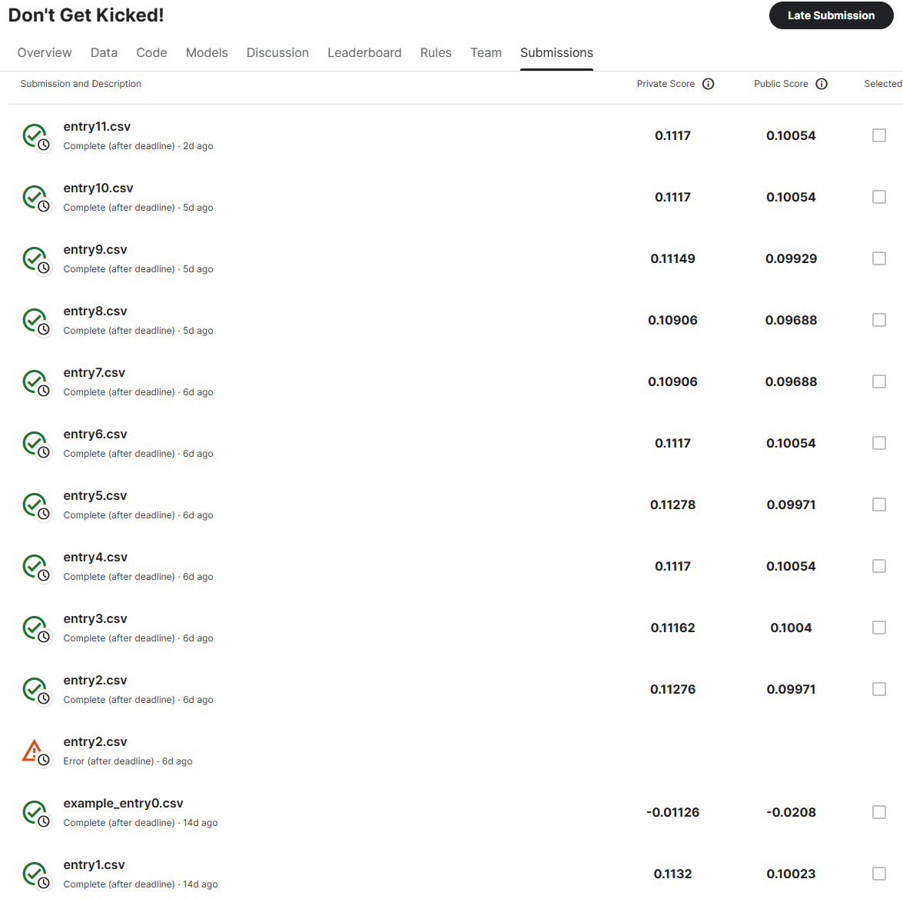
Discussion – Previous Model Iterations
The different entries are the different models that had been tested during building
The lower scoring models occurred when grouping insignificant categorical values into a base case (will be discussed in next slide)
Entry3 is when we realized we should have trained the model against the entire dataset. We had originally left the 80/20 train test split and did not retrain the data
The slight improvement from .1004 to .10054 was after implementing PCA

Slide 37
Discussion – Predictive Power vs. Statistical Significance
Grouping insignificant categorical features (determined by Chi squared test and by looking at the p-values of the coefficients) led to worse model performance and lower Kaggle score against holdout testing data
Make, Color, VNST (State), were the features attempted to be grouped.
Because of this, we decided to keep the original cardinality of the categorical variables
We believe that this may be because significant variance is captured by the different categorical values, and this is lost when grouping into base case
Balancing predictive power and avoiding overfitting is quite difficult, in this case

Slide 38
Discussion – Importance and Remarks
We initially thought the numerical features would have higher coefficients in our model, but this was not the case
The manufacturer columns made up 10 of the top 20 features by absolute value
We determined that many manufacturers tend to be strongly associated with good/bad buys

