Slide 1





PRISM
Protocol Reflexivity, Insolvency, Stress & Marketability Score
FinHack 2026
Case 3:
Decentralized Finance Risk Intelligence Platform
01
Notes:
1

Slide 2
The Problem
Institutions don’t lack data; they lack decision-ready risk.
Exit capacity is hard to see: big TVL can still mean thin real liquidity and painful exits.
Risk is fragmented: liquidity, borrowers, governance, oracles, supply, and news live in separate tools.
Crises compound: outflows, governance moves, and narrative often move together, a single headline score misses that dynamic.
We Answer: “What’s our posture on this exposure and what would change it?”
02
Notes:
2

Slide 3
Three Protocols
Each represents a different risk archetype
Aave
Uniswap
Stargate
Lending
AMM
Bridge
Borrower health, liquidation stress, utilization-style shocks
Liquidity depth, concentrated LP risk, exit quality
Cross-chain flows, connectivity and concentration
Together they power radar, decomposition, stress lab, narrative, and portfolio views as a coherent three-name book.
Notes:
4

Slide 4
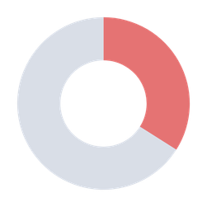
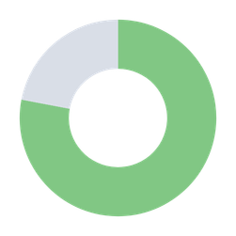
TVL quality matters more than TVL level
$500M TVL
Protocol A
Protocol B
$10B TVL
REDUCE
HOLD
Concentrated liquidity
Governance capture risk
Stale oracles
Crowded unwind path
34
78
Diversified LP base
Healthy collateral mix
Fresh oracle updates
Distributed governance
PRISM
PRISM
Liquidity
Liquidity
Governance
Governance
Oracle
Oracle
Supply
Supply
Managers need one actionable score, not 15 tabs stitched together mentally.
03
Notes:
3

Slide 5
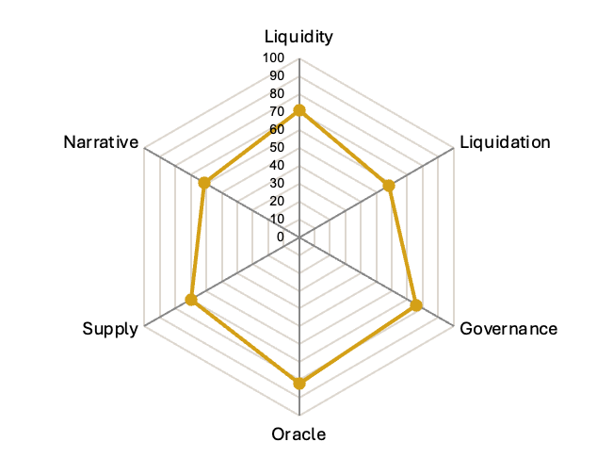

Six Pillars
PRISM
Liquidity Resilience
23%
Governance Capture
19%
TVL trend, bridge flows, slippage simulation
Voting concentration, quorum analysis
Liquidation Cascade
23%
Oracle Dependency
14%
Health factor fragility, ETH shock modeling
Feed freshness and single-source exposure
Supply Pressure
11%
Narrative Risk
10%
Unlocks, emissions, dilution pressure
VADER sentiment and mention velocity spikes
The point is not more metrics — it is a consistent weighting system that converts six risk vectors into a capital allocation decision.
05
Notes:
5

Slide 6
PRISM
Stress Lab: “What happens if ETH drops 20%?”
A four-act cascade makes fragility visible before the market forces the answer.
ETH -20%
Bridge Outflow
Whale Exit
Governance Spike
Crash + Oracle Lag
Users bridge to safety, depth thins
Large LPs withdraw, slippage widens
Emergency vote activity surges
Liquidations accelerate, feeds stale
1-click shock
82 → 71
71 → 58
58 → 44
44 → 19
Action
EXIT
Maximum safe size: 3.6% of protocol TVL
07
Notes:
7

