Slide 1
Industrial Defect Detection, Pre-Trained
Visual-Inspection FM
A defect-detection foundation model, sold as API and edge appliance — inspection ready in days, not months

Slide 2
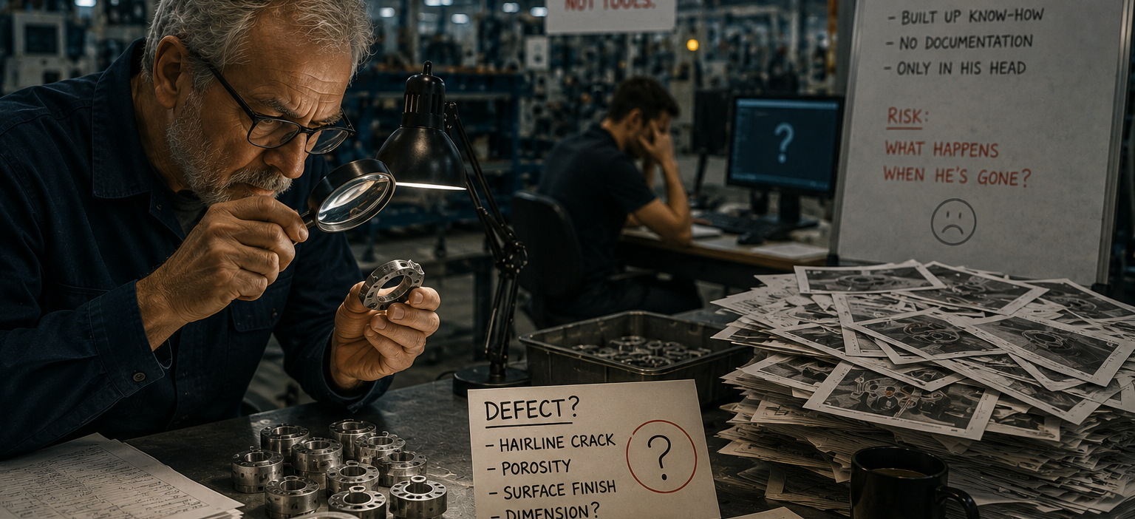
The Problem
Visual Inspection FM
Every manufacturer rebuilds visual inspection from scratch — and quality engineers end up as full-time model babysitters.
Customer need: every manufacturer builds visual inspection from scratch — thousands of labelled defect images per line, weeks of data collection, months of tuning. Generic vision vendors lack industrial data, so accuracy on rare defects, the ones that matter, stays poor. When a new product variant lands, tuning starts over, and no vendor can offer a shortcut because none has the cross-plant defect data foundation models need. Bosch does.
4–8 weeks
of engineering per new SKU with rule-based vision — for a plant with ~100 changeovers a year, that's 400+ engineering-weeks.
€2–4m annually
in vision-setup cost alone for a multi-SKU manufacturer, before counting the cost of any defects still missed.
+30%
accuracy gain of vision foundation models over rule-based systems — and they adapt to new SKUs zero-shot.

Slide 3
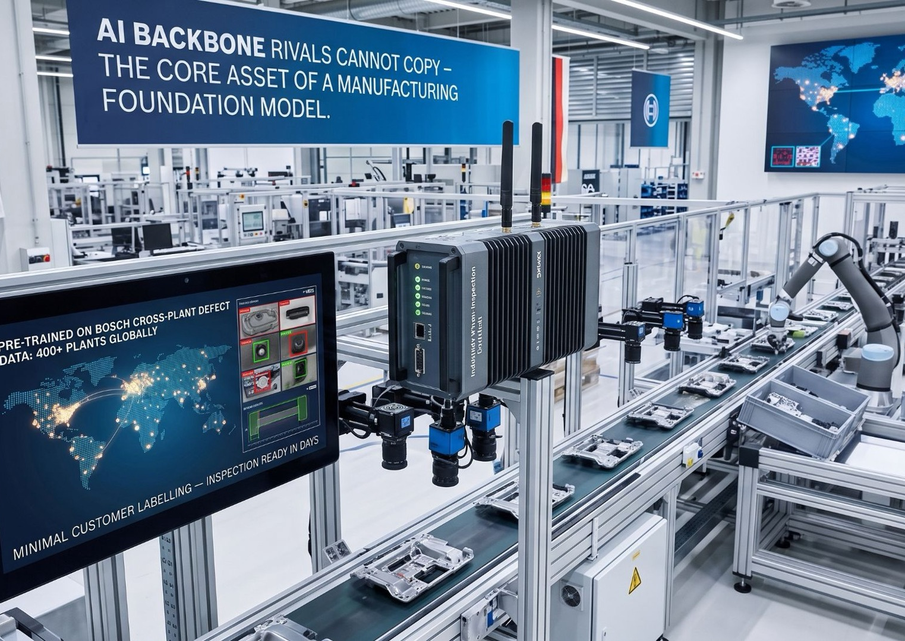
The Concept & Value Proposition
Visual Inspection FM
The moat isn't the model architecture — that's commoditising fast. It's the labelled defect data behind it.
Pre-trained, not built from scratch: a visual-inspection foundation model pre-trained on Bosch's proprietary cross-plant defect data from plants globally. It generalises to new production lines with minimal customer labelling — inspection ready in days rather than months.
A moat that compounds with every deployment: delivered as edge appliance plus API, every new customer deployment adds to the training substrate — every new defect pattern sharpens the base model for every downstream user, sold per line per year.
View concept teaser here →
The result: real Bosch plant data turned into an AI backbone rivals cannot copy — the core asset of a manufacturing foundation model.

Slide 4




Illustrative Solution Approach
Visual Inspection FM
Four capabilities that turn 400 plants of defect data into inspection ready in days, not months.
Pre-Trained Foundation Model
Built on Bosch's proprietary defect image data across Bosch plants and multiple product categories.
Edge Appliance + API
Edge appliance ships to customer site preloaded; API tier for cloud-connected deployments needing shared learning.
Minimal-Label Fine-Tuning
Model generalises from the base rather than starting from scratch — customer-specific defects need only a handful of examples.
Federated Learning Tier
Customers can contribute anonymised defect examples to sharpen the base model, with revenue share for high-value contributors.
Technical Deep-Dive — How The Model Learns A New Defect In Hours, Not Weeks
Adding a new defect type is a fine-tuning step on top of a pre-trained backbone — not training a vision model from zero.
1. Capture few-shot samples
Under 100 images of the new defect captured directly on the line via the edge appliance's own cameras.
2. Embed via the pre-trained backbone
Images pass through weights already trained on Bosch's plant defect corpus, mapped into a rich, general defect-feature space instead of starting blind.
3. Fine-tune the classification head
Only a lightweight head is retrained on the new samples — the backbone stays frozen, which is what makes hours-not-weeks tuning possible.
4. Validate & push to the edge
Model is checked against held-out samples, then pushed live to the edge appliance — inspecting the very next unit down the line.

Slide 5
Potential Entry Use Cases
Visual Inspection FM
Where the hackathon team could focus a first, narrow wedge into the concept.
Automotive Tier-1 Suppliers
Consumer Electronics CMs
Pharma & Medical Devices
Bosch's Own Plant Network
New production lines deployed under IATF 16949 quality thresholds.
New SKUs every quarter, needing inspection ready in days, not months.
Rare defects carry compliance-grade consequences generic vision misses.
First deployment base and paying reference — zero cold-start.
Recommended wedge: start inside Bosch's own plant network — every inspection line becomes a first customer and a live feedback loop, feeding new defect types and edge cases back into the model before it ever reaches an external customer.
REALISTIC EXAMPLE — A TIER-1 AUTOMOTIVE SUPPLIER UNDER IATF 16949
The quality gate that decides whether a part ships
Tier-1 suppliers operate under IATF 16949, the automotive industry's own quality-management standard — a part that passes final inspection is assumed defect-free all the way to the OEM's line.
A supplier adding a new stamped bracket or connector housing needs inspection accurate enough to trust with that assumption from day one, not after months of tuning. A slow rollout means either shipping unvalidated parts or missing the ramp schedule the OEM contracted for — there's no acceptable middle ground.
INDUSTRY-REPORTED OUTCOMES, ONCE LIVE
↓ up to 83%
defect escape rate, vs. legacy sampling-based manual inspection
↓ up to 60%
warranty claims, after AI-based defect detection is deployed across the line

Slide 6
Market Opportunity & Growth
Visual Inspection FM
A machine vision market accelerating on AI, just as regulation makes visual quality evidence non-optional.
TAM 2030
~$42bn
Global machine vision market
SAM 2031
~$28bn
AI-based visual inspection sub-segment
SOM YEAR 5
~$560m
Realistic capture, ~2% of SAM by year 5
Market signals
The industrial machine vision market grows from ~$23.6bn (2025) to ~$42bn by 2030 at ~8.3% CAGR, with the AI visual-inspection subsegment growing materially faster.
Every new production line requires thousands of labelled defect images and weeks-to-months of tuning today — foundation models compress this to days.
The EU AI Act (Regulation 2024/1689) classifies safety-critical inspection AI as high-risk from August 2027 — bringing QMS logging, human-in-loop and provenance obligations that make per-unit visual evidence a compliance necessity, not a nice-to-have.
Category capital is inflecting — Landing AI's large-vision-model approach and Meta's SAM 2 signal that foundation-model economics are moving into industrial vision.

Slide 7

Competitive Landscape & Whitespace
Visual Inspection FM
Nobody has pre-trained on a proprietary, multi-plant defect corpus and shipped it as an edge appliance and API.
Category | Players
Vision AI incumbents | Cognex, Keyence, Landing AI, Instrumental
Industrial defect specialists | Musashi AI, Averroes.ai, Robovision, Zetamotion
Foundation model (general purpose) | Google Vertex Vision, Meta SAM 2, OpenAI Vision
MLOps for industrial vision | Voxel51, Fizyr, Osaro, Ambi Robotics
WHITESPACE
Generic vision models lack industrial defect data. Industrial vision vendors lack the cross-plant scale to train a foundation model. No one has pre-trained on a proprietary, multi-plant defect corpus and shipped it as an edge appliance and API — incumbents own plant-floor trust, AI-native players own the technology, but no competitor combines both.
Category signal: : vision foundation models already beat rule-based systems by 30%+ and adapt to new SKUs zero-shot — the technology has crossed the threshold to be buildable at pace. Landing AI's large-vision-model approach and Meta's SAM 2 are proof the economics are shifting toward foundation models across industrial vision, not just consumer applications.

Slide 8





Bosch's Right to Win
Visual Inspection FM
Assets and structural advantages no vision-AI startup or industrial incumbent can replicate on their own.
Bosch Plants of Proprietary Defect Data
Bosch Center for AI (BCAI)
Bosch's cross-plant defect image corpus is training data no consultancy or startup can replicate.
Deep computer-vision research depth, already deploying models across Bosch production today.
Nexeed + Bosch Security Systems
Safety-Critical AI Pedigree
Nexeed provides the MES/quality integration path; Bosch Security Systems supplies the camera and edge hardware channel.
IEC 61508 and IATF 16949 track record — Bosch can certify AI in production loops in a way startups fundamentally cannot.
Why now: Regulation is turning visual evidence into a legal requirement
Three regulations land within 18 months of each other — the EU Product Liability Directive (Dec 2026), the EU Machinery Regulation (Jan 2027), and EUDAMED (May 2026) — making per-unit visual evidence a matter of personal liability, not optional spend. Cost of Quality already sits at 5–20% of revenue for manufacturers; AI-native quality is the only category that touches prevention, appraisal and failure costs all at once, and every customer deployment adds to a data flywheel that sharpens the model for everyone after them.

