Slide 1
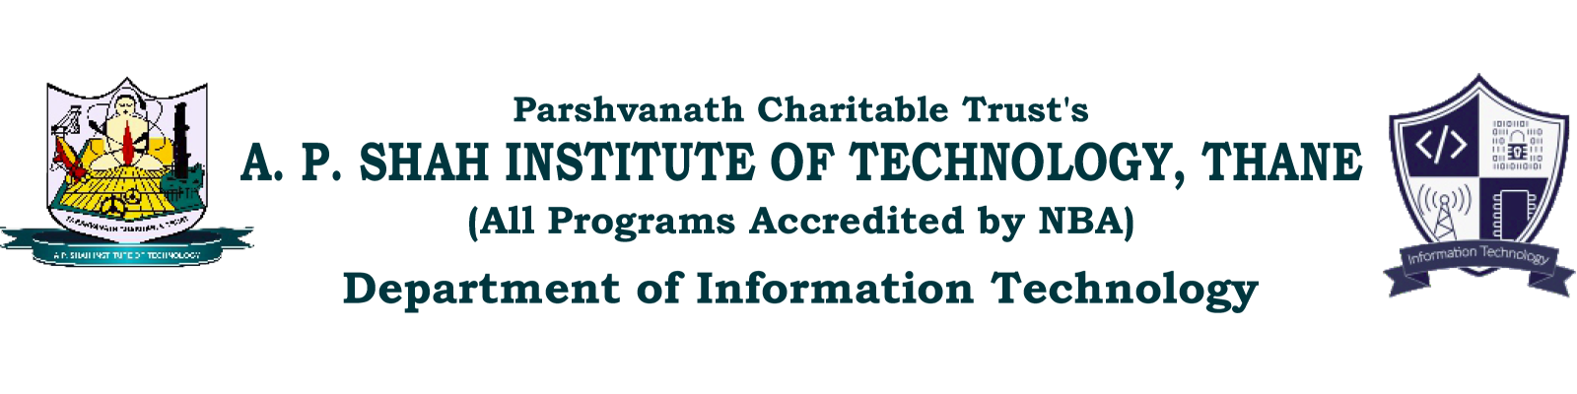
HealthSaver: HealthCare Chatbot Assistance
Pooja Sharma (20104090)
Nainisha Sharma (20104042)
Mayank Viramgama (20104119)
Rahul Yadav (20104085)
Project Guide
Prof. Vijayabharati Jagan

Slide 2
Contents
Introduction
Objectives
Dataset
Literature Survey
Block Diagram
Technology Stack
Result and Discussion
Conclusion and Future Scope

Slide 3
1. Introduction
Problem Identified:
Many people struggle to find reliable health information at home, leading to unnecessary trips to healthcare facilities.
The project plans to develop a chatbot using AIML technology to provide quick and accurate health advice.
The aim is to improve healthcare accessibility and reduce the burden on healthcare facilities.
The project also seeks to cut down unnecessary healthcare visits, potentially leading to cost savings.

Slide 4
2. Objectives
To provide 24/7 assistance
To develop an AIML-based chatbot.
To provide an accurate and timely response.
To Focus on queries related to common wounds and minor health concerns.
To Improve healthcare accessibility.
To Reduce unnecessary healthcare facility visits.

Slide 5
3. Dataset
The dataset contains tags like Greeting, Cuts, splinters, sprains, etc
The dataset contains a set of tags with their corresponding patterns and responses
The tags cover various topics related to health, such as how to treat a wound, etc
Each tag has a set of patterns, which are the user's input queries or questions
For each tag and pattern, there is a corresponding response that the bot will provide

Slide 6
Literature Survey
Sr. No | Authors | Year of Publication | Finding
1. | Jovanovic, Mladjan & Baez, Marcos & Casati, Fabio. | 2020 | The study reveals that healthcare chatbots are not fully utilizing conversational media for improved interactions, particularly in vulnerable situations. It suggests design considerations and suggests further research on appropriate dialog patterns and health outcomes assessment in healthcare chatbot use cases. The study highlights limitations such as a small sample size, reliance on popularity metrics, and lack of health outcomes and information accuracy assessments.
2. | Ayanouz, Soufyane & Anouar Abdelhakim, Boudhir & Benhmed, Mohammed. | 2020 | The proposed system has five main components: an environment where natural language processing (NLP) and dialogue management occur, a question-and-answer system for frequently asked questions, plugins/components for automation and APIs, a node server/traffic server for handling requests and responses, and front-end systems such as Microsoft Teams or Facebook for client-facing platforms. The NLP engine includes an intent classifier and an entity extractor, while the dialogue management system includes a feedback mechanism and policy learning. The question-and-answer system can be trained manually or automatically using company documents.

Slide 7
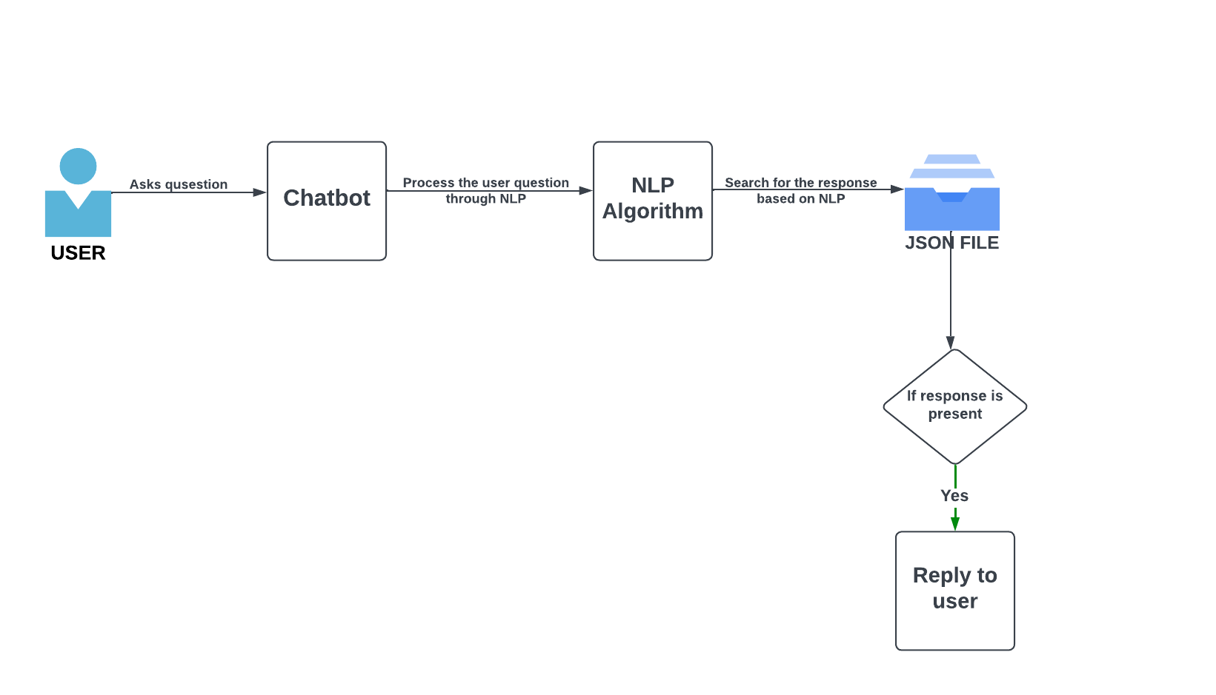
4. Block Diagram

Slide 8
5.Technology Stack
Python
Natural Language Toolkit (NLTK)
NLP Model
Chatbot Framework
Development Environment

Slide 9
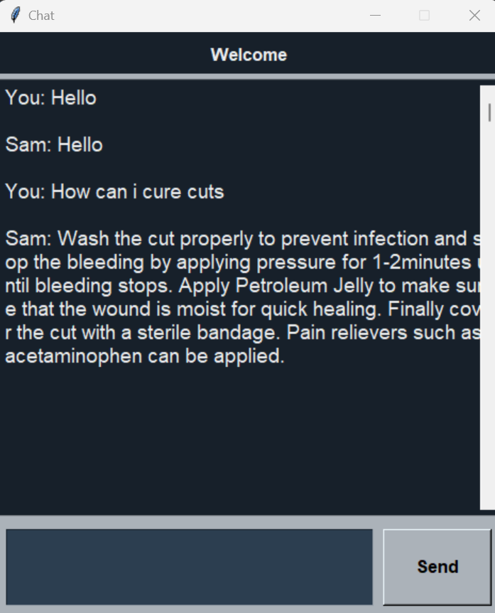
Result and Discussion

Slide 10
Conclusion
The development of an AIML-based chatbot has significantly enhanced healthcare accessibility and convenience.
The chatbot's successful performance during testing validates its potential as a valuable healthcare resource.
This project serves as a testament to the potential of artificial intelligence and AIML in healthcare.

Slide 11
Future Scope
Medical Databases Integration: Incorporate updated medical databases for the latest information.
Multilingual Support: Make the chatbot accessible to a wider audience by adding support for multiple languages.
Personalized Responses: Implement machine learning for personalized responses based on user history.
Voice Interaction: Develop a voice interface for users with limited typing abilities.
Telehealth Integration: Enable users to schedule virtual appointments directly through the chatbot.

Slide 12
Thank You...!!

